Slide 1
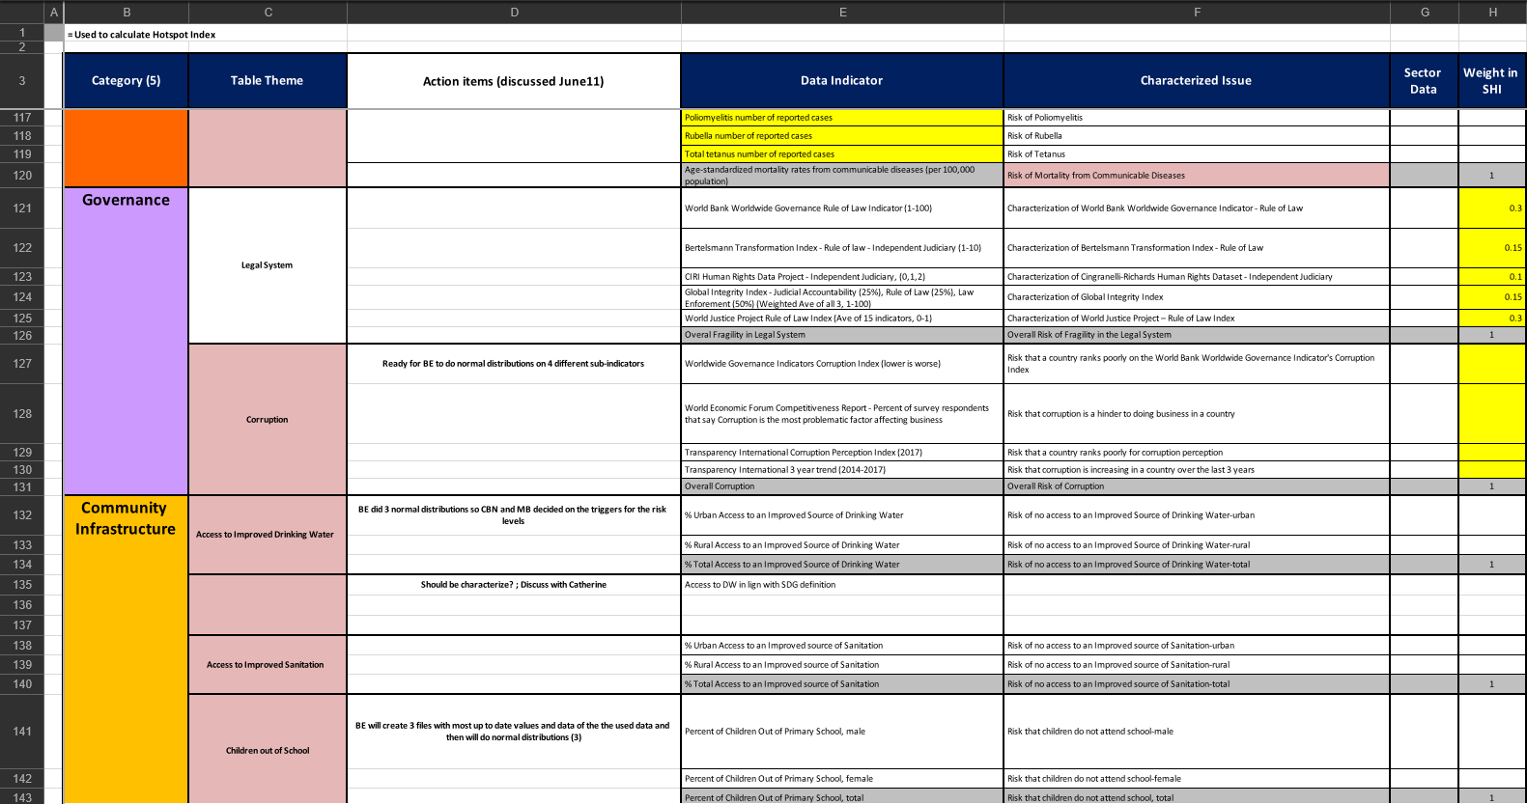
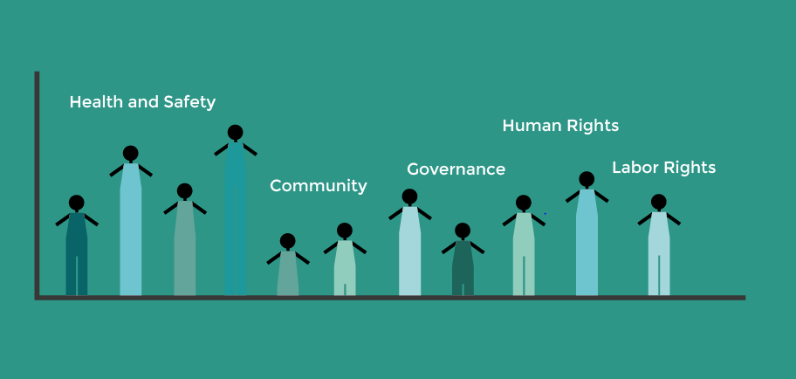
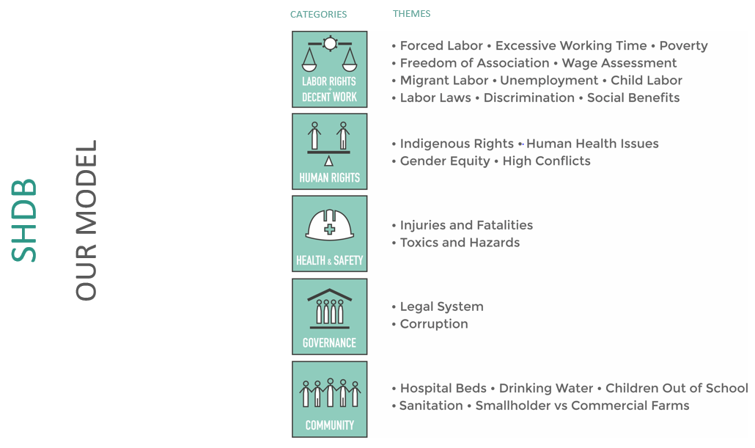
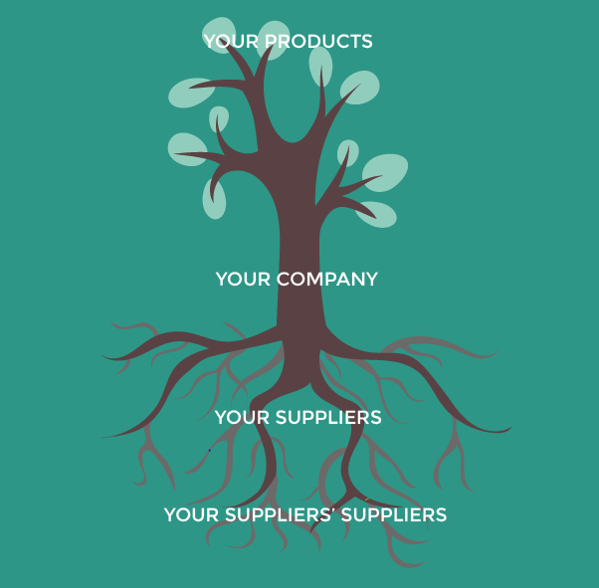
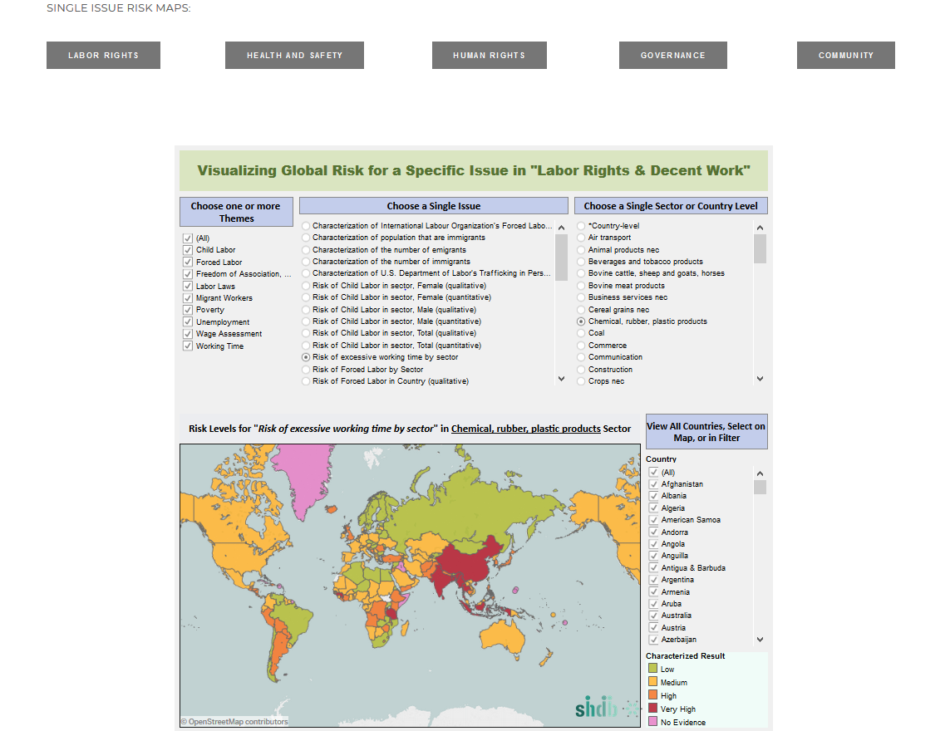
Social Risks in Supply Chains Database
Brandon Epperson, UNH Sustainability Fellow
Mentors: Catherine Benoit-Norris and Greg Norris, New Earth B
Project Summary
Because of the advent of social media and public vigilance concerning corporate ethics, companies are far more wary of their business practices. New Earth B provides a risk mapping tool and a supply chain tool for companies to measure social impact in different areas of social sustainability; child labor, gender equality,, excessive working hours, etc.
SHDB Categories
Objectives
Clean excel files built by New Earth B research
Map GTAP country codes to the excel files
Updating and maintaining the Social Hotspots Database (SHDB)
Future Goals
Incorporate GTAP files into the database
Create a framework for dashboards in Tableau based on the SHDB risk mapping tool
Update New Earth B’s LCA tool
Highlight
Body text
Challenges
Data cleaning and GTAP aggregation
Code testing
New Earth B workplan for cleaning and updating social risk levels within excel files
New Earth B model
Approaches and Methods
Programming using Python 3.6.5
Aggregate GTAP data using ImpactEcon, RunGtap, GTAPAgg, and GTAPAgg2 software
Craft dashboards using Tableau
Preliminary Results
Python functions useful for automating complex tasks
Cleaned and pre-processed excel files to be used for the SHDB
Concept of companies and their suppliers’ impact
Risk Mapping Tool

