Slide 1




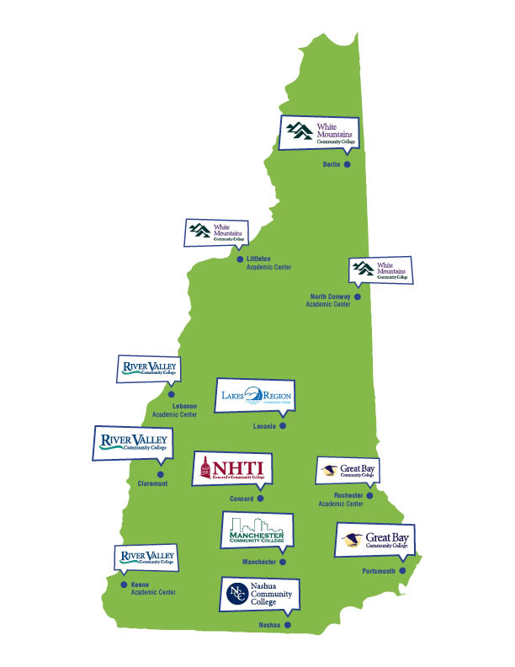
Paving the Way for Community College Transfer Students to Join Noyce
This work is supported by the National Science Foundation under Grant Number 1660706
UNH Noyce Focus
Outcomes
Culturally responsive teaching responds to the US population becoming more culturally and linguistically diverse (CLD)
CLD students often have less favorable outcomes than majority students
STEM teachers need to have high expectations and high support for ALL students to give equal opportunities, and to prepare a diverse workforce
Permanent Equivalencies
By College
STEM Summits held in 2014 and 2016 allowed additional connections to be made and articulation agreements to be advanced
Course equivalencies now exist for the core foundational courses in STEM
  College of Engineering and Physical Sciences has hard coded equivalencies for up to all seven CCSNH campuses in mathematics & statistics, chemistry, and physics
  College of Life Science and Agriculture has hard coded equivalencies for all seven CCSNH campuses in biological sciences
    Important transfer pathways in final stages of packaging these into universal articulation agreement for ten majors!
UNH Education Department working with CCSNH to create a transfer pathway via new dual major program for CCSNH STEM students who wish to explore teaching at UNH
YES!
CCSNH Course Curriculum
UNH Department Review
Feedback
NO
Partnership and Broader Impacts
University of New Hampshire (UNH) and Community College System of New Hampshire (CCSNH)
Leverage existing partnerships, including S-STEM grant (Award Number 1458430) and state goal of increasing STEM graduates
Broadens diversity at UNH; CCSNH has more minority students and Pell grant recipients
Changes; Re-evaluation
Creating Articulation Agreements
Identify faculty “champions”
  At CCSNH, the STEM Group Lead
  At UNH, a department liaison who is on or can engage with department curriculum committee
CCSNH course documents are gathered and loaded onto a Box.com folder shared among the stakeholders
  Syllabus
  Textbook
  Exam Samples
  Laboratory Content
UNH Departments review documents and assess equivalencies
  Feedback is provided in negative outcomes
  Opportunities to revisit, especially with changes or additional information
Additional support provided by College Dean’s Offices
Positive results are hard coded by the College’s Associate Dean
Credit is accepted and transfer students know equivalencies in advance of transfer
UNH Teacher Prep Program
Five year program that begins with a bachelors degree in STEM
Early teaching experience through Exploring Teaching course (typically in sophomore year)
Full year internship with supporting seminar
Inquiry based project and colloquium presentation
University of New Hampshire Noyce team
PI – Dawn Meredith (Physics)
Co-PI’s
  Orly Buchbinder, Sharon McCrone (Mathematics)
  Margaret Greenslade (Chemistry)
  Elyse Hambacher, Kathryn McCurdy (Education)
  Carrie Hall, Leslie Barber (Biology)
  Julie Bryce (Earth Science)
CCSNH Liaison from CCSNH Great Bay Campus: Leslie Barber
Award Number 1660706
Strengthening the Partnership
Communicate Noyce opportunity with CCSNH advisors
Identify and communicate with interested students
Improve equivalencies and articulation agreements to:
  Eliminate uncertainty
  Reduce time to degree
Bibliography
Hernandez, C. M., Morales, A. R., & Shroyer, M. G. (2013). The development of a model of culturally responsive science and mathematics teaching. Cultural Studies of Science Education, 8, 803 – 820.

