Slide 1

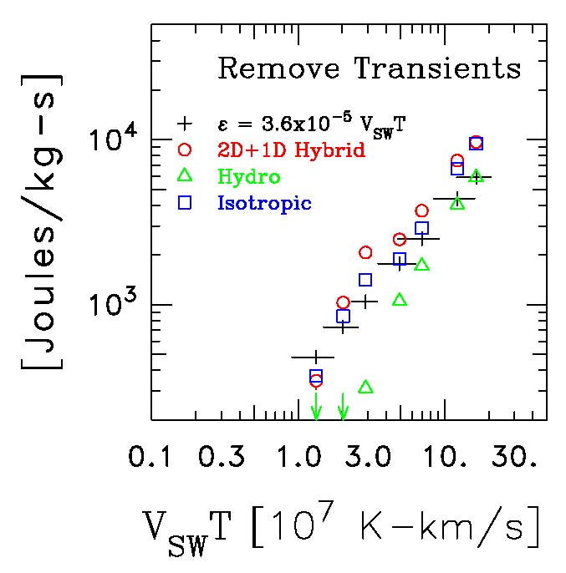
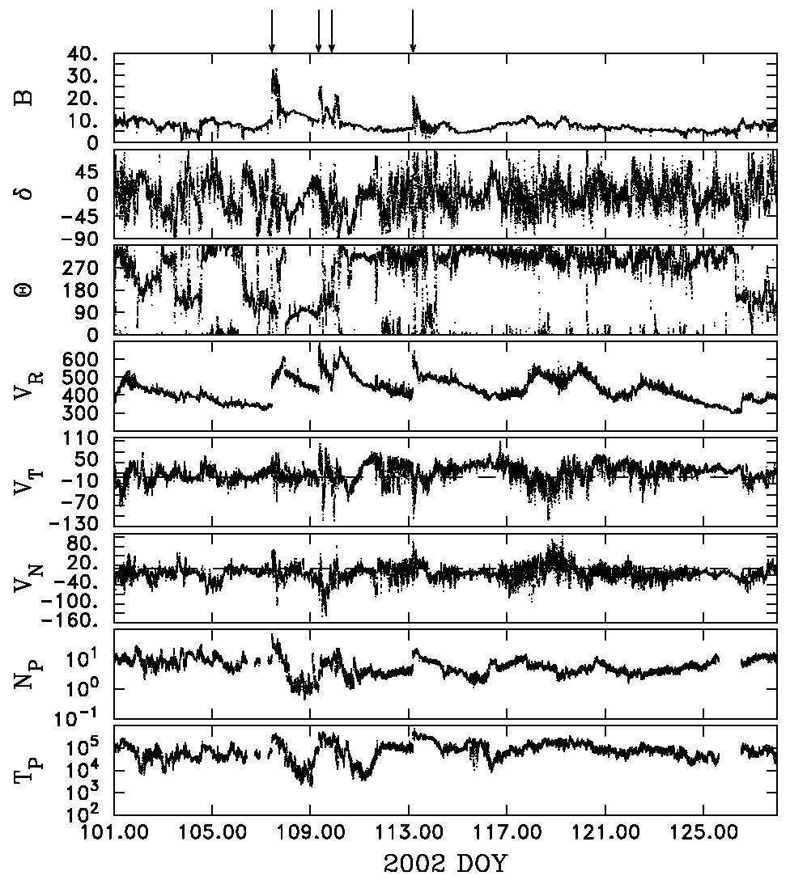
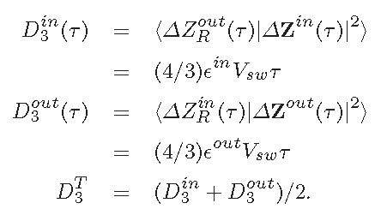
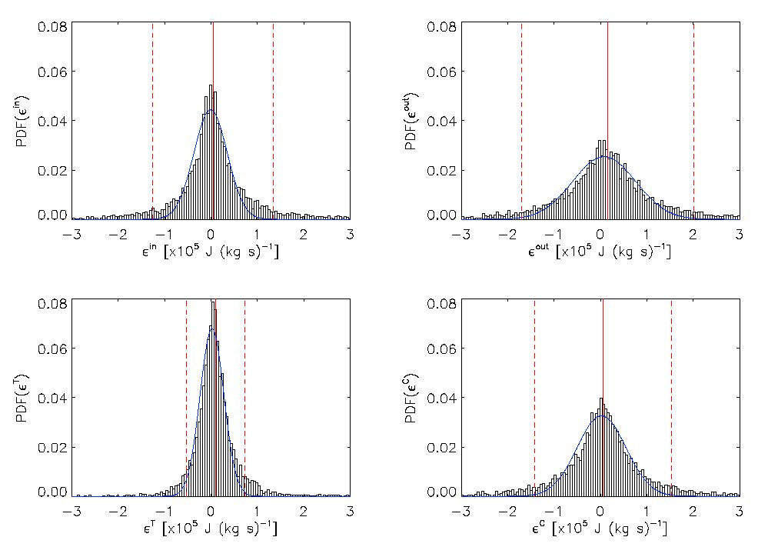
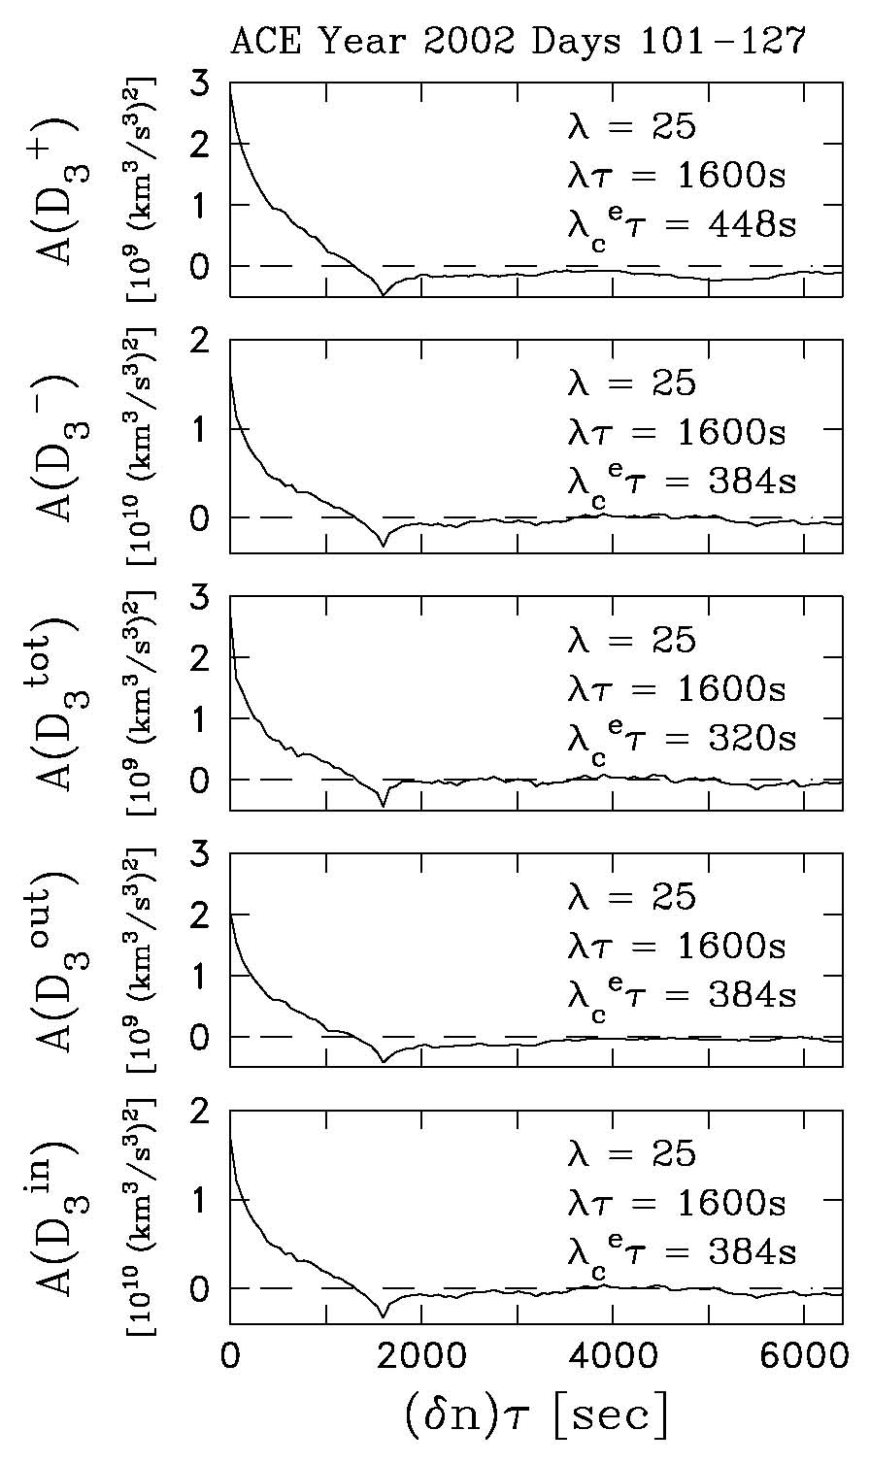
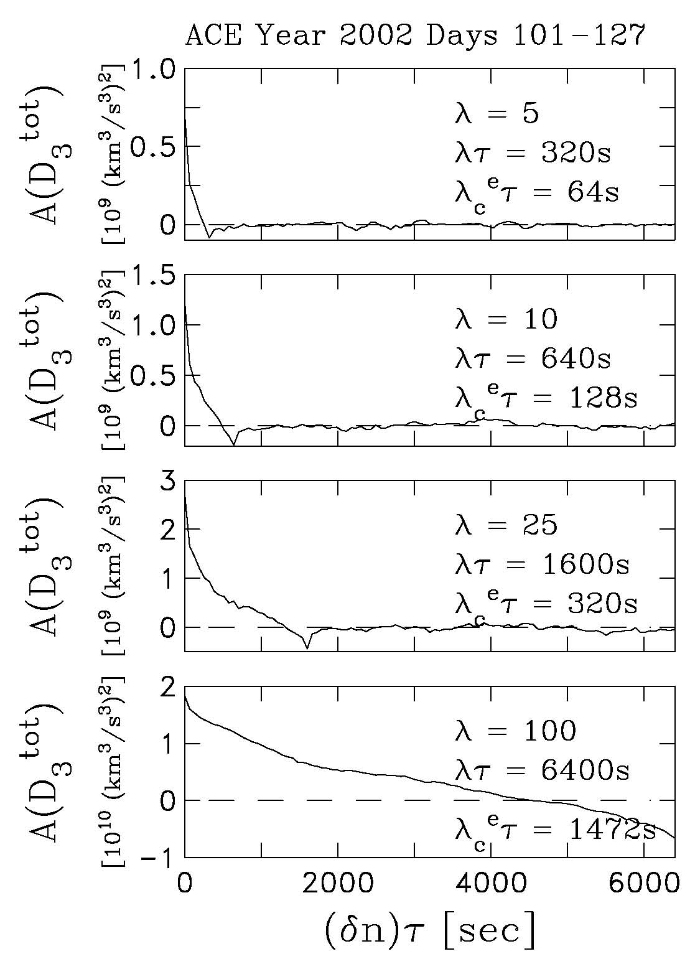
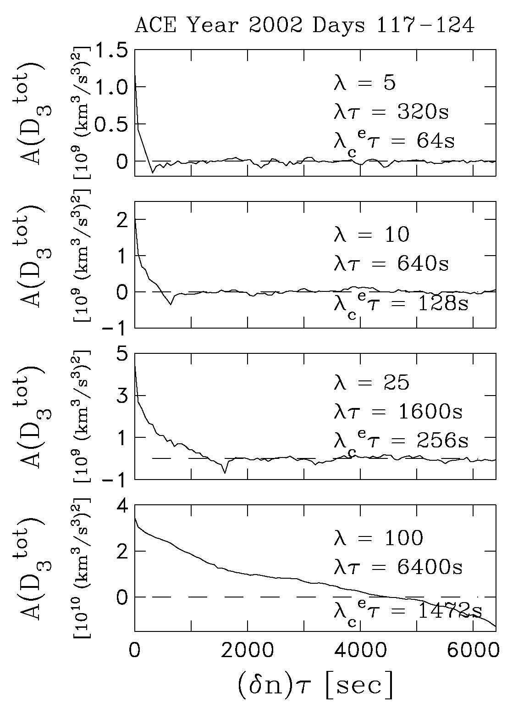
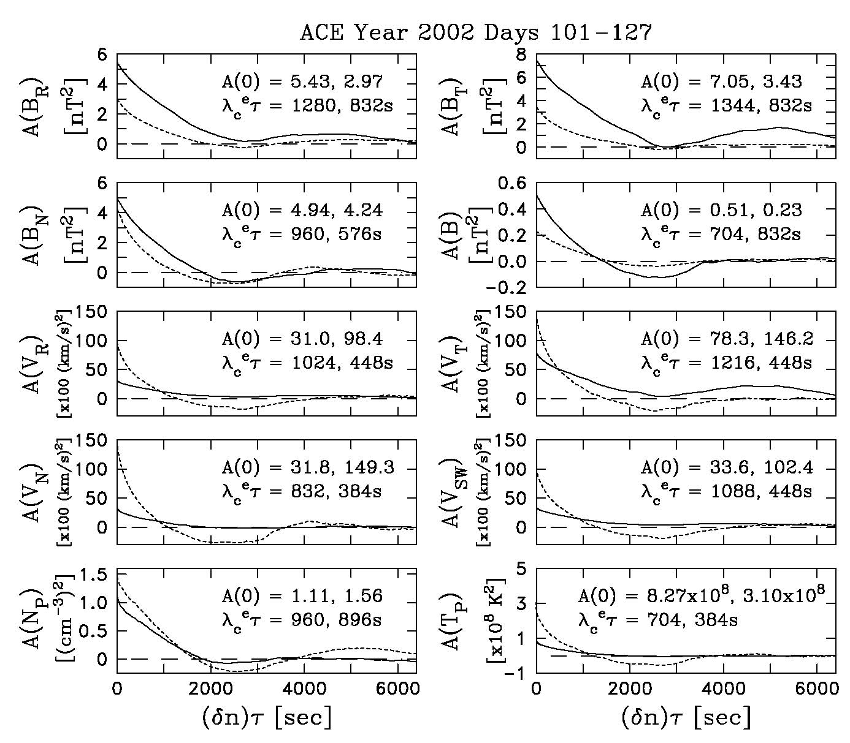
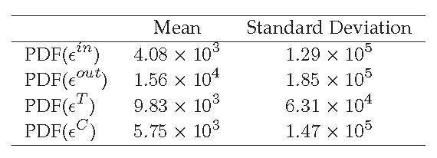
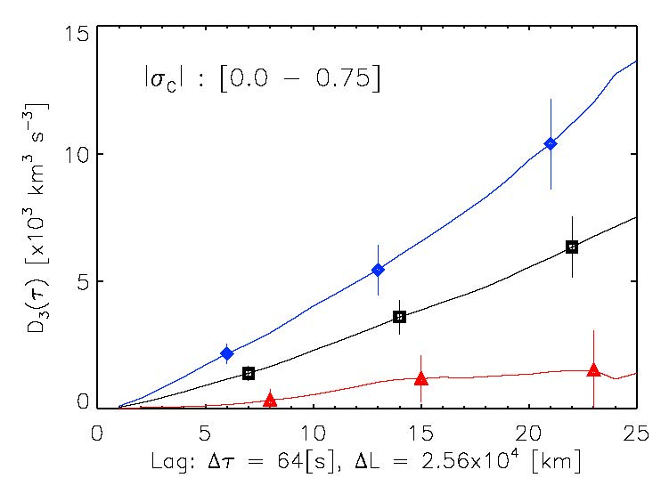
Correlation Scales of the Turbulent Cascade at 1 AU
Charles W. Smith, Bernie J. Vasquez, Jesse T. Coburn, Miriam A. Forman, and Julia E. Stawarz
Abstract: We use ACE data to explore the correlation scale(s) for the third-order structure functions that provide expressions for the rate of energy transport through the turbulent spectrum for solar wind fluctuations at 1 AU. We find that the correlation scale is consistently ~ 20% of the scale of interest within the inertial range. This leads to a view that the nonlinear dynamics are much stronger than normally thought and highly variable.
(Left) Third-moments expressions averaged over many samples produce values for the energy cascade within the interplanetary spectrum that are in good agreement with the observed average heating rates.
When averaged over shorter intervals, they show a high degree of variability but retain the linear scaling that is expected from theory. This suggests that the variations are real and not simply statistical errors.
(Right) We select a solar rotation of typical 1 AU measurements, remove the shock intervals, and compute the correlation functions for the primitive variables.
As expected, the correlation length is ~ 1 hour for all solar wind variables.
But does this mean that the structure functions show correlation scales that are comparable to the primitive variables?
(Below) We use the same standard techniques to define the correlation function and compute the correlation of the third-order terms. We find that the correlation scale varies as ~ 20% of the scale size of interest across the inertial range scales.
The work shown here has been presented in Stawarz et al. (ApJ, 697, 1119-1127, 2009), Coburn et al. (Phil. Trans. Royal Soc. A, 373, 20140150, 2015) and Smith et al. (ApJ, 858, 21, 2018). Support for this effort was provided by Caltech subcontract 44A-1062037 to the University of New Hampshire in support of the ACE/MAG instrument and by NSF/SHINE grant 1622413 to the University of New Hampshire.

