Slide 1

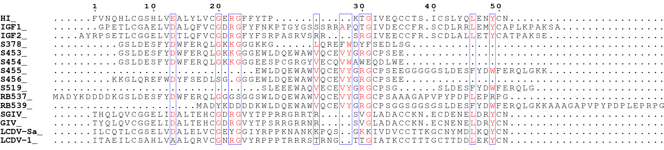
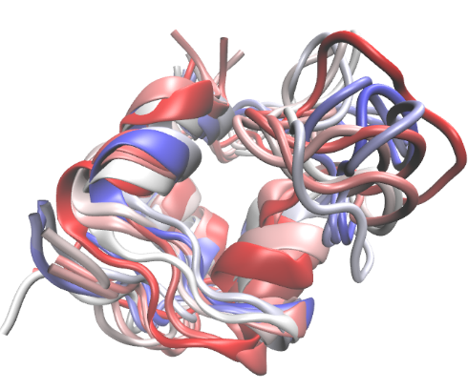
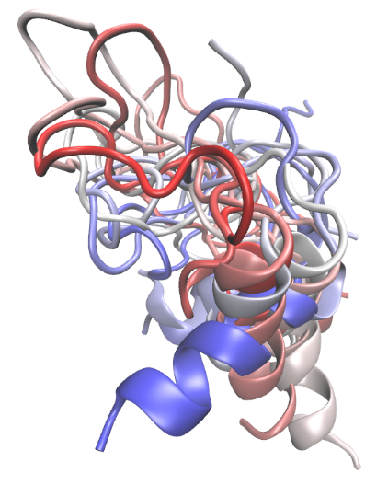
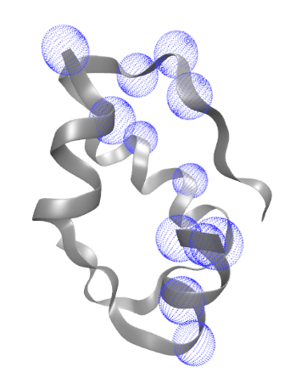
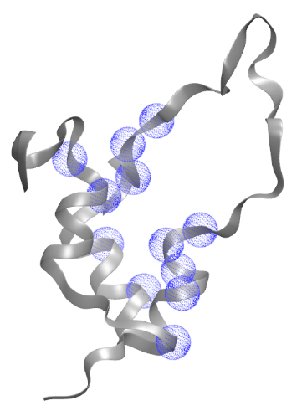
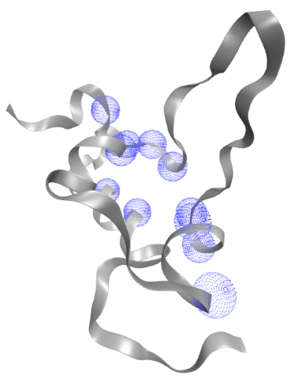
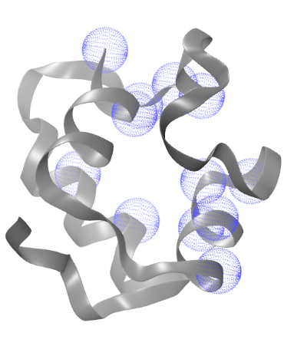
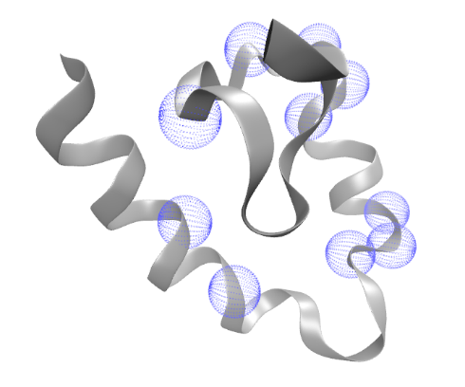
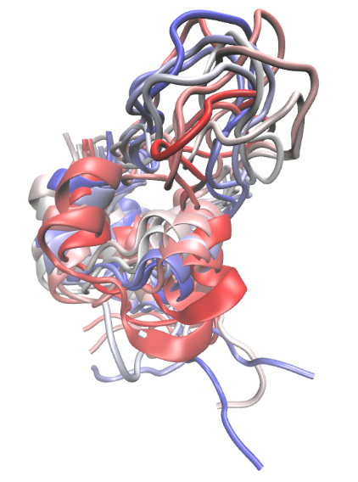
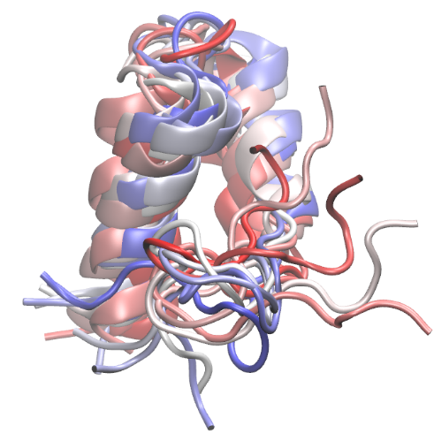
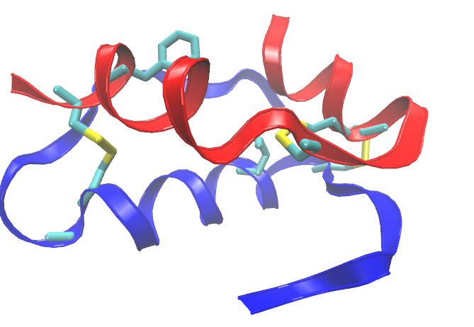
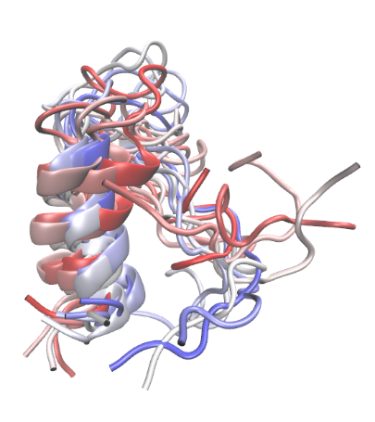
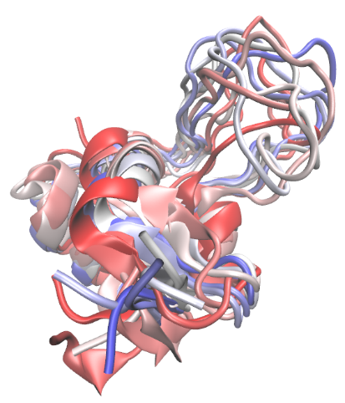
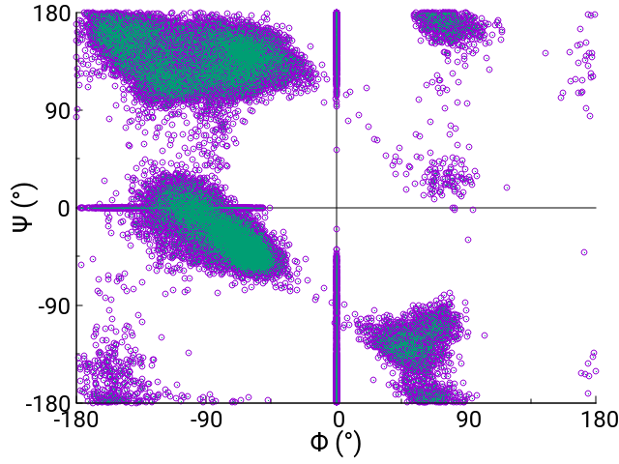
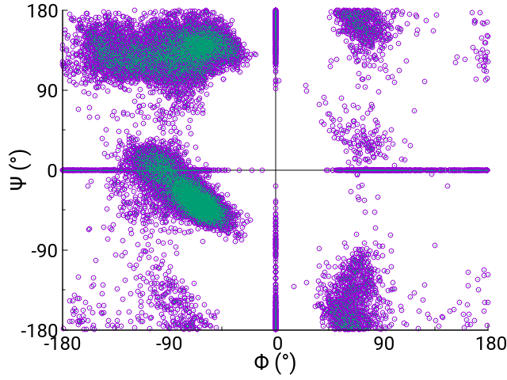
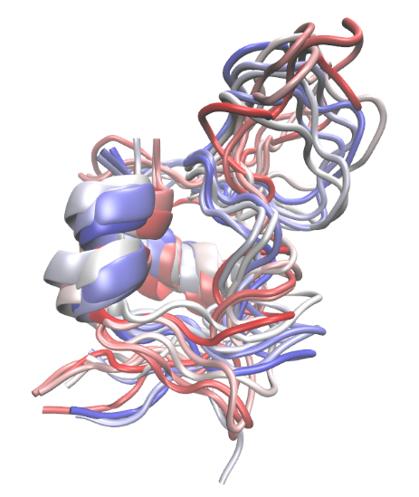
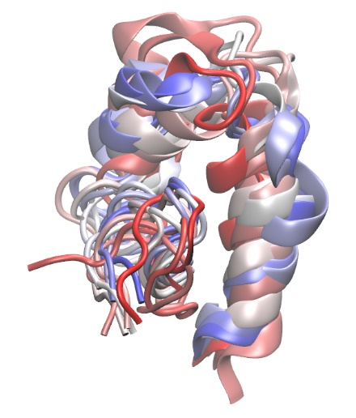
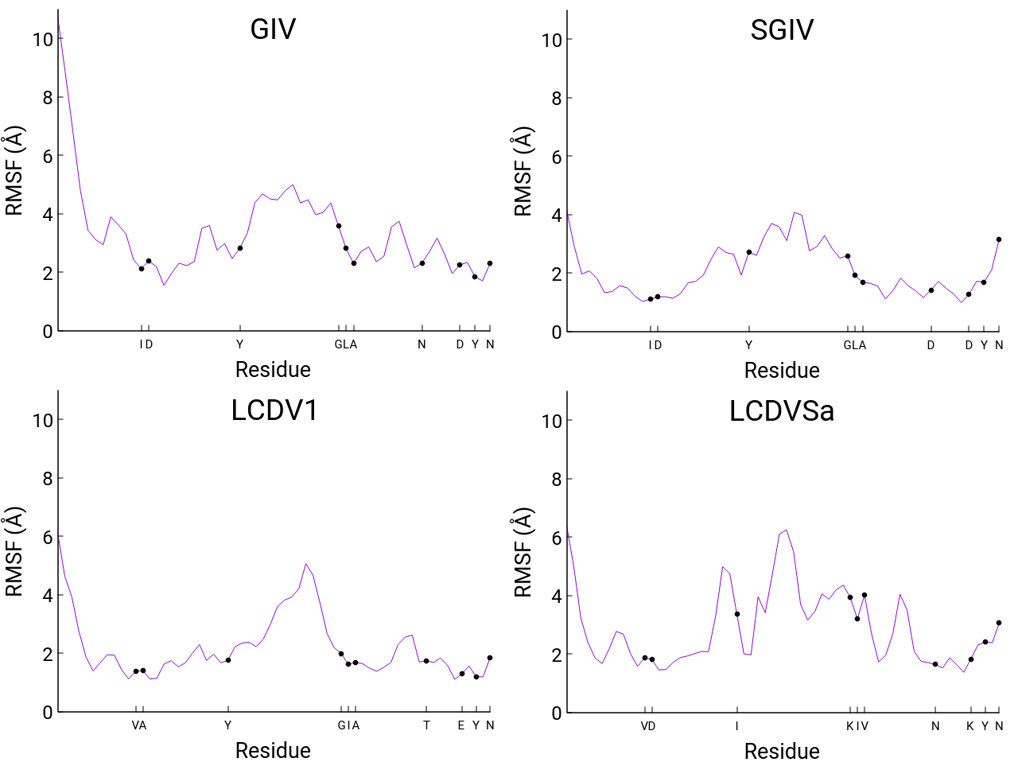
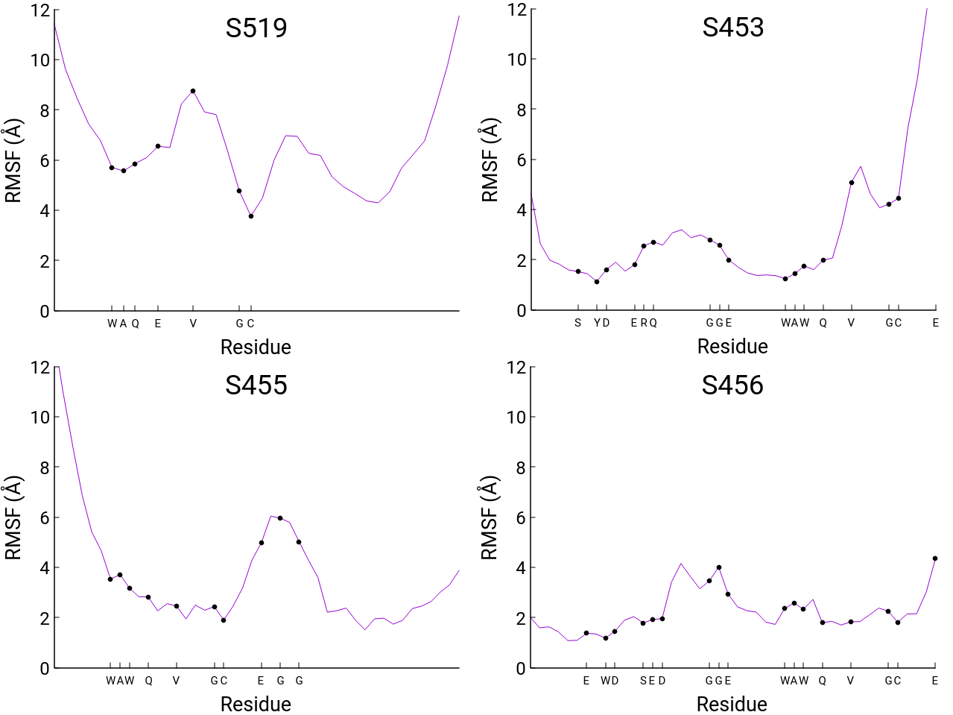
Atomistic Simulations of Viral Insulin Like and Insulin Mimetic Peptides
Evan Redfearn and Dr. Harish Vashisth
Department of Chemical Engineering, University of New Hampshire, Durham, NH 03824
Introduction
Results
Results
Insulin regulates the absorption of glucose in the blood stream by binding to the insulin receptor (IR) and initiating signaling
Peptides which act as agonists and antagonists to the IR have been proposed previously
IR has two binding regions, site 1 and site 2, with specific residues known to be involved in hormone/receptor binding
Mature insulin contains an A chain (red) and a B chain (blue) connected by three disulfide bonds
LCDV1
Figure 1. Sequence alignment of all peptides studied.
SGIV
S519
Insulin
IGF-1
IGF-2
SGIV
S456
GIV
S453
Figure 2. Actual (Ins, IGF1, IGF2) and predicted (SGIV, S456) site 1 residues in various peptides.
LCDV1
S455
Methods
Figure 3. Ramachandran plot of native Insulin (PDB :3I40).
Figure 4. Ramachandran plot of S519.
Known sequences from previously reported viral insulin like peptides (VILPs) and insulin mimetics were modeled using ITASSER
Sequences were aligned using CLUSTALW and analyzed with ESPript 3.0
Predicted structural models were simulated using molecular dynamics (MD) simulations for 1 microsecond in explicit solvent
LCDVSa
S456
Figure 7. Overlay of predicted peptide conformations.
References
Altindis, E. et al. Viral insulin-like peptides activate human insulin and IGF-1 receptor signaling: a paradigm shift for host–microbe interactions. Proc. Natl Acad. Sci. USA 2018, 115, 2461-2466
Schaffer et al. Assembly of high-affinity insulin receptor agonists and antagonists from peptide building blocks. Proc. Natl. Acad. Sci. USA 2003, 100, 4435-4439
Figure 5. Residue fluctuations in “VILP” peptides.
Figure 6. Residue fluctuations in mimetic peptides.

