Slide 1


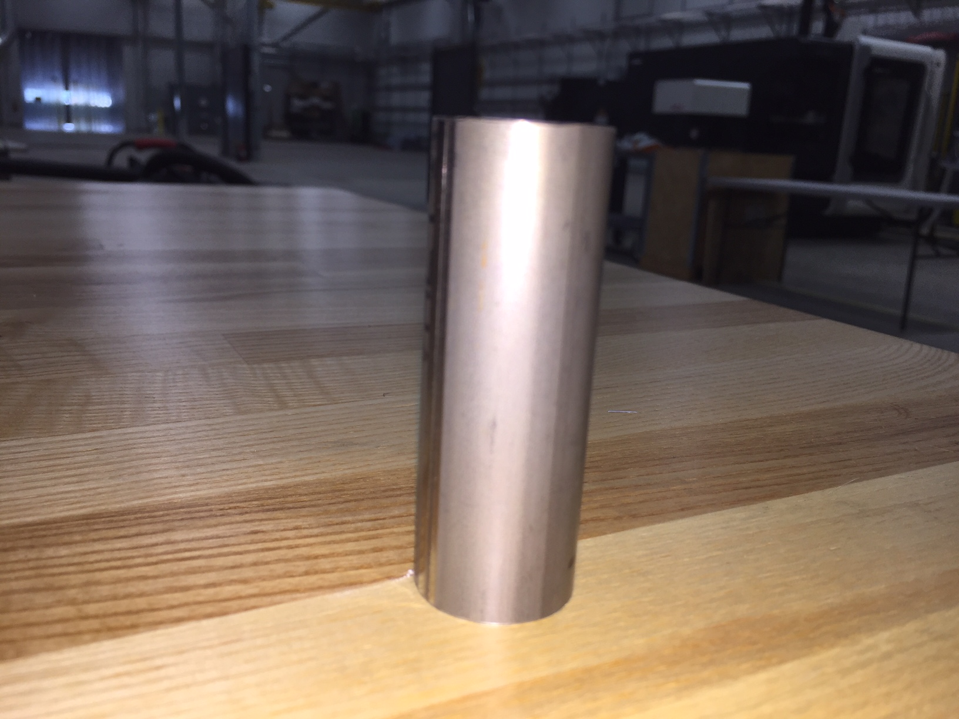
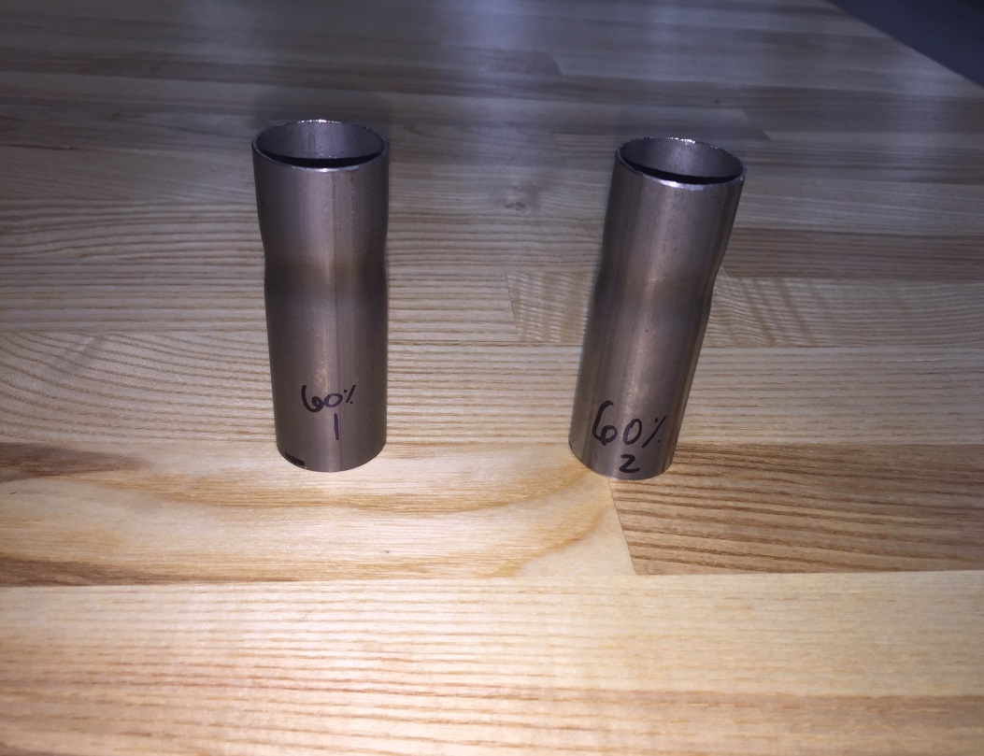
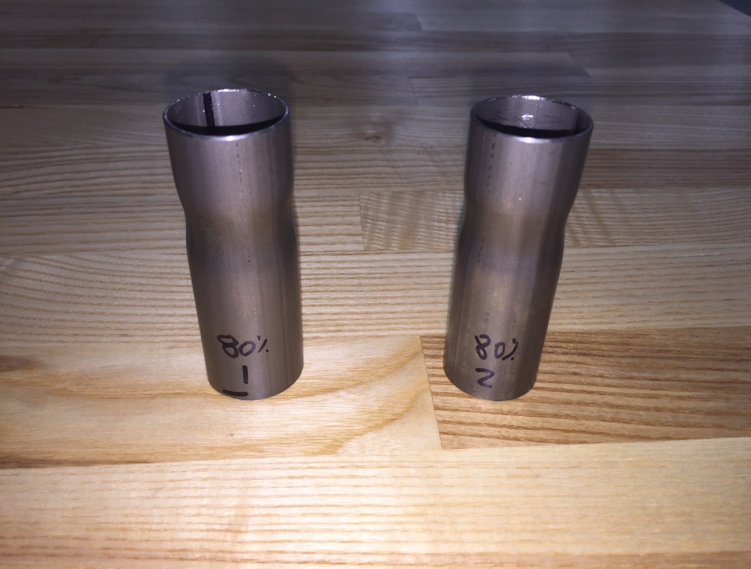
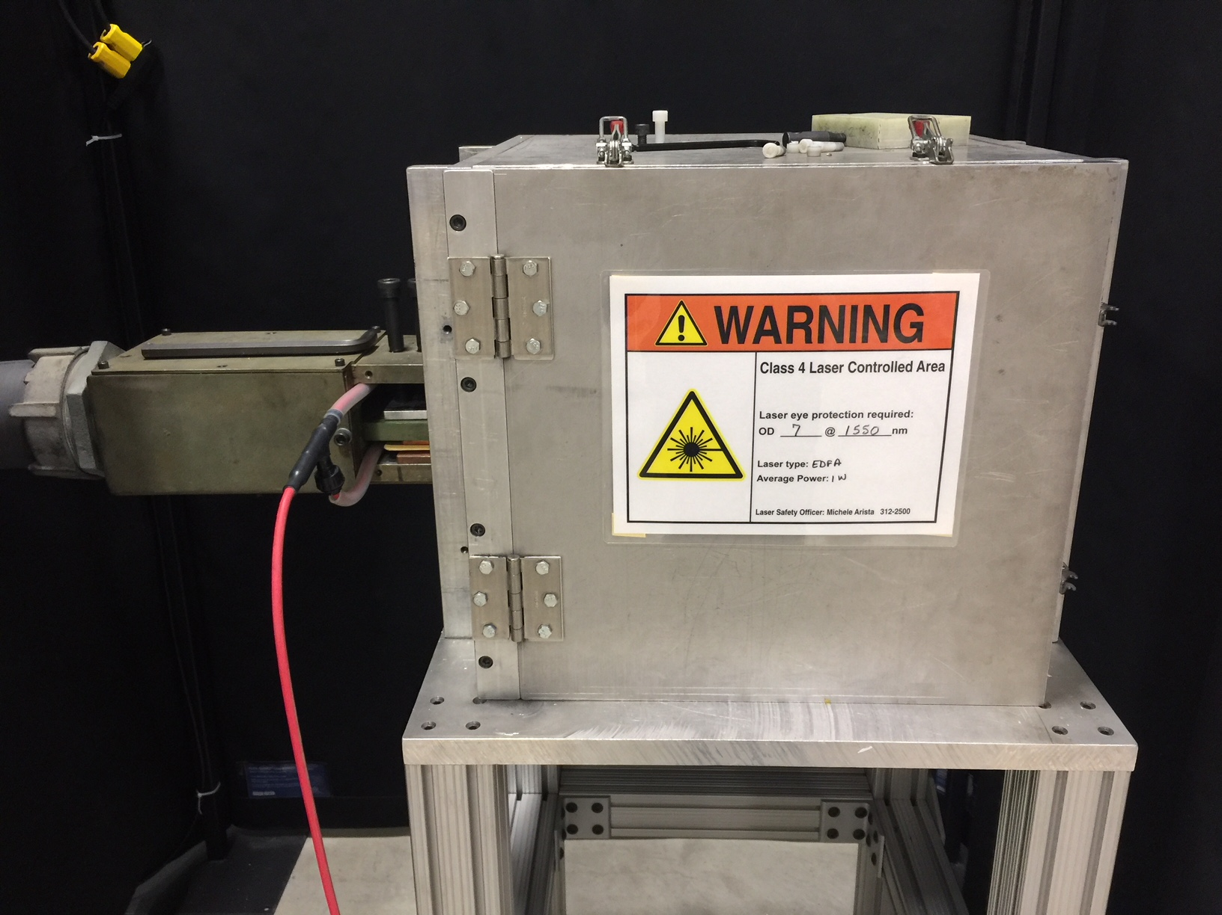
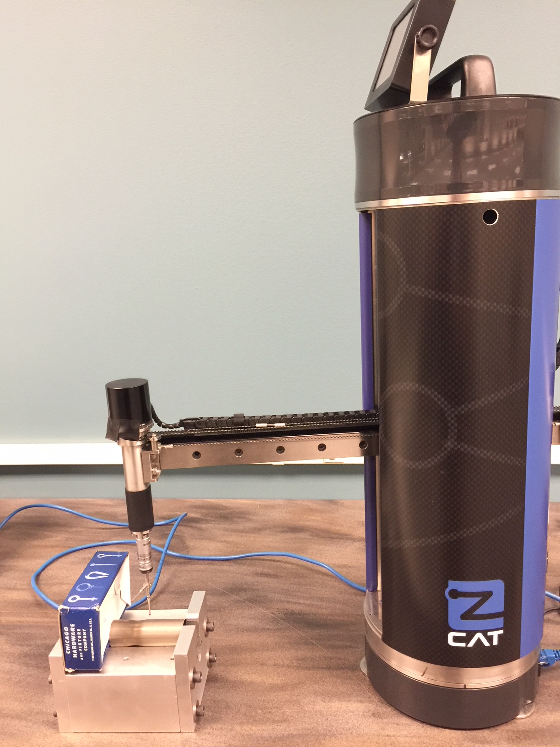
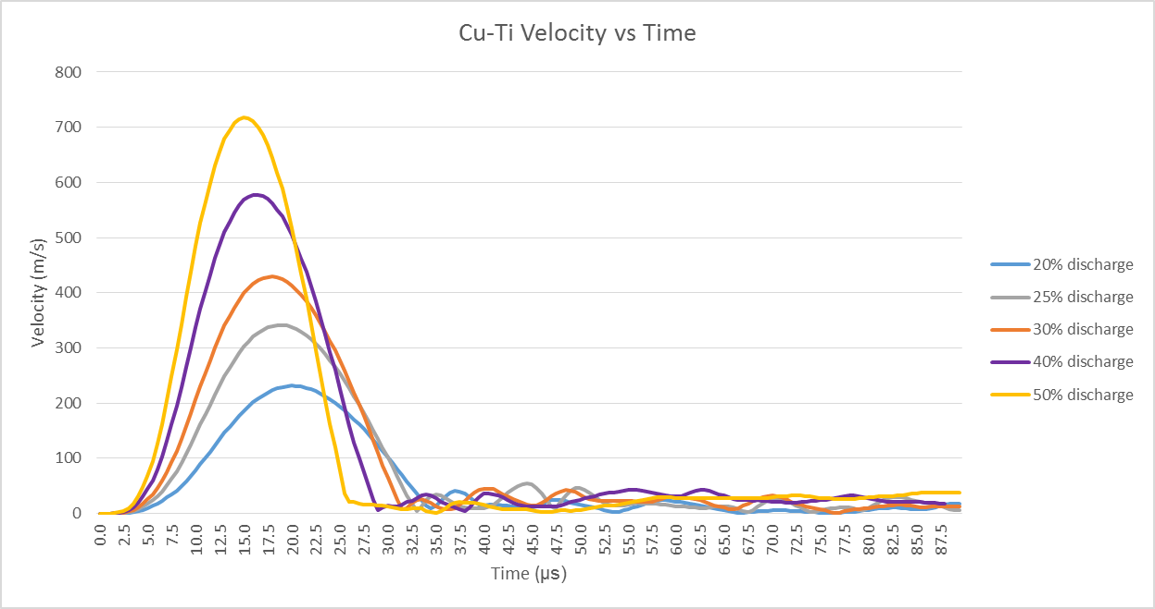
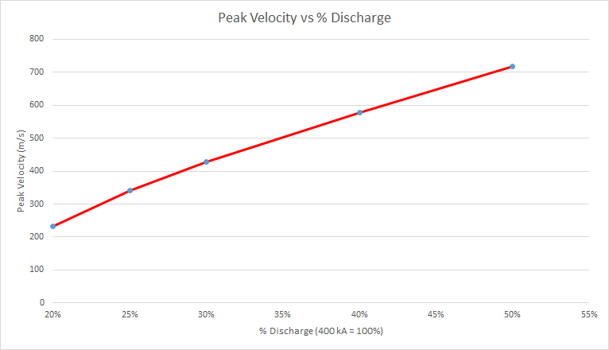
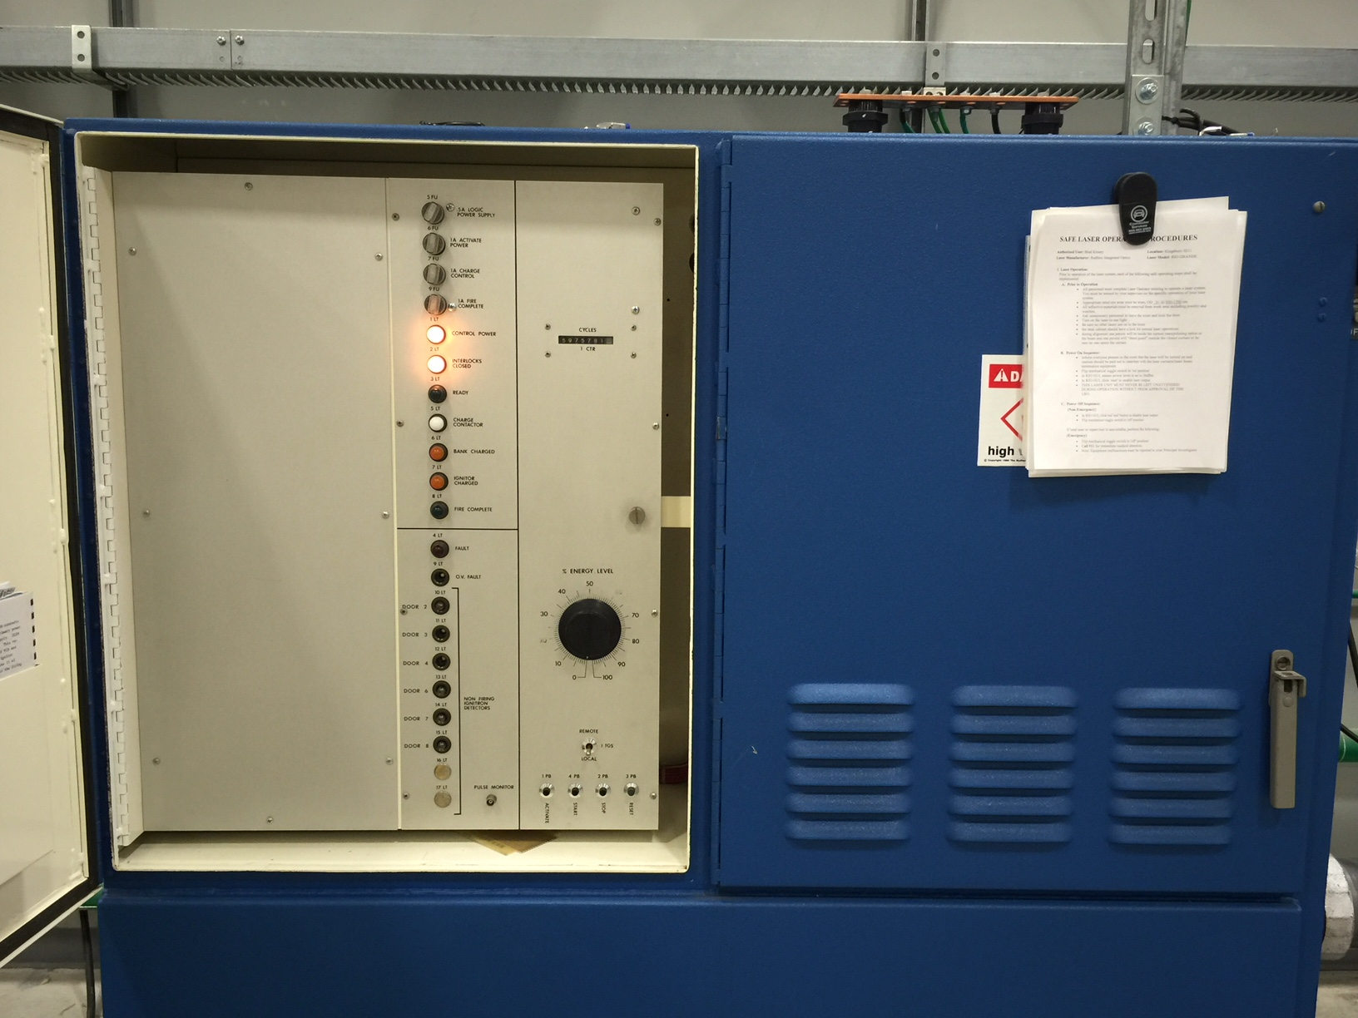
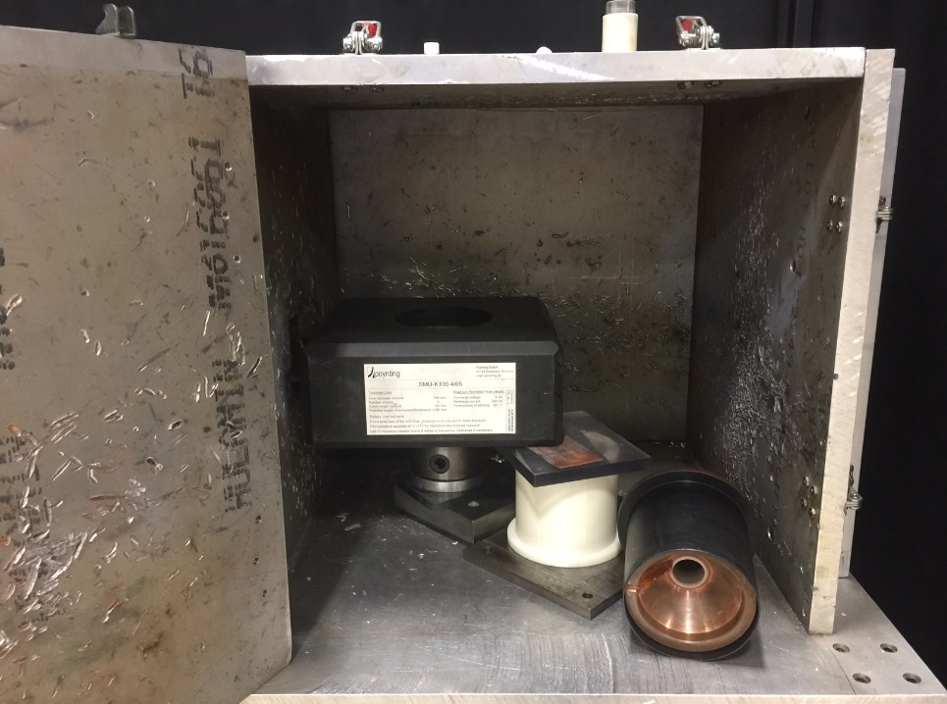
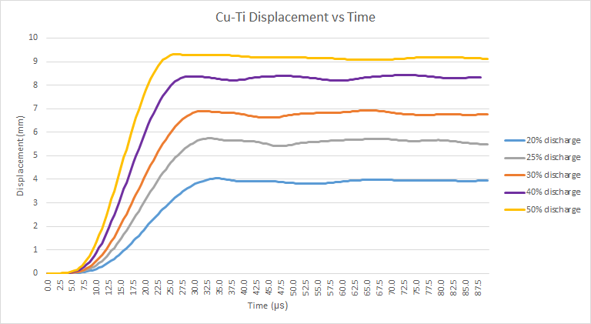
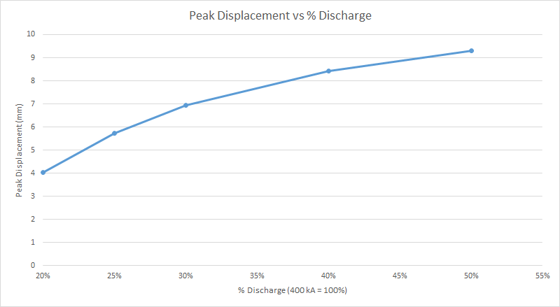
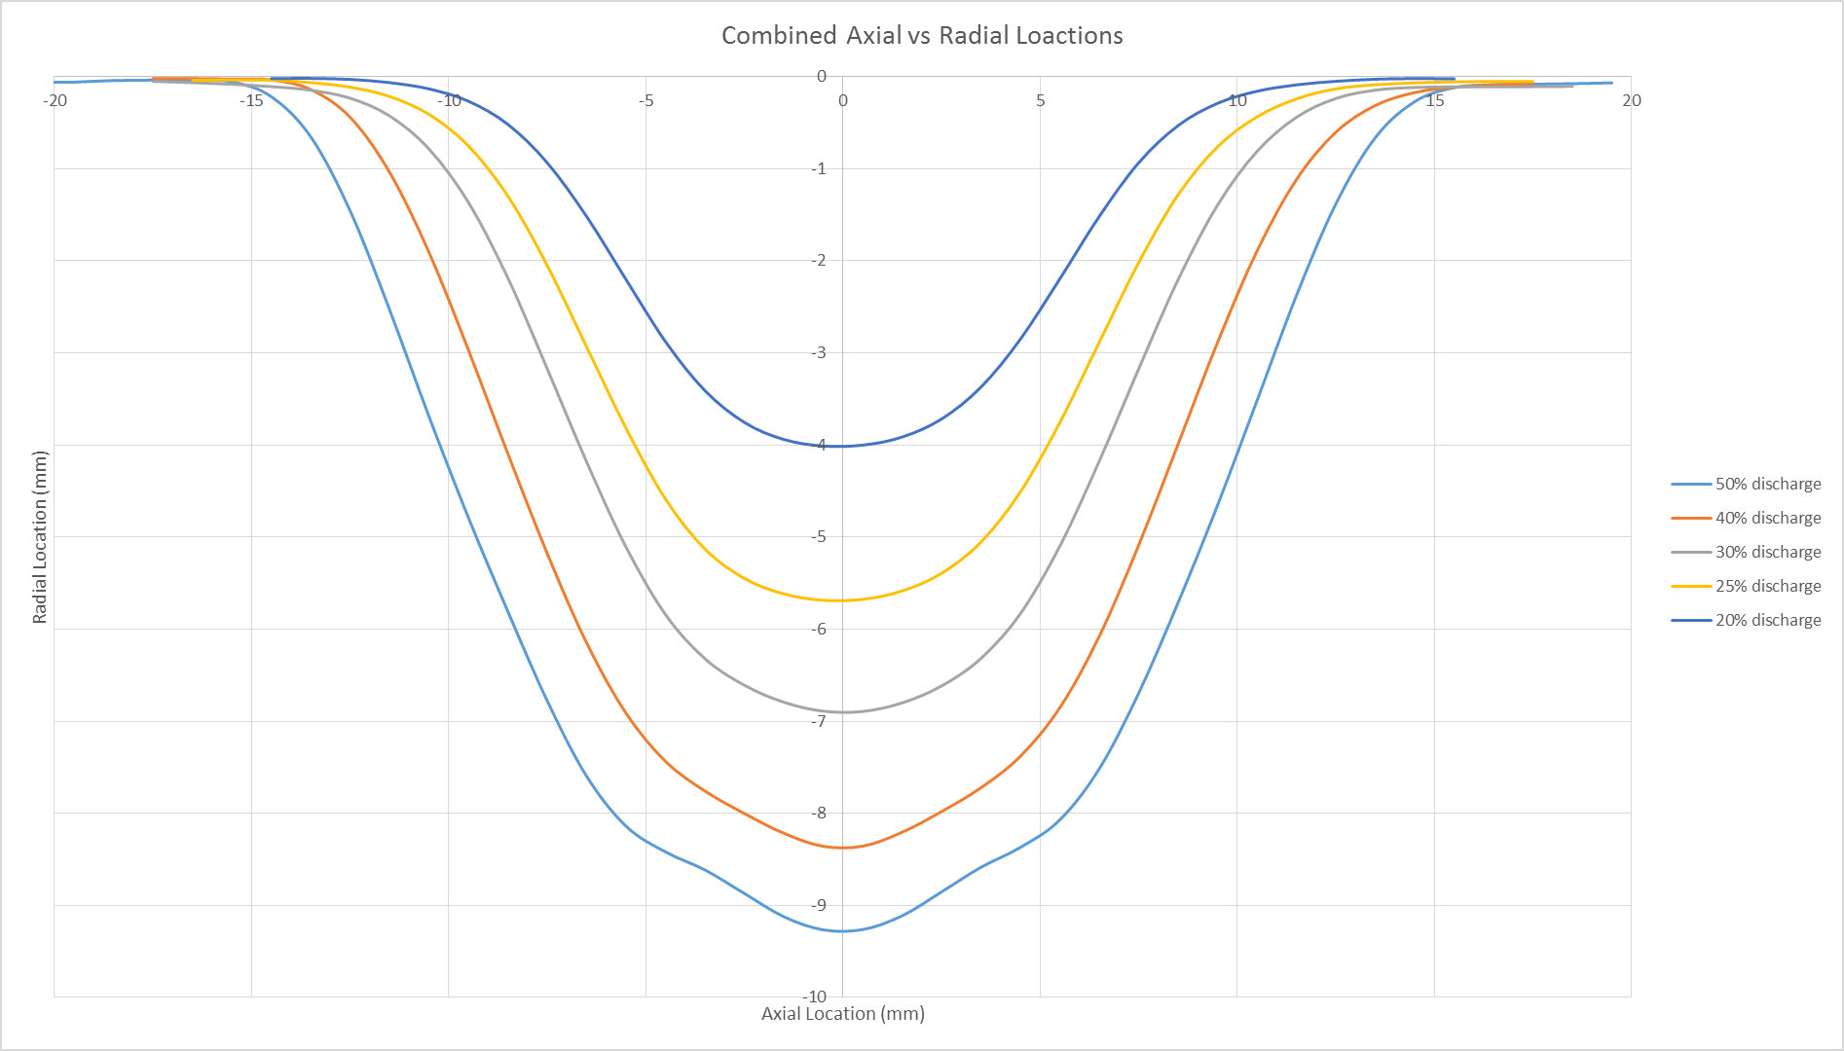
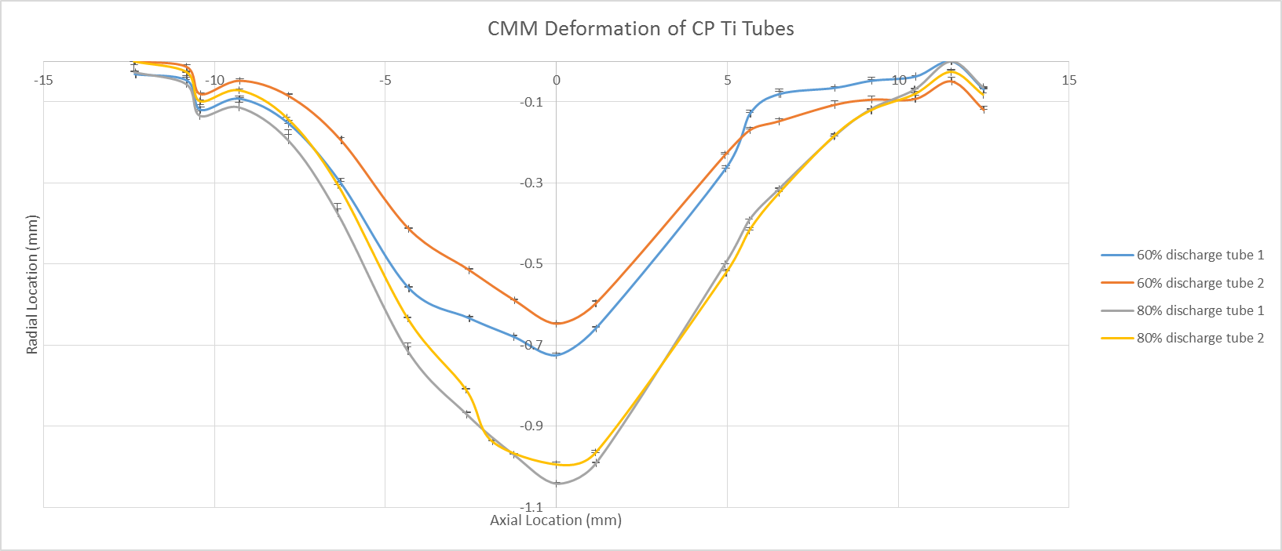
Numerical Simulation and Experimental Investigation of
Commercially Pure Titanium Tube Compression by Electromagnetic Pulse
Kyle Plante • Pinkerton Academy, Derry NH • kplante@pinkertonacademy.org
Abstract
Methods Continued
Results Continued
A Finite Element Analysis (FEA) model was utilized in order to predict the behavior of a commercially pure titanium (CP Ti) tube in response to an electromagnetic pulse. Of interest were how much the tube would compress as a result of the pulse, how fast the tube would compress, and at what time the peak compression velocity of the tube would occur. These parameters were of interest in order to set the optimum distance for magnetic pulse welding of the CP Ti tube to a copper alloy rod. In order to ensure the accuracy of the computer models, trials were run on the CP Ti tube, and the FEA results were compared with experimental data. The results clearly show that there are some incorrect parameters set in the FEA model as the CP Ti tube deformation from experiments are significantly different than the predicted results from the FEA.
4. Measure maximum velocity of the work piece utilizing Photon Doppler Velocimetry (PDV) and compare the results from the FEA. (Note: due to equipment issues with the PDV, this was not completed.)
5. Utilizing the Zcat Coordinate Measurement Machine (CMM) measure the deformation present in each sample of CP Ti and compare to the predicted results from the FEA (See figure 4).
Introduction/Background
Figure 9: The CP Ti tubes after undergoing compression via electromagnetic pulse. Left is the 40% capacitance discharge where no deformation was noted. Center are the two 60% capacitance discharge tubes, where minimal deformation was noted (approximately 0.9 mm). Right are the 80% capacitance discharge tubes, where more deformation was noted (approximately 1.1 mm) but not on the order predicted by the FEA.
Magnetic Pulse Welding (MPW) is a process in which metals of a dissimilar nature can be "cold" welded together. It has many applications in the automotive, aerospace, and medical industries where different metals may need to be joined together. Energy stored in a capacitor (See figure 1) is quickly dissipated into a specially designed copper coil to induce a strong magnetic field (See figure 2). In the center of the insulated copper coil a magnetic field shaper is placed to direct the magnetic field toward the workpiece. This magnetic field generates an opposing magnetic pulse in the workpiece which results in the workpiece being accelerated at a high rate causing a high velocity impact (on the order of hundreds of meters per second) of the workpiece into its counterpart. This impact results in a strong metallurgical bond. This process is advantageous in that it does not often reach the melting point of the materials to weld them together, thus keeping their specific properties intact (Shanthala and Sreenivasa, 2016).
Figure 3: The MPW apparatus set up and secured ready for the current to be discharged through it.
Figure 4: The Fowler Zcat Coordinate Measuring Machine, utilized to measure the deformation in the CP Ti tubes.
Discussion
Results
Upon the initial test of 40% capacitance discharge it became obvious that the experimental results were not going to match the computer models, as there was no noticeable deformation present in the CP Ti workpiece. Figure 9 demonstrates the differences in the workpieces. If the computer model was correct the 40% discharge sample would show even more deformation that what the 80% sample currently shows. In order to rule out equipment failure an aluminum workpiece was placed in the EMF apparatus and the capacitor was turned down to 20%. There was noticeable deformation in the aluminum workpiece indicating that the problem not lie with the equipment but with the computer model. The experimental results also indicate that having a CP Ti tube as a workpiece to weld to a copper shaft via MPW may not be possible. The amount of deformation present would seem to indicate that the velocity the CP Ti reaches is most likely insufficient to generate a proper weld.
Figure 5: FEA results for velocity of the CP Ti tube workpiece over time. As energy output increased the peak velocity also increased in a fairly linear fashion, in particular after 30% energy.
Figure 1: The 12 kJ capacitor bank utilized to create the magnetic field that causes the workpiece to accelerate.
Insulated Copper Coil
Magnetic Field Shaper
Figure 2: A metal box containing the insulated copper coil, and the field shaper in which the CP Ti tube is inserted to undergo compression
Figure 6: FEA results for the peak displacement of the CP Ti tube workpiece. As energy level increased so did the peak displacement, though it is not as linear as peak velocity indicating that there are diminishing returns as energy output increases.
In order to determine the critical parameters necessary for MPW to occur, an analytical model can be used to reduce cost and waste of materials compared to empirical experimentation (Kinsey and Nassiri, 2017). Alternatively, utilizing the LS-Dyna software package, a FEA model can be produced to assess the critical parameters necessary to weld a CP Ti tube to a copper alloy rod. The critical parameters are the workpiece peak velocity, workpiece peak velocity time, and workpiece displacement. By noting the time at which the peak velocity occurs, and the displacement of the tube at that time, the optimum distance to place the tube from the rod to insure a collision at peak velocity can be determined. In order to ensure the accuracy of the FEA model, trials experiments utilizing the apparatus described above were carried out on CP Ti tubes, without including the copper rod in order to compare the predicted velocity and deformation from the FEA simulations to the experimental results.
Future Steps
Examine the FEA model in order to ensure that not only are the physical properties of the CP Ti workpiece correct, but the electrical properties as well.
When the parameters are correct in the FEA model run simulations at 60% and 80% capacitance discharge and compare with experimental data collected.
Examine the predicted velocity to see if MPW is possible. Velocities greater than 300 m/s are required to successfully achieve MPW (Nassari et al. 2015).
Figure 7: FEA results of the deformation of the CP Ti tube at various energy levels. As energy increased so did the depth and breadth of the deformation. Of note is that at energy levels higher than 30% wrinkling of the tube was predicted, as shown by the waviness of the curve.
Literature Cited
Methods
Shanthala K. and Sreenivasa T. N., (2016) Review on electromagnetic welding of dissimilar materials, Frontier of Mechanical Engineering, v. 11, n. 4, p. 363-373
Kinsey B. and Nassari A., (2017) Analytical model and experimental investigation of electromagnetic tube compression with axi-symmetric coil and field shaper, Manufacturing Technology v. 66, p. 273-276
Nassari, A., Chini, G., Vivek, A., Daehn, G., and Kinsey, B., (2015) Arbitrary Lagrangian– Eulerian finite element simulation and experimental investigation of wavy interfacial morphology during high velocity impact welding, Materials & Design, v. 88, p. 345-358
1. Run computer simulations in LS-Dyna on a CP Ti tube using commercially available properties for CP Ti, and vary the amount of energy the tube is exposed to. Simulations at 20%, 25%, 30%, 40%, and 50% capacitance discharge were modeled.
2. Download the predicted peak velocity and peak displacement data into Microsoft Excel and generate scatter plots of the results.
3. Acquire CP Ti grade 2 tube and cut them into 100mm sections to test experimentally. Place the tubes into the MPW apparatus and run 3 trails at each percent discharge (See figure 3). (Note: in order to save time, energy levels of 30%, and 40% were chosen; however, no deformation was noted, so trials at 60% and 80% discharge were run.)
At this point 3 trials were conducted to verify the FEA at 40% capacitance discharge; however, no deformation was noted on the CP Ti tube. Power was then increased to 60% capacitance and 2 trials were conducted, and then increased again to 80% capacitance discharge with another 2 trials conducted. The following are the result of those trials.
Acknowledgements
Figure 8: CMM measurements of the deformation present in the CP Ti tubes exposed to 60% and 80% capacitance discharge. The FEA analyses was not conducted at the powers levels the trials were run at.. Error bars indicated the high and low measurements for each tube from the CMM
This research was supported with funding from the National Science Foundation’s Research Experience for Teachers in Engineering Grant (ENG-1711781). I would also like to thank my advisor, Dr. Brad Kinsey, for his help in guidance in this project, Shunyi Zhang for his support with manipulating the computer models, and Wunderly Rote for her help in learning the equipment necessary to carry out this research, and answering my mundane questions about engineering topics that I knew little about. I would also like to thank Dr. Stephen Hale, Allison Wasiewski, and the Leitzel Center staff for putting together this program and managing the day to day activities.

