Slide 1
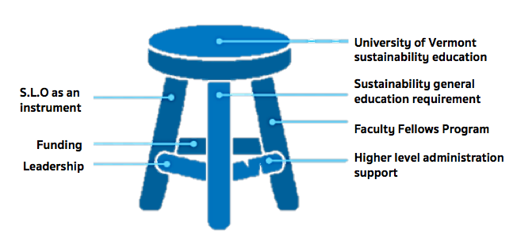
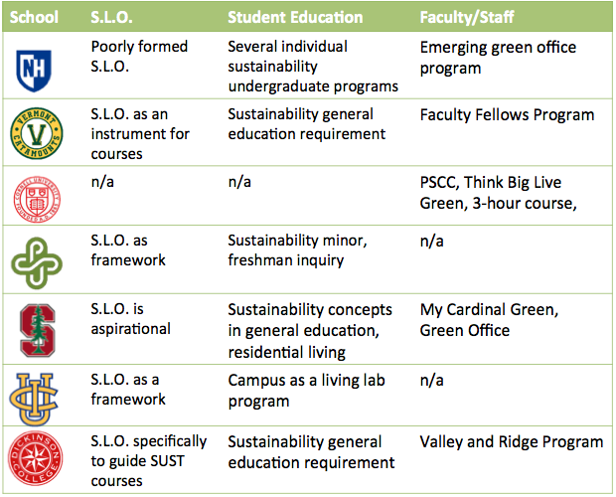
Sustainability Learning Outcomes in Higher Education
Sofia Rodriguez, UNH Sustainability Fellow, Summer 2018
Mentor: Vanessa Levesque, UNH Sustainability Dual Major
Introduction
UNH is recognized leader in sustainability, yet does not have a holistic strategy for sustainability education and training. Sustainability in Higher Education requires a whole university approach that connects curriculum, campus, community strategies and action (Müller-Christa, et al. 2014).
What are Sustainability Learning Outcomes?
Although UNH has them, we recognize that they are not apart of a holistic strategy for sustainability education. Sustainability Learning Outcomes are specific learning goals around sustainability that are articulated in order to target the audience's knowledge of sustainability (Bielefeldt, 2013)
Methods
Researching how other Institutes of Higher Education are incorporating sustainability learning to students, faculty and staff.
"Lay of the Landscape" : Researched 41 Institutions of Higher Education through STARS and online research.
In-depth interviews with 7 Institutions that are exceling in at least one of the three ways to promote sustainability (Table 1)
Created an on-going annotated bibliography of reports, websites and academic papers.
Limitations:
Only choosing schools that report to STARS even though there are several non-reporting schools that are leaders in sustainability such as Harvard University and UCLA.
Research was not done on graduate programs or certificates
Unable to conduct interviews with Cornell and PSU.
Figure 1: UVM "3 legged stool". This image represents the 3 methods of promoting sustainability.
Objectives
Why is this important?
This provides a great opportunity for the University of New Hampshire to be the first to create a holistic sustainability learning outcome.
Goals:
Identify the range of methods by which institutions of higher education promote sustainability learning throughout their campus.
Identify best practices that UNH can learn from and what UNH can do to excel in sustainability.
Discussion
My research is valuable to the university as it brings together information about sustainability education at schools across the country. Findings are being presented to Faculty and Staff in the sustainability education committee to decide how to move forward at UNH. I will be attending meetings to continue my work in the fall semester.
Questions for UNH to consider:
1. Does UNH want aspirational set of SLO or instrumental guide to create sustainability courses?
2. Does UNH want to incorporate broader sustainability competencies into their SLO?
3. Should UNH unify the sustainability majors/minors? If so, how?
4. Should UNH improve informal sustainability education opportunities?
5.. Does UNH want to bring sustainability education to faculty and staff? If so, how?
Results
1. Having a University Wide Sustainability Learning Outcome
  Some schools go through an explicit process to create SLOs while others create SLOs after the fact
  There are two ways that schools "use" SLOs: either as a aspirational goal or used as a guide to create sustainability courses.
  Competencies are another avenue to promote sustainability at an institute of higher education (Wiek, 2011). Competencies provide a more general than learning outcomes and often include concepts such as systems thinking, futures thinking and interpersonal skills.
2. Sustainability Education Program for undergraduate students
  Most formalized undergrad programs have sustainability general education requirements with sustainability across the curriculum programs.
  Unique approaches to sustainability education includes campus as a living lab program (UCI) and undergraduate residential living (SU).
3. Faculty and Staff sustainability learning
  Sustainability across the curriculum faculty workshops improve curriculum.
  Sustainability programs for faculty and staff typically focus on conserving resources without much formal teaching or learning outcomes.
References
1. Wiek, A., Withcombe, L., Redmna, C.L. (2011) Key competencies in sustainability: a reference framework for academic program develpoment. Sustainability Science.
2. Müller Christa, G., Sterling, S., van Dam-Mierasc, R., Adomßent, M., Fischerd, D.,Rieckmann, M., (2014). The role of campus, curriculum, and community in higher education for Sustainable Development
3.Bielefeldt, R.A. (2013)." Pedagogies to Achieve Sustainability Learning Outcomes in Civil and Environmental Engineering Students", Sustainability, 5(10), 4479-4501.
Table 1: 3 ways of promoting sustainability at 7 schools.

