Slide 1
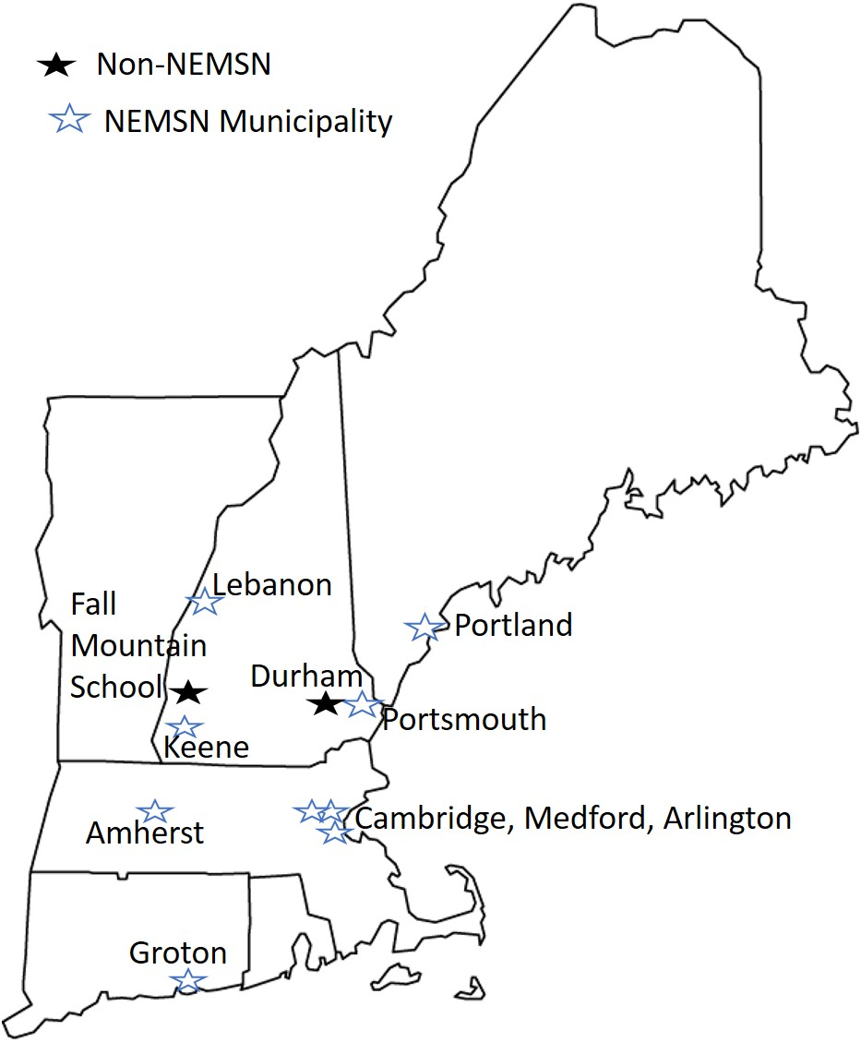
Understanding and Reducing Barriers to “Impact Investment” Opportunities
Claire McCarthy, UNH Sustainability Fellow, Summer 2018
Mentors: Michael Swack PhD, Henry Herndon, UNH Center for Impact Finance
This project analyzes current climate action projects in New England, the finance-related barriers these projects are facing or have faced, and what can be accomplished to lessen the effects of these barriers.
Objectives of the research
Research and understand projects in the planning process throughout New England and their financing needs
Understand the tools that are available to fund and/or finance sustainable projects
Understand the common barriers faced by municipalities carrying out sustainable projects
Address how municipalities can minimize barriers to financing and/or funding projects with case studies and other research
Methods and Approach
Background information:
Researched methods of green financing and funding: bonds, loans, grants, equity investment
Researched general barriers to utilizing these types of financing/ funding instruments and possible solutions to barriers
Demand for green financing and understanding barriers:
Reached out to NEMS Network members via surveys and interviews
Contacted and interviewed other municipal leaders regarding projects in pipeline and completed projects
Understanding barriers, political and financial:
Contacted leaders from various organizations in NE (public and private) regarding state policies and state financial incentives and potential barriers from a policy perspective
Major Findings
Methods of financing from NEMS Network Survey:
Common Barriers:
Administrative Capacity
  Most common issue—almost every municipality noted this in survey or interview. A preventive barrier to financing or funding.
Lack of knowledge or understanding of how financing these projects works or the options available.
Hesitancy or inability to engage in long-term debt producing projects and a tendency to focus on smaller, shorter-run, quick payback projects. Some of the barriers that lead to this include:
  Lack of coordination for longer projects
  Changing regulations and incentives
  Lack of support from town (residents and/ or municipality)
Low current city funds and difficulty accessing grant money
New Hampshire Specific Barriers:
Many political barriers
  Opposition of solar energy legislation from the Governors office (two recent vetos of bi-partisan legislation)
  antagonism toward renewable subsidies by the government: seen in the Governor’s Update to the State Energy Strategy
  Lack of town political support in some cases
General lack of coordination from the State
Contractors “flock” to MA where there are more rebates at higher rates to complete their projects for cheaper
  Sunraise Investment example
Massachusetts Specific Barriers:
Contradicting, complex and lack of cohesive regulations and programs
  SMART, SREC II, and Net Metering contradictions
  Towns are unaware of all options
Discussion and Recommendations
This research sheds light on the most prominent issues faced in New England which can lead to guided change. These changes can make the current barriers manageable or less present. Some recommendations include:
Municipalities could benefit from “green” finance education—possibly utilize UNH Cooperative Extension or similar organization for educational programs.
Towns could benefit from creating a position dedicated to sustainability and implementing climate action projects in their towns. Positions often “pay for themselves” through the energy savings from the projects the position completes: Arlington, MA
Utilize municipal leases or power purchase agreements to finance energy projects—doesn’t put municipality into indebtedness, and project doesn’t have to pass through town council: Portsmouth solar PPA, Fall Mountain municipal lease.
Due to many limitations with the current state of the research, next steps would be to continue to address these research questions with the possibility of narrowing a focus to a state or a type of project. Further research is needed for transferable data.
Grant Money | Current Municipal Funds | Debt (bonds, loans) | Equity money | Other
6/13 | 8/13 | 5/13 (All General Obligation Bonds) | 1/13 | 3/13 (Utility incentive funding, Power Purchase Agreement, etc.)
Figure 1: Entities Contacted for research. Does not include individuals not representing a community

