Slide 1
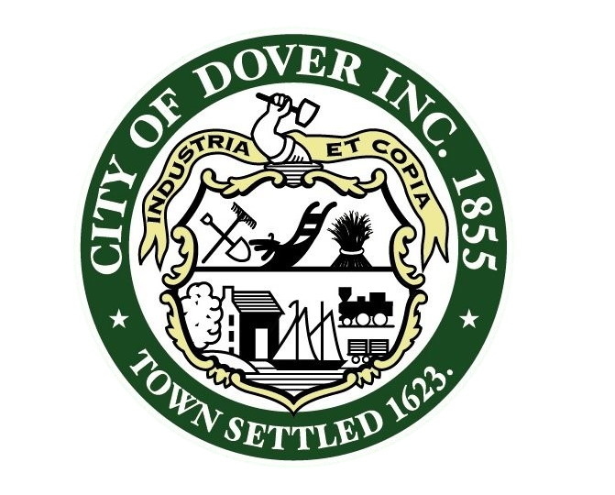

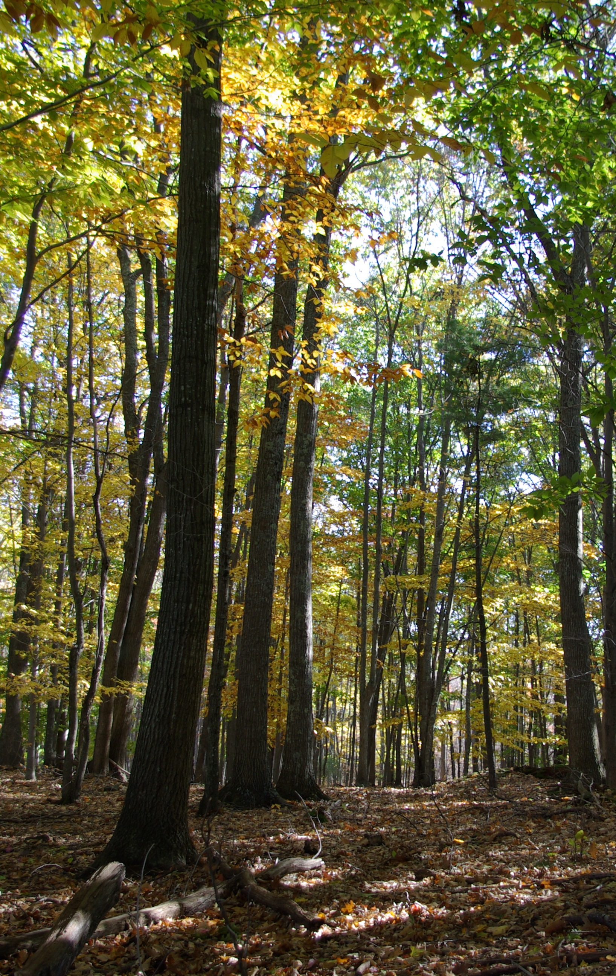

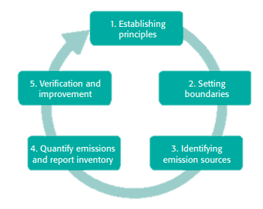


Measuring Municipal Carbon and Nitrogen Footprints
Jackson Kaspari, UNH Sustainability Fellow, Summer 2018
Mentor: Elena Piekut, City of Dover, NH Planning Department
As a result of this project, Dover will become the first city to establish a combined GHG and nitrogen inventory for its local government operations (LGO)
Introduction
Emissions Sectors
Scope Contributions
Carbon Footprint: Total amount of greenhouse gases (GHGs) produced to directly and indirectly support human activities.¹
Nitrogen Footprint: The amount of reactive nitrogen released to the environment as a result of an organization’s resource consumptions.²
Footprint Baseline: A selected time period to which future footprints are compared.³
Sectors | Scope 1 Direct Emissions | Scope 2 Indirect Emissions | Scope 3 Indirect Emissions
Stationary Fuels | X
Municipal Fleet | X
Fertilizer and Animals | X
Purchased Electricity |  | X
Transmission & Distribution Losses |  |  | X
Employee Commuting |  |  | X
Employee Travel |  |  | X
Solid Waste |  |  | X
School Food |  |  | X
Paper |  |  | X
Wastewater |  |  | X
LGO Baseline Benefits ³
Leads to the identification of opportunities to improve energy efficiency
Demonstrates climate change leadership
Allows reduction targets to be set and executed in a cost effective manner
A
B
Figure 4. A breakdown of the total carbon (A) and nitrogen (B) footprints by scope.
https://www.cbc.ca/news/canada/how-canada-s-provinces-are-tackling-greenhouse-gas-emissions-1.3030535
Weather
Equivalencies
Scope | Description ³
1 | Emissions from sources that are directly owned or controlled by the organization. Example: Fossil fuel combustion
2 | Indirect emissions such as those produced from the consumption of electricity
3 | Emissions that are a consequence of the organization’s operations. Example: Employee commuting or business travel
 | 2016 | 2017 | % Change
HDD ⁶ | 5,976 | 6,147 | 3
CDD ⁶ | 685 | 623 | -9
TDD | 6,661 | 6,770 | 2
11,260 acres of fully developed forest were required to sequester Dover’s 2017 LGO GHG emissions ⁷
C & N Footprints
https://foodrevolution.org/blog/best-worst-foods-to-eat/
The amount of nitrogen emitted by Dover’s 2017 LGO equated to enough food to feed ~8,600 people for one year ⁹
9,560
Goals
Completed EPA Portfolio Manager profile for City and School facilities
Baseline carbon and nitrogen footprint calculations for the City of Dover’s municipal operations via Portfolio Manager and the SIMAP tool
Reports, including recommended goals, to be presented to City leaders, staff and the general public
Recommendations for adaptations to SIMAP methodologies and the user interface to allow a version that can support municipal calculations while being aligned with the Greenhouse Gas Protocol best practices for LGOs.
11,260 acres of forest is equivalent to ~66% of Dover’s total land area ⁸
https://www.nrcs.usda.gov/wps/portal/nrcs/main/nh/technical/landuse/forestry/
8,600 people = ~28% of Dover’s population ⁸
Discussion
Now that a baseline is established for 2017 Dover can compare its LGO footprints for years to come.
Upcoming solar projects will reduce LGO carbon footprint.
Large contribution of wastewater to the LGO nitrogen footprint highlights the importance of wastewater treatment and management.
What I’ve learned: The process of conduction a LGO GHG and nitrogen inventory as well as insight into how municipalities operate.
Next steps include analyzing reduction scenarios and working with City leaders to establish targets.
Methodology
Figure 2. A comparison of the total carbon footprints as a result of Dover’s LGO between 2016 and 2017.
⁴
References
⁵
Time for Change. What is a carbon footprint – definition. https://timeforchange.org/what-is-a-carbon-footprint-definition (accessed June 15, 2018)
Galloway, J. N.; Winiwarter, W.; Leip, A.; Leach, A. M.; Bleeker, A.; Erisman, J. W.; Nitrogen footprints: past, present and future. Environ. Res. Lett. 2014, 9.
Fong, W. K.; Sotos, M.; Doust, M.; Schultz, S.; Marques, A.; Deng-Beck, C.; Global Protocol for Community-Scale Greenhouse Gas Emission Inventories.
Energy Star Portfolio Manager. https://www.energystar.gov/buildings/facility-owners-and-managers/existing-buildings/use-portfolio-manager (accessed June 8, 2018).
Sustainability Indicator Management & Analysis Platform. https://unhsimap.org/ (accessed June 27, 2018)
Weatherdatadepot. https://www.weatherdatadepot.com/ (accessed August 1, 2018)
Greenhouse Gas Equivalencies Calculator. https://www.epa.gov/energy/greenhouse-gas-equivalencies-calculator. (accessed July 6, 2018)
Economic + Labor Market Information Bureau. https://www.nhes.nh.gov/elmi/products/cp/profiles-htm/dover.htm (accessed July 31, 2018)
Galloway, J. N. Department of Environmental Sciences, University of Virginia, Charlottesville, VA. Personal communication, August 2018.
Figure 1. GHG Protocol’s five major steps for conducting a local government operations inventory. ³
Figure 3. A comparison of the total nitrogen footprints as a result of Dover’s LGO between 2016 and 2017.

