Slide 1
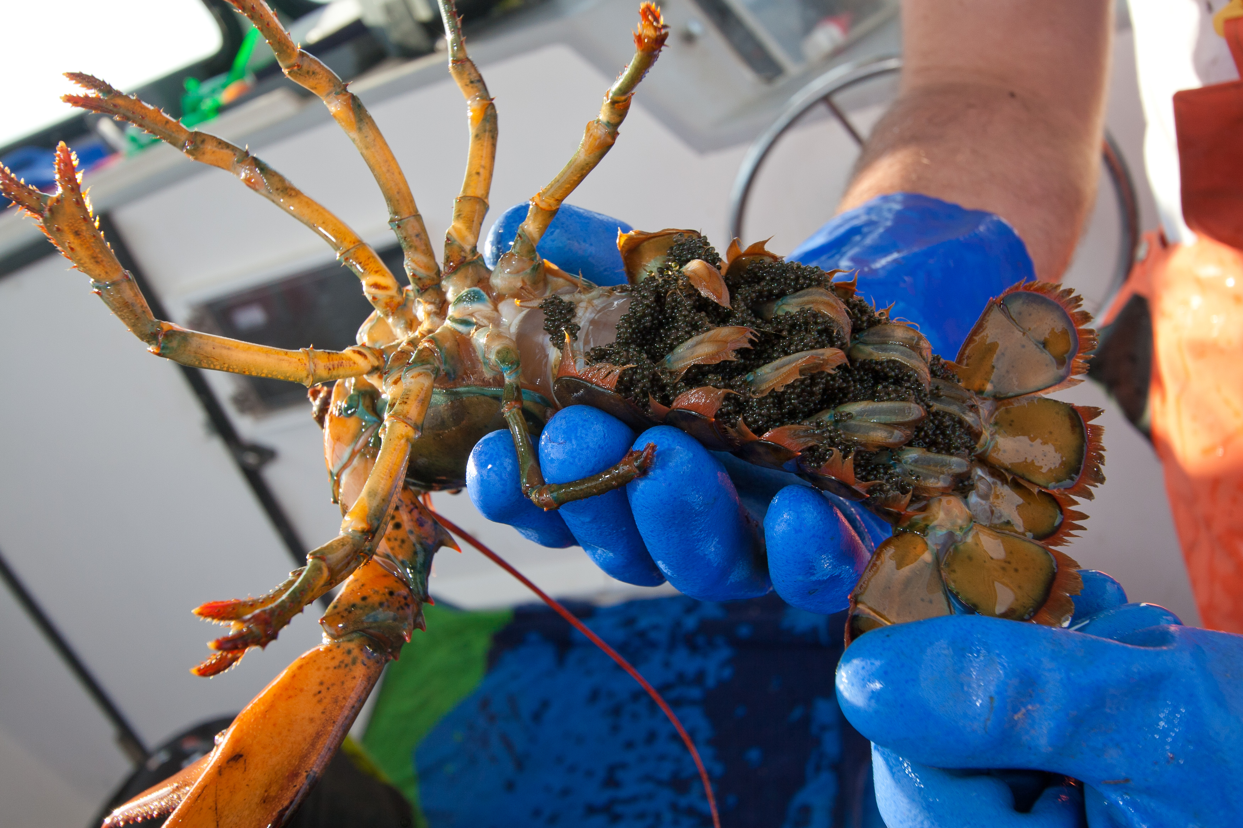
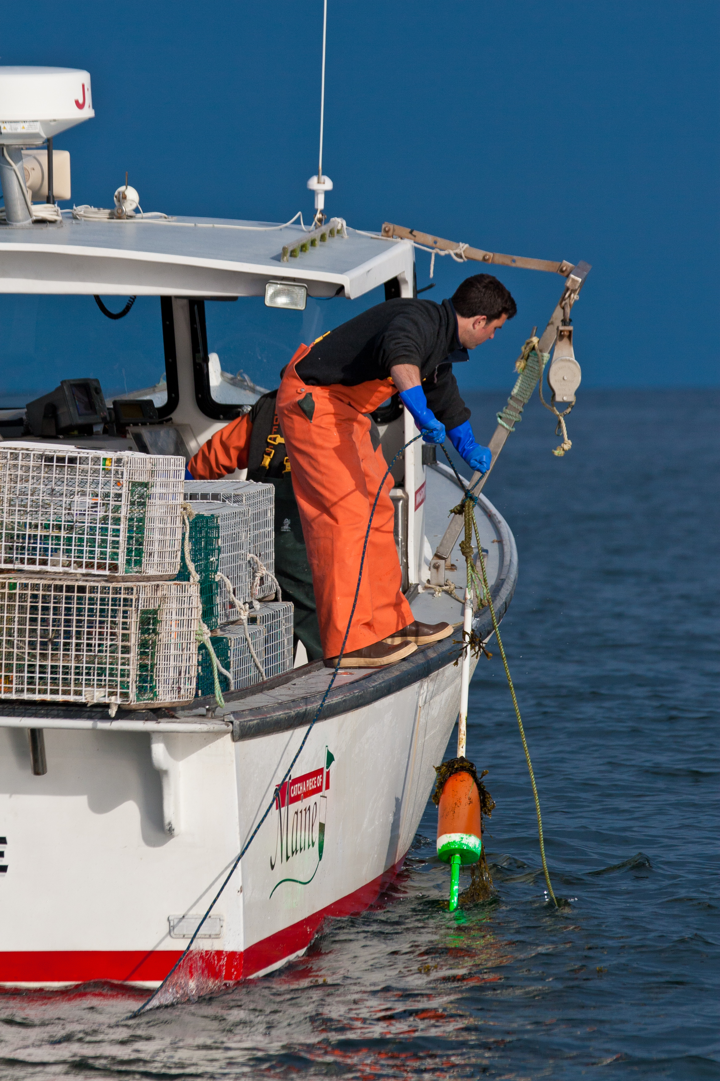
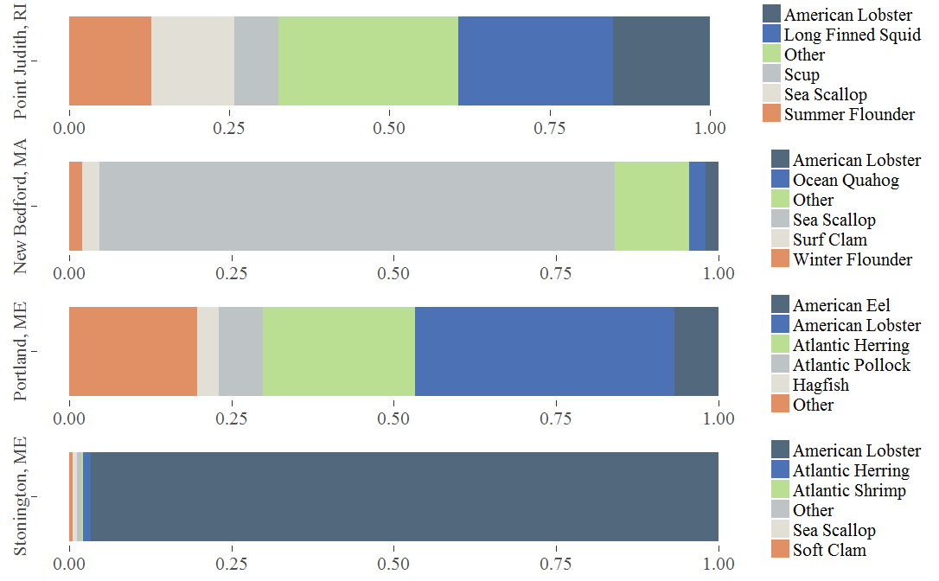
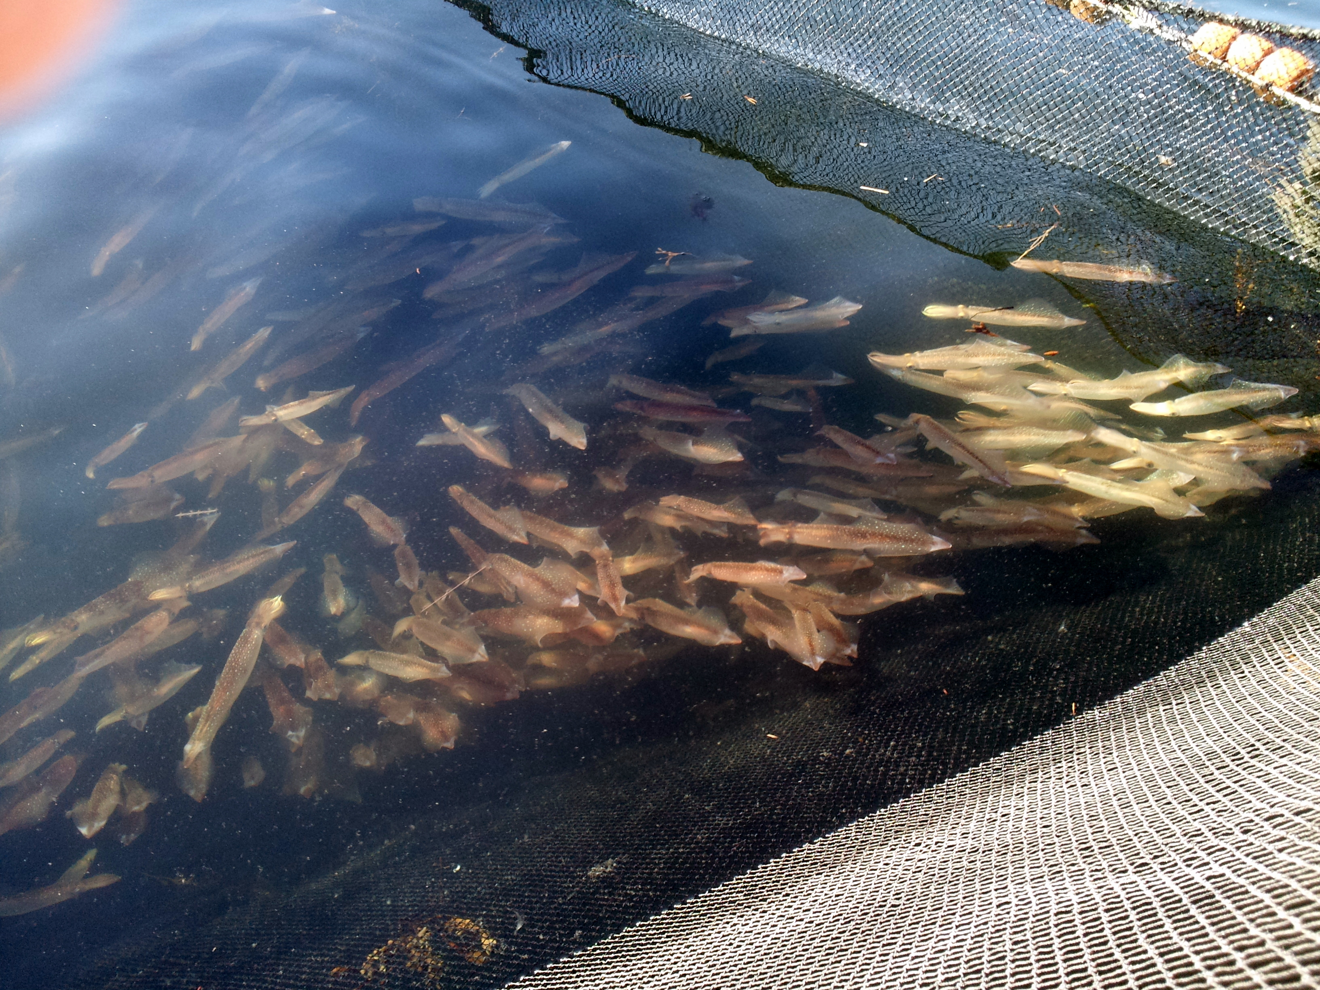
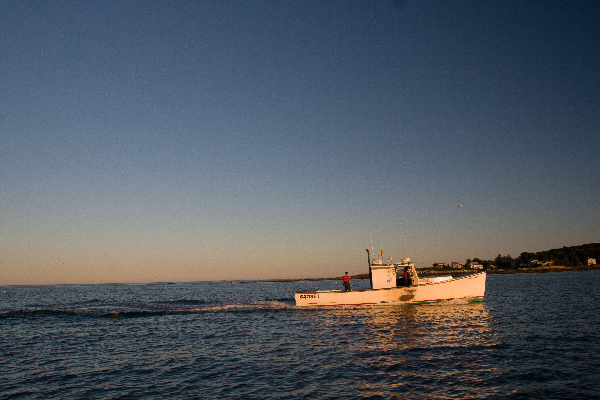
Climate Adaptation Information for Fishing Communities
Sabrina Kerin, UNH Sustainability Fellow, Summer 2018
Mentors: Kathy Mills, Ph.D., Gulf of Maine Research Institute
Background
Climate change is already impacting fish populations, marine ecosystems, and fisheries. How fishing communities will be affected by climate change depends on the species they target and their capacity to adapt. GMRI is leading a Northeast-wide assessment of climate change vulnerability and adaptation strategies for fishing communities.
Four Focus Ports
Catch Composition by Port
Key Questions
How will species availability change?
What are the economic impacts?
How will the community adapt?
Project Goals
Analyze in-depth interviews for 4 focus ports
Identify community-specific facilitators and barriers to adaptation
Summarize existing climate change adaptation frameworks and determine where project results can be incorporated
Methods
In-depth interviews, qualitative data extraction & interpretation
“If unhampered by regulations, fishermen have the capacity and skill to adapt their businesses and fishing operations to a changing ecosystem. Politics is the limiting factor”
Point Judith, RI
Qualitative Interview Results
Adaptation Facilitators
Knowledge & Entrepreneurship
Protected Working Waterfront
Fishermen Led Conservation Efforts
  & Ocean Stewardship
Access to Financial Capital
Adaptation Barriers
Access (Permits, Licenses, Quota)
Management Structure & Regulatory Fragmentation
Scientific Time Lags & Management Rigidity
Business Consolidation & Specialization
Access to Markets & Local Demand
Community Identified Adaptation Options
Target Emerging Species
Ecosystem Based Fishery Management
Regulatory System focused on Wasting Less Catch
Improved Market Access & Local Demand
Results
Phases & Subprocesses of Adaptation
Adapted from Moser & Ekstrom, 2010
Detect Problem
Gather/Use Info
(Re)Define Problem
Develop Options
Select Option(s)
Implement Option
Monitor Option and Environment
Evaluate
Assess Options
Understanding
Managing
Discussion & Next Steps
Ocean temperatures are warming rapidly in the Gulf of Maine
Fishermen, fishing communities, and management councils will all need to collaborate to buffer the impacts of a rapidly changing environment
GMRI hopes to identify viable adaptation pathways for all four ports, utilizing the information collected from interviews, ecosystem models, and economic impact evaluations
This project has been an incredible introduction into the complex world of fisheries!
Planning
Adaptation Progress by Community
Stonington, ME
Portland, ME
References
Moser & Ekstrom. 2010. PNAS. 5: 11016-22031
Detect Problem
Gather/Use Info
(Re) Define Problem
Develop Options
Assess Options
Select Option(s)
Implement Option
Monitor Option & Environment
Evaluate
New Bedford, MA
Point Judith, RI
“The irony is that the ocean will have same amount of potential, but we will not be permitted to pursue it” Point Judith, RI

