Slide 1
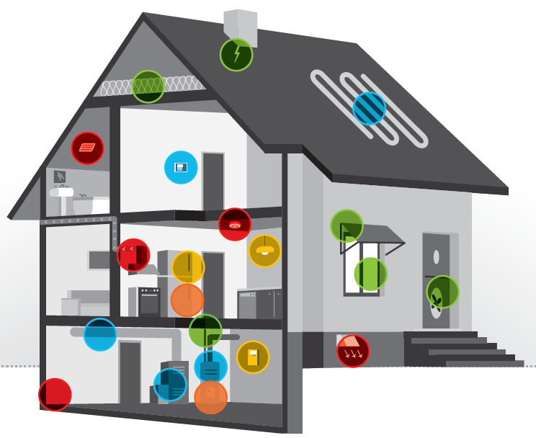












Promoting Better Health Through Climate Change Mitigation
Abby Gates, MSPH Candidate, UNH Sustainability Fellow, Summer 2018
Mentor: Jared Ulmer, MPH, AICP, Vermont Department of Health Climate & Health Program
Objectives
Assess health co-benefits of building weatherization strategies
Estimate potential impacts of weatherization strategies on the health of Vermonters
Communicate health co-benefits of weatherization to key partners and stakeholders
Weatherization Strategies
Mechanical
Heating & cooling systems, ducts,
pipes, water heater
Building Shell
Insulation, air sealing, roof/wall leaks,
windows & doors, solar screens
Healthy & Safety
Combustion safety, ventilation systems,
mold assessment, smoke & carbon monoxide detectors
Electric & Resident Education
Energy efficient lighting & appliances, resident education regarding indoor air quality and safe use of any new mechanical equipment
+Health
Mold remediation, advanced ventilation, lead & radon remediation, pest & dust mite remediation, walk-off mats, floor replacement, accessibility, education
Results
Table 1. Health Benefits of Wx and Wx+Health
Health Outcome | Confidence | Direction of Effect | Related Indoor Environmental Quality Outcomes
General Health | High
Asthma | High
Upper Respiratory | High
Cardiovascular | Medium
Neurological | Low
Infectious Disease | Low
Accidental Injury | Low
Mental Health | High
Productivity | High
Financial Stress | High
Social Health | Medium
Healthcare Utilization & Costs | Medium
$
Introduction
Weatherization (Wx)
  Home performance improvement process that addresses energy efficiency issues by way of cost-effective building improvements
  Weatherization + Health (Wx+Health)
  Prioritizes delivery of health benefits through Wx
Wx offers household & societal benefits
  Household: reduces energy expenditures, improves thermal comfort, improves health outcomes, reduces healthcare costs
  Societal: reduces healthcare utilization, reduces GHG emissions and pollutants, enhances resiliency against effects of climate change
Vermont’s 2016 Comprehensive Energy Plan¹
  Priority: Improve the health of indoor environments and reduce energy bills through improved building weatherization
  Priority: Reduce negative health impacts expected to occur as a result of climate change
  Goal: Weatherize 25% of the state’s housing stock (~80,000 units) by 2020
Vermont Climate Action Commission, 2017²
  Goal: Weatherize 20,000 low-income homes by 2020
Source: U.S. Department of Energy
Wx Impacts on Indoor Environmental Quality
Reduce relative humidity Improve temperature control
Reduce mold Improve indoor air quality
Reduce allergens Enhance safety
Eliminate pest intrusion Energy expenditure savings^{i}
$
$
$
Discussion
Evidence is growing in support of a positive association between weatherization strategies and health benefits
Evidence is strongest for certain populations of concern
  Minority populations
  Households of low socioeconomic status
  Residents with preexisting chronic health conditions
Recommendations
Consider standardizing review approach to include emphasis on specific intervention strategies delivered to the study population
Limit review of health outcomes of concern to those with the highest confidence for improvement due to weatherization
As studying the connection between weatherization and health is an emerging field, consider using epidemiological literature to draw tighter connections between IEQ outcomes of Wx to health outcomes of interest, as opposed to limiting to only studies that explore connections specifically between Wx and health outcomes
Consider growing importance of air conditioning or passive cooling as means to combat extreme heat
Methods
Conducted a literature review of weatherization strategies and associated indoor environmental quality outcomes and health benefits
Interviewed key partners to investigate local examples where relevant actions are taking place
Applied findings, where possible, of evidence and assessment methods to estimate possible health impacts of Wx and Wx+Health within the state of Vermont
Produced technical documentation of the aforementioned findings
Produced a clear, concise communication tool for key partner and stakeholder communication purposes
References
Vermont Department of Public Service (2016). Comprehensive Energy Plan 2016.
Vermont Climate Action Commission (2018). Executive Order No. 12-17 Report to the Governor.
U.S. Department of Energy, Office of Energy Efficiency & Renewable Energy (2018). Weatherization Works!
Footnotes
i. While not a direct component of indoor environmental quality, reduced household energy expenditures is a benefit of weatherization strategies intended to collectively improve energy efficiency.

