Slide 1

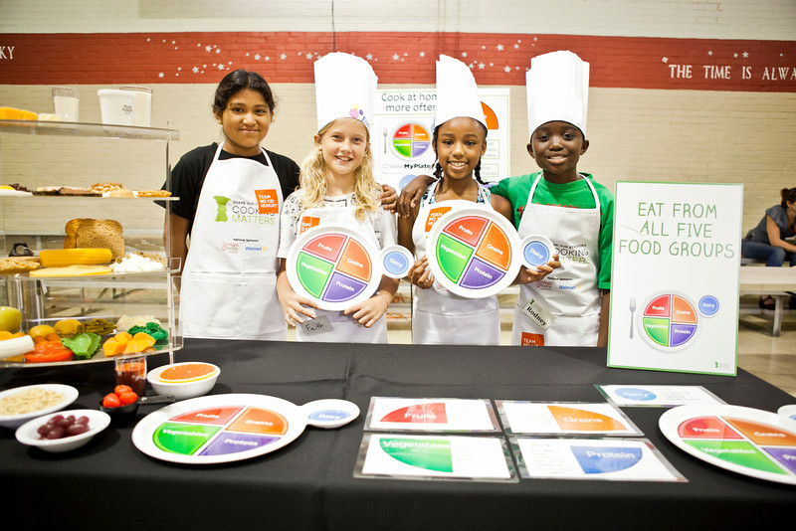

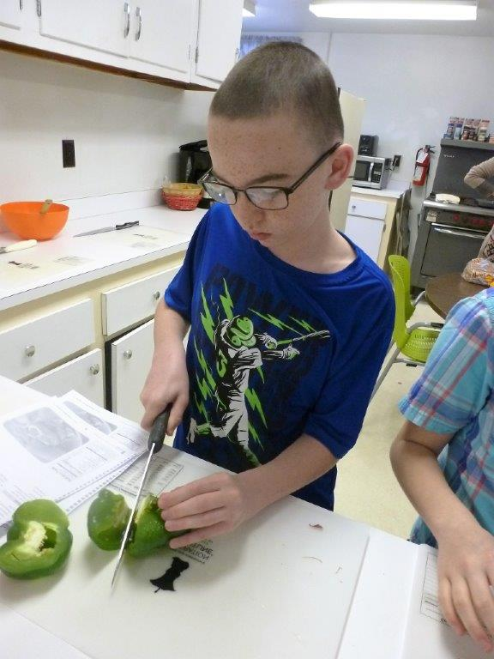



NH Sustainable Food Access: Programming Outreach
Kira Wadsworth, UNH Sustainability Fellow, Summer 2018
Alexis Dwyer, New Hampshire Food Bank
Introduction
Addressing Food Insecurity
The Cooking Matters Program aims to empower families at risk of hunger with the skills, knowledge, and confidence to prepare healthy and affordable meals. 12.3% of American households were food insecure at least some time during the year in 2016^{[1].} Understanding the barriers to accessing these types of programs is important to better understand the issues that those who are food insecure face every day. This project aims to shed light on some of these issues.
This graph represents participant responses to the question “How did you find out about this class?
Results
A Community Leader is key when it comes to recruiting for programs. Individuals within an agency or school energized about the program drive program recruitment success. Perceived barriers (childcare, transportation, perceptions of inaccessibility) were overcome when participants were encouraged by a trusted community member.
goo.gl/gMtFG8content_copyCopy short URL
Many participants expressed need for continued connection to Cooking Matters through social media platforms like Facebook Groups
This graphs represents participant responses to the question “What did you like most about the class?
Discussion
This project represents a snapshot of programming trends in America. I learned that difference in perception of program access causes discrepancies between participants, partner agencies, and coordinators. The perception that families don’t have enough time for the program is dismissed when everyone who finishes it wishes there were more. Being able to meet people where they are, and having a community champion are key to driving program participation and success. These findings can hopefully guide marketing strategies to better meet the needs of the target population while also fulfilling other stakeholder engagements.
Next Steps
Utilization of updated Outreach toolkit
Continue to identify key leaders within each community
Develop online media platform for program outreach & communication
Cooking Matters for Kids (2)
Objectives
Determining Driving and Limiting Factors
Determine limiting and driving factors to program participation
Develop solutions to encourage program participation
Develop comprehensive outreach packet for program coordinators and partner agencies
Method
Community Outreach
“This is a great opportunity to spend time with your kids and give them hands on learning and they even teach you!”
-CM Gilford Participant
“Feeding a child is about more than just nutrition; it’s also a means of communicating love” (3)
Research
Best outreach practices
Community assessment
Outreach
Interviews
Dialogue sessions
Results
Outreach toolkit
Participant Perspective
References
“Household Food Security in the United States in 2016”. September 2017. Retrieved from “https://www.ers.usda.gov/publications/pub-details/?pubid=84972
Image retrieved from http://cookingmatters.org/sites/default/files/Kids_Class_Graduation_-_South_Carolina_1.jpg
https://chronicleofsocialchange.org/news-2/low-income-parents-buy-junk-food-kids-just-low-prices
Photo by Kira Wadsworth

