Slide 1
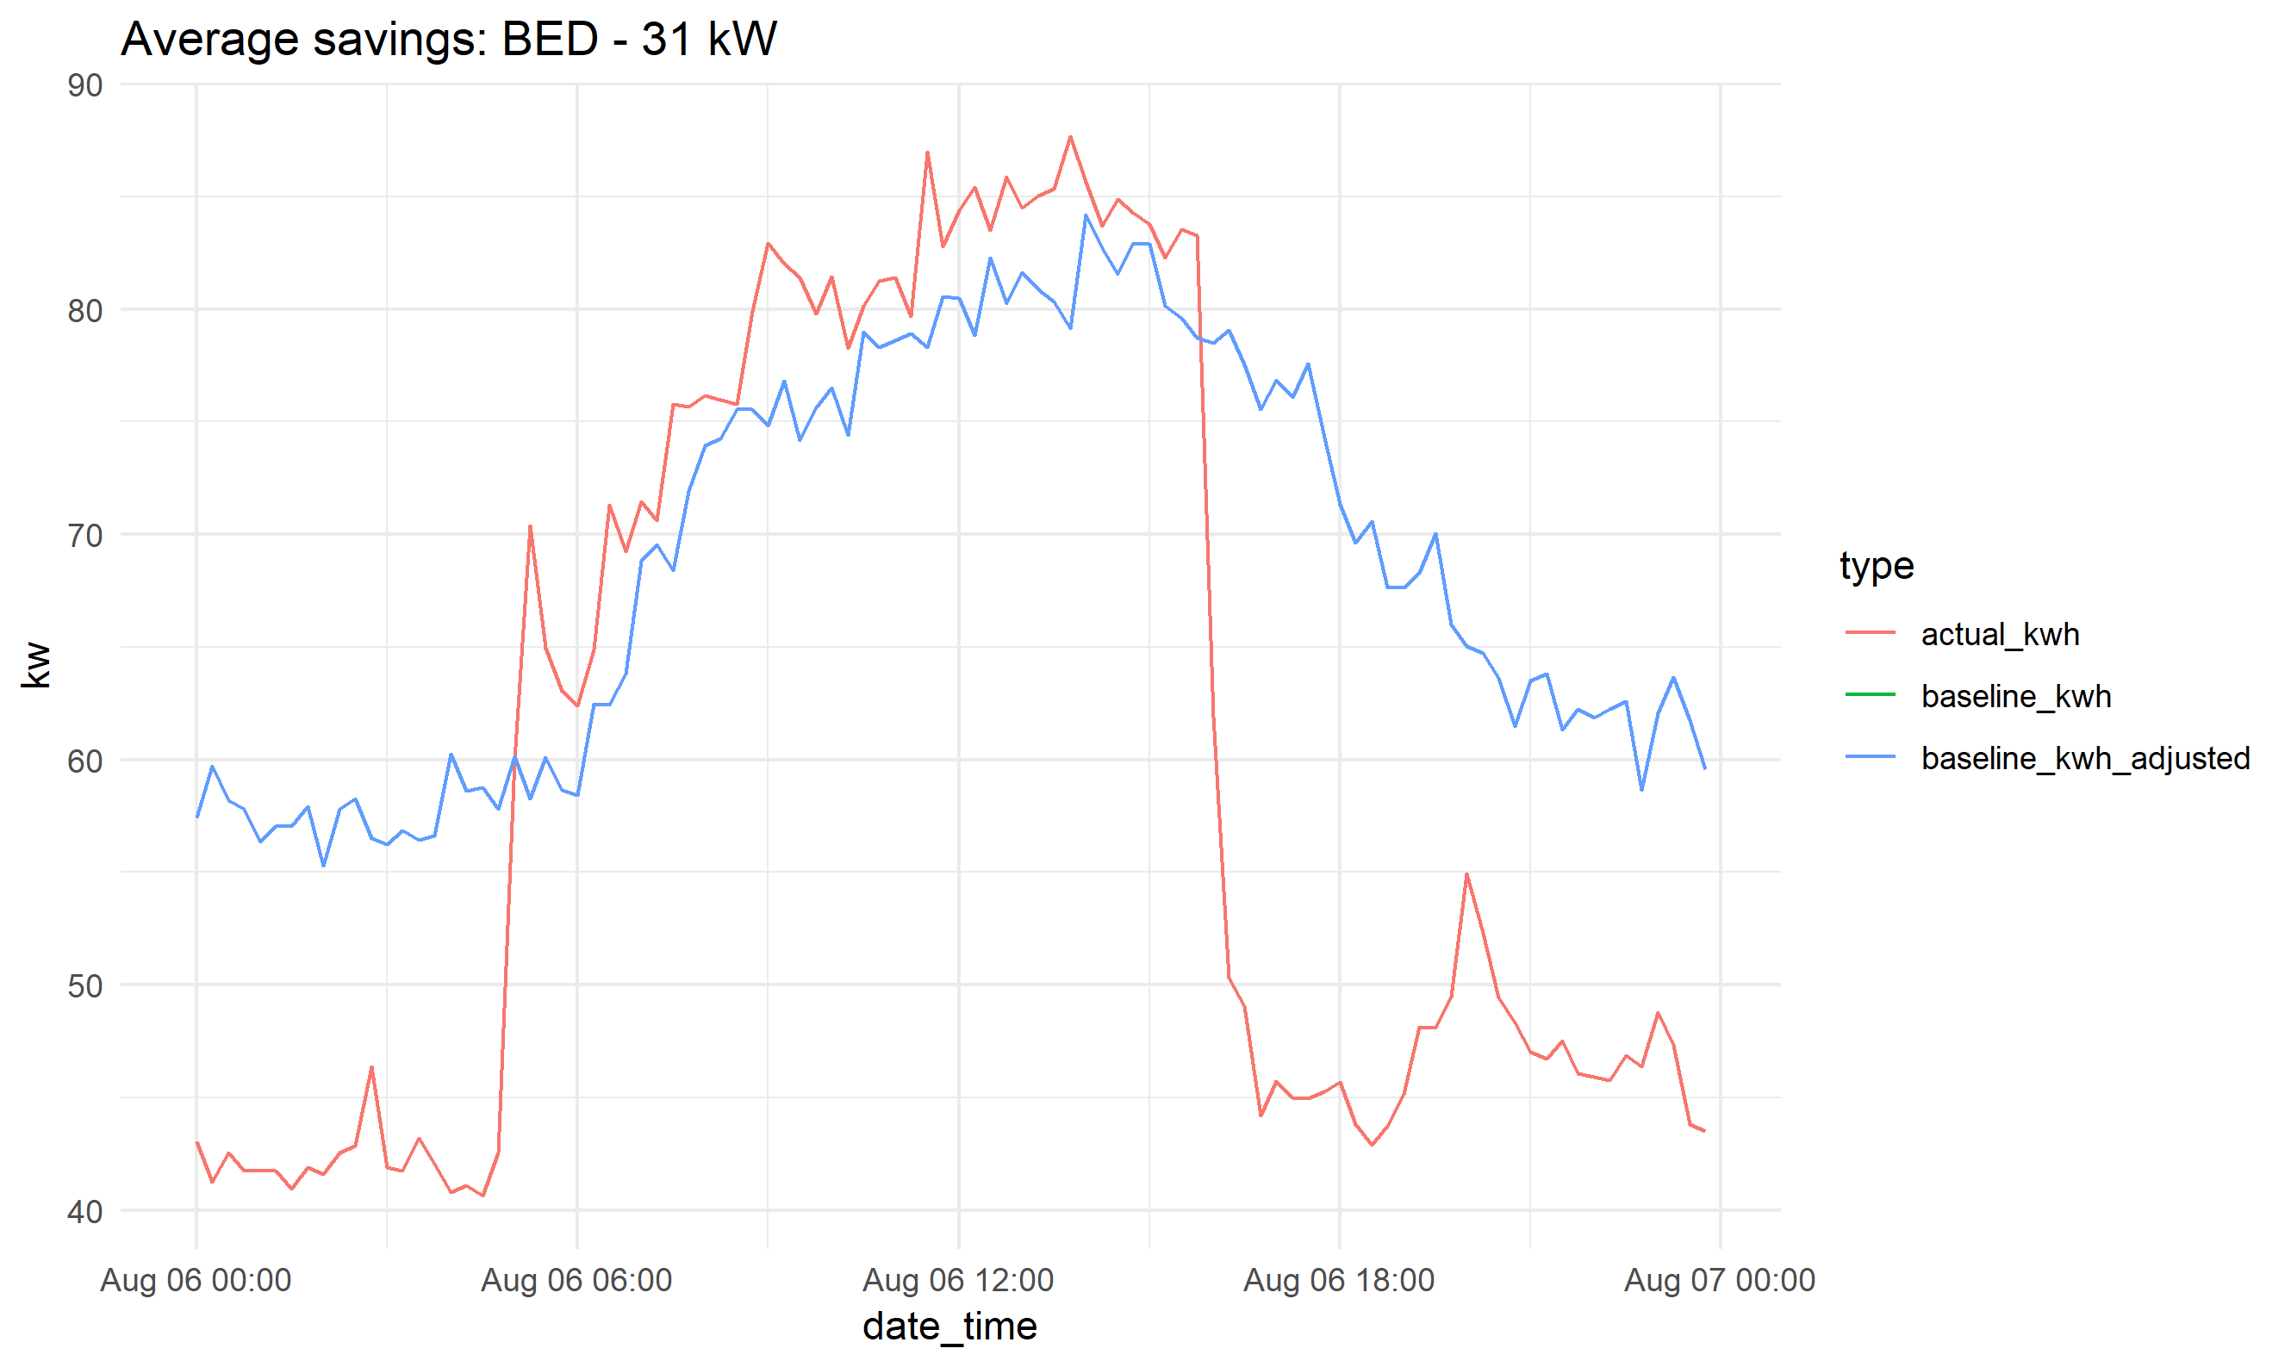
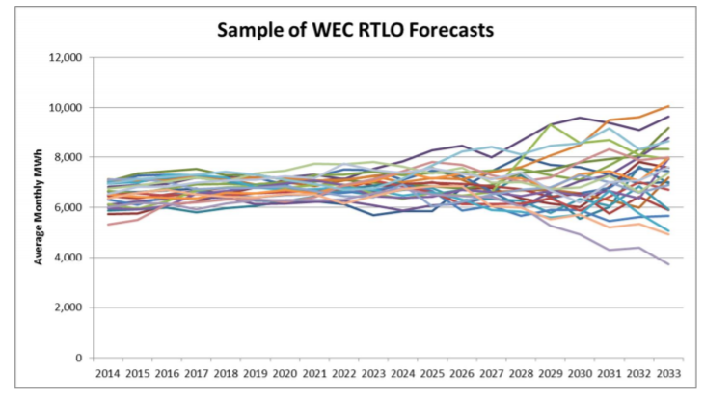
Integrated Resource Planning and Load Flexibility Analysis
Michaela Levine, UNH Sustainability Fellow, Summer 2018
Mentor: James Gibbons, Burlington Electric Department
For BED’s next IRP…
Introduction
An Integrated Resource Plan (IRP) is an electric utilities’ plan to meet the future energy needs of its customers at the lowest cost, including both economic and environmental costs. Vermont utilities are required to file an IRP with the Department of Public Service every 3 years. Following its 2016 IRP, the Public Utilities Commission (PUC) asked Burlington Electric Department (BED) to:
research measures to control customer loads remotely or through incentive programs,
analyze the costs of energy transformation (Tier 3) projects in terms of first year acquisition costs and discuss how incentive levels for Tier 3 projects were established,
provide an evaluation of the continued operations and economics of the McNeil Power Plant, and
provide an assessment of pilot projects for the next IRP that is due in 2020 [1].
In addition, BED is exploring opportunities improve the IRP process through greater integration, robust uncertainty analyses, market modelling, comprehensive societal cost evaluations, valuations of the land impact of energy resources, and the impact of climate change on load growth.
The objective of this project is to identify or create models that BED could use in the next IRP to address the requests of the PUC and develop recommendations on how BED could improve their IRP process in general.
Methods
The following resources were used to identify or develop models to address the issues described above and improve BED’s IRP process:
IRPs from other utilities
White papers and peer reviewed literature
Interviews with BED staff and external experts
Results/Discussion
Tier 3 incentives: Literature on the elasticity of technology adoption indicates that reducing financial barriers will increase adoption, but the alternative compliance payment limits BED’s ability to increase incentive amounts.
Figure 1. Projected EV sales as a function of incentives offered
Load Controls: BED should evaluate the amount of load it could potentially control and evaluate how rate design can further the goals of the IRP.
McNeil Power Plant: Develop a review methodology that incorporates metrics other than the simple economic performance of the plant such as the impact to the local/regional economy, environmental goals of BED, portfolio diversity, and the grid.
Pilot Projects: Data collected through pilot projects can be used to gain insight into Tier 3 technologies’ impact to load.
Figure 2. Adapted from Seattle City Light’s IRP showing how data from the EV charging pilot project could be used to analyze effect of dynamic rates on load profiles and growth. San Francisco has a dynamic rate, but Seattle does not [2].
Integration:
Uncertainty analysis: Monte Carlo analyses can be used to assess the entire range of possible future outcomes and their probability.
Figure 3. Figure from Washington Electric Co-op’s IRP demonstrating Monte Carlo analysis of load projections Each line represents a simulation of load growth [3].
Market Modelling: While the Department has requested that other utilities acquire market modelling software capability, BED’s current spreadsheet based approach seems adequate at this time.
Societal Costs: BED could add to their current method of evaluating societal costs (using a carbon multiplier) by incorporating the impacts of co-pollutants and by valuing the impact of technology options on achieving policy objectives. BED will also evaluate the land area impact and distance from Burlington of its resources.
Climate Change: As weather is a significant driver of load, climate change will impact future energy needs. Given that the planning horizon of the IRP is 20 years, future changes in heating and cooling demand should be considered.
Load Flexibility
Introduction
Load flexibility involves shifting energy use from periods of high demand and high energy prices to periods of lower demand.
This allows for less curtailment and greater integration of renewable energy as weather patterns driving renewable production do not perfectly match demand. Additionally, load flexibility allows energy use to be shifted away from peak times, which reduces capacity and transmission costs.
Methods
Typical end-use load profiles of commercial buildings and literature on the sheddable load from end-uses during peak energy events were used to estimate the demand response potential (the ability to decrease, increase, or shift load) of commercial and City buildings in Burlington.
Results/Discussion
The size of the “virtual battery” that could be deployed in City buildings during peak energy times has been estimated to be 1.10-1.3 MWs (for the ISO-New England system peak). If BED can leverage this battery, approximately $116,000-131,000 of savings could be realized. A spreadsheet tool has been developed that can be used to assess the peak savings that could be achieved for BED for any commercial building in Burlington and the bill savings a customer could receive under a dynamic rate structure.
Figure 4. Load profile of BED’s Pine Street office during a peak event (red) compared to baseline (blue) showing significant load shed from HVAC and lighting.
Tier 3
Load Forecast
(energy and demand)
Energy Services
T&D
References
State of Vermont PUC. 2017. Petition of City of Burlington Electric Department for approval of its 2016 Integrated Resource Pan.
Seattle City Light 2012 Integrated Resource Plan, Appendix 3.
Washington Electric Cooperative, Inc. 2014 Integrated Resource Plan: 2014-2033.

