Slide 1
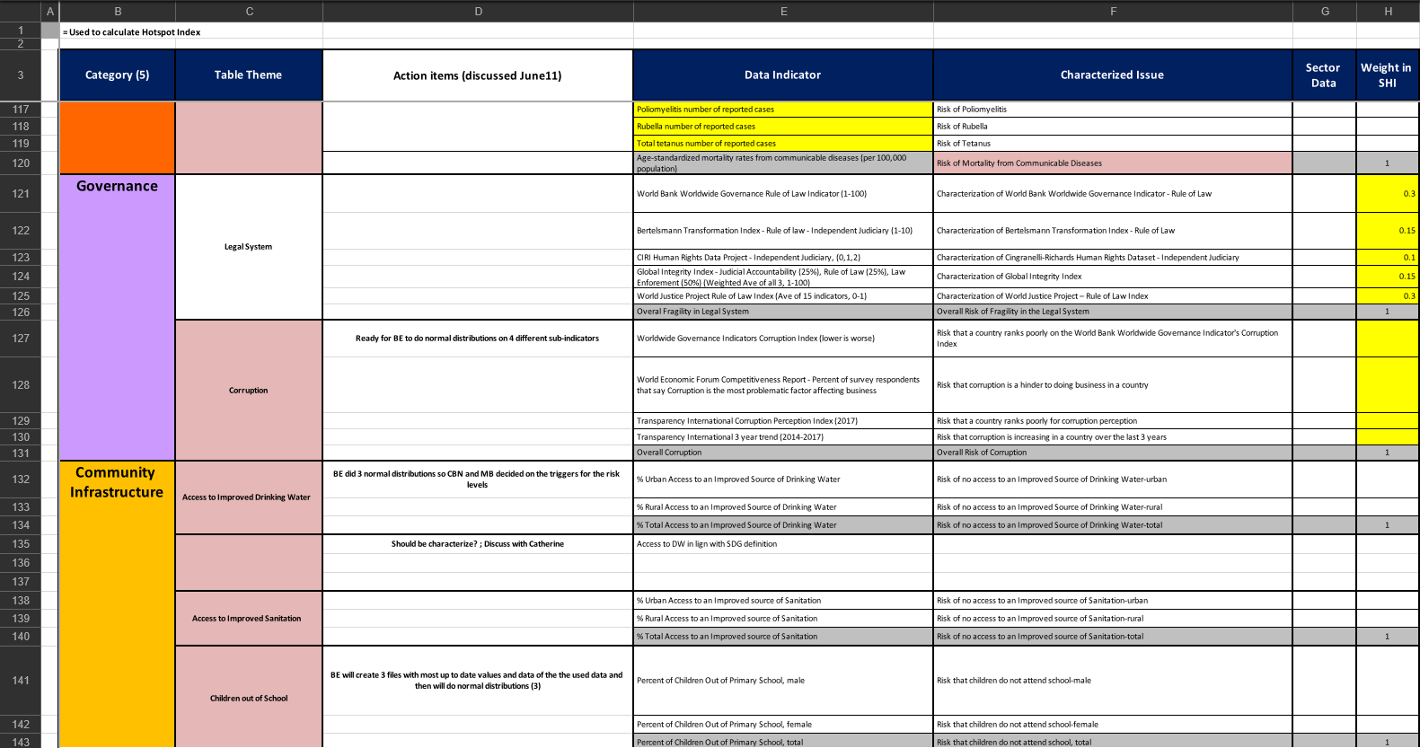
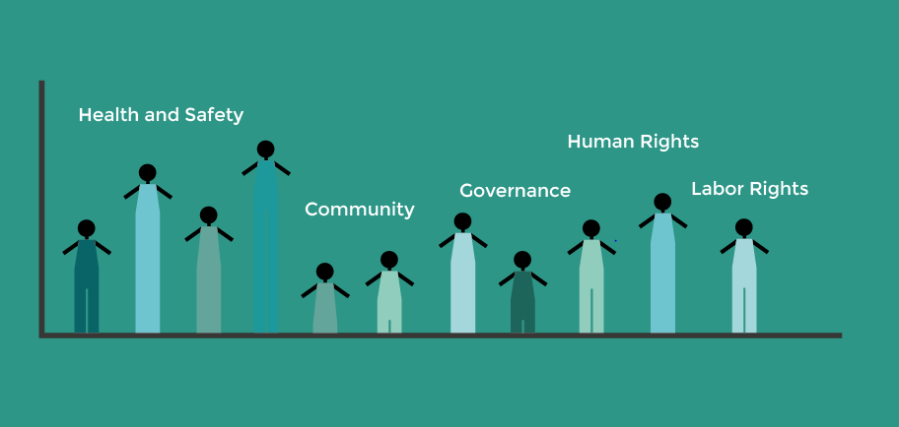
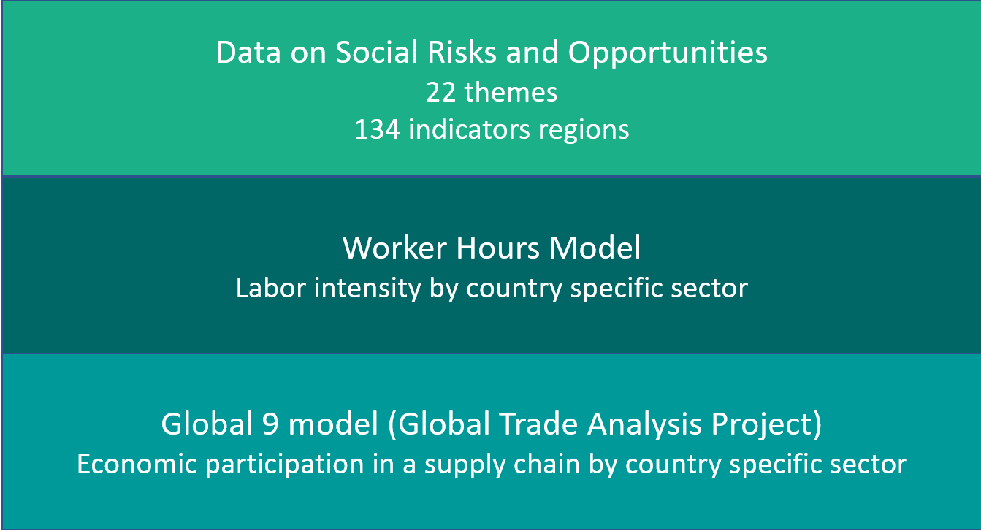
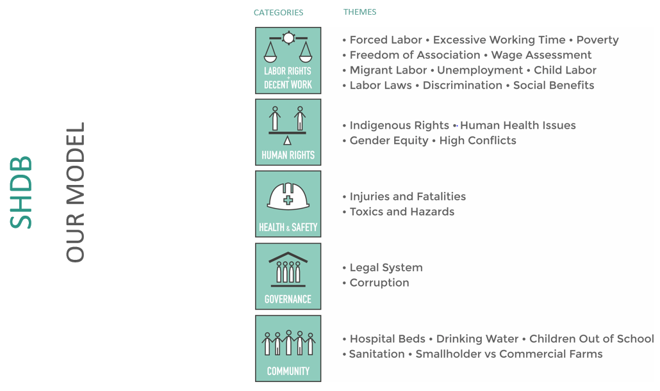
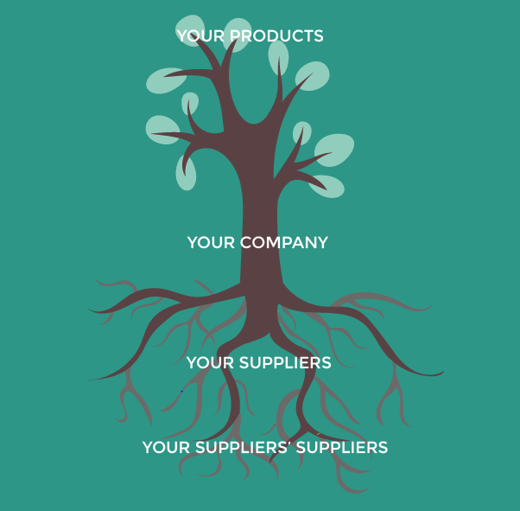
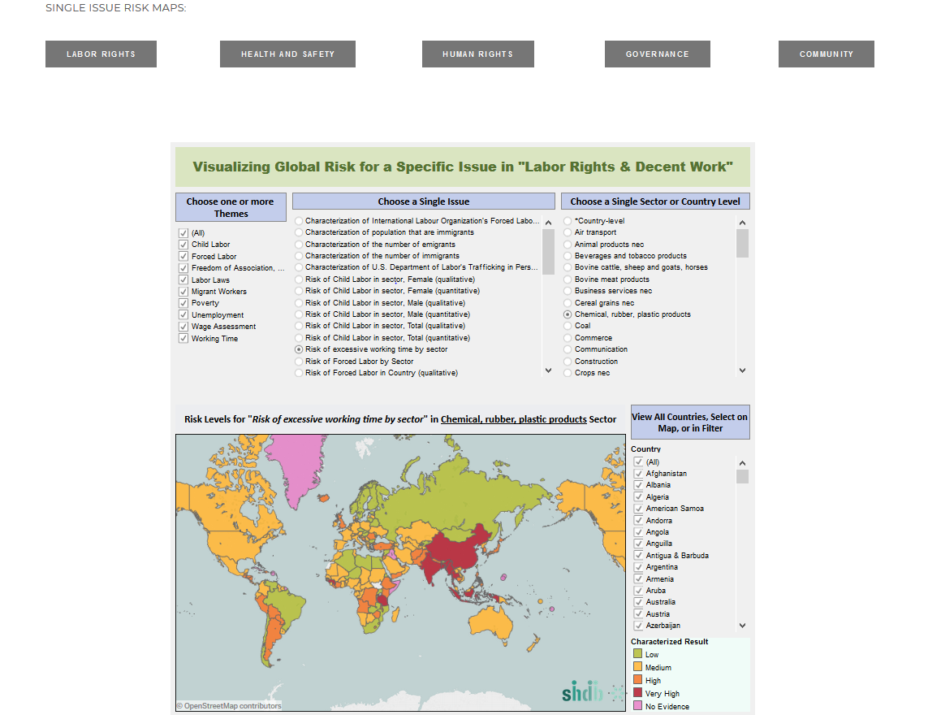
Social Risks in Supply Chains Database
Brandon Epperson, UNH Sustainability Fellow
Mentors: Catherine Benoit-Norris(Ph.D) and Greg Norris(Ph.D), Monique Bennema, Vikas Chandolas, Philipp Bolt, New Earth B, Summer 2018
Project Summary
Because of the advent of social media and public vigilance concerning corporate ethics, companies are far more wary of their business practices. New Earth B provides a risk mapping tool and a supply chain tool for companies to measure social impact in different areas of social sustainability; child labor, gender equality,, excessive working hours, etc.
SHDB Categories
Objectives
Update and maintain the Social Hotspots Database (SHDB)
Create online dashboards allowing clients to measure social risks
Future Goals
Test out the new Tableau dashboards and find the most intuitive interface based on user feedback
Make sure to leave behind clear instructions for the next analyst
Highlight
Body text
Discussion
Clients can now look at the social risks within their supply chain given they know their suppliers’ location and country-specific sector
New Earth B workplan for cleaning and updating social risk levels within excel files
New Earth B model
Approaches and Methods
Programming using Python 3.6.5
Aggregate GTAP(Global Trade Analysis Project) data using ImpactEcon, RunGtap, GTAPAgg, and GTAPAgg2 software
Create an MRIO model(Multi-Regional Input Output model)
Craft dashboards using Tableau
Results
Social Risks Mapping Tool
Concept of companies and their suppliers’ impact
Risk Mapping Tool
(Previous Version)

