Slide 1


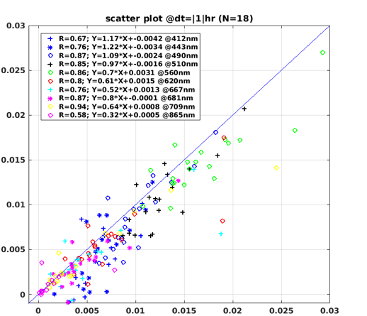
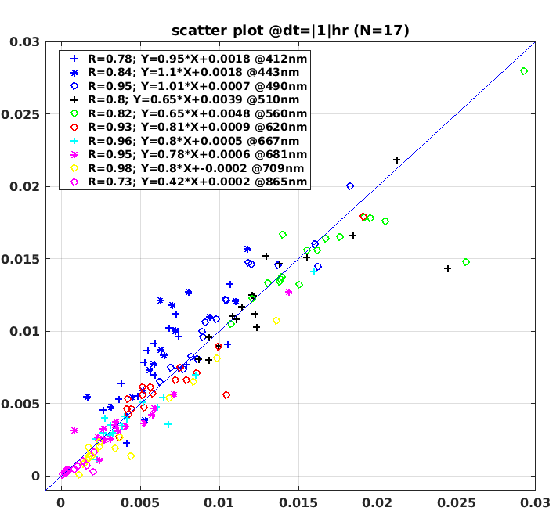
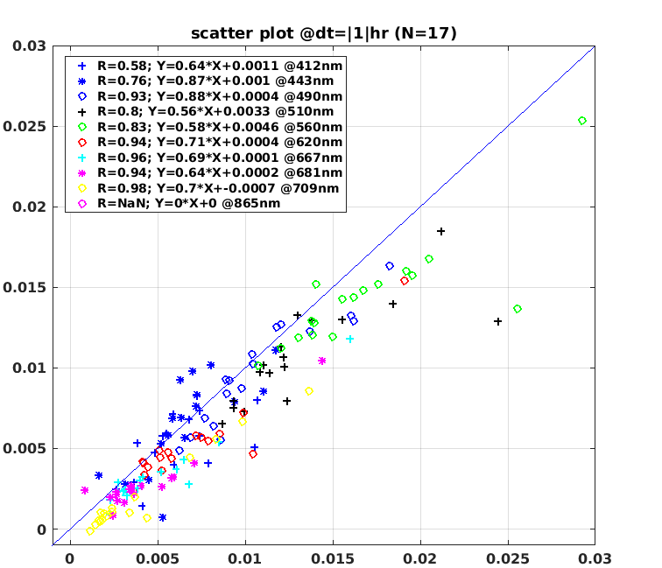
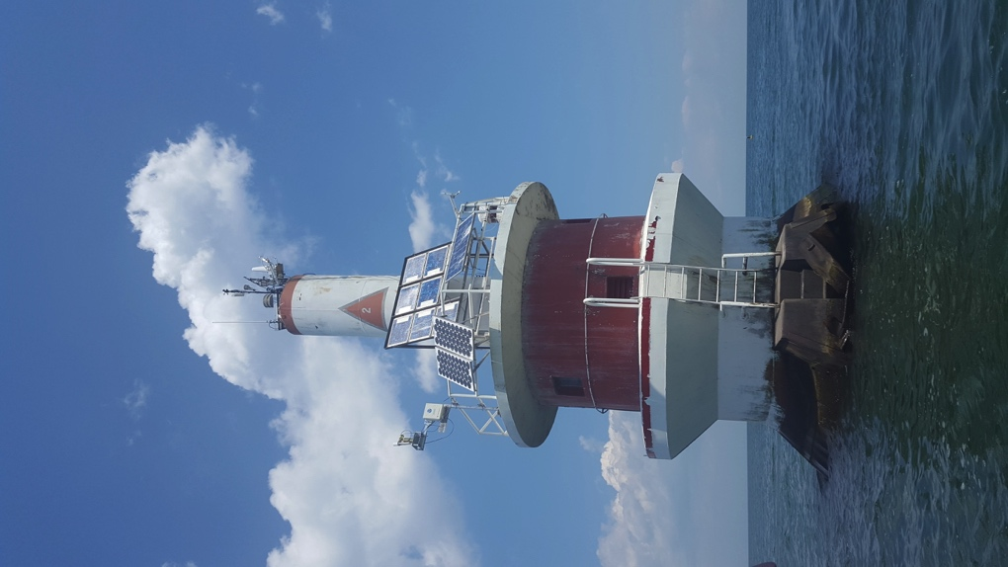
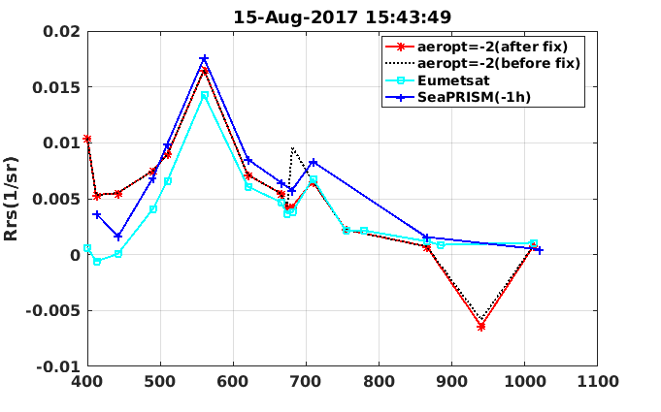
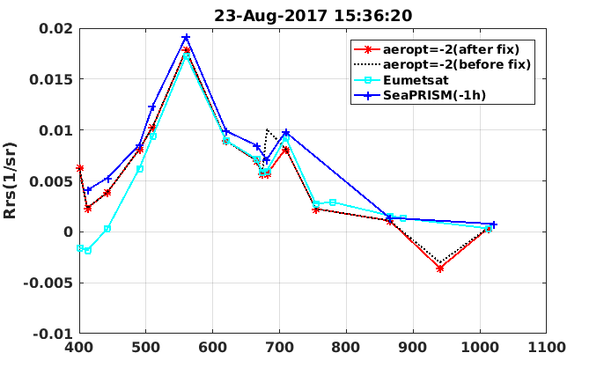
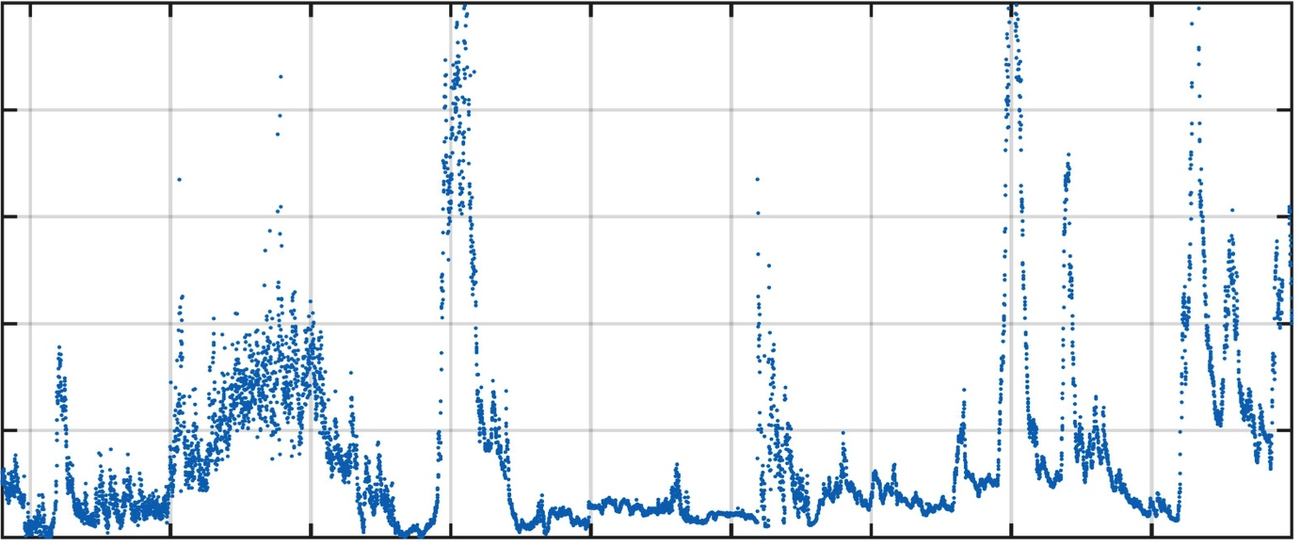
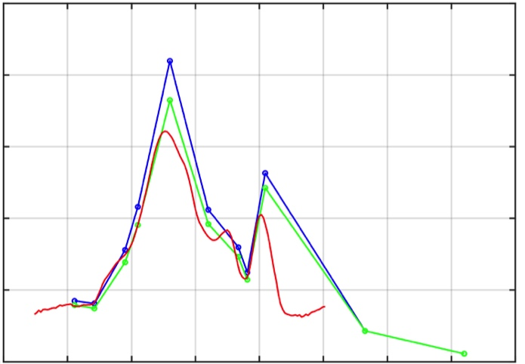
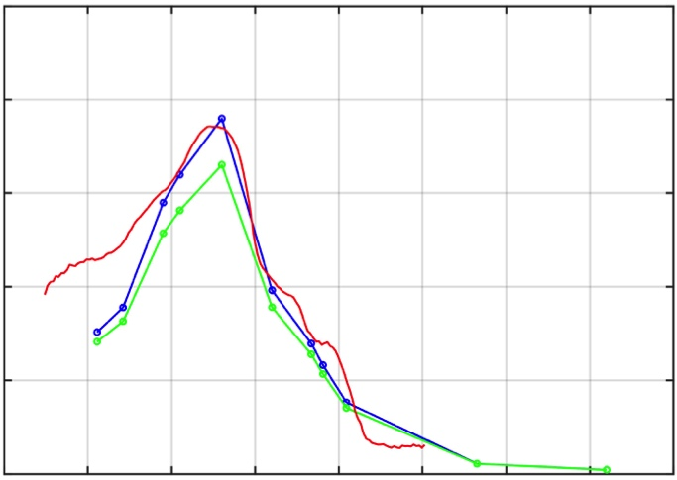
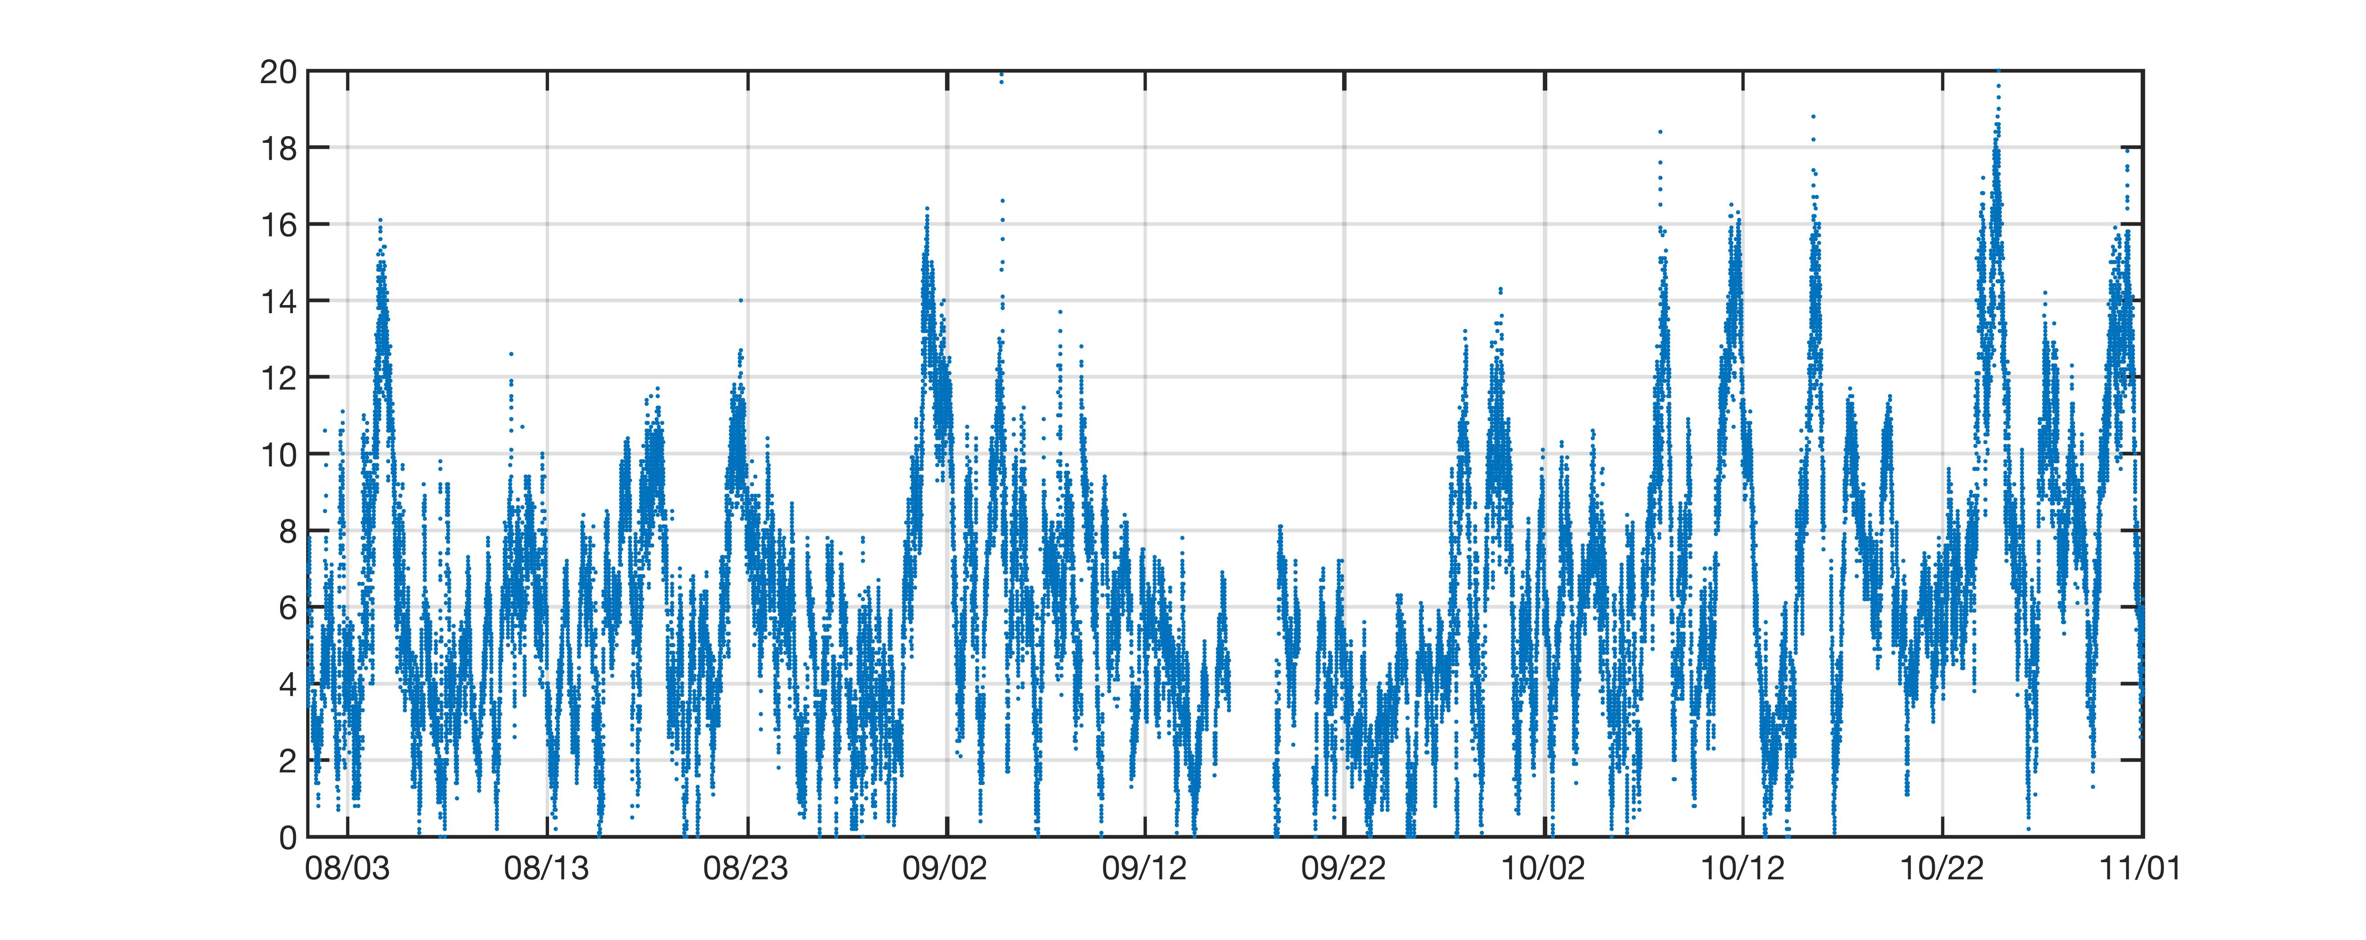
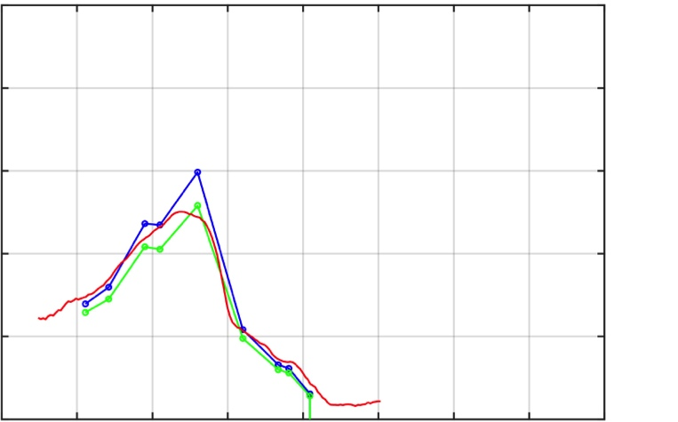
First look at a lake-configured SeaPRISM for remote sensing applications
Timothy S. Moore¹, Hui Feng¹, Steve Ruberg², Menghua Wang³, Paul DiGiacomo³, Veronica Lance³, Ron Muzzi², Tom Johengen⁴, Steve Constant², and Kyle Beadle²
¹University of New Hampshire, Durham, NH
²Great Lakes Environmental Research Laboratory, NOAA, Ann Arbor, MI
³NOAA/NESDIS Center for Satellite Applications and Research (STAR), College Park, MD
⁴Cooperative Institute for Limnology and Ecosystems Research, University of Michigan, Ann Arbor, MI USA
Abstract
In the summer of 2017, a SeaWiFS Photometer Revision for Incident Surface Measurements (SeaPRISM) instrument was deployed in western Lake Erie and integrated into the AERONET-OC network (Figure 1). This is a new 12-channel version that includes bands in the red/NIR region. The main purposes of the instrument are to characterize radiance uncertainties for satellite sensors, and to provide continuous stream of water quality products from bio-optical algorithms for HAB monitoring. The instrument is maintained by the U.S. National Oceanic and Atmosphere Administration (NOAA).
OLCI Rrs(0+) sr⁻¹
OLCI Rrs(0+) sr⁻¹
OLCI Rrs(0+) sr⁻¹
SeaPRISM Rrs(0+) sr⁻¹
SeaPRISM Rrs(0+) sr⁻¹
SeaPRISM Rrs(0+) sr⁻¹
Figure 4. SeaPRISM/OLCI matchups rendered from 3 different atmospheric correction schemes. Left: Eumetsat standard level-2 processing; Middle: Standard SeaDAS level-2 processing using Bailey et al (2010); Right: Level-2 SeaDAS processing with the scheme by Gordon and Wang (1994)
Optical water types (OWT) analysis
OWT
Hyperspectral OWT means with standard deviations from Moore 2014.
SeaPRISM and Hypergun data were processed for OWT classification.
1
Rrs (0-) sr⁻¹
2
Figure 1. The SeaPRISM is mounted on the west side of a Coast Guard tower in western Lake Erie, at approximately 6m height and 13 km from the nearest shoreline. The tower is part of NOAA GLERL’s real-time observational network (ReCON), equipped with instruments that measure a variety of atmospheric and water properties.
3
4
5
6
7
Methods & Data
The 12-channel SeaPRISM operated from August 15, 2017 to October 7, 2017. It is currently operating (start early June 2018).
Channel configuration: 411, 442, 491, 510, 560, 620, 667, 681, 709, 869, 936 and 1020 nm (red – new channels added).
Conditions at site alternate between eutrophic and mesotrophic states depending on location of river plume from north (Detroit River).
Hyperspectral above-water radiance was measured weekly at the site with a Satlantic Hypergun.
Level-1 and Level-2 S3/OLCI data were acquired from Eumetsat via the NOAA Coastwatch website.
Level-1 OLCI data were processed to Level-2 with Seadas 7.5.
NOTE: All SeaPRISM data presented here based on quality level 1.0 (L1.0).
0.06
OWT 1
SeaPRISM
0.06
In situ Hypergun
0.05
0.05
0.04
0.04
Rrs (0-) sr⁻¹
0.03
0.03
0.02
0.02
0.01
0.01
0
0
400
500
600
700
400
500
600
700
Wavelength (nm)
0.06
OWT 3
0.06
Figure 5. Matchup comparisons for 2 cloud-free OLCI scenes over Lake Erie. Black dashed lines indicate SeaDAS 7.5 processed L2 data (default). Bug discovered -> new patch (red line).
0.05
0.05
0.04
0.04
Rrs (0-) sr⁻¹
0.03
0.03
0.02
Membership
0.02
0.01
1
0.01
0
0.9
0
Rrs 709 nm
400
500
600
700
400
500
600
700
0.8
0.04
0.06
OWT 4
0.06
0.7
OWT
0.05
0.05
0.6
1
0.04
0.04
0.03
3
Rrs (0-) sr⁻¹
NOAA Hypergun matchups
4
0.03
0.03
0.5
sr⁻¹
5
0.02
0.02
0.4
0.02
6
0.01
0.01
7
0.3
Overall, Rrs agree but some difference with SeaPRISM processing is evident with consideration to the chl-based f/Q modification (Figure 2).
It is likely that f/Q should not be applied to SeaPRISM data in most conditions at this site, but sometimes is more appropriate.
Optical conditions at site is similar to overall basin characteristics (Figure 3), but probably under-represents highly eutrophic conditions more common to southern part of basin.
not classified
0
0
0.01
400
500
600
700
400
500
600
700
0.2
0.06
OWT 5
0.06
0.1
0.05
0.05
0
25
0.04
0.04
Rrs (0-) sr⁻¹
0.03
Turbidity
WE4 BUOY
0.03
0.02
20
0.02
0.01
low wind
0.01
0
15
0
400
500
600
700
NFU
high wind
400
500
600
700
0.06
10
0.06
OWT 6
0.05
0.05
0.04
0.025
0.025
0.04
8/21/2017
9/5/2017
5
Rrs (0-) sr⁻¹
0.03
0.020
ΔT=50min
0.020
0.03
0.02
sr⁻¹
sr⁻¹
ΔT=11.5min
0.02
0.01
Rrs(0+)
0.015
0.015
0.01
0
0.010
0.010
0
400
500
600
700
400
500
600
700
0.06
0.005
0.005
0.06
OWT 7
0.05
0.05
0.04
0.025
300
400
500
600
700
800
900
1000
0.04
Wavelength (nm)
Wind speed m/s
Rrs (0-) sr⁻¹
0.03
0.020
9/11/2017
ΔT=5.2min
0.03
0.02
sr⁻¹
0.02
0.01
Rrs(0+)
0.015
Satlantic Hypergun
0.01
0
0.010
0
400
500
600
700
SeaPRISM with f/Q
8/3
8/13
8/23
9/2
9/12
9/22
10/2
10/12
10/22
11/1
400
500
600
700
0.005
SeaPRISM without f/Q
Wavelength (nm)
Wavelength (nm)
300
400
500
600
700
800
900
1000
Figure 7. Time series of SeaPRISM L1.0 Rrs 709 nm (top), turbidity from adjacent buoy system (middle), and wind speed from anemometer from tower (bottom). Red circles highlight low wind (solid red line) and high wind (dashed red line) events.
Figure 6. Left: Rrs(0-) spectra plotted with dominant water type (OWT means from Moore et al 2014). Left: SeaPRISM data; Right: NOAA collected in situ data. Spectra intensity proportional to OWT membership. OWT 2 not detected.
Wavelength (nm)
Figure 2. Three same-day Hypergun (Satlantic) matchups within 1 hour were observed in different optical conditions.
0.03
Preliminary Results/Thoughts
S3/OLCI level-2 matchups show favorable comparisons; Eumetsat processing shows underestimate in blue bands relative to SeaDAS processed data (Figure 4).
Matchup details from 2 scenes revealed a bug in SeaDAS 7.5 code; alpha patch appears to fix bug (Figure 5).
OWT assignments tested applicability of ‘global’ (non-native) OWTs using SeaPRISM and NOAA in situ data sets (Figure 6).
58% of SeaPRISM quality L1.0 data assigned to OWTs; 97% of in situ data assigned. This is interesting and needs further exploration (some related to SeaPRISM quality level).
Tme-series patterns for SeaPRISM observations and contemporaneous turbidity measurements from adjacent buoy are coherent (Figure 7).
Wind plays a key role in optical properties of the water (Figure 7), and can result in high Rrs for different reasons. High wind: water column is mixed inducing sediment resuspension; low wind: cyanobacteria (when present) float to surface forming highly-reflective near- or at-surface populations.
These results set preliminary uncertainties on satellite-derived Rrs in a lake environment with a large dynamic range.
The OWT analysis is revealing, and provides insights into how membership functions behave across a high temporal resolution time series: Global vs. Regional OWTs?, quality control criteria for AERONET, time scales for OWT transitions, etc.
sr⁻¹
0.02
Rrs(0+)
0.01
400
500
600
700
800
Wavelength (nm)
Figure 3. Spectral distributions of SeaPRISM (blue) and in situ collected Rrs (NOAA from 2014-2017 from all stations in western basin).
Acknowledgment: We graciously acknowledge receiving financial support from NOAA’s Satellite & Information Service’s Center for Satellite Applications and Research, NOAA’s Great Lakes Observing System and NASA grants NNX15AL43G and NNX17AG53G for funding this activity.

