Slide 1




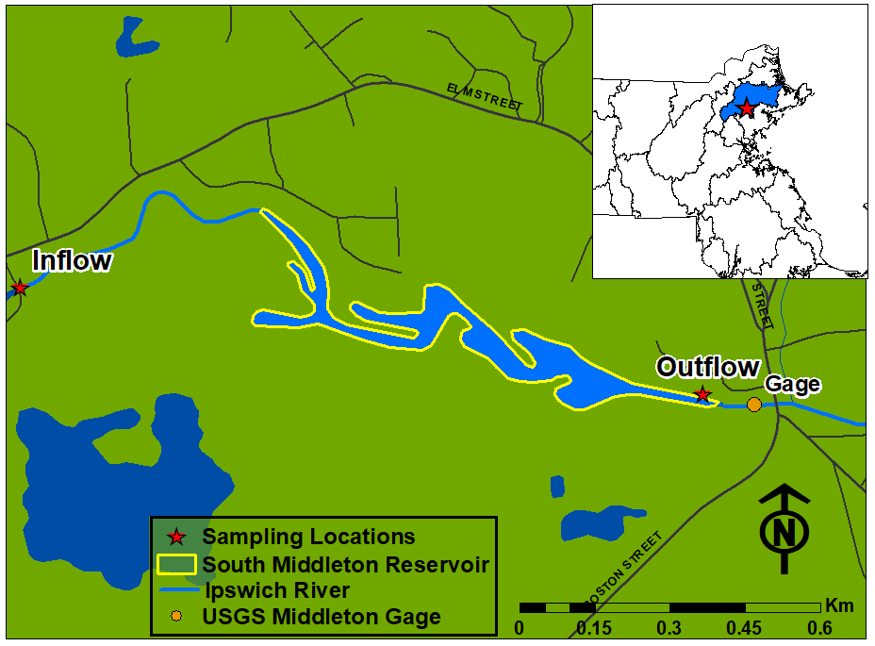
How do small dam removals affect reach-scale nitrogen exports?
Chris Whitney, Wil Wollheim
Plum Island Ecosystems LTER
University of New Hampshire, Department of Natural Resources and the Environment, chris.whitney@unh.edu
Motivation
DON makes up the majority of the reservoir N budget
Removal of reservoir leads to increased TN flux
Watersheds in the northeastern US have been found to remove the majority of the anthropogenic nitrogen (N) that reaches the landscape.
Previous studies have shown that reservoirs account for a substantial proportion of this N removal and that this removal is controlled by physical and hydrological characteristics.
With more than 2 million small dams across the US, this suggests that reservoirs may be a significant sink for anthropogenic N.
However, dams are being removed across the country without a complete understanding of the effect of their removal on reach-scale biogeochemical process rates or the subsequent effect on river network-scale N fluxes.
This research will determine how dam removals affect reach-scale N fluxes to better understand the implications for altered N fluxes to coastal ecosystems
23.4 % DIN
62.6% DON
14.0 % PN
Increase
19.3 % DIN
66.9% DON
13.8 % PN
Decrease
DIN & DON show strong relationships with hydraulic load
R_{DIN} = 93.3∗HL^{-0.293}
p = 0.03
N fluxes after removal of the dam were modeled using the N removal vs. hydraulic load empirical relationships and assumed an increase in hydraulic load from diminished surface area after the dam removal. The increase in DIN fluxes are predicted to offset the decrease in DON and PN fluxes, resulting in a net increase in total N fluxes from the reach.
 | DIN (kg yr⁻¹) | DON (kg yr⁻¹) | PN (kg yr⁻¹) | TN (kg yr⁻¹)
2016 | +290.0 | -136.1 | -30.7 | +123.3
2017 | +477.3 | -216.8 | -47.5 | +212.9
R_{DON} = -24.0∗HL^{-0.197}
p = 0.05
Study Area and Methods
R_{PN} = -31.7∗HL^{-0.157}
p = 0.45
Removal of SMD will result in greater DIN fluxes from the reach
Reach-scale DON and PN fluxes will both be lower after the removal of SMD
The increase in DIN flux more than makes up for the decrease in DON and PN fluxes, leading to a net increase in TN fluxes from the reach after the dam is removed
These empirical relationships can be used to predict N removal over changing hydraulic loads.
 | DIN (kg yr⁻¹) | DON (kg yr⁻¹) | PN (kg yr⁻¹) | TN (kg yr⁻¹)
2016 | +290.0 | -136.1 | -30.7 | +123.3
2017 | +477.3 | -216.8 | -47.5 | +212.9
Increasing Q
Reservoir reduces DIN, increases DON, little change in PN
Discussion
Production
The reservoir is effective at removing DIN during the growing season but also consistently produces DON throughout the year.
We predict that removal of the dam will result in a net increase in TN exports from the reach; however, continued monitoring will reveal whether this hypothesis is supported.
Future work will investigate the net effect of human dam removals and construction of new beaver dams on river network-scale N exports from PIE watersheds.
The addition of impoundments outside of PIE LTER will help to increase the understanding of the effect of dam removals on both reach and river network-scale N fluxes across a wider range of basin characteristics.
All forms of N should be considered in reservoir mass balances as studies focusing on inorganic N are missing a significant component of the N budget
DIN and DON removal exhibited significant relationships with HL however seasonal trends in PN suggest different controls on PN exports during the growing and non-growing seasons
SMD was effective at removing DIN during the growing season but also produced DON throughout the year
Removal of SMD will lead to a decrease of DON and PN fluxes however the increase in DIN fluxes results in a net increase in total nitrogen exports from the reach after the dam removal
Inclusion of reservoir N removal from LTER sites across the country will add strength to the observed relationships, helping to increase the understanding of the effect of dam removals on river network-scale N exports and coastal processes
Removal
Study takes place in the reservoir created by the South Middleton Dam on the Ipswich River in Middleton, MA
  Dam was constructed in 1900
  Catchment area of 113.8 km²
  Scheduled for removal in summer 2019
Mass balance of dissolved inorganic (DIN), dissolved organic (DON), and particulate nitrogen (PN)
  LOADEST used to estimate mean monthly reservoir N fluxes
References
¹Van Breemen N, Boyer EW, Goodale CL, et al (2002) Where did all the nitrogen go? Fate of nitrogen inputs to large watersheds in the northeastern U.S.A. Biogeochemistry 57–58:267–293. doi: 10.1023/A:1015775225913
²Seitzinger S, Harrison JA, Bohlke JK, et al (2006) Denitrification Across Landscapes and Waterscapes: A Synthesis. Ecol Appl 16:2064–2090. doi: 10.1890/1051-0761(2006)016[2064:dalawa]2.0.co;2
³David MB, Wall LG, Royer T V., Tank JL (2006) Denitrification and the nitrogen budget of a reservoir in an agricultural landscape. Ecol Appl 16:2177–2190. doi: 10.1890/1051-0761(2006)016[2177:DATNBO]2.0.CO;2
⁴Graf WL (1993) Landscapes, commodities, and ecosystems: The relationship between policy and science for American rivers. In: National Research Council (ed) Sustaining Our Water Resources. The National Academies Press, Washington, DC, pp 11–42.
Total monthly discharge-weighted DIN fluxes were generally lower exiting SMD
DON fluxes were always greater leaving the reservoir
PN fluxes showed little change due to the effect of the reservoir
During the low flow summer months when coastal ecosystems are the most sensitive to elevated N loads, the reservoir had the greatest effect on N fluxes exiting the reach with both the greatest removal of DIN as well as the highest production of DON taking place during that period.

