Slide 1



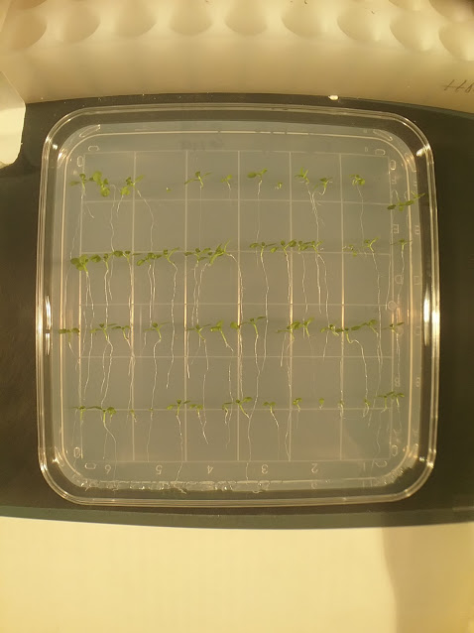
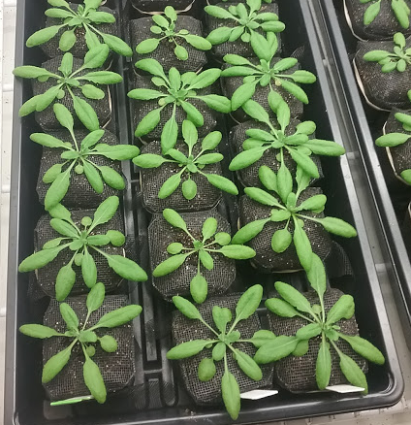
Do RPA-dependent epigenetic modifications regulate early flowering in Arabidopsis thaliana?
Emily Berry and Kevin Culligan
Department of Molecular ,Cellular and Biomedical Sciences, University of New Hampshire, Durham, NH 03824
Introduction
Methodology
Results
Epigenetics is the study of heritable changes not found in DNA sequences, typically as methylation of certain histones. This can occur through histone methylation, acylation, or phosphorylation (Carey, 2012). Previous research focused on the RPA1A/B/C/D/E genes involved in DNA damage and repair in Arabidopsis thaliana (Aklilu, 2013). The goal of this experiment is to identify any possible epigenetic differences between the wild-type and RPA1C, RPA1E and RPA1C/E A. thaliana mutants that may cause the early flowering phenotype. From this research, epigenetic modifications could be identified and the results could help researchers better understand how DNA methylation and histone modifications affect other phenotypes of an organism. Early flowering is also seen in agricultural settings and can severely affect crop yields (Craufurd, 2009). This could also help researchers avoid early flowering in these mutants during experiments.
Data will be collected weekly. The data collected includes the number of rosette leaves, the diameter of the rosette and the height of the main stem.
After 31 days, plant tissue is collected for DNA extraction. Samples from the rosette leaves and upper portion of the stem are collected and frozen.
Genomic DNA is extracted using the Qiagen Plant tissue Mini kit.
The extracted genomic DNA is used for a global DNA methylation assay.
Table 3: Average diameter of each strain by day (n=10)
Results
Table 1: Average rosette leaves per plant for each strain
RPA1E and RPA1C/E have larger average diameters compared to Col-O and RPA1C
This initial change in average diameter occurs around 21-28 days
Research Questions
1. What is the average difference in flowering time (in days) between the RPA1C/E and other strains?
2. Do any epigenetic modifications cause or contribute to early flowering in the RPA1C/E mutants?
Future Directions
Perform additional replicates to compile additional data on plant growth, focusing on RPA1E and RPA1C/E
After analyzing the global DNA methylation assay results, decide whether it is necessary to conduct bisulfite pyrosequencing experiments to locate any significant changes in methylation between the mutants and wild-type
Methodology
Seeds are sterilized prior to sowing, then sown separately on Phyto-agar and stratified for 72 hours.
Seed plates are left to germinate (5-7 days), until the roots reach a length of ~2cm, then planted in individual pots for the duration of the data collection (n=10).
Table 2: Average stem length of each strain
References
Day 21;
Col-O n=3; RPA1C n=0; RPA1E n=3, RPA1C/E n=4
Day 28;
Col-O n=9; RPA1C n=10, RPA1E n=10; RPA1C/E n=10
Day 31;
Col-O n=9; RPA1C n=10; RPA1E n=10; RPA1C/E n=10
Aklilu, B. (2013). Genetic analysis of the Replication Protein A large subunit
family in Arabidopsis reveals unique and overlapping roles in DNA repair, meiosis and DNA replication. Nucleic Acids Research, 42 (5).
Carey, N. (2012). The Epigenetics Revolution: How Modern Biology is rewriting our understanding of Genetics, Disease, and Inheritance. New York City: Columbia University Press.
Craufurd, P.Q. and T.R. Wheeler. (2009). Climate Change and the flowering time of annual crops. Journal of Experimental Biology, 60 (9), 2529- 2539.
Acknowledgements
Figure 1: Seedlings are plated on Phyto-agar
Figure 2: A. thaliana plants, apx. 28 days
Day 21; Col-O n=3; RPA1C n=0; RPA1E n=3, RPA1C/E n=4
Day 28; Col-O n=9; RPA1C n=10, RPA1E n=10; RPA1C/E n=10
Day 31; Col-O n=9; RPA1C n=10; RPA1E n=10; RPA1C/E n=10
I would like to thank the UNH McNair Program Department, the Culligan lab, as well as my family for their continued support in my pursuit towards a career in research.
Funded by UNH McNair and NSF Grant MCB-1716396 to K.C.
Contact information; esb1003@wildcats.unh.edu

Slide 2

This poster template provided courtesy of
UNH ESRC Poster Printing Services
Trust us to make your poster look GREAT!
Website: http://posters.unh.edu
Poster Guide: http://goo.gl/1E7TJY
DELETE THIS SLIDE BEFORE PRINTING

