Slide 1
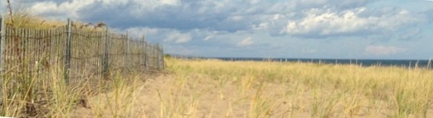



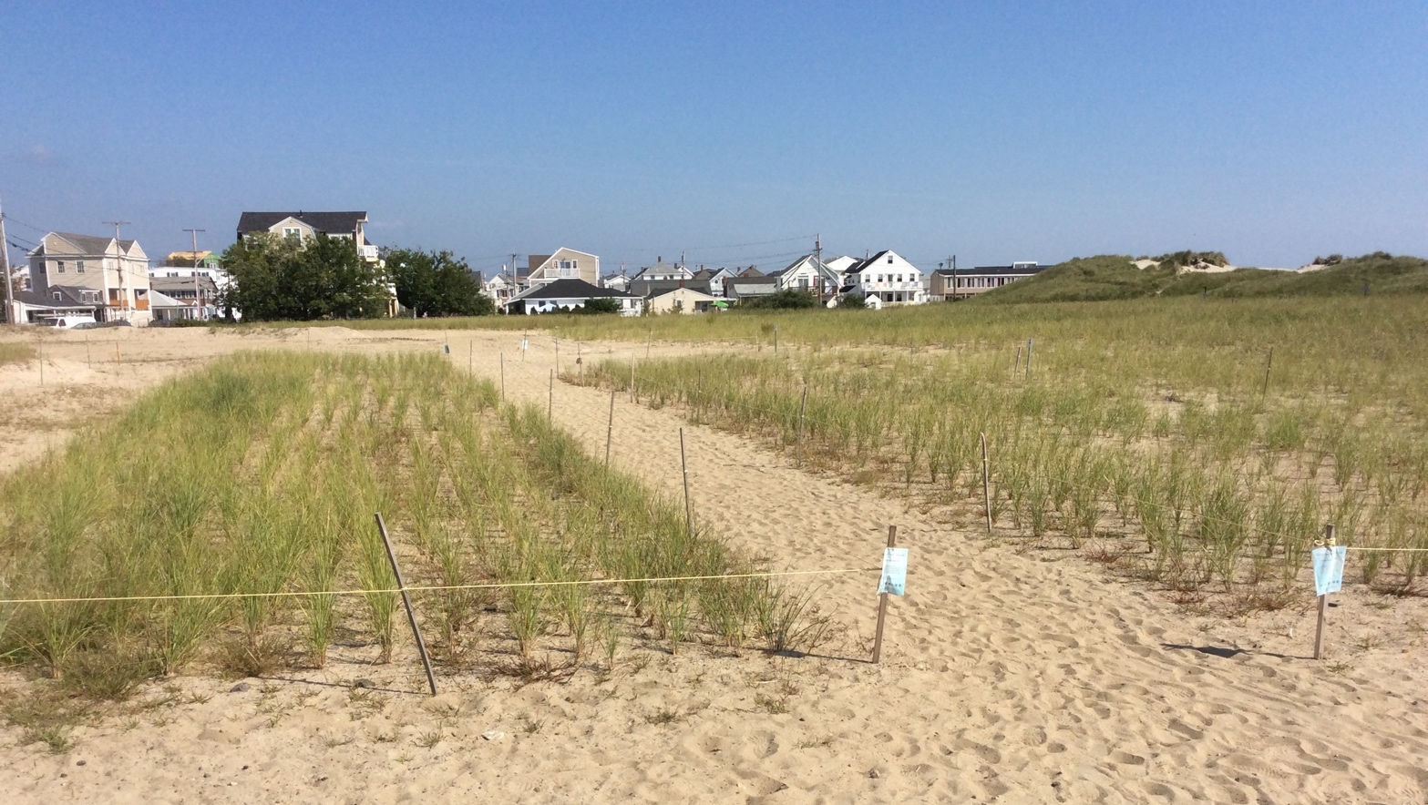
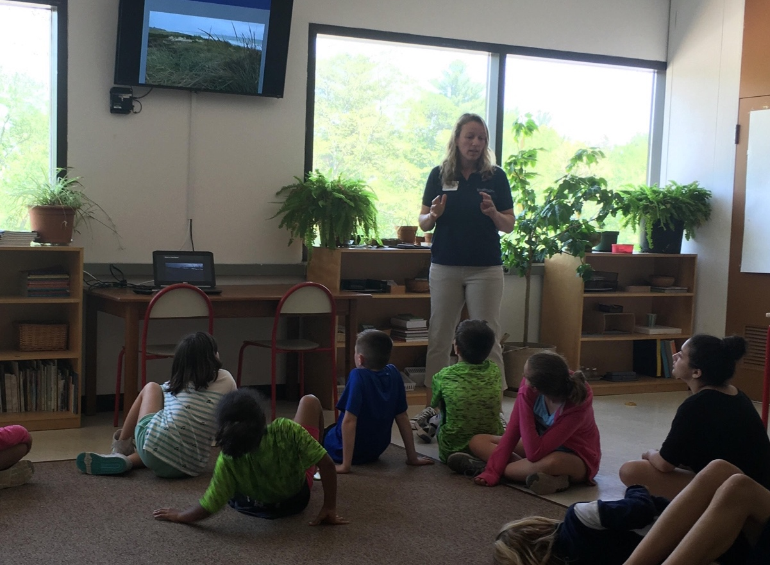
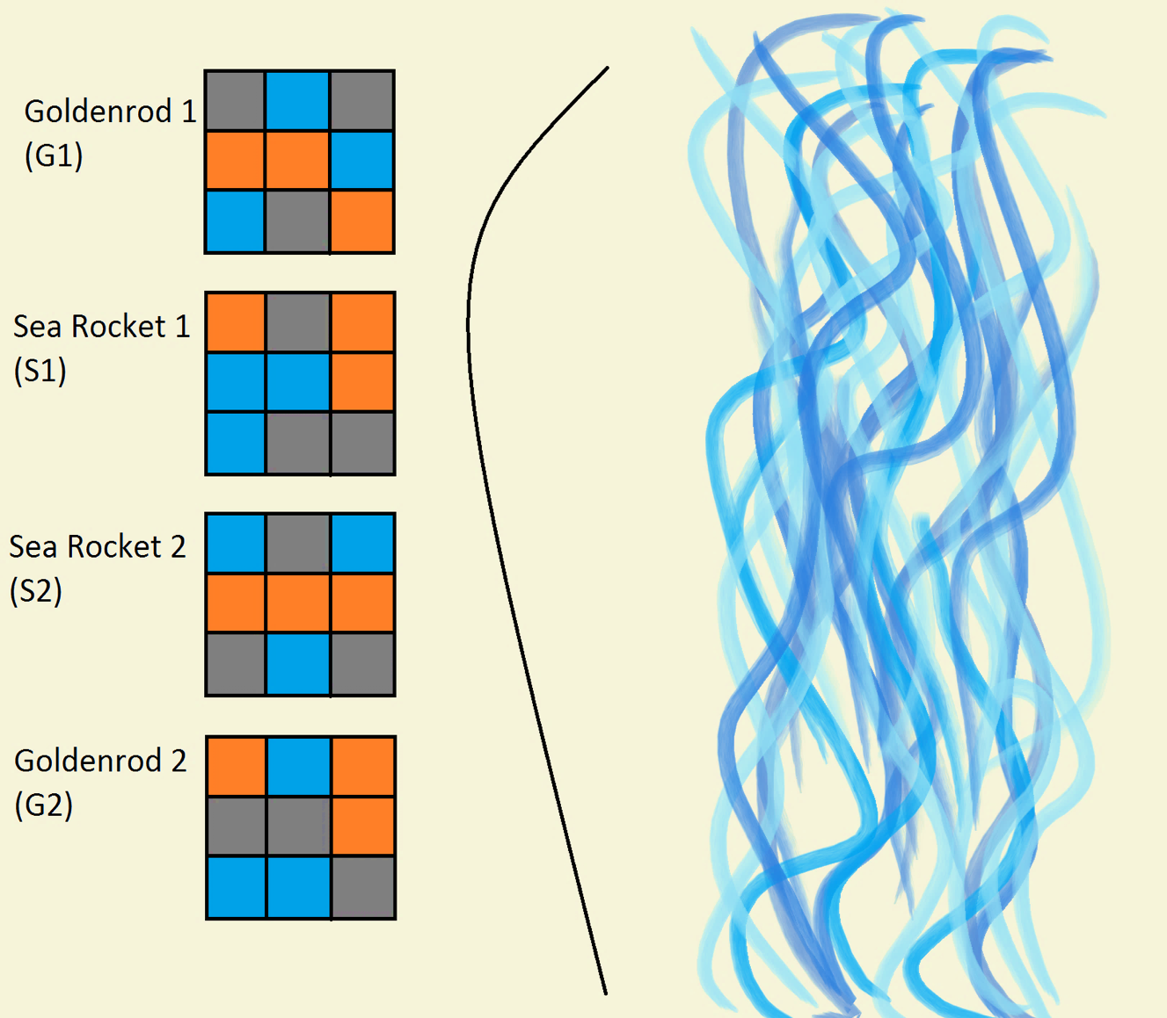
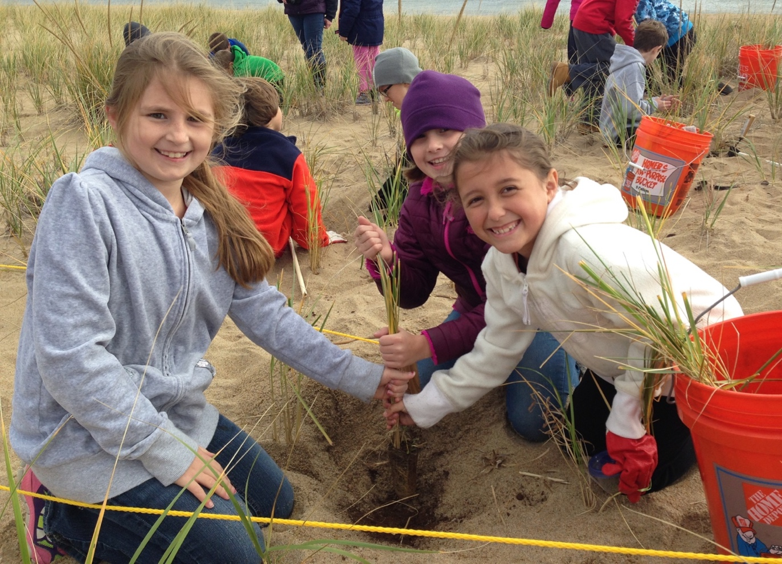
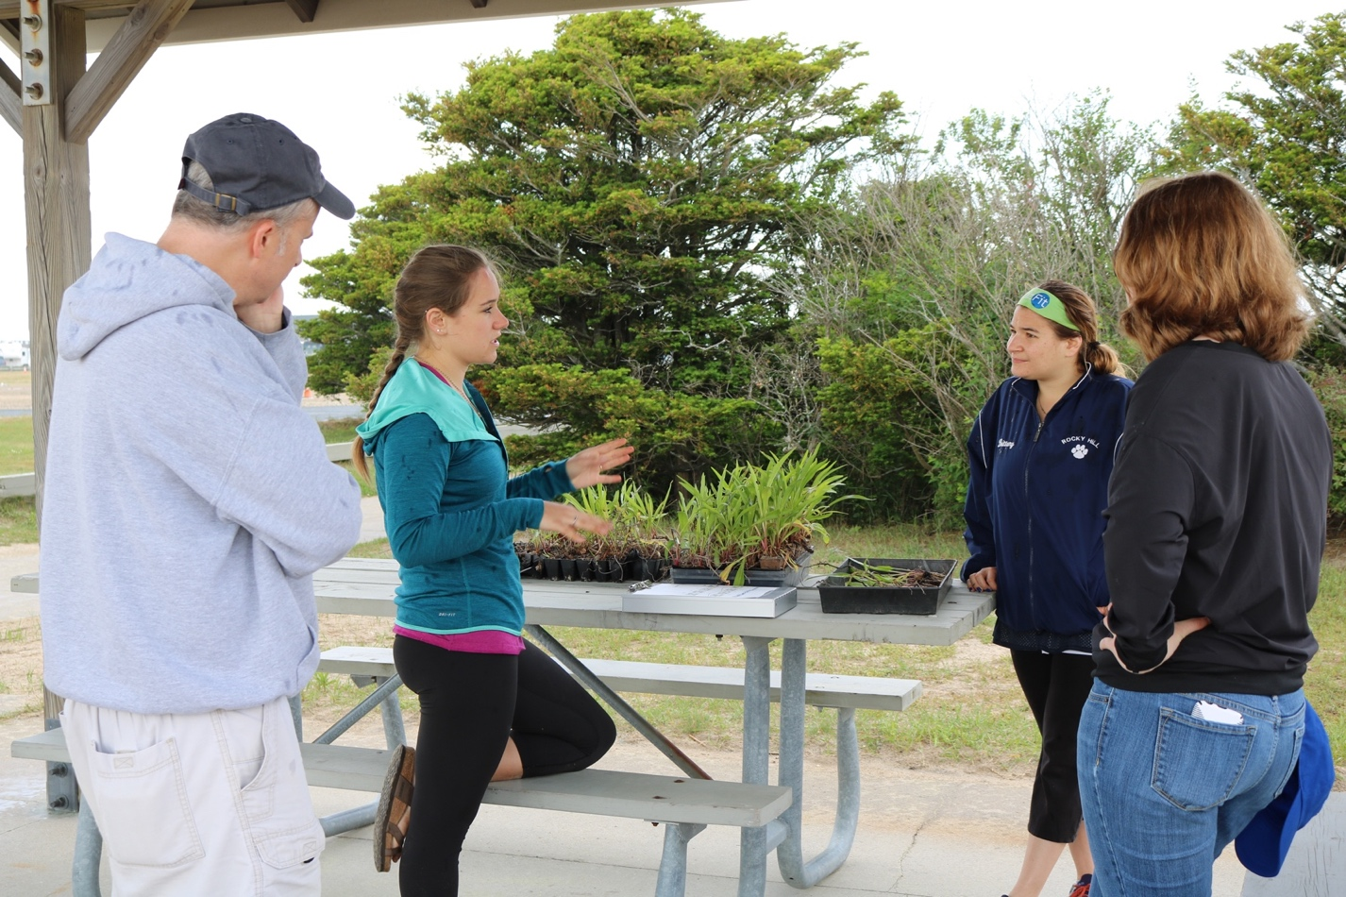
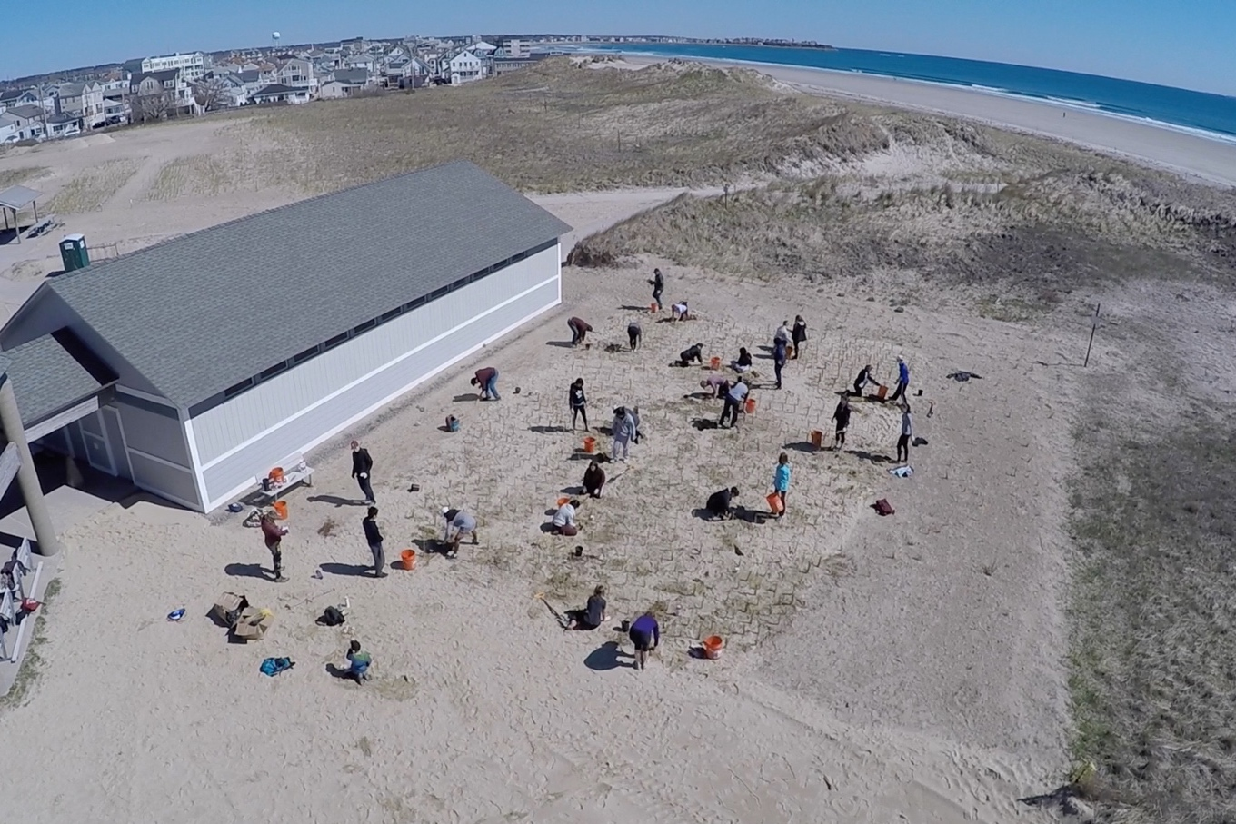
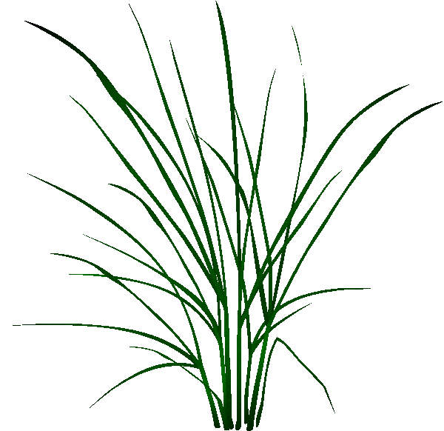
Community-based sand dune restoration and research on the New Hampshire Seacoast
Kendall Young¹ – NH Sea Grant Doyle Fellow
Alyson Eberhardt^{2,3}, David Burdick¹, and Gregg Moore¹
¹University of New Hampshire, ²NH Sea Grant, ³UNH Cooperative Extension
Why sand dunes?
A Common Garden of plants as a resource for homeowners
Sand dunes are an important defense for coastal properties as they buffer the coast from erosion and flooding associated with storms. Dunes face continued pressure from storm surge, dune die-off, and destruction of beachgrass (Ammophila breviligulata) from foot traffic. A team from NH Sea Grant, UNH Cooperative Extension and UNH (the UNH Coastal Habitat Restoration Team) are using a variety of methods to restore dunes in New Hampshire and northern Massachusetts with the primary goals of:
  Increasing the resilience of dune systems
  Engaging and empowering the community
A Common Garden of dune plants was created at Hampton Beach State Park, NH as a resource for local residents who want to enhance dunes on their own property.
Dune plants are offered to residents at no cost with guidance on how to plant them.
The Common Garden’s location at one of NH’s most visited state parks serves to draw public attention to dune restoration efforts
An experiment to inform growth of Common Garden plants
Working with schools and community volunteers
A pilot research experiment was conducted with the goal of increasing plant diversity in the Common Garden. A previous attempt to grow species other than beachgrass was not successful. We sought to evaluate the potential for companion planting to increase plant survival and growth.
Students participate in a classroom lesson about dune ecosystem functions followed by a day in the field planting native dune plants. Last year the UNH Coastal Habitat Restoration Team worked with more than 700 students in dune restoration efforts. Participating in an active restoration effort provides students authentic scientific experience while addressing a real world problem.
Objective
Methods
To evaluate companion planting as a method to increase growth of Seaside Goldenrod (Solidago sempervirens) and American Searocket (Cakile edentula) in the Common Garden
2 experimental plots were established per species with 9 plants per plot
Plants were randomly assigned a number of companion plants (color corresponds to charts) - 0 (blue), 1 (orange) or 3 (grey)
Weekly growth measurements were recorded
Relative growth was calculated as H₂-H₁/H₁ where H₂ is plant height at each date and H₁ is initial plant height
Results
Diagram of experimental design at Hampton Beach State Park
Conclusion
Community volunteers were recruited, trained and mobilized to assist in dune restoration activities. Over 250 adult volunteers contributed to the project in the last year, both increasing the amount of restoration accomplished and expanding our network of local stewards knowledgeable about the functions of sand dunes.
The results of this pilot study suggest that companion planting goldenrod and searocket with beachgrass does not increase plant growth relative to plants without companions. Plants were larger at the time of planting than those in the prior unsuccessful attempt. Size at the time of transplanting was likely a factor in the success of plants in the current experiment.
Future efforts to plant goldenrod and searocket in the Common Garden do not require companion beachgrass but should ensure that transplants are of a minimum size (12 cm for goldenrod and 8 cm for searocket based on the results of this study).
Photo credit: Gregg Moore

