Slide 1
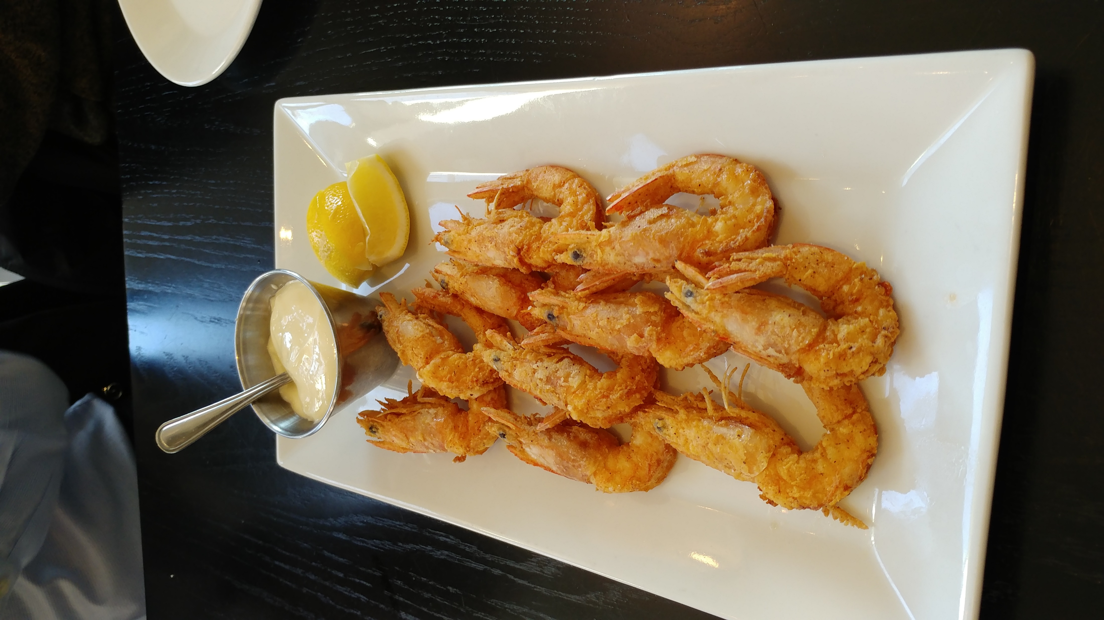
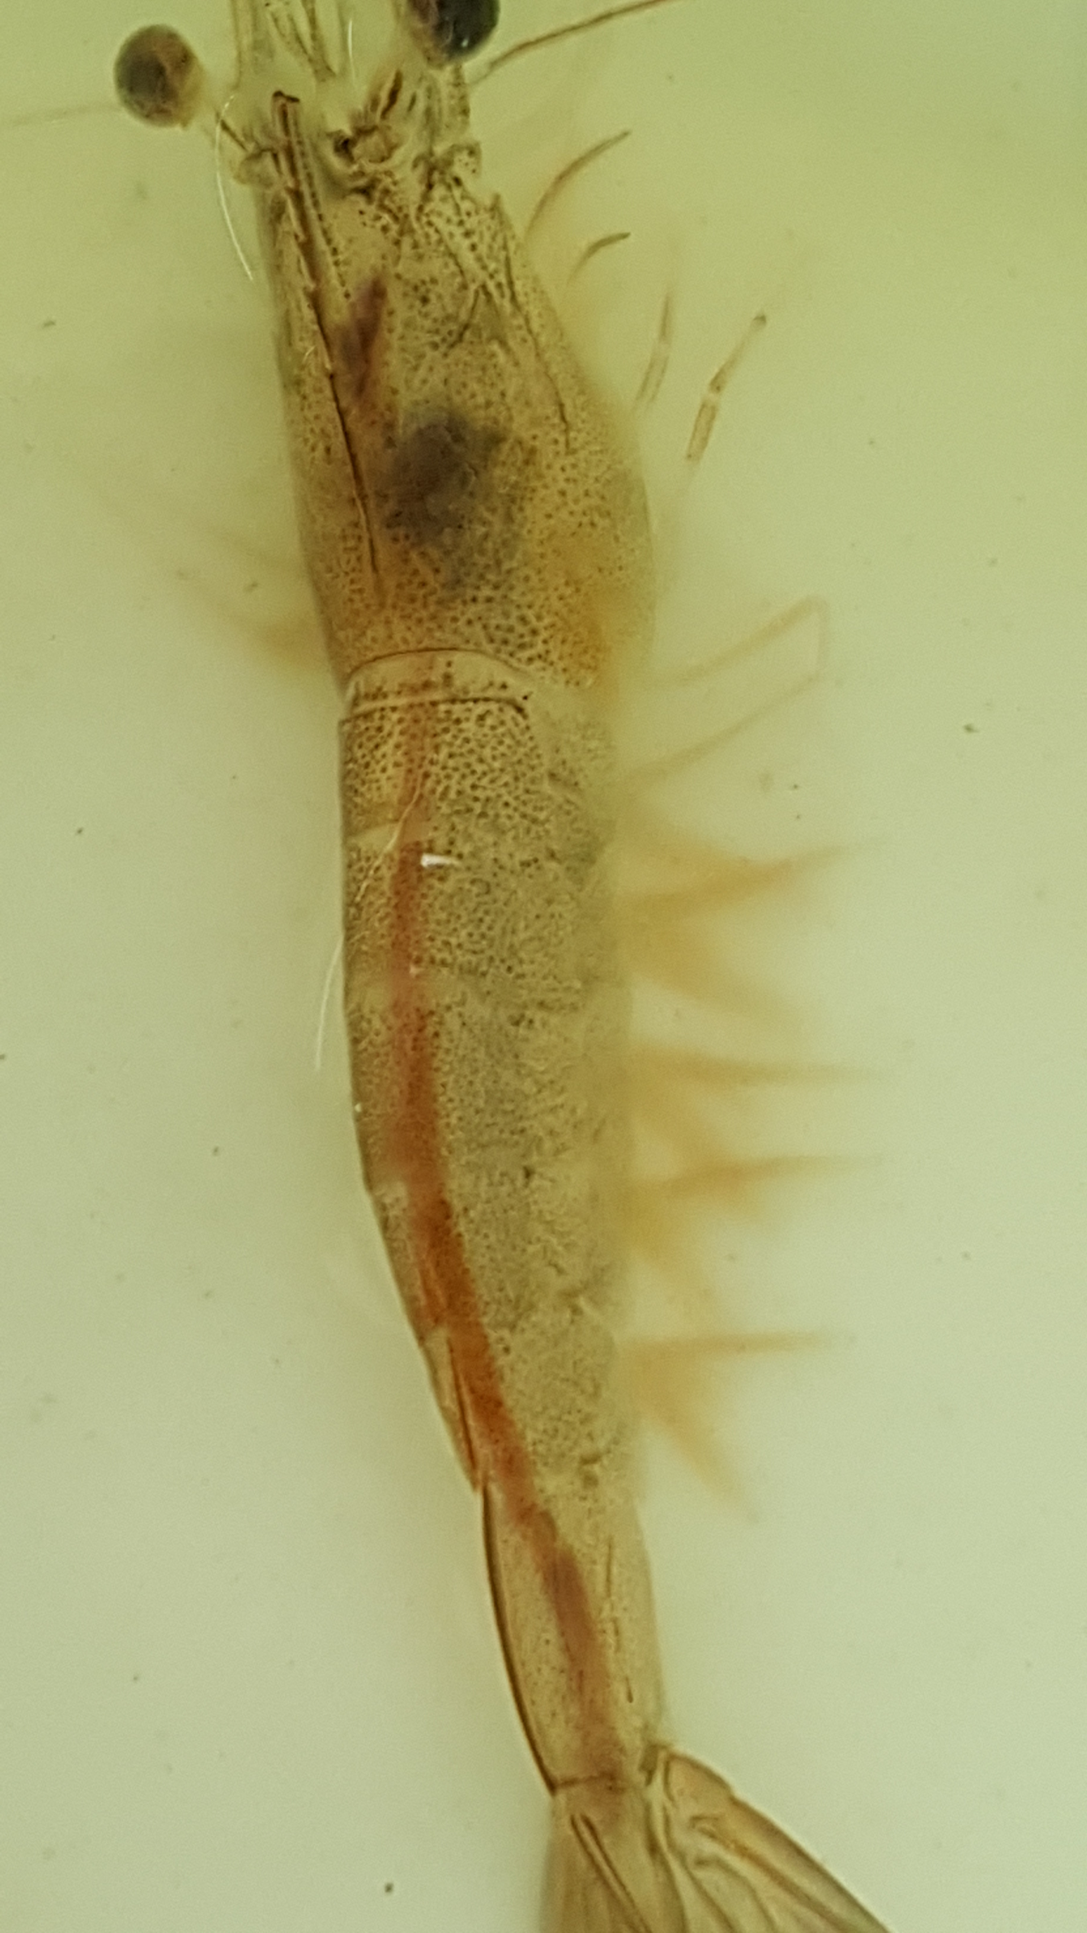
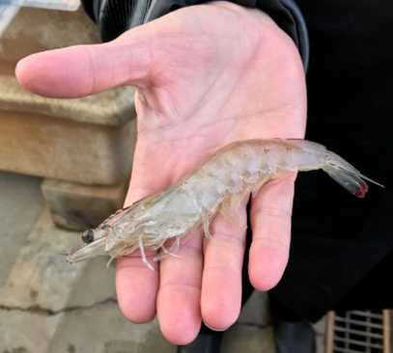
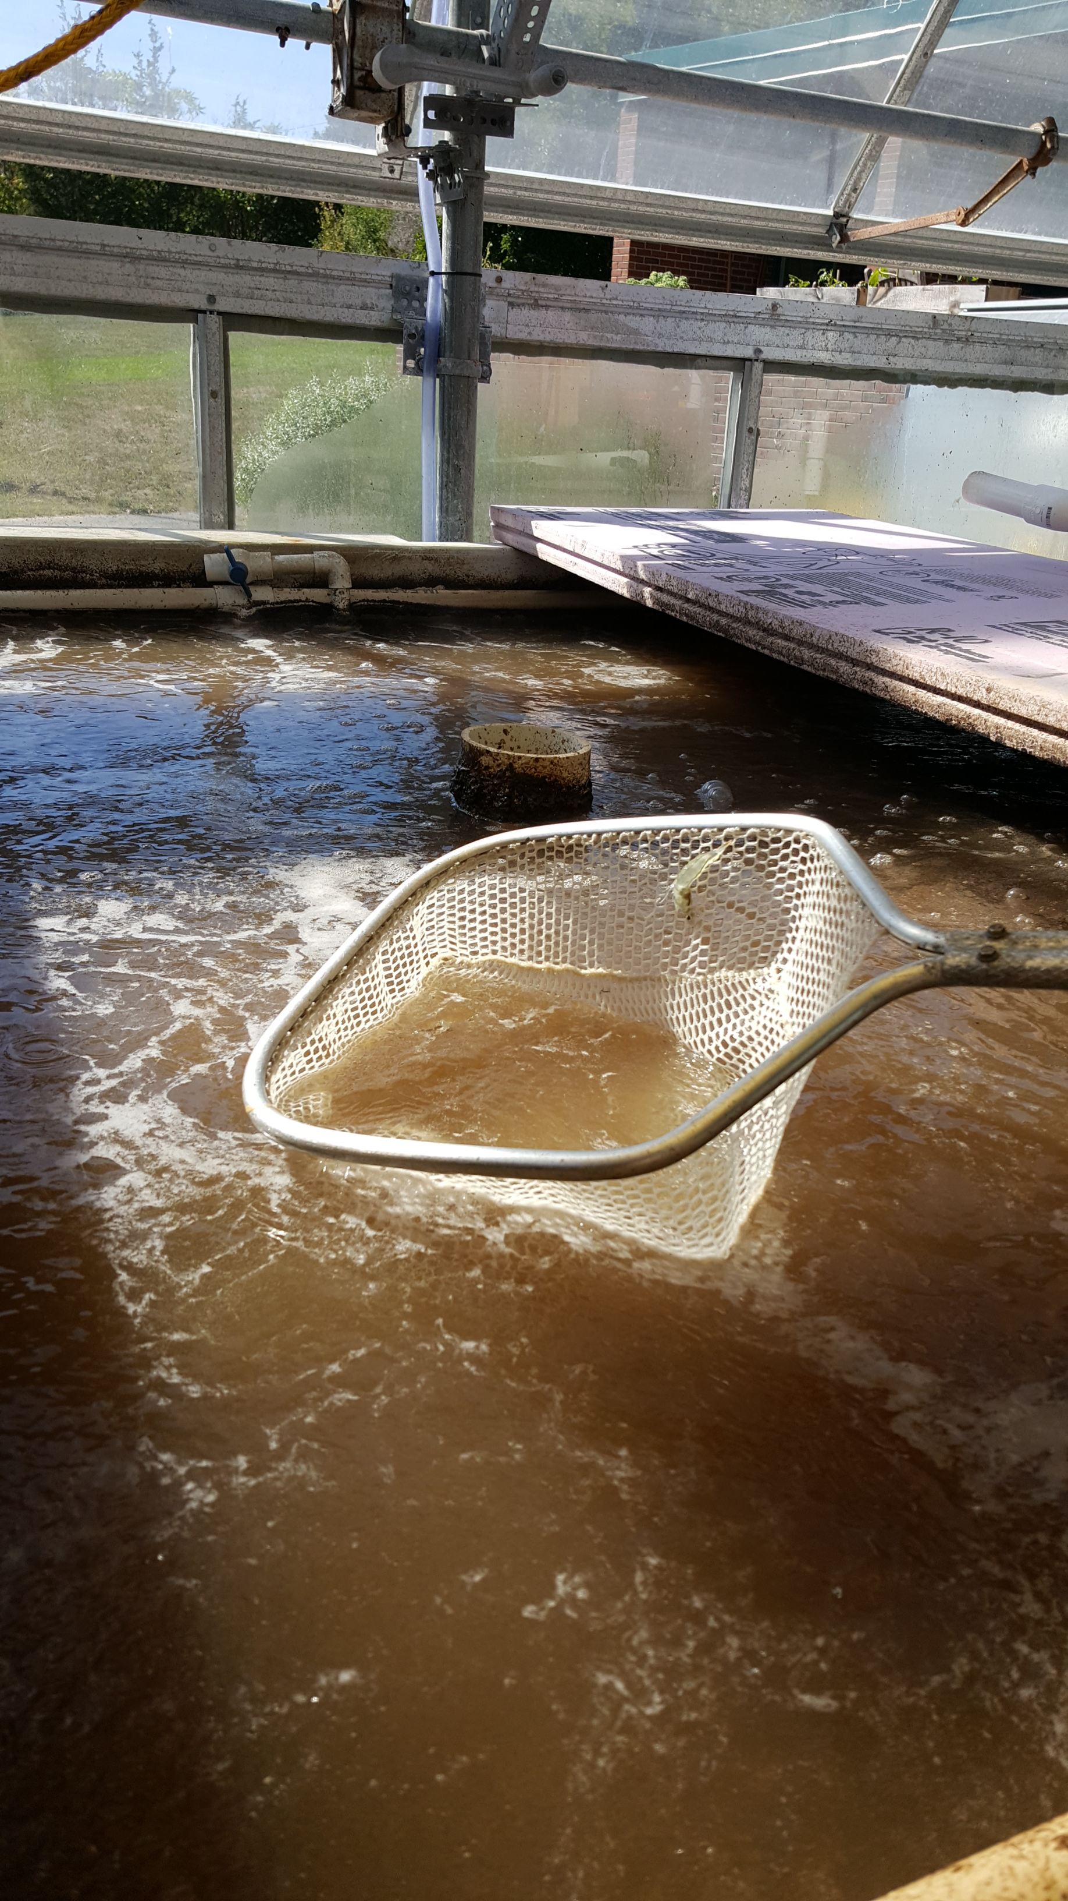

Farm Raised Pacific White Shrimp in a New Hampshire Green House
Michael Chambers ¹, Erich Berghahn ², Arron Jones ³
How we got started with this product
Aquaculture is an important field in today’s world with the growing need for safe and sustainable food production. Bio-floc aquaculture is on the rise in the US and utilizes pacific white shrimp grown in barns or greenhouses. To examine this new technology, NH Sea Grant funded a demonstration project at the University of New Hampshire’s Jackson Estuarine Lab greenhouse. Here we are testing the productivity of a relatively small-scale system to determine the practicality of its use by farmers, fishermen or entrepreneurs.
What is Bio-floc/why use this method?
Bio-floc consists of multiple types of nitrosomonas bacteria. This bacteria acts as a living filter in the system by utilizing the shrimp waste and converting it back into a usable product. The bacteria keeps harmful nutrient levels low while boosting the growth rate and immune system of the shrimp. The Bio-floc is like wine in the sense that it matures and becomes better with age. The ability to re-use the Bio-floc water minimizes the water usage of this system. The shrimp can reach market size in four months.
About the product
The final tank cultured product is a superior quality shrimp, grown locally, and distributed fresh, eliminating the need for chemical preservatives used in processing and shipping. The resulting taste and texture is markedly improved due to the sustainable farming practices, and high-quality feed sources (Zeigler) employed by this production method.

