Slide 1



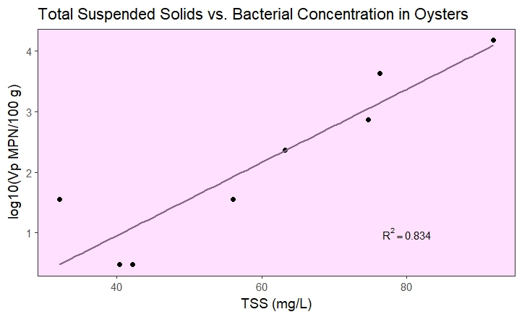
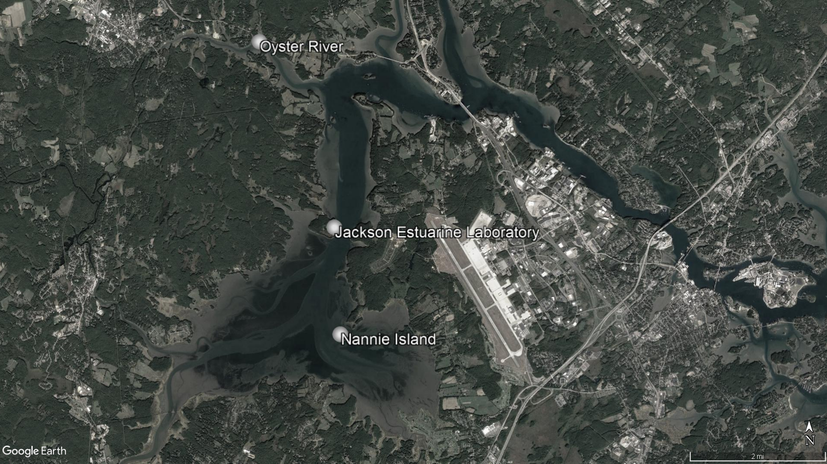
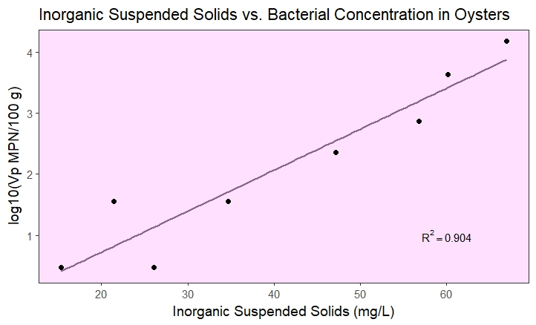
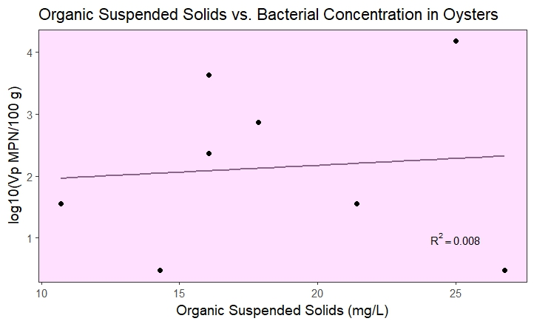
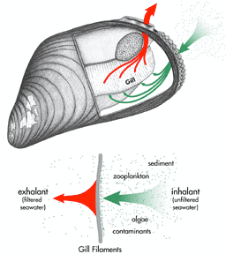
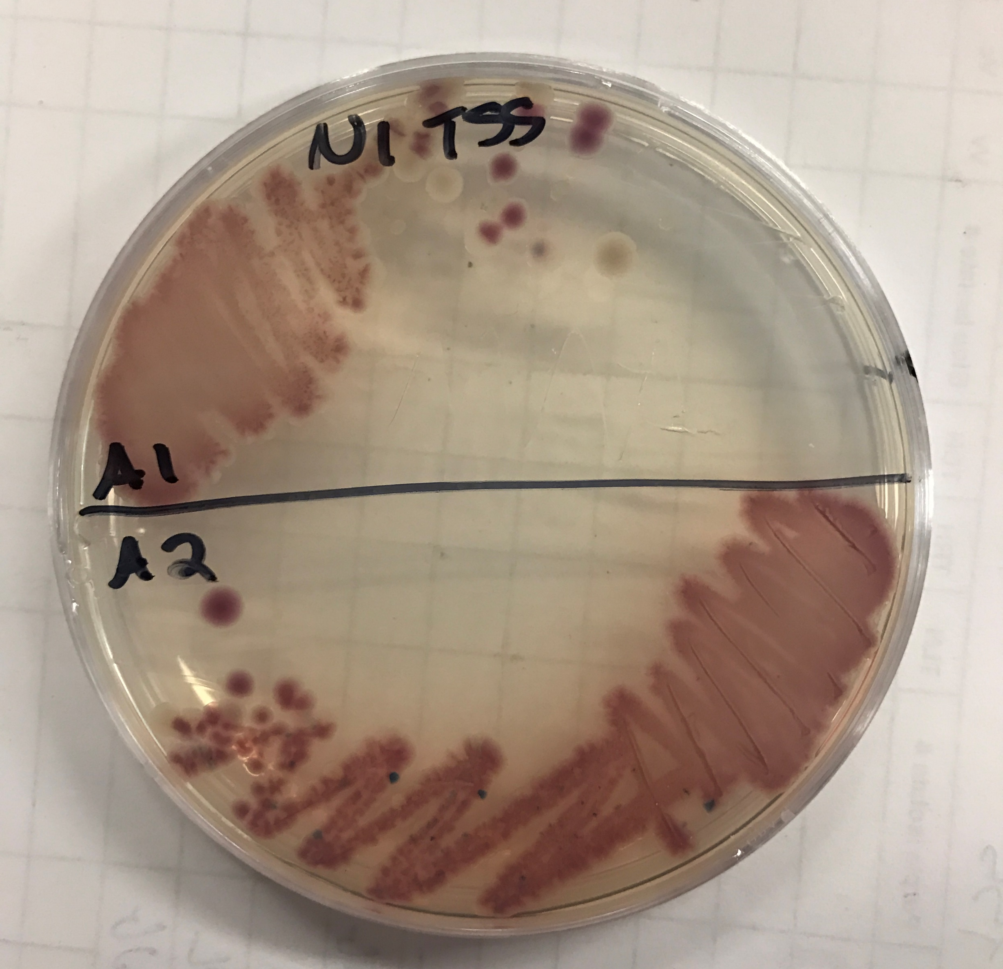
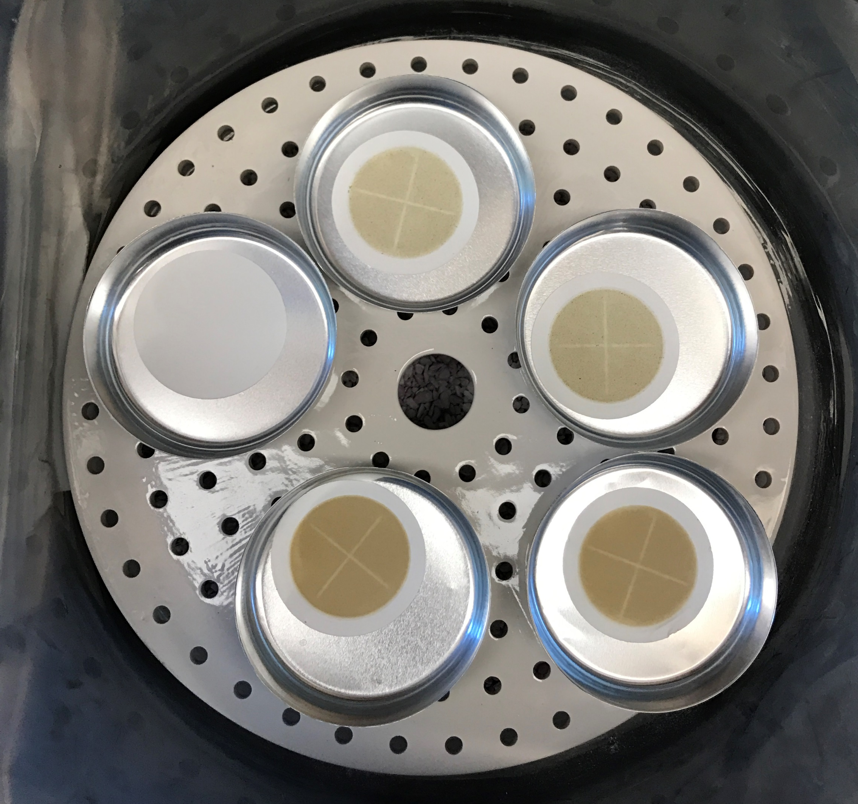
Impact of Suspended Particles on Vibrio parahaemolyticus Contamination in Great Bay Oysters
Audrey K. Berenson¹ and Dr. Stephen Jones, Faculty Advisor²
¹Department of Molecular, Cellular, and Biomedical Science, University of New Hampshire
²Department of Natural Resources and Environmental Science, University of New Hampshire
Background
Results
Vibrio parahaemolyticus disease has recently become more common during summer in the Northeastern region of the United States.^{1,2} Vibrio parahaemolyticus is a bacterial species that is found globally as a natural member of coastal ecosystems, such as Great Bay Estuary in New Hampshire. It can cause infection by entering the body through open wounds or by consumption of raw or undercooked seafood, particularly shellfish such as oysters. Infection via consumption has not yet occurred in New Hampshire, but it has become a critical issue and concern for shellfish growers and consumers in the Northeast, in part due to changing environmental conditions in regional coastal areas.³ Understanding more about the bacteria and the mechanism of contamination of oysters could provide insight into the disease and preventative measures.
Figure 2. There is a somewhat strong relationship (R² = 0.834) between the mass per volume of the total suspended solids and the V. parahaemolyticus concentration in the oysters.
V. parahaemolyticus Contamination of Oysters via Suspended Solids
Plankton
V. parahaemolyticus
Inorganic Particles
Figure 1. Locations of Jackson Estuarine Laboratory and Sampling Sites. Samples are processed at Jackson Estuarine Laboratory after collection during low tide at Oyster River and Nannie Island.
Re-Suspension (tides, storms, water activity)
Previous UNH Research
Figure 3. The strongest relationship (R² = 0.904) can be seen between the inorganic portion of the suspended solids and the V. parahaemolyticus concentration in oysters.
Previous research has identified an array of environmental and climatic conditions that correlate with V. parahaemolyticus concentrations in oysters, including water temperature, salinity, chlorophyll a, dissolved organic carbon and pH.^{2,3,4} Various studies report that V. parahaemolyticus concentrations can be higher in the sediment than in the surrounding water column and oysters.⁵ The sediment can be suspended by recreational activities in the Bay, strong tides, and weather events. The sources and causes of variation in V. parahaemolyticus concentrations in oysters are still being characterized, however it is likely that bacteria accumulate in oysters via filtration of suspended sediment particles.⁶
Oysters
Sediment
Methods
Total Suspended Solids (TSS)
Inorganic Suspended Particles
Organic Suspended Particles
Plankton
Free Floating Bacteria
Sample Collection – Biweekly (June-August, 2017), samples were collected at Nannie Island and Oyster River, during low tide. Twelve medium/large viable oysters and one liter of water collected from one foot under the surface were collected at each site and stored on ice until processing.
Oyster Processing – After sampling, collected specimens were processed the same day at Jackson Estuarine Laboratory. Oysters were shucked and the meat and liquor was blended. The blended oysters were enriched for Vibrio spp. with Alkaline Peptone water (APW) in a triplicate serial dilution. The dilution tubes were incubated overnight at 37°C. Turbid tubes were streaked on ChromAgar Vibrio, which were then incubated overnight at 37°C. Selected colonies were streaked on Tryptic Soy Agar and incubated at room temperature overnight. Selected colonies were grown in Heart Infusion broth, which was then used for Polymerase Chain Reaction (PCR) testing for the presence of the Thermolabile Hemolysin (tlh). PCR results were viewed by electrophoresis using a 1.2% TBE gel. The bacterial concentrations of V. parahaemolyticus were estimated using a Most Probable Number (MPN) table from the Food and Drug Administration.
Water (Suspended Solids) Processing – 280 mL of shaken water were filtered through 1.5 μm pore Microfiber filters. The filters were dried in a drying oven at 100°C overnight before being heated in a muffler furnace at 550°C for 30 minutes. Masses were measured initially as well as after both the drying process and the incinerating process.
Data – Data was analyzed using the program R Studio. All data was logarithmically transformed and two outliers were rejected.
Figure 4. There is no relationship (R² = 0.008) between the organic suspended solids and the V. parahaemolyticus concentration in oysters.
Bivalve Shellfish Contaminant Filtration
​
Acknowledgements
Conclusions
Thank you to the Hamel Center for Undergraduate Research and the contributors to my Summer Undergraduate Research Fellowship that made all of this possible: Mr. Dana Hamel, the J. Raymond Hepler Endowed Fund, and Ms. Renee Gilberti. Thank you to the New Hampshire Agricultural Experiment Station as well as New Hampshire Sea Grant for your support. Thank you to my incredible mentor, Dr. Stephen Jones, for all of the guidance, advice, and assistance you’ve provided throughout my research career. Thank you to Meghan Hartwick for all of your assistance with data analysis and other aspects of the project. Thank you to my friends and family for your support throughout all of my endeavors. Thank you to Kari Hartman, Derek Rothenheber, Jackie Lemaire, Lexi Bunda, Randi Foxall, Jen Halstead, Chris Peter, and Heather Gilbert for your assistance throughout this project.
There is a somewhat strong, positive relationship between the total suspended solids and the V. parahaemolyticus concentration in Great Bay Estuary oysters. However, the positive relationship between the inorganic suspended solids and the V. parahaemolyticus concentration in the oysters was stronger. Inorganic suspended solids appears to be the better indicator of the V. parahaemolyticus concentration in oysters than the total suspended solids. There is no visible correlation between the organic suspended solids and the V. parahaemolyticus concentration in Great Bay Estuary oysters. V. parahaemolyticus might be adhering itself to inorganic solids in the sediment before it is suspended. Once the solids are suspended, they are susceptible to filtration by oysters at the bottom of the bay. There are many factors that contribute to oyster contamination that must be explored further. Based on this study, it would appear that inorganic solids is a likely contributor to oyster contamination and it should be a focus of further research.
References
1. Jones, SH. (2011). Microbial Pathogens and Biotoxins. State of the Gulf of Maine. Gulf of Maine Council on the Marine Environment. http://www.gulfofmaine.org/state-of-the-gulf/docs/microbial-pathogens-and-toxins.pdf
2. Urquhart, E.A., Jones, S. H., Yu, J. W., Schuster, B. M., Marcinkiewicz, A. L., Whistler, C. A., et al. (2016) Environmental conditions associated with elevated Vibrio parahaemolyticus concentrations in Great Bay Estuary, New Hampshire. PLoS ONE 11(5): e0155018. doi:10.1371/journal.pone.0155018
3. Baker-Austin, C., Trinanes, J. A., Gonzalez-Escalona, N., & Martinez-Urtaza, J. (2017). Non-Cholera Vibrios: the microbial barometer of climate change. Trends in Microbiology, 25, 76-84. doi: 10.1016/j.tim.2016.09.008
4. López-Hernández, K. M., Pardío-Sedas, V. T., Lizárraga-Partida, L., Williams, J. de J., Martínez-Herrera, D., Flores-Primo, A., … Rendón-Castro, K. (2015). Environmental parameters influence on the dynamics of total and pathogenic Vibrio parahaemolyticus densities in Crassostrea virginica harvested from Mexico’s Gulf coast. Marine Pollution Bulletin, 91(1), 317–329. https://doi.org/10.1016/j.marpolbul.2014.11.015
5. Jones, S., Striplin, M., Mahoney, J., Cooper, V., & Whistler, C. (2010). Incidence and abundance of pathogenic Vibrio species in the Great Bay Estuary, New Hampshire. Proceedings of the Seventh International Conference on Molluscan Shellfish Safety, 2(June), 127–134.
6. Lovell, C. R. (2017). Ecological fitness and virulence features of Vibrio parahaemolyticus in estuarine environments. Applied Microbiology and Biotechnology, 101, 1781-1794. doi: 10.1007/s00253-017-8096-9
Bivalve Image from: Nadeau, E. & Finlayson. (2003). Gulfwatch:Monitoring Chemical Contaminants in Gulf of Maine coastal waters.
Future Directions
Further exploration of the potential impacts of suspended particles by comparing the mass of the total suspended solids and the inorganic fraction with the concentration of V. parahaemolyticus in the water should be the goal of future analysis. Determining sanitation practices that could minimize contamination due to suspended solids (such as depurination) could be of benefit as well. This project could be extended by repeating this experiment, but filtering a portion of each water sample through a filter with a pore size of 0.45 μm as well as a filter with a larger pore size, so that free floating bacteria could be distinguished from bacteria that are adhered to suspended particles.

