Slide 1

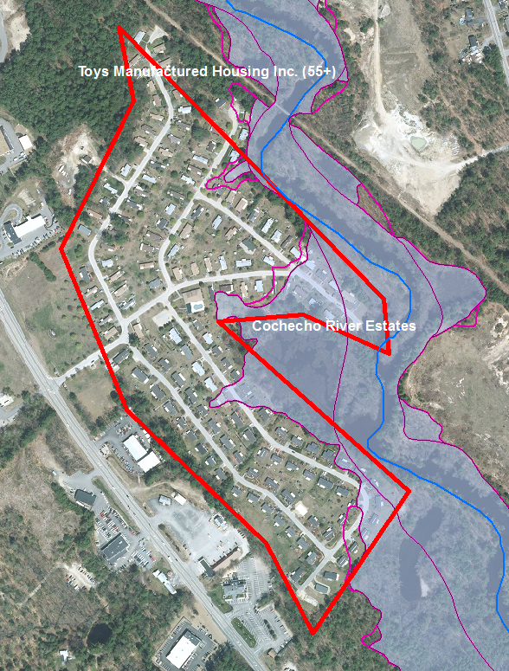
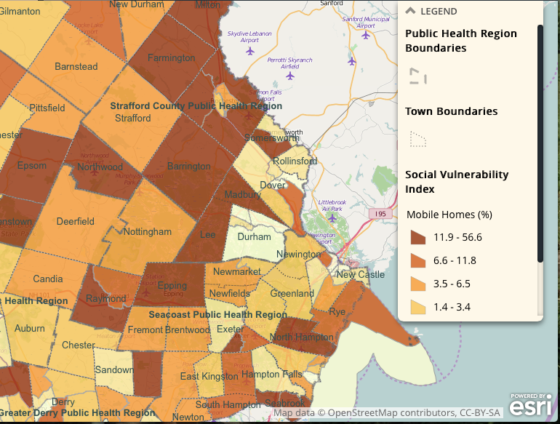
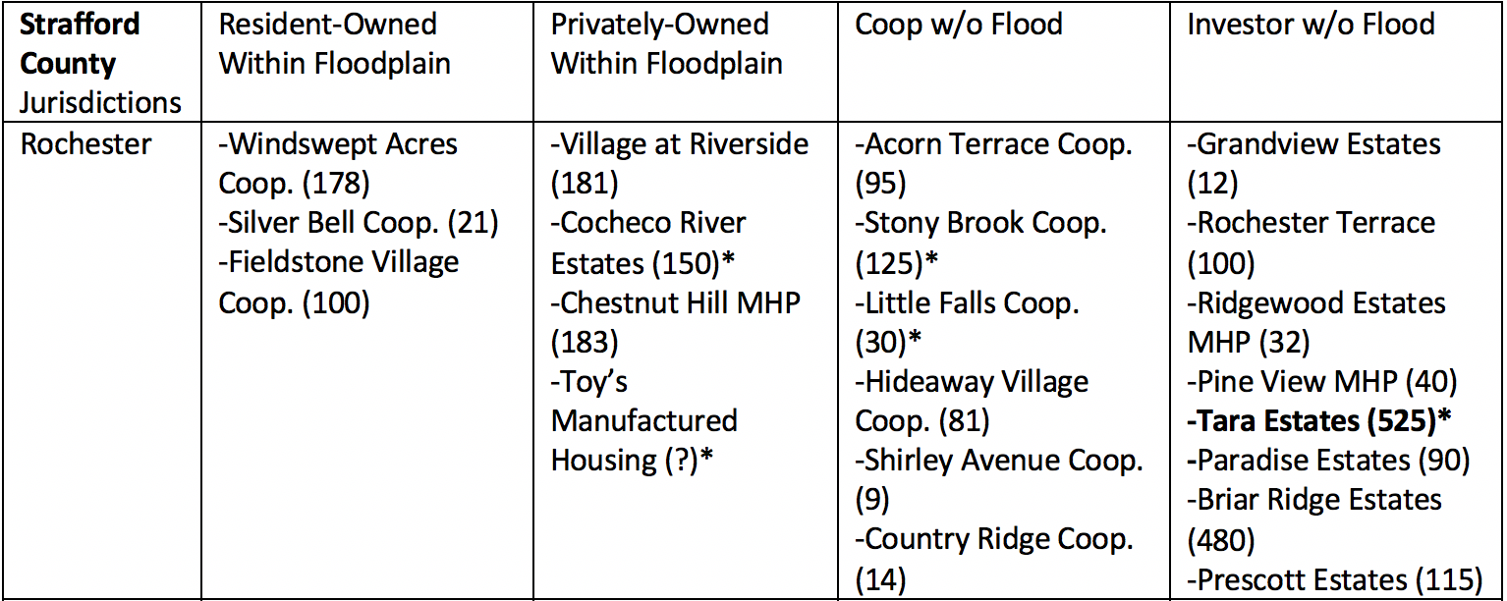
Flooding Risks in the Coastal Watershed of New Hampshire:
Factors of Resilience in Manufactured Home Parks
Dylan Kelly
Advised by Julia Peterson
Overview
Methodology
The Next Step
Manufactured home parks are highly vulnerable to extreme weather events. It is not only the physical structure of these homes that makes them vulnerable, but also their geographic locations, ownership and social structure. Some of the largest rivers in the coastal watershed of New Hampshire pose flooding risks for manufactured home communities along their banks. An examination of how resilience can be increased was undertaken with the goal of sharing information to assist municipal officials and community leaders with decision making related to disaster preparedness. The town of Rochester, NH was chosen as the focus area for this examination.
Technical Analysis
Use ArcGIS to identify parks within the FEMA 100 year floodplain
Social Science and Research
Conduct research and interviews with town officials and park leaders
Outreach
Provide a list of considerations to town officials and park leaders based on interview results
An interview with the assistant Chief of the Rochester Fire Department provided valuable insight about disaster planning and community outreach that was used in conjunction with research into factors of both resilience and vulnerability to flooding events. All of the considerations and actions deemed appropriate for building resilience in manufactured home parks were synthesized using the format of an ESRI Story Map. This user friendly web-based platform is an effective method for sharing information with a wide range of audiences. Once the Story Map has been further developed it will be ready to share with the intended audiences and promote effective community action.
Building Resilience
Floodplain Development
Park Ownership
Proper Emergency Planning
Community Outreach
Image 3. New Hampshire Department of Health and Human Services: Social Vulnerability Index, Mobile home percentages
Image 1. The different categories of the factors that contribute to community resilience.
Image 2. FEMA 100 year floodplain data with Estimated boundary of Cochecho River Estates
Image 4. Identified Manufactured Home parks in Rochester, NH with the number of homes and age restrictions (* = ages 55 plus)
Image 5. Summary of considerations and actions to be shared with park leaders and municipal officials

