Slide 1


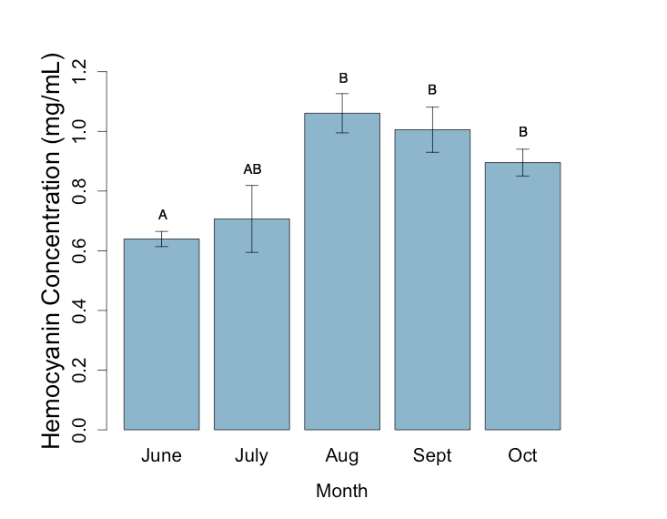
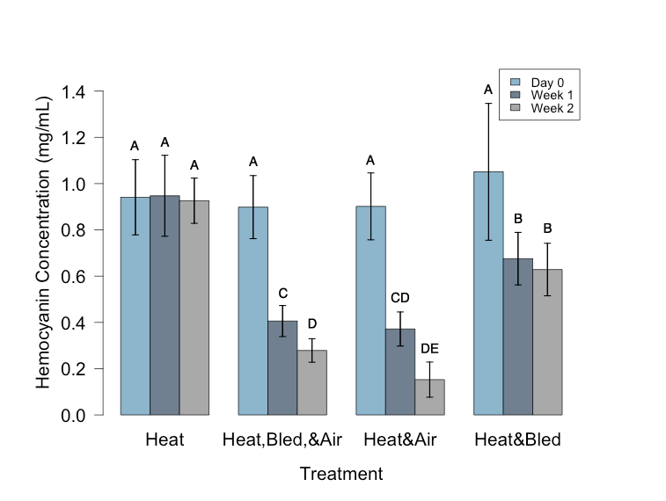
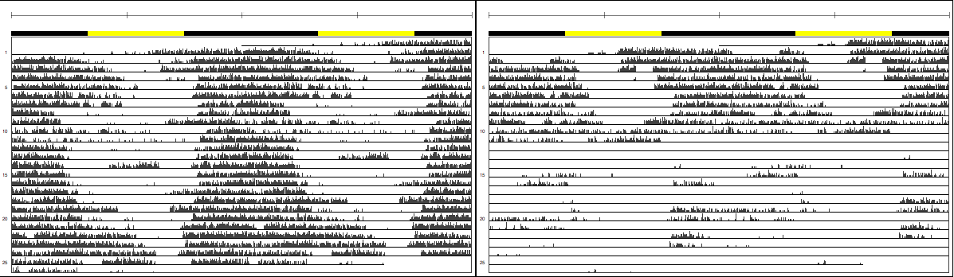
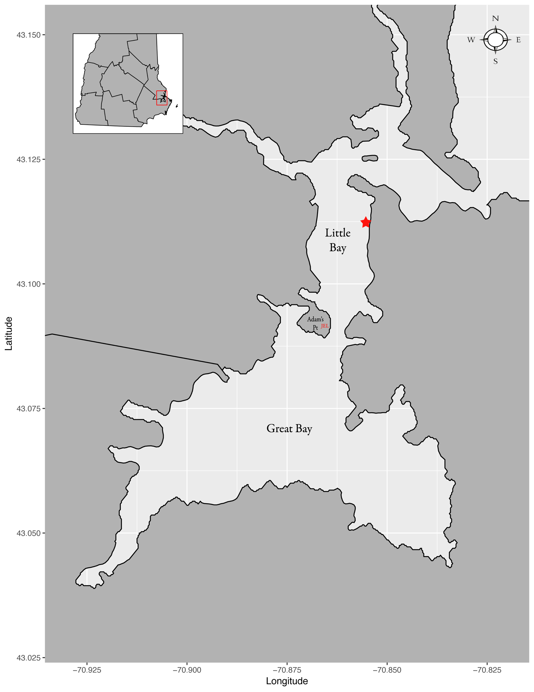
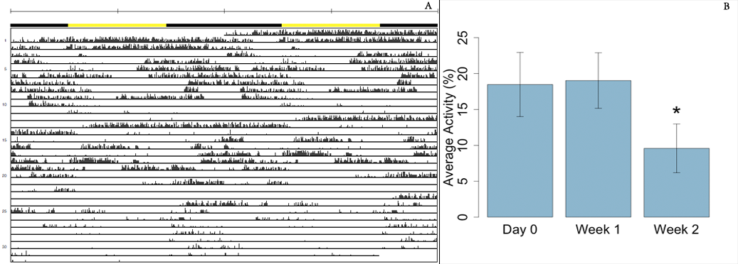
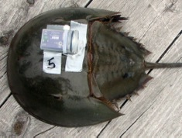
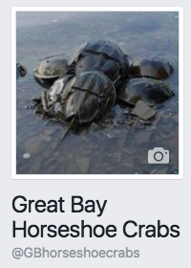


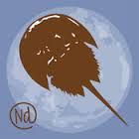
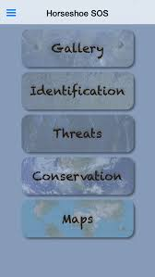

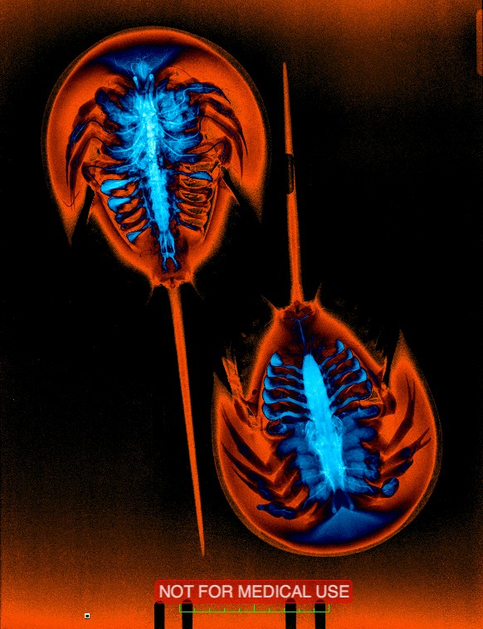
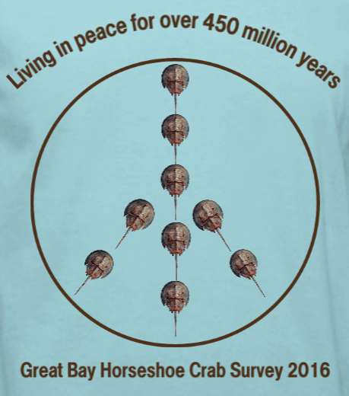
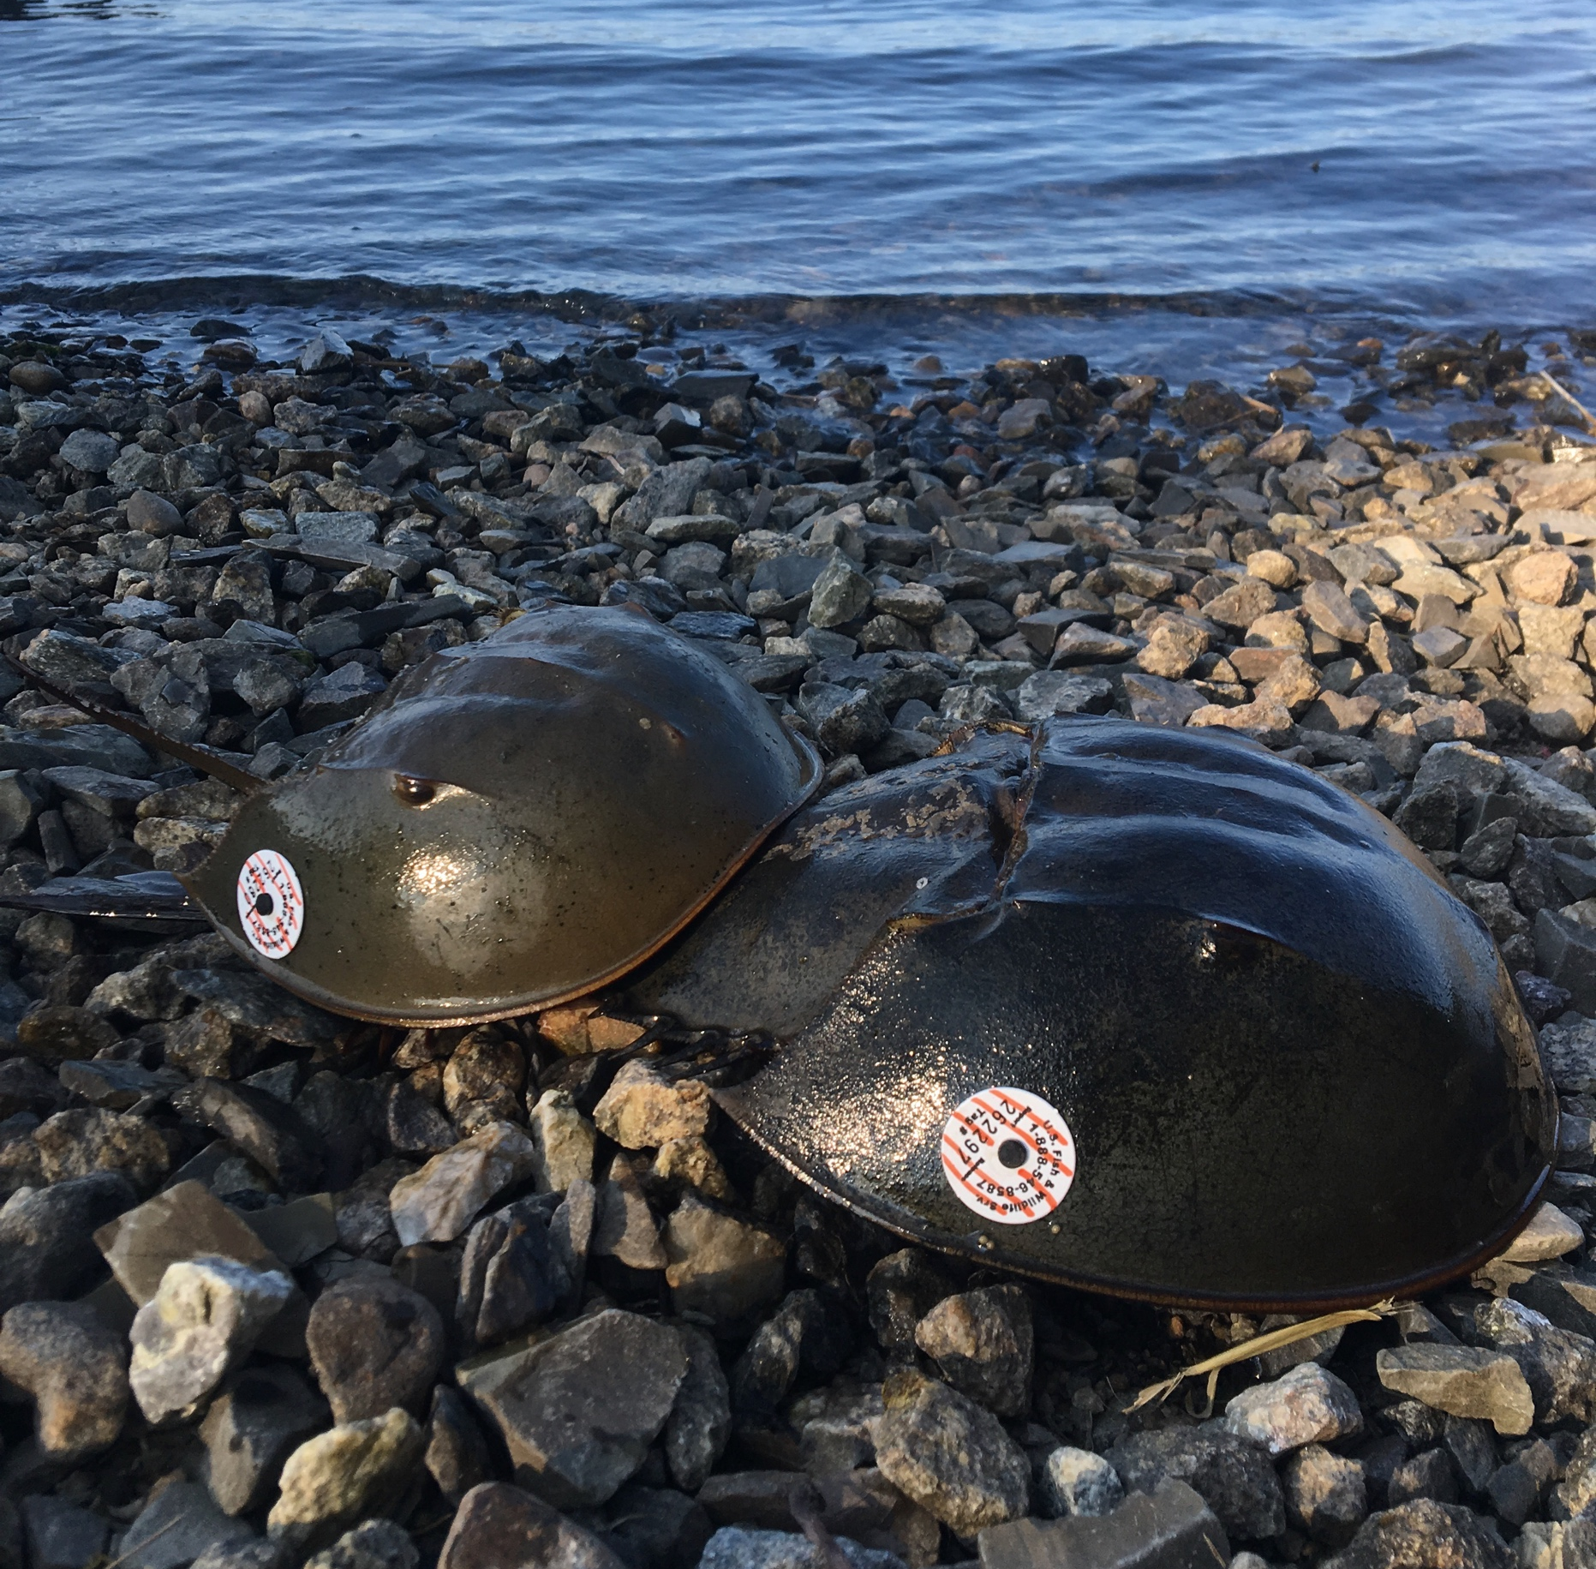

Effects of the Biomedical Bleeding Process on the Physiology and
Behavior of the American Horseshoe Crab, Limulus Polyphemus
Meghan Owings¹, Winsor H. Watson III¹, Chris Chabot²
University of New Hampshire, Durham, New Hampshire, 03824
Plymouth State University, Plymouth, NH, 03264
Introduction
 | Experimental Groups (n = 8 for each) | Control groups (n = 8 for each)
Bleeding Only | 30% blood volume extracted | No blood extracted
Air Exposure | 8 hrs out of water and 30% blood volume extracted | 8 hrs out of water but no blood extracted
Heat | Increased water temperatures for 4 hrs (~90°C) and 30% blood volume extracted | Increased water temperatures for 4 hrs but no blood extracted
Full Bleeding Procedure | 8 hrs out of water, increased water temperatures for 4 hrs (~90°C), and 30% blood volume extracted | 8 hrs out of water, increased water temperatures for 4 hrs (~90°C), but no blood extracted
LAL “Industry-Standard” Bleeding Procedure*
The American horseshoe crab, Limulus polyphemus, is found in bays and estuaries along the Atlantic coastline of North America, including Great Bay, NH.
Commercially, L. polyphemus is used as bait in the eel and whelk fisheries, and its hemolymph is used to produce Limulus Amebocyte Lysate (LAL).
LAL is used in the biomedical industry to test medical devices, vaccines, and pharmaceutical drugs for pathogenic Gram-negative bacteria.
Landings for biomedical bleeding have increased to ~600-750,000 crabs/year.
Estimates of post-release, post-bleeding mortality of animals from the biomedical bleeding procedure range from 5-30%, while sublethal effects include reduced hemocyanin concentrations and decreased overall activity.
Our major goal is to determine which of three major stressors from the “industry-standard” bleeding process causes the most deleterious effects on the animals.
Hemolymph is obtained in a process that lasts for 24-72 hours.
Trawl or hand-harvest capture of horseshoe crabs.
Animals held on boat or dock, often out of water at summer temperatures.
Transported to, and from, biomedical facility (in or out of water).
Held in tanks (sometimes overnight) at biomedical facility (in or out of water).
30% of their hemolymph is extracted.
Returned to place of capture, or released in a new location (or sold for bait).
*may slightly differ according to the different biomedical facilities
Results: Sublethal Behavioral Impacts
Results: Hemocyanin Concentrations
test
Fig 3. Actograms showing ~3 weeks of activity for each animal. There was no significant difference in overall activity of animals only exposed to heat (left panel), but there was a significant (week 1: p=0.002; week 2: p=0.0001) decrease in the activity of the animals exposed to heat and bleeding (right panel). Red arrows indicate when animals were exposed to heat, and the blue star indicates when bleeding occurred. The LD cycle is indicated by the yellow and black bars on top. Numbers on x-axis represent number of days. Note: both of these animals were nocturnal.
Fig 4. Impact of the full bleeding procedure on locomotion. A. Actogram showing a significant (p=0.07) decrease in activity 2 weeks after treatment. B. Weekly activity of animals exposed to the full bleeding procedure. There was no significant decrease in activity 1 week post-treatment, but there was a significant (p=0.01) difference 2 weeks post-treatment. This suggests a delayed effect of the biomedical bleeding process on the animals. Asterisk represents significant differences. Error bars represent standard error of the mean.
There were significant seasonal fluctuations in hemocyanin levels
Hemocyanin concentrations impacted by combination of stressors
Exposure to heat and bleeding caused a significant decrease in overall activity 1 and 2 weeks post-treatment
Measure the impacts of blood loss, high temperatures, and air exposure on the behavior of horseshoe crabs in the laboratory.
Examine the effects of the same three stressors on hemocyanin concentrations.
Heat Only
Heat and Bled
Methods
Horseshoe crabs were collected by divers at Fox Point,
Great Bay Estuary, NH (Fig. 1).
For each trial: 16 males (8 control:8 experimental)
were randomly selected and fitted with HOBO acceler-
ometers secured to the carapace (Fig. 2) so that
we could record their overall activity and the expression
of daily and tidal rhythms.
Behavioral data were collected for 1
week prior to the treatment (baseline) and 2 weeks
post-treatment.
In some cases, 30% of their total hemolymph volume
was removed, following the procedure of Armstrong and
Conrad (2008) and Anderson et al. (2013).
Hemolymph samples (1 mL) were collected from each animal every 8 days for analysis of hemocyanin concentrations using the procedure of Coates et al. (2012).
Actograms and periodograms were created using ActoJ to determine the types of rhythms expressed. Repeated measures ANOVA’s, Tukey’s tests, and Students T-tests (α<0.05) were used to determine effects on overall activity levels.
Fig 5. Hemocyanin concentrations were significantly (p<0.05) lower in animals sampled in June in comparison to those sampled in August-October.
Fig 6. Hemocyanin concentrations of animals in different treatment groups. There were no significant (p>0.05) changes over time when animals were exposed to only heat. However, there were significant (p<0.05) decreases in when animals were exposed to a combination of stressors.
Summary/Discussion
Fig 1. Map of Great Bay, NH
Bleeding and air exposure did not lead to as many behavioral changes as heat plus bleeding, or the full bleeding procedure.
Not all of the behavioral and physiological changes were immediate.
Based on the effects of heat alone, animals that are selected for the biomedical bleeding process should be kept at their preferred temperatures.
The full bleeding procedure had more impact on overall activity than any stressor alone. This suggests a synergistic interation between all the stressors involved in the bleeding process.
Animals collected in the late summer/fall might be better able to withstand the impacts associated with the biomedical bleeding process, due to higher levels of hemocyanin in their blood.
There was a 14% mortality rate in all the trials, indicating that there are both lethal and sublethal impacts of the biomedical bleeding process on the behavior and physiology of horseshoe crabs.
Delayed decreases in overall activity in response to all 3 stressors
Fig 2. Methods. A. Flow-through seawater tanks containing 1-m diameter mesh enclosures where horseshoe crabs were held for each experiment at UNH Jackson Estuarine Laboratory. B. Horseshoe crab fitted with a HOBO accelerometer, held in place with duct tape and cable ties. C. Hemolymph samples on ice, kept for further analysis.
Related Outreach Projects
Great Bay Horseshoe Crab Survey
Horseshoe SOS
App
SMCC Horseshoe Crab Radiography
A
B
C
References
Acknowledgements
Anderson, R.L., W.H. Watson III, and C.C. Chabot. 2013. Sublethal behavioral and physiological effects of the biomedical bleeding process on the American horseshoe crab, Limulus Polyphemus. Biol Bull 225: 137-151.
Armstrong, P., and M. Conrad. 2008. Blood collection from the American horseshoe crab, Limulus polyphemus. J Vis Exp 20: 958.
Coates, C. J., E.L. Bradford, C.A. Krome, and J. Nairn. 2012. Effect of temperature on biochemical and cellular properties of captive Limulus polyphemus. Aquaculture 334: 30-38.
Hurton, L., J. Berkson, and S. Smith. 2005. Estimation of total hemolymph volume in the horseshoe crab Limulus polyphemus. Mar Freshw Behav Physiol 38: 139-147.
Fig 7. This citizen science driven project worked with USFWS and NH Fish and Game to estimate the population of horseshoe crabs in Great Bay.
Fig 8. This app educates users on the ecology of horseshoe crabs, allows them to complete population surveys on their phone, and promotes conservation and awareness.
Fig 9. This project allowed students and faculty at St. Joseph’s College to image horseshoe crabs to learn more about the impacts of the biomedical bleeding process.
This project was funded by a NH Sea Grant (R/HCE-4) to Win Watson (UNH) and Chris Chabot (PSU). I would like to thank everyone who helped participate in this project, including Cam, Tori, Ben, Meghan C. and Alex for their help with animal collections and accelerometer experiments. I would also like to thank Win and Chris for their guidance, help, and support throughout this project.

