Slide 1


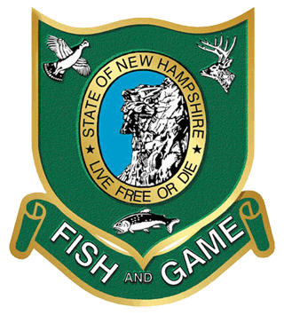
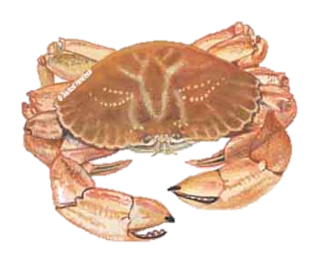

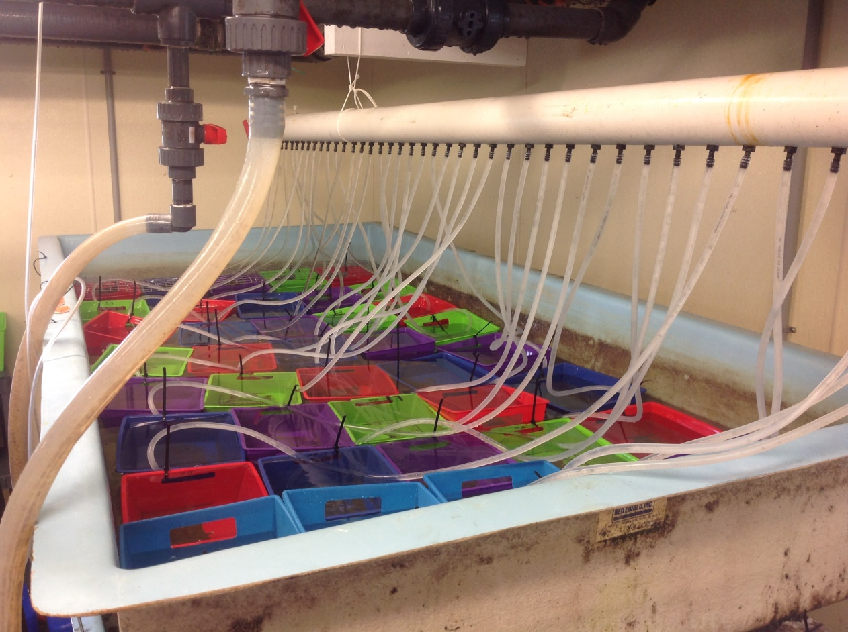
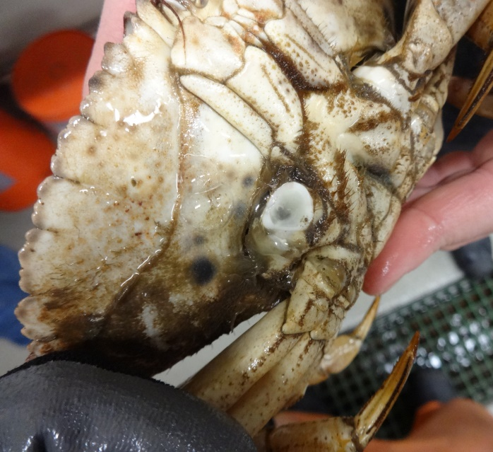
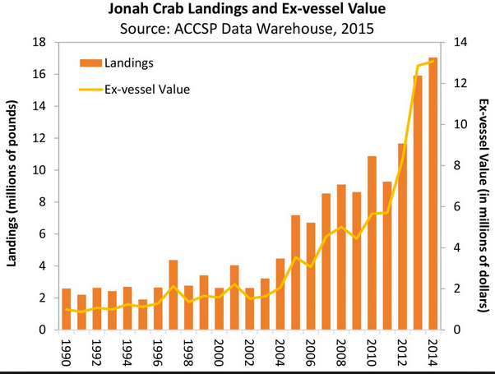
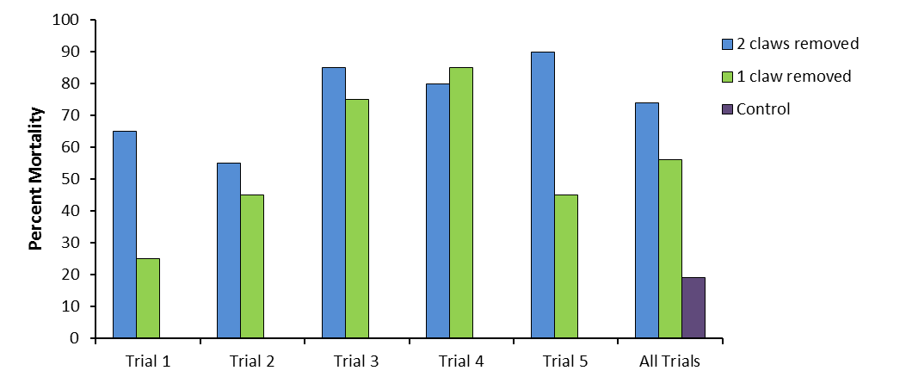
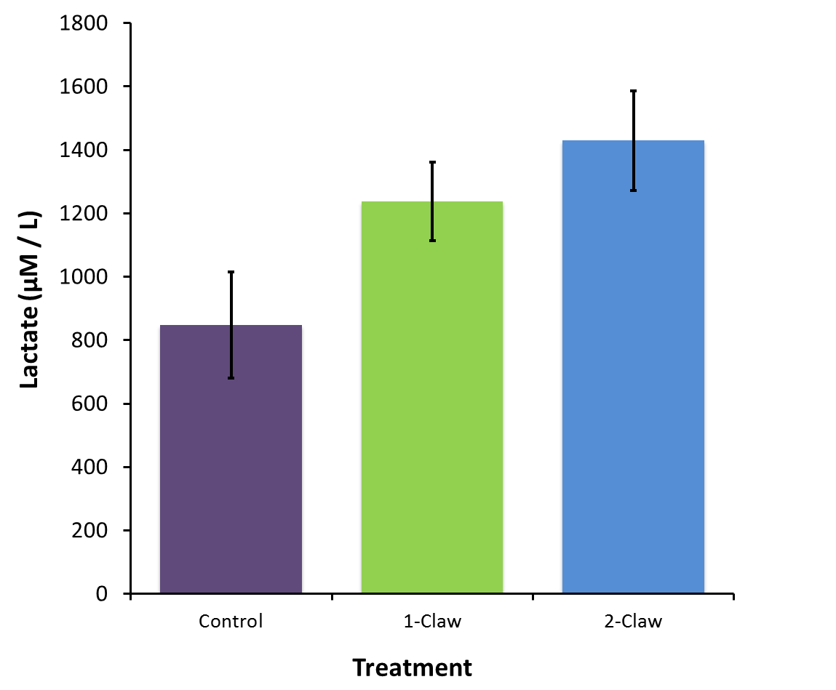
A fishery in flux: Claw removal and its impacts on survivorship
and physiological stress in the Jonah crab (Cancer borealis)
Jason S. Goldstein^{1,2}, Joshua Carloni^{2,3}, Anna Dorrance² and Rebecca Kibler¹
¹ Wells National Estuarine Research Reserve, 342 Laudholm Farm Road, Wells, ME
² Department of Biological Sciences, University of New Hampshire, Durham, NH
³ New Hampshire Fish and Game Department, 225 Main Street, Durham, NH
Background
Materials and Methods
Found in coastal and shelf waters along the Atlantic coast of North America, from Newfoundland to Florida, Jonah crab (Cancer borealis) have been harvested as incidental bycatch in the New England lobster fishery for at least 80 years (Reardon 2006). Over the past 20 years however, landings of Jonah crabs in New England have more than quadrupled (Fig. 1). The majority of these landings are occurring concomitantly with the decline of the southern New England lobster population (ASMFC 2014).
Laboratory Trials
Market sized Jonah crabs (average carapace width = 139 ± 1.08 mm) were collected by local fishermen in traps during normal fishing operations off the coast of New Hampshire in both state and federal waters. Crabs were held in recirculating seawater tanks and subjected to one of three treatments (one, two, or no claws removed) over five trials from December 2014 through January 2016 (four weeks/trial, n = 20/treatment).
Crabs were placed into individual holding bins within a large flow-through seawater tray at ambient conditions. All three treatments were fed both a cooked mussel with shell removed (soft food item) and a live mussel (hard food item) to evaluate foraging activity twice during each trial (Fig. 2).
Claw removal (declawing) techniques followed from instructional sessions by local fishermen with considerable experience in this harvesting practice. Also recorded were the size (mm) and location of break (Fig. 3) during declawing as well as pre- and post-declawing weight (g), claw weight, and shell condition (old or new shell).
As a result, the long-term health of this emergent fishery is of significant concern (Seafood Watch 2014). Moreover, the biological implications of harvesting through the live removal of claws (one preferred method) remain mostly unknown. Claw removal (declawing) occurs in other crab fisheries (e.g., Robinson 2008, Gandy et al. 2016) and results in dramatic physiological stress (Patterson et al. 2007) along with changes in behavior and overall activity.
Our goal for this ongoing study is to evaluate
Fig. 2: Laboratory tank set-up.
Fig. 3: Location of claw break.
Biochemical assays
Physiological stress in de-clawed crabs was also evaluated using two key assays: glucose and lactate; A subset crabs (n = 25/treatment x 2 trials) were examined over both short- (5-10 min post-claw removal) and long-term (~24-36 hours later). For each crab, a small blood (haemolymph) sample was withdrawn from the sinus using a 2-ml syringe and a 25-gauge needle. Blood samples were snap-frozen before being stored at -80°C. Glucose and lactate (μM/L) were quantified colorimetrically using biochemical assay kits (Eton Bioscience, San Diego, CA).
Fig. 1: Mortality rates for Jonah crabs subjected to one of three treatments during five laboratory trials from December 2014 through January, 2016.
Field Trials
We conducted two field trials (n_{total} = 48 crabs) of crab mortality with the goal of comparing our lab-based mortality rates to crabs that were kept in the field and handled similarly. Crabs were placed into individual compartments within standard ventless lobster traps and anchored off the UNH research pier at a depth of ~5 m. Traps were pulled and all crabs were checked in the same manner and time interval as in the lab-based work.
(1) the survivorship of crabs post-claw removal; (2) short- and long-term physiological impacts (stress) from claw removal and; (3) how claw removal impacts overall foraging behavior in these crabs.
Preliminary Results
Discussion
Mortality
Across all trials (n_{total} = 232 crabs), 19% of crabs died when no claws were removed (control), 56% when one claw was removed and 74% when both claws were removed. Mortality rates between trials ranged from 30 to 75% when one claw was removed, and from 45 to 95% when two claws were removed (Fig. 4). A majority of the mortality for crabs with one or two claws removed occurred within the first 6 days after initial declawing.
Our results suggest that double-claw removal incurs markedly more mortality (~74%) compared with single-claw removal (~56%) and control animals (~19%).
Lactate appears to be a relevant indicator of stress response in Jonah crabs (Fig. 5) and is the major end product of anaerobic metabolism; higher concentrations indicate attempts by the animal to mediate the effects of a stressor (Albert & Ellington 1985). These effects appear over both short- (minutes) and long-term (> 24 hr.) periods; this has been reported in other crustaceans as well (Patterson et al. 2007). Further analysis of these biochemical markers is ongoing.
Jonah crab landings have increased substantially since 2004 and continued studies on behavior (feeding) and growth are ongoing in an effort to better understand Jonah crabs and manage this developing fishery in The Gulf of Maine.
Feeding Activity
Across all trials during the secondary feeding, 96% of control crabs fed on both the hard (shelled) and soft (shucked) food items and 96% of the crabs foraged on at least one of the food items. In contrast, 74% of crabs with one claw removed and 47% of crabs with two claws removed foraged on at least one food item (Table 1).
Treatment | Ate Nothing | Ate Shucked | Ate Only Shelled | Ate Both | Ate Something
Control | 4 | 0 | 0 | 96 | 96
One Claw Removed | 26 | 29 | 0 | 46 | 74
Two Claws Removed | 53 | 35 | 0 | 12 | 47
Table 1. Percent of Jonah crabs subjected to one of three treatments that foraged during the secondary feeding, all trials combined.
Fig. 4: Mortality rates for Jonah crabs subjected to one of three treatments during five laboratory trials from December 2014 through January, 2016.
Fig. 5: Lactate levels in crab haemolymph sampled at 24-hours post declawing for a subset crabs (n = 25/treatment x 2 trials, control = 8) from each treatment. Total lactate is an indicator of physiological stress. (p < 0.05^{)*}
Literature Cited & Acknowledgements
Albert, J.L. and W.R. Ellington. 1985. Patterns of energy-metabolism in the stone crab, Menippe
mercenaria, during severe hypoxia and subsequent recovery. J. Exp. Zool. 234:175–183.
Atlantic States Marine Fisheries Commission (ASMFC). 2014. Jonah Crab Fishery: A briefing. Report
downloaded from: http://www.asmfc.org/.
Gandy, R., C. Crowley, D. Chagaris, and C. Crawford. 2016. The effect of temperature on release mortality of declawed Menippe mercenaria in the Florida stone crab fishery. Bull. Mar. Sci. 92: 1-16
Patterson, L., J., T. A. Dick, and R. W. Elwood. 2007. Physiological stress response in the edible crab,
Cancer pagurus, to the fishery practice of de-clawing. Marine Biology. 152: 265-272.
Reardon. K. 2006. Development, assessment, and management of a potential directed fishery for
Jonah crab (Cancer borealis), in the near shore Gulf of Maine. Master’s thesis, Univ. of Maine, 136p.
Robinson, M. 2008. Minimum landing size for Northeast Atlantic stocks of deep-water red crab,
Chaecon affinis (Milne Edwards and Bouvier, 1894). ICES J. Marine Science. 65: 148-154.
Seafood Watch. 2014. American lobster, Atlantic rock crab, Jonah crab: Homarus americanus, Cancer
irroratus, Cancer borealis. Monterey Bay Aquarium. Report downloaded from:
www.seafoodwatch.org.
Blood Work
Analyses of our biochemical work are not yet complete, however some of our results suggest a trend of increasing glucose and lactate levels in crabs that have had their claws removed. Both short- and long-term efforts of these parameters are apparent through at least two of our trials (Fig. 5).
Field Trials
A total of two field trials were conducted concurrently with laboratory trials. Preliminary review of this data suggests results comparable to the laboratory trials.
Future Research
Our goal is to complement our existing work with other components that include:
Investigate growth and regeneration in crabs where claws have been removed and compare various declawing techniques.
Determine how wound size, break location, shell condition, and temperature (seasonal component) affect mortality in crabs.
Evaluate feeding and activity behavior of declawed crabs vs. controls using time-lapse video and accelerometers (some of our preliminary trials that suggest behavior is altered considerably).
We would like to thank Nate Rennels, Nancy Whitehouse, Cameron Phelps, and Damon Frampton for assistance with maintenance of the experiment, blood sampling, and providing live animals. This project was funded in part by a Maine Sea Grant award (DV-16-12) to JSG.
Notes:
Main Text – Arial 28
Fig. captions – Arial 22
Remove YCCC logo and affiliation.
Add ME Seagrant Logo
Reorder affiliations
Move fisheries graph (Fig. 5) to background. Reorder figs.
Update table 1. Fix data (need to look at raw sheets?)
If space, update future research. Maybe add to Prelim. results section.
Add Cameron to acknowledgments

