Slide 1

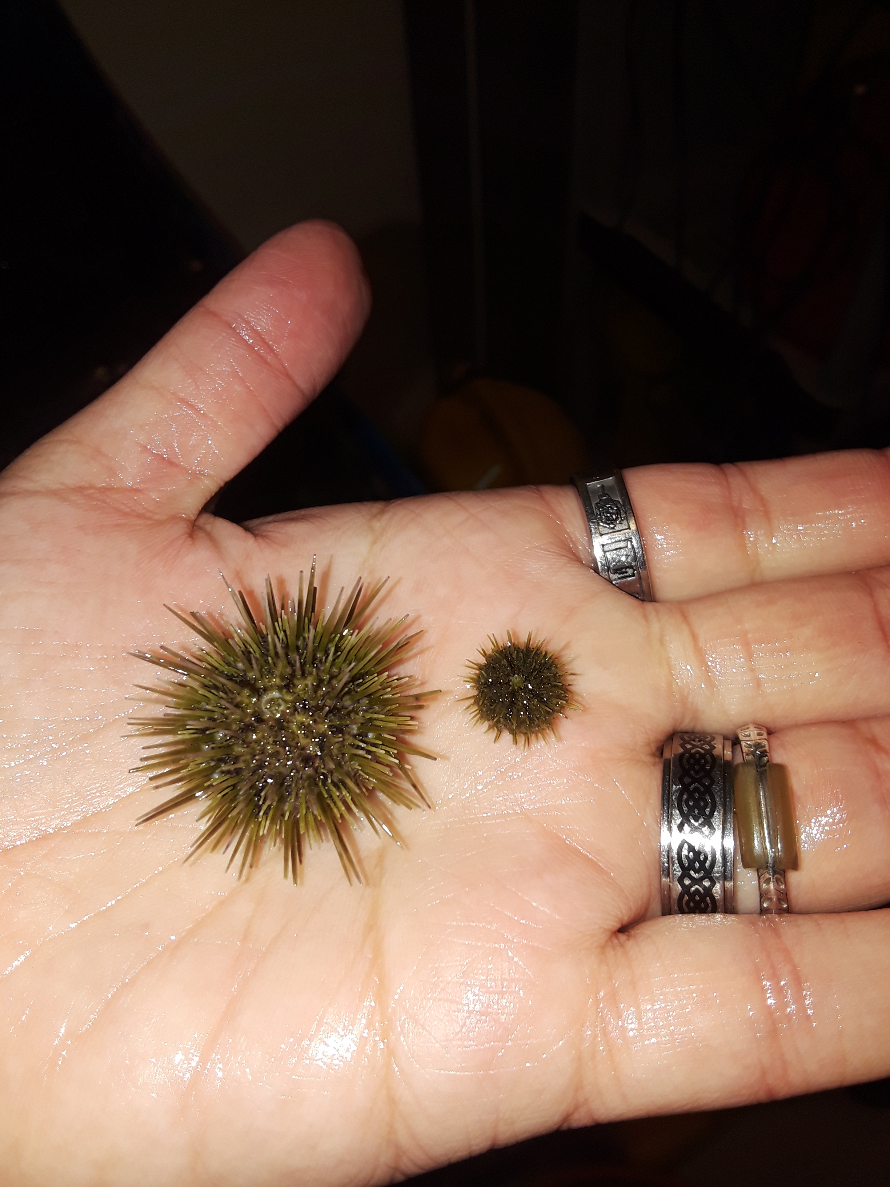
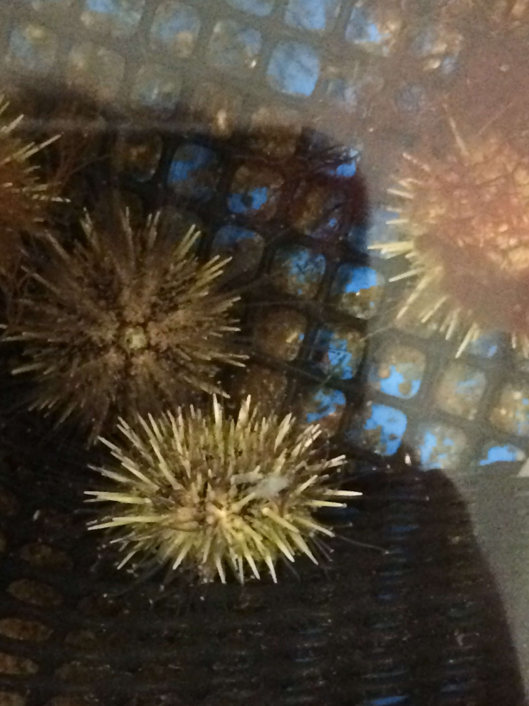
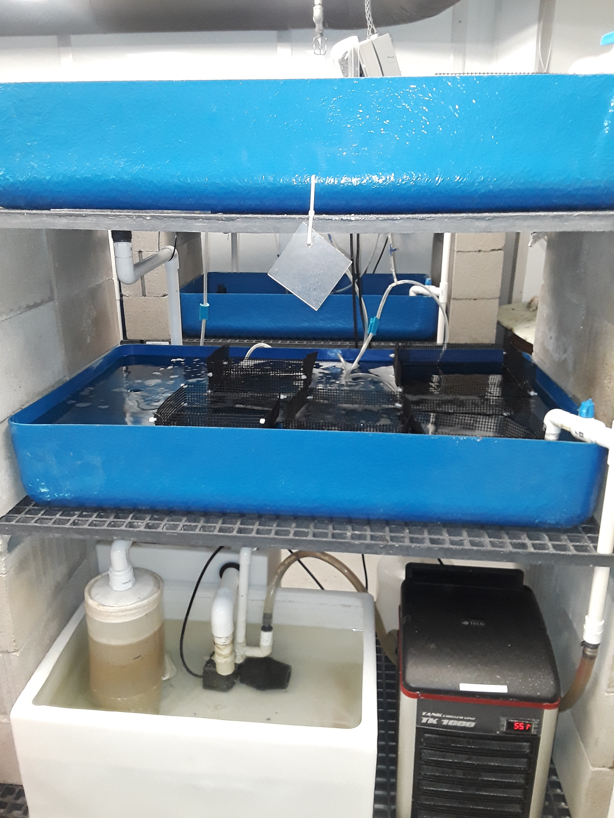
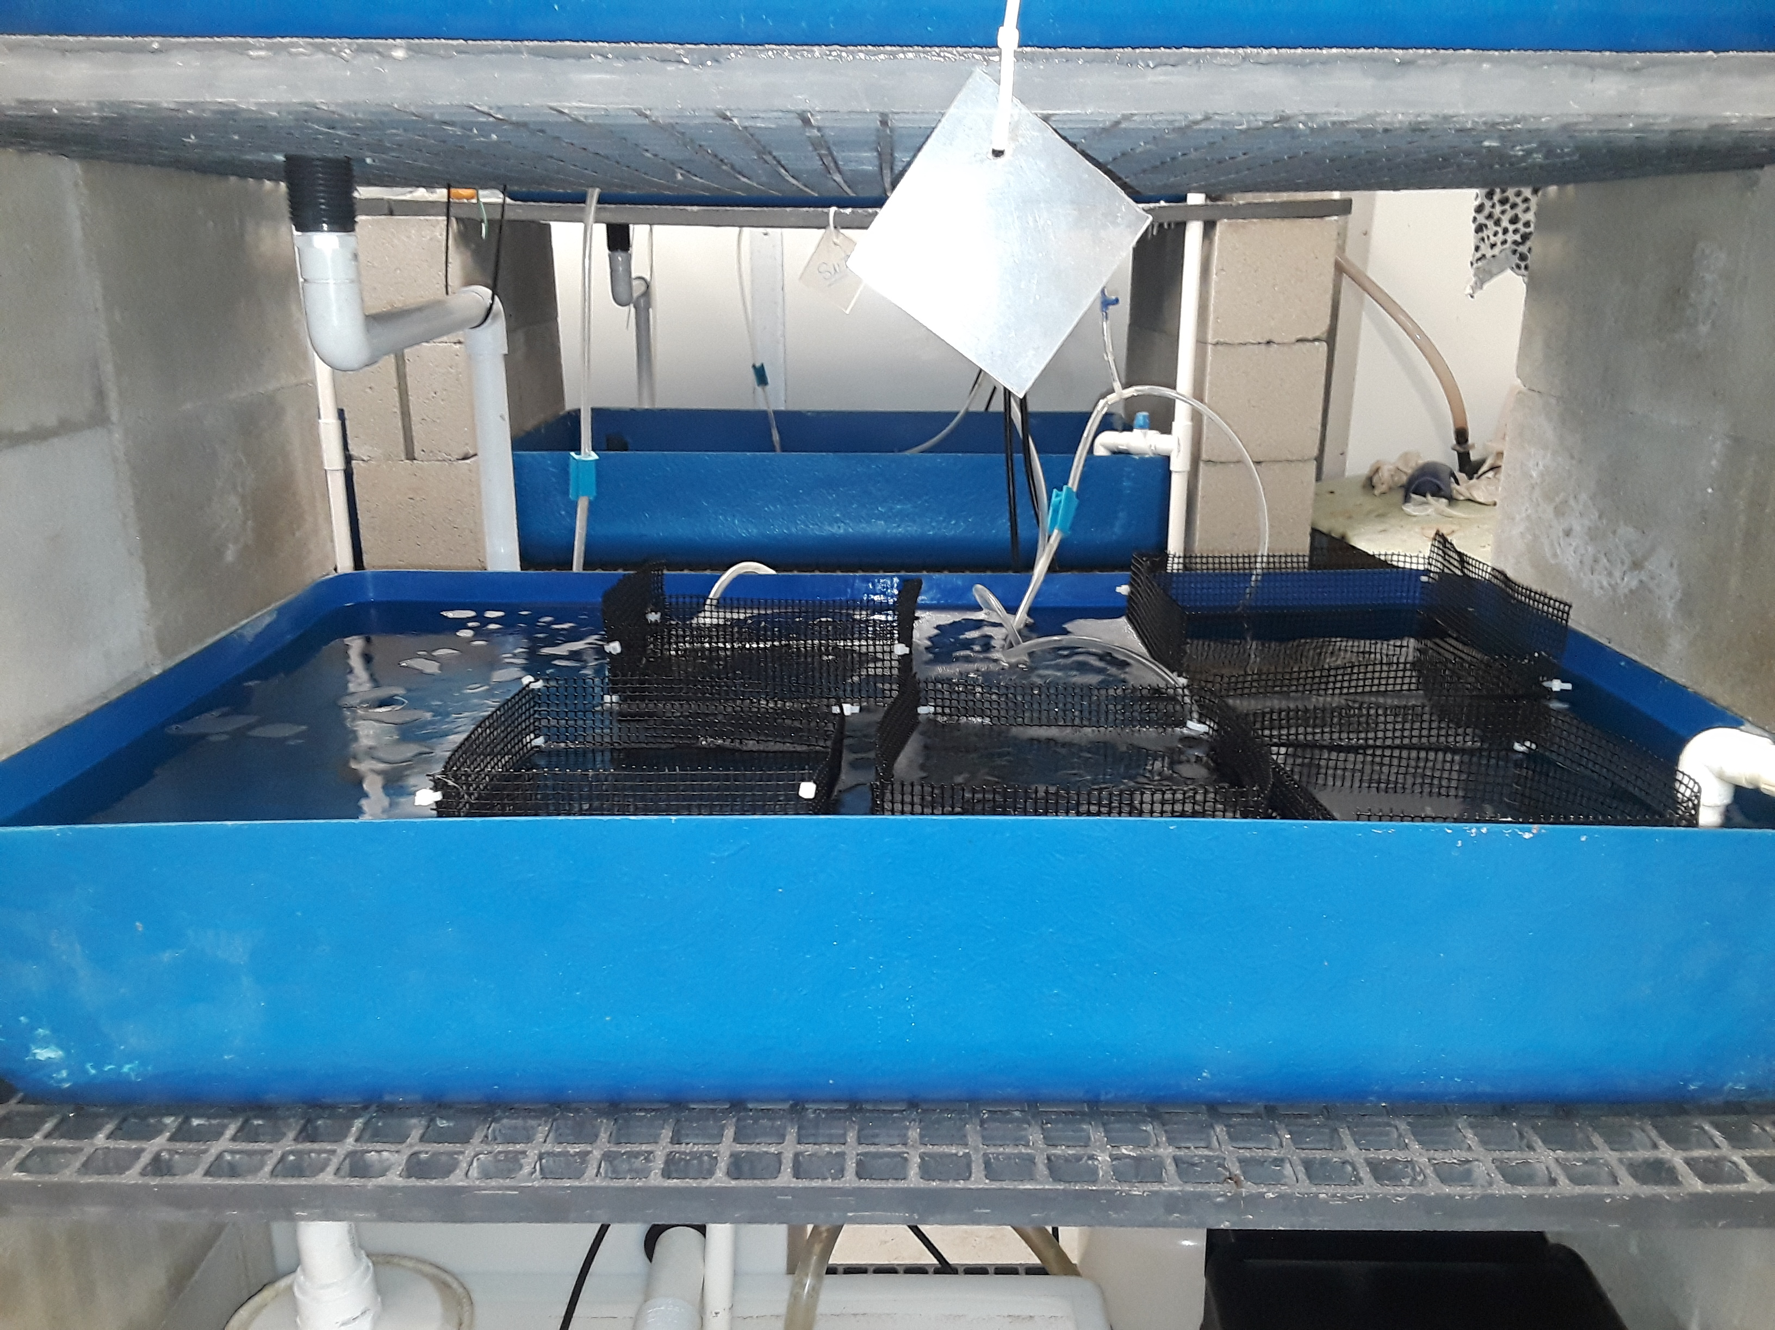
Green Sea Urchin Aquaculture
Project Lead: Tiffany Winter
Team: Sierra Moline, Matt Dean, Molly Erickson
Advisor: Dr. Larry Harris
Background
Methodology
Methodology Continued
Figure 1. S. droebachiensis Figure 2. S. droebachiensis juveniles
The green sea urchin (Strongylocentrotus droebachiensis) is used as source of food largely in Japan where they utilize the gonads to make a sushi known as uni^{[1]}
Due to this from 1987 to 1996 sea urchin harvesting production decreased by half (measured in millions of pounds)^{[2]}
Since then research into the life history of S. droebachiensis has been of increased interest in order to ascertain ways of including it in aquaculture
Figure 3. The water system
Fall Semester: Dietary Studies
The 156 juveniles were divided into 3 groups determined by measuring the test with a caliper
        Small: 0.5cm-1.0cm
        Medium 1: 1.1cm-1.6cm
        Medium 2: 1.1cm-1.6cm
        Large: 1.7cm-2.5cm
The medium was split into 2 groups due to the shear abundance of them over the small and large groups
These 4 groups will then be further (randomly) divided amongst 12 cages with approximately 12 juveniles per cage
Each of the 4 groups will receive 1 of the 4 macroalgae
        Samll: Dasysiphonia
        Medium 1: Kelp
        Medium 2: Kelp with Membranipora
        Large: Gracilaria
The 2 medium groups are receiving the kelp variations to allow for a further study to be carried out on whether the omnivorous diet is more nutritious and allows for better growth rates than the herbivorous diet
The growth over time will be tracked by first measuring the individuals as they are randomly sorted to calculate the mean of that cage and then individuals will be measured every 2 weeks to track the mean of each of the 12 cages
The study will run until approximately12/19 to allow for 5 sets of data to be collected
Figure 4. Six cages will be
kept in each bin
Spring Semester: Various Studies
All studies below are open to developments as new information is ascertained from the current undergoing studies
Growth (developmental) Study- spawning will be carried out in January to track development from larval stage to juvenile stage
Behavioral Study- studying reactions to different food types by exposing but not feeding the urchins a certain type of food
Density Study- studying the population densities at which individuals can live at before individuals and/or the population starts to suffer
More potential study ideas to arise
References
Hagen NT. 1996. Echinoculture: from fishery enhancement to closed cycle cultivation. World Aquaculture. 27(4):7.
Williams CT, Harris LG. Growth of juvenile green sea urchins on natural and artificial diets. University of New Hampshire Sea Grant Program, Durham, NH.
Nestler EC, Harris LG. The importance of omnivory in Strongylocentrotus droebachiensis (Müller) in the Gulf of Maine. University of New Hampshire Undergraduate Research Opportunities Program, Durham, NH.
Introduction
This study is looking into multiple parts of the life history of S. droebachiensis to ascertain more information about the organism which would assist in incorporating them into aquaculture
During the Fall semester the study is going to focus on diet by using four different macroalgae to determine which one appears to be the most nutritious by measuring growth over time in juveniles
      Kelp: a known food source
      Kelp with Membranipora: there are some studies that suggest an omnivorous diet provides better growth rates^{[2,3]}
      Dasysiphonia: a known invasive species of seaweed
      Gracilaria: a known invasive species of seaweed
156 juvenile urchins ranging from .7cm to 2.5cm were collected for the dietary study
During the Spring the dietary information learned in the Fall will be used in potential density, growth, and behavioral studies
Acknowledgements
The research team would like to give our deepest thanks to Dr. Larry Harris for his time and guidance thus far and continuing into the future of these studies. The processes we are learning of conducting research will no doubt be invaluable no matter what scientific career each of us pursues.
We would also like to thank Sea Grant for the funding which is making our research possible and allowing us to further develop our researching skills in a way that will contribute to the scientific community.

