Slide 1


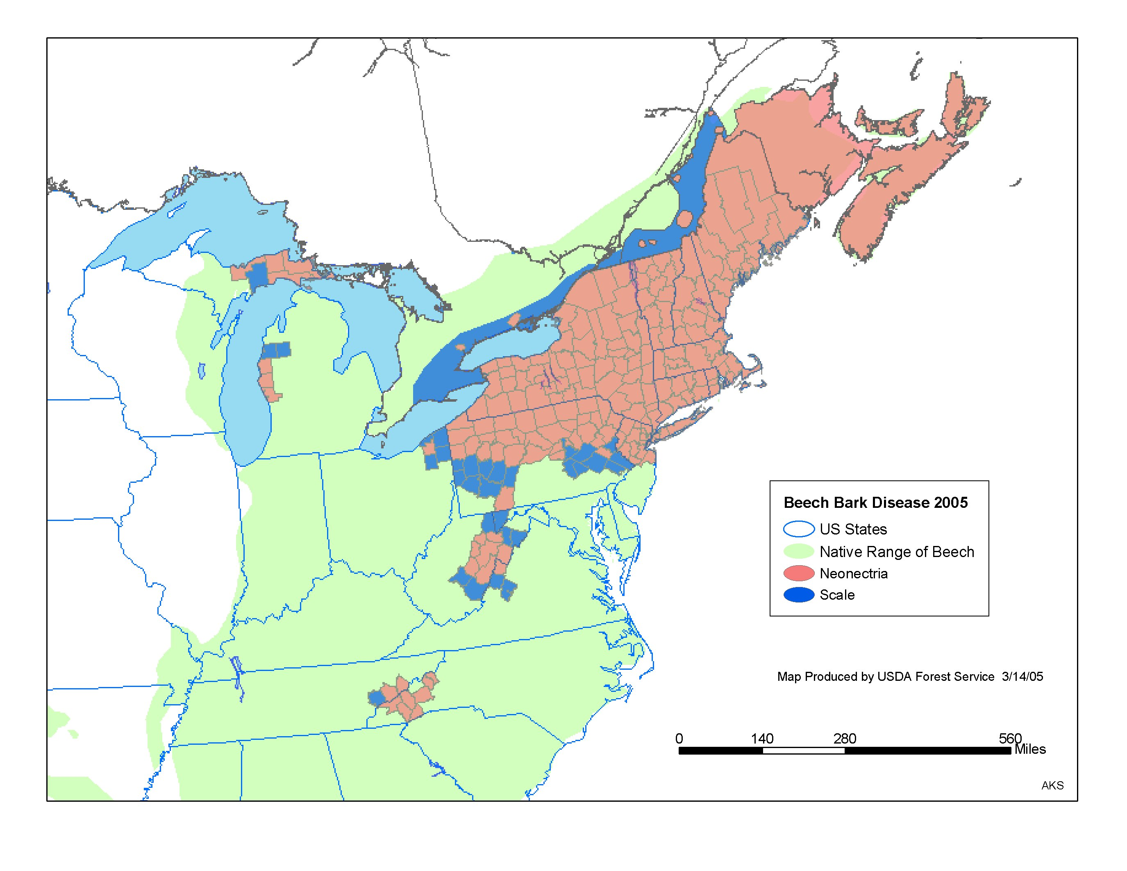
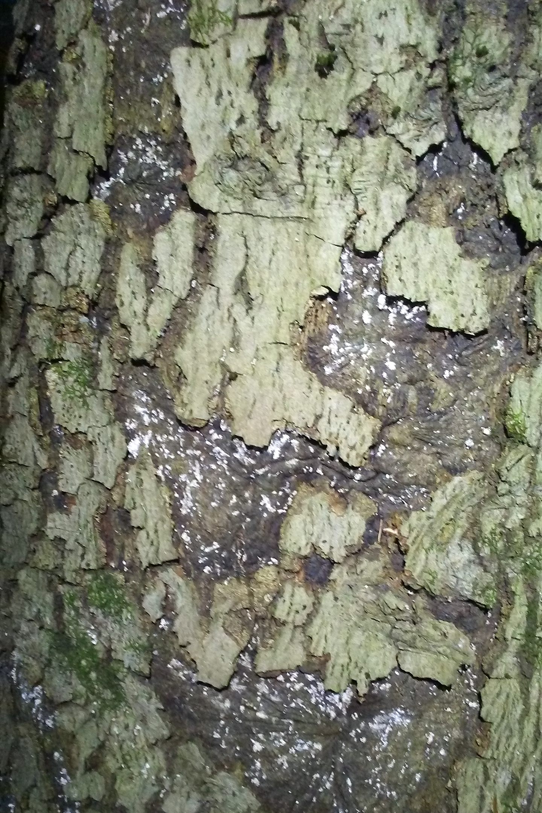
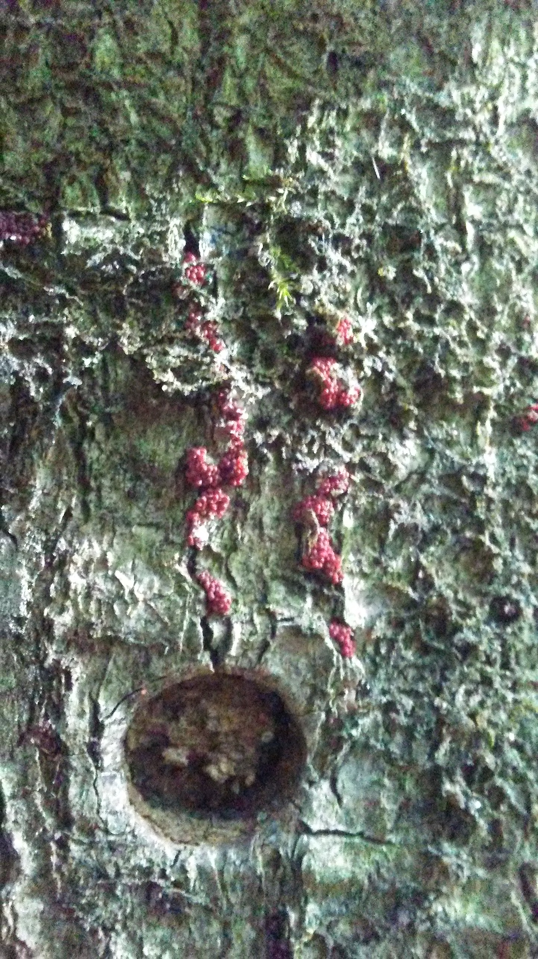
Population genetics and community ecology of beech bark disease complex
Eric W. Morrison, Jeremy Heath, Jeff R. Garnas
Department of Natural Resources, University of New Hampshire, Durham, NH 03824
For more information:
http://mypages.unh.edu/garnaslab or @jeffgarnas
Presenting authors:
eric.morrison@unh.edu; jeff.garnas@unh.edu
Background
Beech bark disease (BBD) is a widespread decline disease of American beech (Fagus grandifolia) arising from the interaction between a non-native scale insect (Cryptococcus fagisuga) and one of 2-3 ascomycete fungi (primarily Neonectria ditissima and N. faginata).
In the face of this exotic decline disease, beech has maintained or even increased its role as a dominant component of eastern forests, but now occurs in much smaller, denser stands due to strong recruitment and survival by beech despite increased mortality rates.
The less aggressive generalist, N. ditissima, has been reported as an early colonizer in the advancing front and infects non-beech hosts such as Betula lenta (black birch), while in aftermath forests the BBD-obligate fungus, N. faginata, may be dominant.
The overarching goal of this research is to develop the beech bark disease system as an emerging model for understanding pathogen-tree interactions and contemporary evolutionary change.
Objectives:
Examine patterns and consequences of co-occurrence among fungal BBD agents at multiple spatial scales and to determine the effects of spillover of N. ditissima (BBD-associate that causes target canker on a variety of hardwood hosts) on co-occurring species across the range of BBD.
Reconstruct population structure of N. faginata and N. ditissima across the range of BBD to determine rates of gene flow and local adaptation to host, climate, or local site conditions.
Proposed transects:
Approximate seed/bark
sampling locations:
Additional seed
source locations:
Fig. 1 Sampling of BBD populations across the current range of infection. BBD was introduced c. 1890 in southeastern Canada and has spread southwest. Longitudinal and latitudinal gradients were sampled in order to disentangle temporal effects of disease onset and effects of climate.
Fig. 2 Images of BBD infected bark. Trees were assessed for scale load and fruiting body load in infected stands.
Left panel: Cryptococcus fagisuga scale (white markings).
Right panel: Perithecia of N. faginata fungus (red bodies).
Fig. 3 NMDS ordinations of ITS2 barcoding data from bark fungal communities. Preliminary data were collected to assess ITS2 as a barcode for detection of N. faginata and N. ditissima.
Top panel: Bark plugs (points) were taken from three tree types. Both apparently healthy and diseased American beech and diseased black birch were sampled.
Bottom panel: Occurrence of N. ditissima and N. faginata in sampled bark. N. ditissima was detected in a single sample (red border). N. faginata was detected in symptomatic and asymptomatic beech.
Ongoing work and next steps
Cultures of N. faginata and N. ditissima are being isolated from across the range of BBD in order to generate a draft genome for N. faginata (MinION and Illumina HiSeq 2x250; N. ditissima draft genome currently available in Mycocosm) and to perform genome re-sequencing for population genetics analysis.
The ITS2 region is able to discriminate N. faginata and N. ditissima, however both of these species are convoluted with other Neonectria species on the basis of ITS similarity (>99% ITS2 sequence similarity). Prior to population genetic sequencing, sequencing of EF-1α and RPB2 genes from selected isolates will confirm species identify.
ITS2 metabarcoding will be performed across the range of BBD in order to examine frequency patterns of the primary fungal causative agents. In addition, disease state of infected trees was recorded and healthy trees were sampled in order to assess contribution of co-occurring fungal communities to disease severity and/or resistance to BBD infection.
beech
N. ditissima
detected

