Slide 1

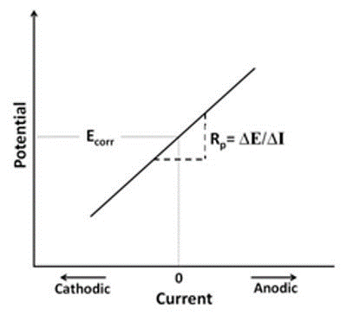
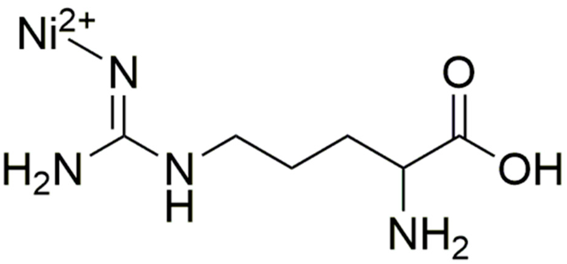
Investigation of the Sensing and Stability Characteristics of a Nickel (II) Oxide Film
Charlie Gasperoni, Christian Tooley, and Jeffrey M. Halpern
Background
Experimental Setup
Modification Technique
  Nickel was deposited on the electrode by sweeping the potential from -0.8V to 0V for 40 cycles in 2mM Ni(NO₃)₂
  The surface was then passivated by flowing 0.1 M NaOH and sweeping from 0V to 0.6V for 40 cycles
  Nickel oxide surfaces have known electrocatalytic properties¹
  Amino acids are common biomarkers of many diseases²
  The sensing capabilities of a Nickel (II) Oxide film was analyzed, as well as the electrochemical stability.
  Roushani, M., Shamsipur, M. & Pourmortazavi, S.M. (2012), J Appl Electrochem, 42: 1005.
  Woo, H. , Chun, M. , Yang, J. , Lim, S. , Kim, M. , Kim, S. , Myung, W. , Kim, D. and Lee, S. (2015), CNS Neurosci Ther, 21: 417-424.
Sensing experiments were done using a glassy carbon electrode in a standard 3 electrode flow cell
Stability experiments utilized an amorphous carbon electrode in a 3 electrode eQCM setup
Ag/AgCl was used as the reference electrode
Platinum was used as the counter electrode
  Primary Method used was Cyclic Voltammetry, a potential sweep in a cyclic manner
  Current response is measured and translated into a Cyclic Voltammogram
  Oxidation and Reduction activity is commonly perceived as peaks and waves in the graph
  Polarization Resistance is a non-destructive technique that can be used to calculate corrosion data
  By shifting the voltage from its resting potential and recording the current change, one obtains a Polarization Resistance Curve
  The corrosion rate can be extrapolated by fitting a tangent line to the point where zero external current is flowing, and then using the equation below.
CR = I_{corr *} K_{p} * μ_{eq} / ρ * A
CR: Corrosion Rate K_{p}: Constant (Defines Units)
I_{corr}: Corrosion Current μ_{eq}: Equivalent Weight (Atomic Weight / # of electrons transferred)
ρ: Density of material A: Area of sample
Sensing Method
Stability Method
Sensing
Stability
0.1 M NaOH used as Blank Sample
Blank 0.1 M NaOH Corrosion Rate: 2.026 x 10⁻³ mpy
Alanine
Serine
Alanine
Serine
Corrosion Rate: 1.960 x 10⁻³ mpy
Corrosion Rate: 2.088 x 10⁻³ mpy
Arginine
Valine
Arginine
Valine
Corrosion Rate: 3.354 x 10⁻³ mpy
Corrosion Rate: 2.035 x 10⁻³ mpy
Conclusions
    No clear trend of current versus concentration
    Interested in investigating the surface stability
Conclusions
    Corrosion of the metal oxide film could be being accelerated by arginine
    A Schiff-Base Complex is formed between NiO and Arginine, increasing the solubility of the metal
Acknowledgements: Thanks to the Department of Chemical Engineering at the University of New Hampshire, The Hamel Center for Undergraduate Research, The SEEDS Lab, NIH P20 GM 113131

