Slide 1

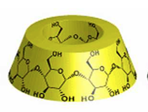
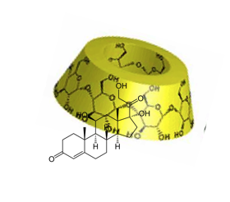
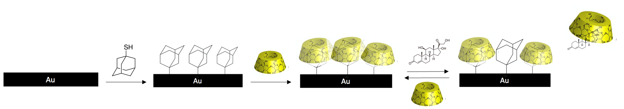


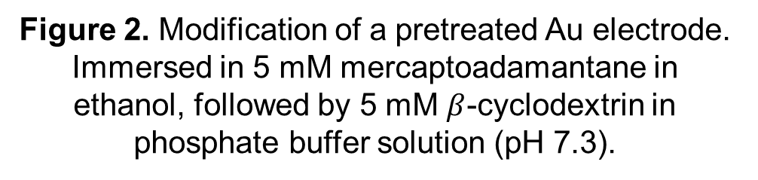
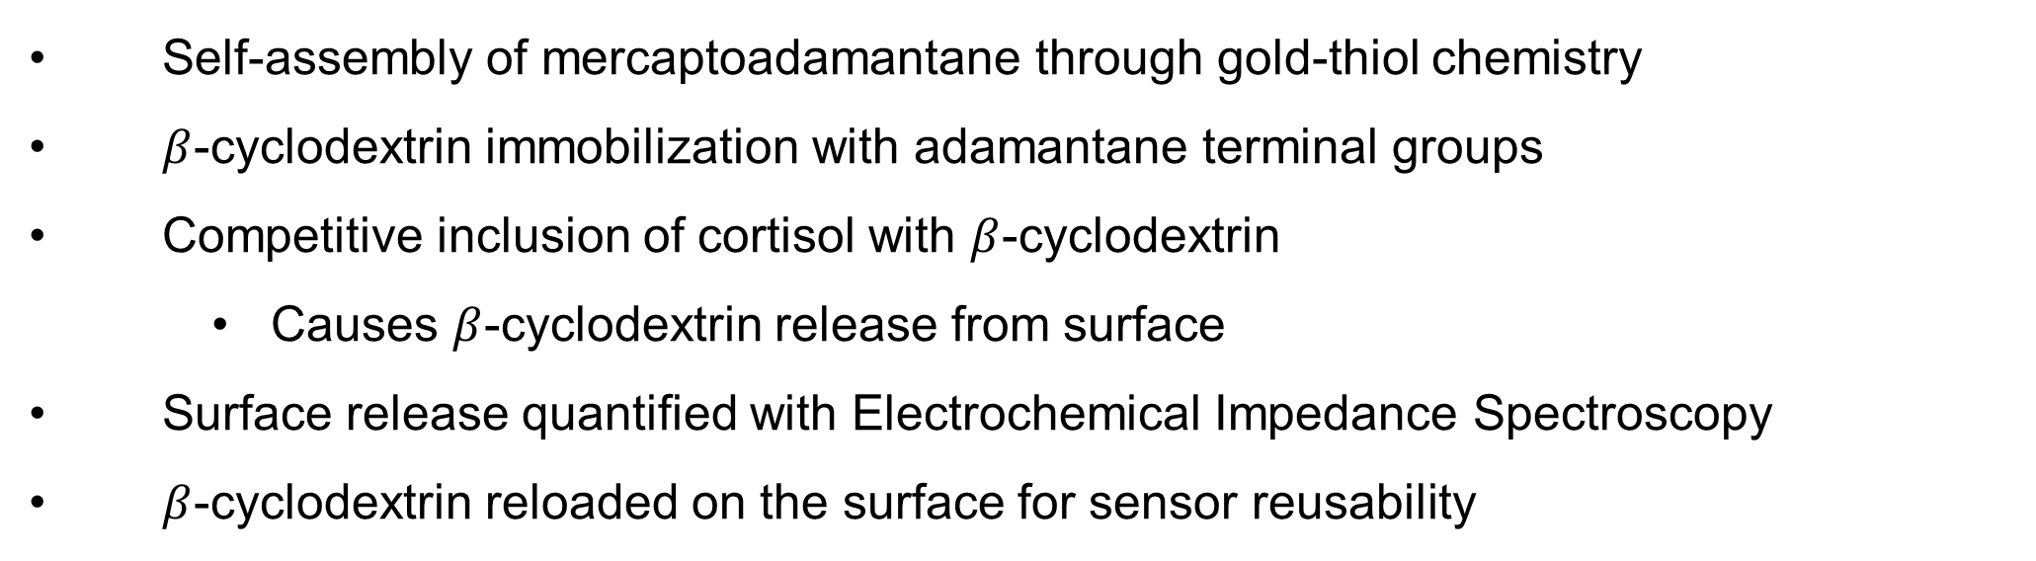
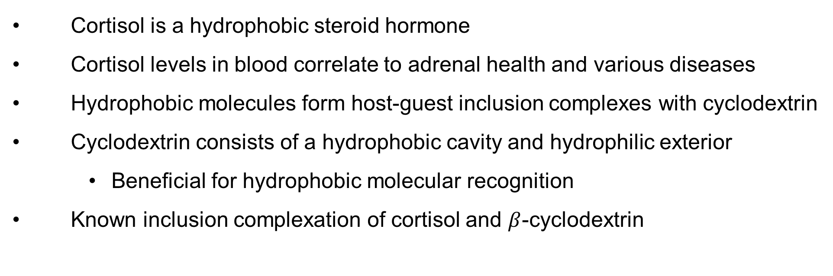
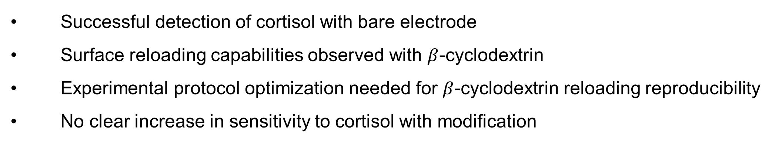
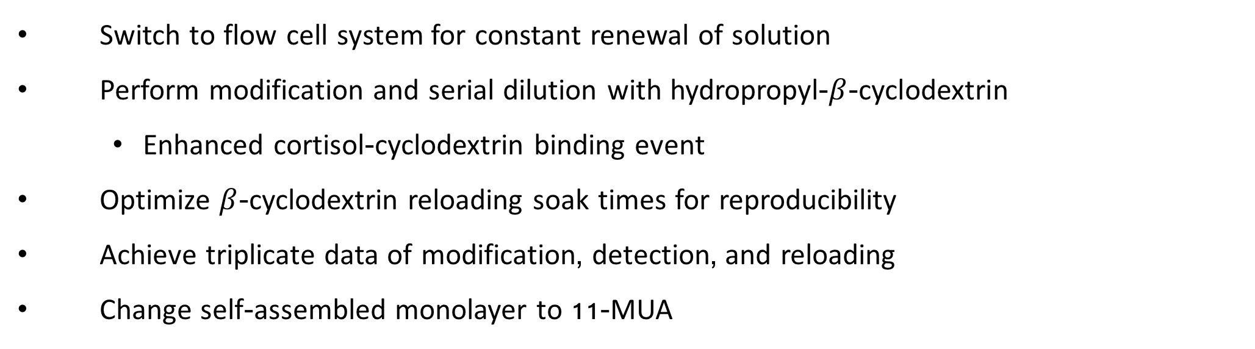

Development of a Cyclodextrin Immobilized Electrochemical Sensor
Mckenna Merrill and Jeffrey M. Halpern
Surface Enhanced Electrochemical Diagnostic Sensors (SEEDS) Laboratory
Department of Chemical Engineering, University of New Hampshire
s
Introduction
Modification and Sensing
Electrochemical Impedance Spectroscopy
Cortisol is a hydrophobic steroid hormone
Cortisol levels in blood correlate to adrenal health and various diseases
Hydrophobic molecules form host-guest inclusion complexes with cyclodextrin
Cyclodextrin consists of a hydrophobic cavity and hydrophilic exterior
  Beneficial for hydrophobic molecular recognition
Known inclusion complexation of cortisol and $β$-cyclodextrin
Self-assembly of mercaptoadamantane through gold-thiol chemistry
$β$-cyclodextrin immobilization with adamantane terminal groups
Competitive inclusion of cortisol with $β$-cyclodextrin
  Causes $β$-cyclodextrin release from surface
Surface release quantified with Electrochemical Impedance Spectroscopy
$β$-cyclodextrin reloaded on the surface for sensor reusability
Performed in a three electrode system
Application of an alternating current potential
Redox couple: 5mM Fe(CN)₆^{3-/4-}
Component of interest:
  R_{CT}: Resistance to the flow of electrons at the working electrode’s interface
  Quantified through analysis of Nyquist plot
  Randle’s Equivalent circuit components
R_{CT}: Charge transfer resistance
Z_{w}: Warburg impedance
R_{s}: Solution resistance
C_{dl}: Double layer capacitance
Randles Equivalent Circuit
Nyquist Plot
Cortisol
$β$-cyclodextrin
Inclusion complex
Patent pending
Cortisol Detection with Bare Au
AD-$β$-CD Modification
Cortisol Detection with AD-$β$-CD Modification
Figure 1. Cortisol serial dilution conducted in phosphate buffer solution (pH 7.3) with a polished electrode treated with oxygen plasma. Faraday measurements conducted separately in 5mM Fe(CN)₆^{3-/4-}.
Figure 2. Modification of a pretreated Au electrode. Immersed in 5 mM mercaptoadamantane in ethanol, followed by 5 mM $β$-cyclodextrin in phosphate buffer solution (pH 7.3).
Figure 3. Cyclic voltammogram of modification progression. Performed with a scan rate of 100 mV/s.
Figure 5. Cortisol serial dilution conducted with modified surface in phosphate buffer solution (pH 7.3) with modified surface. Faraday measurements conducted separately in 5mM Fe(CN)₆^{3-/4-}.
Cortisol Concentration (nM) | Rct (kOhms) | Rct – Rct₀ (KOhms)
0 | 20.53 | 0
2.5 | 38.5 | 18
5 | 51.58 | 31.1
10 | 54.09 | 33.56
20 | 65.04 | 44.51
40 | 73.23 | 52.7
80 | 77.72 | 57.19
160 | 81.93 | 61.4
300 | 84.78 | 64.25
500 | 87.87 | 67.34
700 | 88.36 | 67.83
Cortisol Concentration (nM) | Rct (kOhms) | Rct – Rct₀ (kOhms)
0 | 669 | 0
2.5 | 884 | 215
5 | 945 | 276
10 | 855 | 186
20 | 965 | 296
40 | 1120 | 449
80 | 904 | 235
160 | 926 | 257
300 | 883 | 214
500 | 852 | 183
700 | 814 | 145
$β$-Cyclodextrin Reload
No clear trend in detection. Hypothesis: Inclusion reformation between the surface and $β$-cyclodextrin.
Conclusion
Future Work
Successful detection of cortisol with bare electrode
Surface reloading capabilities observed with $β$-cyclodextrin
Experimental protocol optimization needed for $β$-cyclodextrin reloading reproducibility
No clear increase in sensitivity to cortisol with modification
Switch to flow cell system for constant renewal of solution
Perform modification and serial dilution with hydropropyl-$β$-cyclodextrin
  Enhanced cortisol-cyclodextrin binding event
Optimize $β$-cyclodextrin reloading soak times for reproducibility
Achieve triplicate data of modification, detection, and reloading
Change self-assembled monolayer to 11-MUA
Figure 4. Reloading consists of immersing the adamantane-modified electrode in a 5 mM β-CD in PBS for 30 minutes followed by a 45 minute soak in 200-proof ethanol.
Acknowledgements
NIH P20 GM 113131, SEEDS laboratory, Dr. Jeffrey Halpern, Department of Chemical Engineering, Hamel Center for Undergraduate Research, College of Engineering and Physical Sciences
Notes:
Changes:
Cite figures under EIS
Change EIS maybe? Add bullet points, add concen. vs rct maybe?
Make calibration curve larger
Figure captions?? Make less confusing, add table
Talk about electrode pretreatment before nyquist plots
New panel for reloading?
Scale axes
Know oxygen plasma wattage

