Slide 1
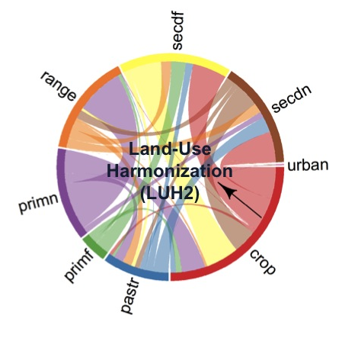
Enabling future Land-Use Harmonization scenarios
within the E3SM land model
Louise Parsons Chini, Katherine Calvin, Ritvik Sahajpal, George Hurtt
Background and Motivation
E3SM Land-Use Translator
Human land‐use and land‐use change are key drivers of change to the Earth’s carbon cycle and climate system. As a result, their accurate representation within Earth System Model (ESM) experiments is an increasingly important goal. The Land‐use Harmonization (LUH) connects historical land‐use reconstructions with future land‐use projections from Integrated Assessment Models (IAMs), attempts to preserve all future gridded changes depicted by the IAMs, computes associated land‐use transitions, and provides this data in a consistent format designed for use in ESMs. The 6th
Coupled Model Inter‐comparison Project
(CMIP6) recently made land‐use a required
forcing, and the LUH2 dataset was made
an entry card for participating in CMIP6
runs. Over the past two years, the LUH
team have enabled the LUH2 historical
data for the years 1850‐2015 to be used
within E3SM. We now turn our attention to
converting and enabling the use of the
LUH2 future scenarios in E3SM, specifically
the LUH2 SSP5 RCP8.5 scenario.
The converted LUH2 future scenario is
then used as an input to the E3SM
Land-Use Translator (LUT) in offline mode
to translate the five land-use states into
16 land cover types. The final states of the
historical period are used as an initial
condition in this process so that states
transition continuously from the historical
to future periods. The figure shows LUT
output (solid lines), LUH2 output (dotted
lines) and IAM output (dashed lines).
Global cropland area trends from LUT
compare very well with those in LUH2. Grassland also compares well with the LUH2 grazing land, despite definitional differences. Forest area definitions between the three models are also quite different, yet global trends also compare well.
Land-Use Harmonization Data
LUH2 improves upon LUH1 in multiple ways, including finer spatial resolution (0.25 x 0.25 degrees), earlier model start date (850 AD), additional land‐use states and transitions including multiple cropland and pasture types, improved spatial detail for wood harvesting and shifting cultivation (including constraining forest loss patterns with Landsat data), and new data layers of land management information such as irrigation and fertilizer usage (Hurtt et al. in prep).
The use of LUH2 data for E3SM involves conversion of
gridded land-use fractions to 0.5 x 0.5 degrees, and then
aggregation of the 12 LUH2 land-use types into the 5
land-use states of LUH1 (cropland, grazing land,
primary natural vegetation, secondary natural vegetation,
and urban land) annually, for the years 2015‐2100. The
annual wood harvest grids are also converted into
0.5 x 0.5 degree fractions of vegetation harvested from
primary forest, secondary mature forest, secondary
immature forest, primary non-forest, and secondary
non-forest.
Next Steps
Additional diagnostics will be run to ensure that the LUT output is consistent with the land-use changes from LUH2 and consistent with the underlying details of the original IAM scenario. Alternative land cover conversion choices for each land-use transition type will also be explored: for example, which land cover types should replace cropland and grazing land when those land-use categories are abandoned, and which land cover types should be removed when cropland and/or grazing land are expanded?
The LUT output will then be run through makesurfdat to generate a corresponding surface file for use in E3SM (along with converted wood harvest files). All methodology and algorithms will be documented within Confluence.
For additional information, contact:
Louise Chini
Research Assistant Professor
Department of Geographical Sciences
University of Maryland
(301) 405-4050
lchini@umd.edu
e3sm.org

