Slide 1
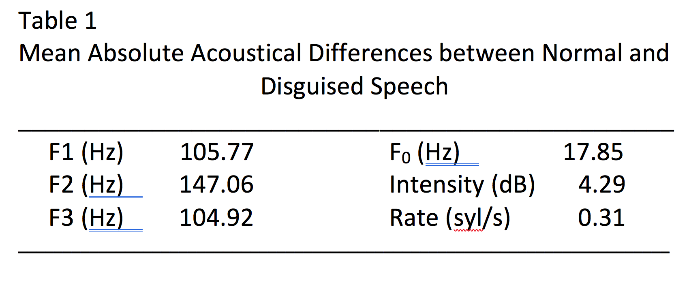
Acoustic Characteristics of Disguised Speech:
Speaker Strategies and Listener Mistake Patterns
Allan B. Smith, Nealy Mason, Molly Browne, and Brendan Sullivan
Introduction to Speaker Recognition and Disguise
Speaker recognition is defined as the identification of individuals based on characteristics of their speech (e.g., Cambier-Langeveld, 2007; Zetterholm, Sarwar, Thorvaldsson, & Allwood, 2012). One branch of speaker recognition is automatic speech recognition, which involves objective assessment of speaker identity using acoustic measures of speech. Automatic speaker recognition would have many useful purposes. In the field of speech forensics, cases such as harassment by telephone, extortion, and kidnapping sometimes involve audio-recordings of a defendant. Automatic recognition of a defendant’s speech might lead to conviction. Moreover, the same technology could support acquittal by showing acoustic differences between a defendant’s speech and speech in a recorded sample submitted as evidence.
One of the major challenges for speaker recognition is that people can disguise their voice to conceal their identity (Amin, 2013; Dilda & Hollien, 2015; Künzel, 2000). While people can disguise their speech with external devices such as computer applications, or by speaking through a cloth or into a jar (Clark & Foulkes, 2007; Wu, 2014), physiological adjustments may be used to change speech without any external objects or computer applications. For example, whispering, pitch-changing, nose-pinching, faking an accent, and mumbling all change speech output (Bartle, & Dellwo, 2015; Dilda & Hollien, 2015). This type of disguising the voice is the focus of the present study.
Purpose of the Study
Past studies of forensic speech disguise have focused on how speakers can be correctly identified (e.g., Cambier-Langeveld, 2007; Dilda & Hollien, 2015). However, little is known about (1) how people choose to disguise their speech, and (2) how listeners match, even if inaccurately, natural speech to disguised speech. Knowing more about these factors would provide a fuller understanding of disguised speech and the challenges it presents for automatic recognition.
Research Questions
1. How accurate are listeners in matching a speaker’s disguised and true speech?
2. How do speakers change their speech when they disguise it?
3. When listeners match speakers correctly, which acoustic characteristics correspond with the match?
4. When listeners match speakers incorrectly, which acoustic characteristics correspond with the match?
Method
Participants
Speakers were 13 women, age 18-25.
Listeners were a different group of 5 participants.
Procedures
Speaking task: Participants read the first paragraph of the rainbow passage in their normal voice. Then they read the paragraph again while speaking in a manner that would make their identity difficult for listeners to recognize.
Acoustic analyses: All 26 recordings (13 normal, 13 disguised) were analyzed with CSL for mean F1, F2, F3, F₀, intensity, and speaking rate.
Listening task: Listeners were presented 26 audio file icons shown on a computer screen (13 icons labelled as normal; 13 labelled as disguised) in random order. Participants listened and attempted to match them by speaker.
Results and Discussion
Research Question 1. Speakers were correctly matched by listeners in only 28.8% of attempts. Individual listeners ranged from 15.4% to 38.5% accuracy.
Research Question 2: While individual speakers clearly changed acoustic characteristics of their voices, the direction of change differed among individuals, obscuring group differences. Therefore, the absolute within-speaker change between normal and disguised conditions was calculated (Table 1). Changes to disguised speech were comparable across formants, but when calculated as % of frequency change, F3 remained very stable. Additionally, the correlation between normal and disguised conditions was strongest for F3 among the acoustic variables (r = .82, p < .01). Changes to mean F₀ and intensity were also minimal (Table 1) , with moderately strong correlations in true matches (Figure 1).
Research Question 3. Listeners’ correct matches showed high correlations for speaking rate (r = .89, p < .01) and for intensity (r = .83, p < .01). In contrast, F2 changed the most between normal and disguised conditions (r = .35, n.s.).
Research Question 4. Listeners’ incorrect matches were most strongly correlated with F2, suggesting that this aspect of the acoustic signal may have misguided listeners’ decisions. Moreover, recall that F2 was not a very dependable indication of true matches, so reliance on F2 could not lead to many correct identifications. In contrast, incorrect matches were not strongly related to F3, which was more promising as an identifier because it changed very little in true matches.
These results suggest that the acoustic variables speakers alter when disguising their voice differ from variables that listeners rely on when attempting to match recordings from the same individual. In particular, listeners’ incorrect matches were often similar in F2, which would not be a good identifier because speakers changed F2 substantially. Conversely, F3 was a promising identifier of true matches because speakers changed F3 very little, and true matches showed strong correlations in F3. These findings may assist in (1) identifying individuals from recordings in which they have disguised their voice, and (2) recognizing when individuals have been incorrectly identified with the disguised voice of another individual.
References
Amin, T. B. (2013) Detecting voice disguise from speech variability: Analysis of three glottal and vocal tract measures. The Journal of the Acoustical Society of America 134, 4068.
Bartle, A. & Dellwo, V. (2015). Auditory speaker discrimination by forensic phoneticians and naive listeners in voiced and whispered speech. The International Journal of Speech, Language and the Law, 22, 229-248.
Cambier-Langeveld, T. (2007). Current methods in forensic speaker identification: Results of a collaborative exercise. The International Journal of Speech, Language and the Law, 14, 223-243.
Cao, W., H. Wang, Zhao, H., Q. Qian, Abdullahi, S. M. (2016). Identification of Electronic Disguised Voices in the Noisy Environment. International Workshop on Digital Watermarking, 75-87.
Clark, J. & Foulkes, P. (2007). Identification of voices in electronically disguised speech. The International Journal of Speech, Language and the Law, 14, 195-221.
Dilda, G. S., & Hollien, H. (2015). Vocal disguise and speaker identification. Proceedings of Meetings on Acoustics, Vol. 25.
Künzel, K. (2000). Effects of voice disguise on speaking fundamental frequency, Forensic Linguistics. 7, 149-79 (2000).
Wu et al. (2014). Identification of Electronic Disguised Voices. IEEE Transactions on Information Forensics and Security, 9, 489-500.
Zetterholm, E., Sarwar, F., Thorvaldsson, V. & Allwood, C.M. (2012). Earwitnesses: the effect of type of vocal differences on correct identification and confidence accuracy. The International Journal of Speech, Language and the Law, 19, 219-237.
Abstract
A group of 13 female participants were recorded in two conditions (1) speaking normally and (2) altering speech to conceal their identity (i.e., disguised speech). Participants were not instructed in how to disguise their voices because we were interested in which changes they would choose. Listeners were largely inaccurate in matching participants’ disguised speech to their normal speech. Changes in normal vs. disguised voices were highest in the second formant (F2), while the third formant (F3) remained fairly stable. When listeners made correct matches, the pairs were similar in speaking rate and F₀, as shown by significant correlations. Incorrectly-matched pairs showed the highest correlations for F2, suggesting that listeners may have been misled by this acoustic cue. Overall, F3 and speaking rate appeared to be useful acoustic indicators of identity when matching normal and disguised speech samples. Of those two variables, F3 was apparently underutilized by listeners in their attempts at matching.

