Slide 1
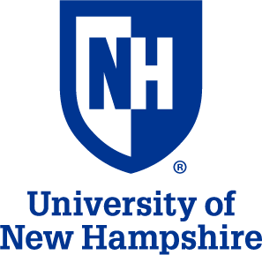
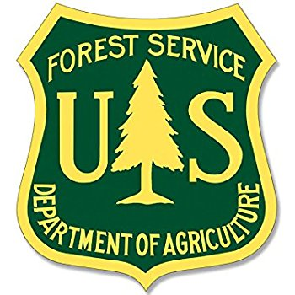
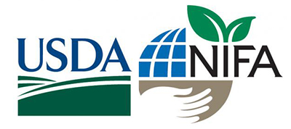
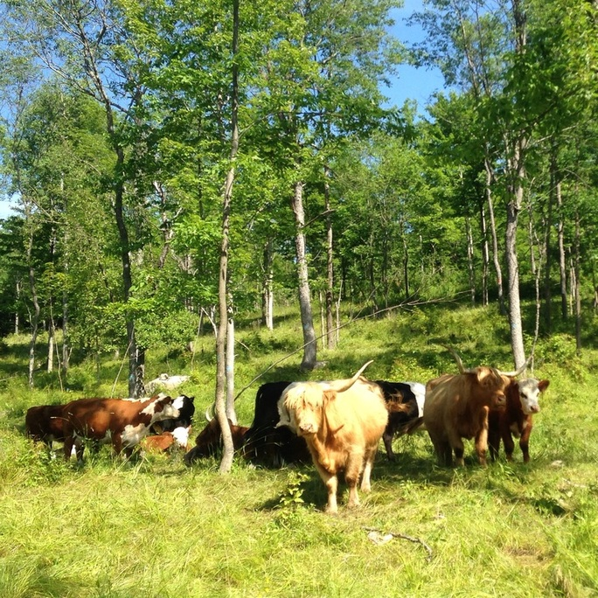
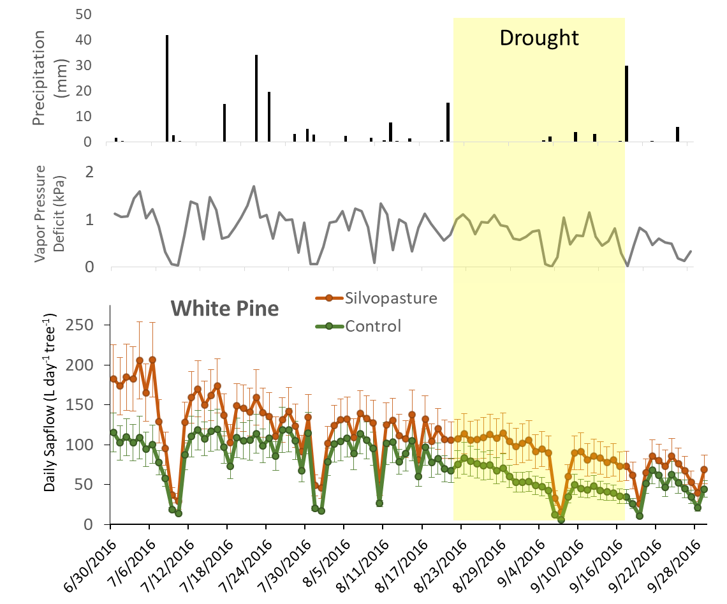
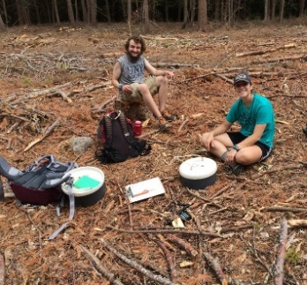
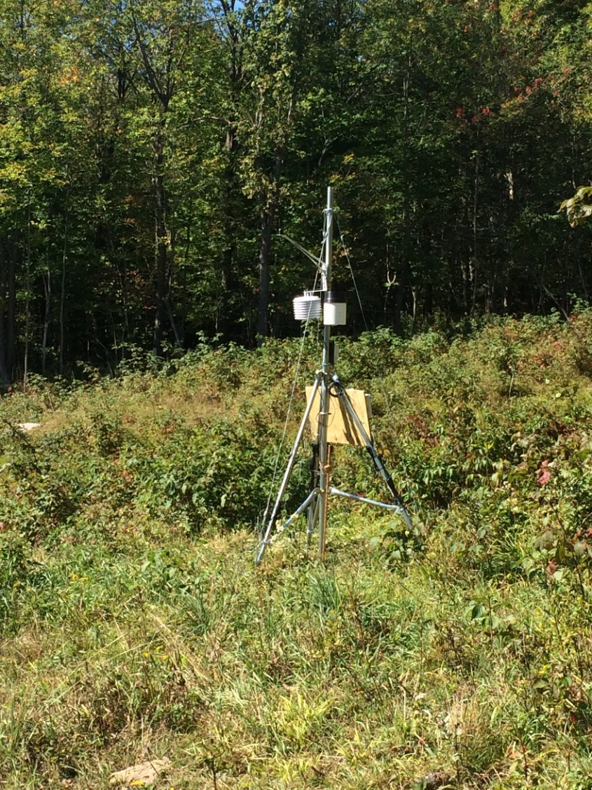
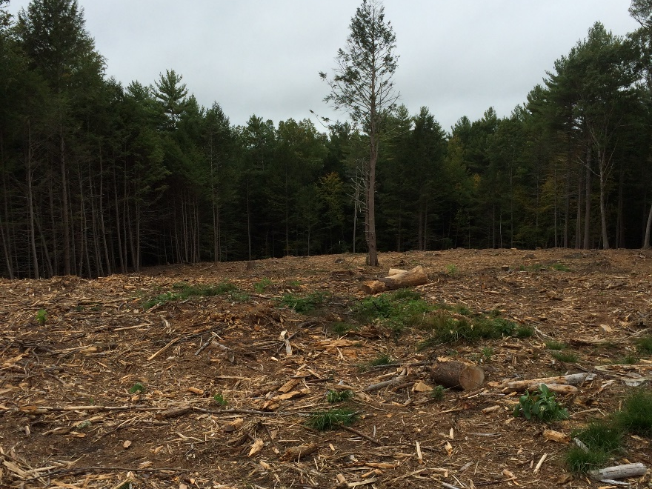
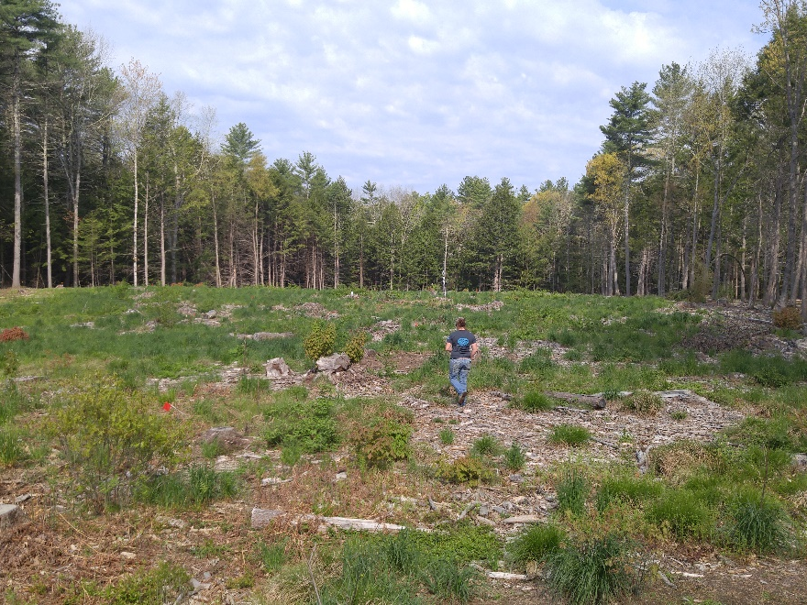
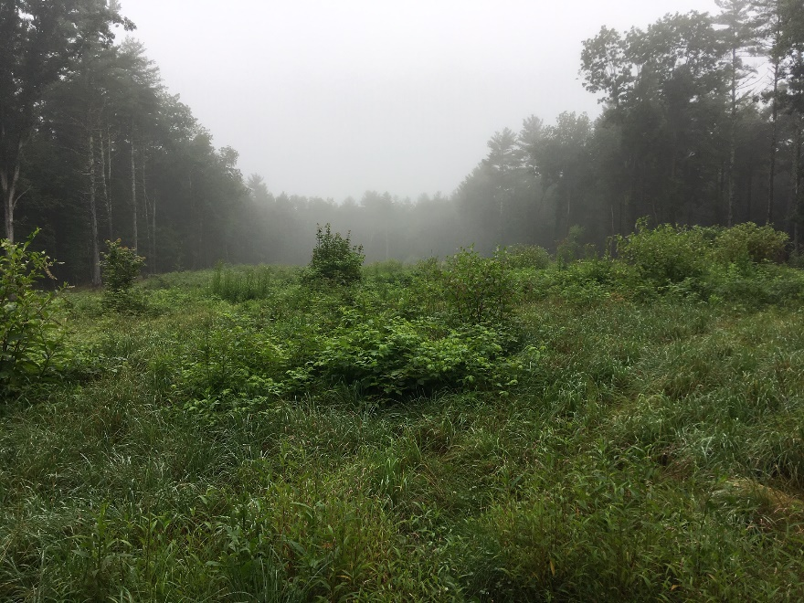
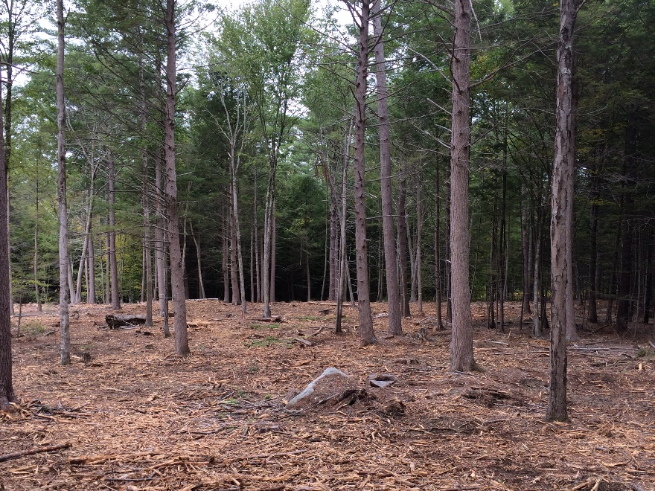
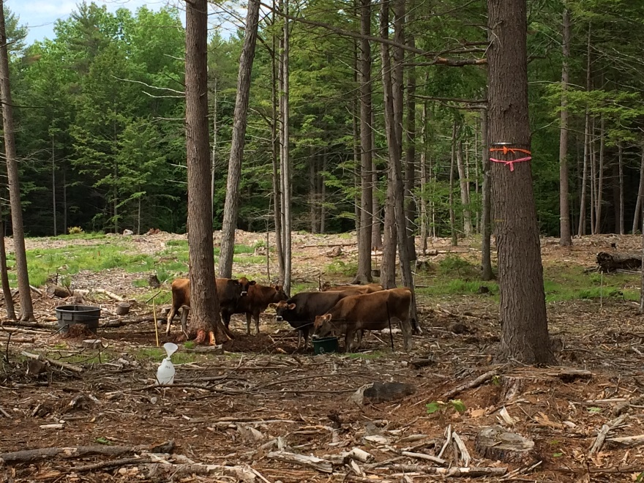
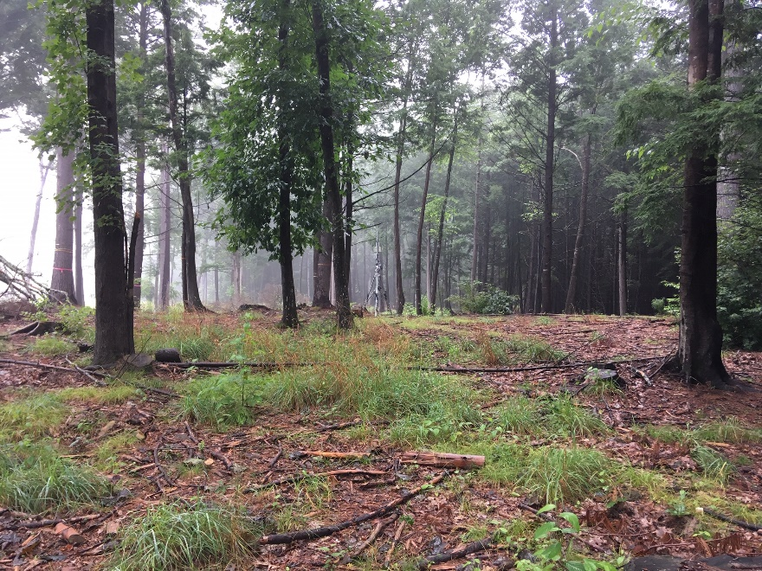
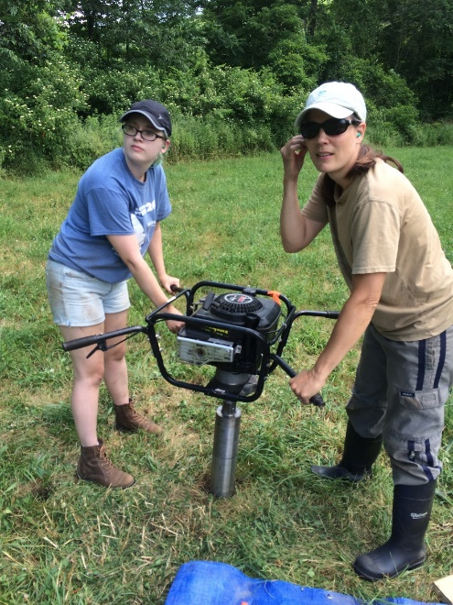
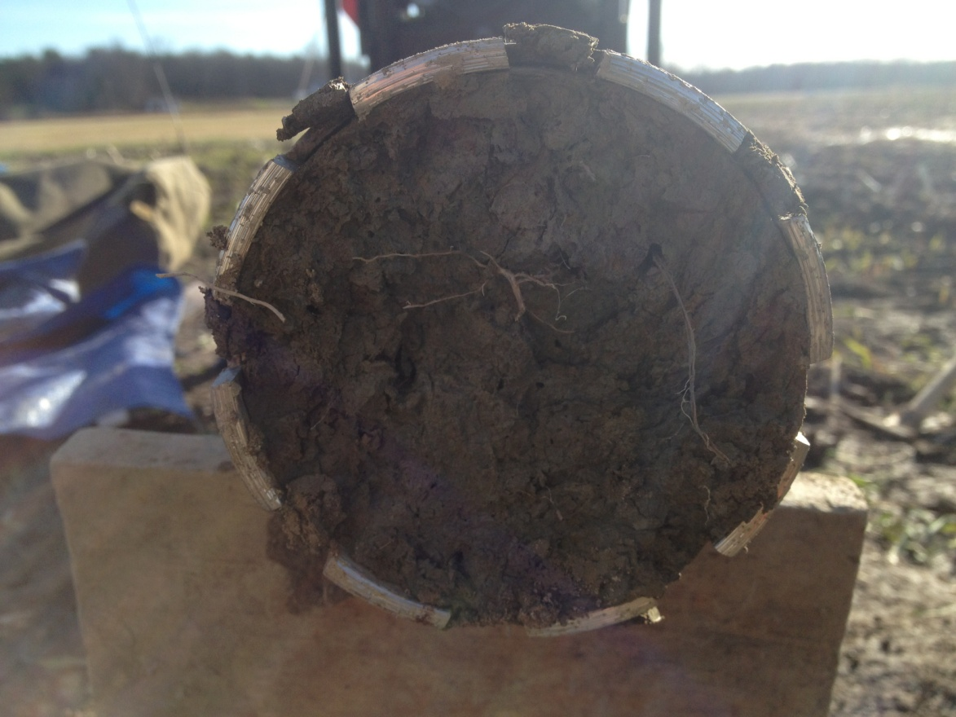
Getting from here to there: protecting and promoting ecosystem services during the conversion of forests to fields in New England
Alexandra Contosta¹, Richard Smith², Heidi Asbjornsen², Joseph Orefice³, Nathan Siegert⁴
¹Institute for the Study of Earth, Oceans and Space, University of New Hampshire, ²Department of Natural Resources and the Environment, University of New Hampshire, ³ Yale School of Forestry and Environmental Studies, Yale University, ⁴USDA Forest Service, Northeastern Area State and Private Forestry
New England farmers are clearing their forests to expand their agricultural land base.
Objective 2: Quantify changes in supporting, regulating, and provisioning ecosystem services
Conversion to silvopasture may reduce, maintain, or increase water regulating services
Conversion to silvopasture may mitigate losses in climate regulating services
Silvopasture is the deliberate integration and livestock, forages, and trees, and may offer an alternative.
Figure 5. Surface unsaturated and subsurface saturated hydraulic conductivity (K_{h} and K_{sat}) in forest, converted silvopasture, and converted open pasture (Stewart et al., in prep). Soil hydrology in silvopasture could be more similar to that of the forest or the converted open pasture depending on site and land use history.
We aim to determine: 1) how forest-to-agriculture conversion affects ecosystem services; and
2) if conversion to silvopasture can minimize these impacts.
Figure 1. Beef cattle
grazing in silvopasture
Figure 7. Fluxes were measured weekly using a static chamber technique.
Figure 4. Precipitation, vapor pressure deficit, and sapflow within forest and silvopasture plots at the UNH ODRF. Yellow shaded area shows a period of historic drought in 2016 (Coble et al., in prep). The silvopasture was not as susceptible to drought, which might be related to higher soil moisture.
Objective 1: Establish forest-to-field conversion plots at two sites in New England
Figure 6. Total seasonal fluxes of CO₂ and N₂O in reference forest, converted silvopasture, converted open pasture, and reference pasture (Contosta et al., in prep). Fluxes from silvopasture soils of both greenhouse gases tended to fall between those of forests and open pastures.
UNH ODRF
North Branch Farm
Figure 2 Location of plots at the UNH Organic Dairy Research Farm, Lee, NH, and North Branch Farm, Saranac, NY. Plots were established in 2015 at UNH and in 2012 at North Branch Farm.
North Branch Farm
UNH Organic Dairy Research Farm
Silvopasture may minimize changes in microclimate that result from land use conversion.
Figure 8. Soil temperature in converted silvopasture (thinned) more similar to reference forest than converted pasture (clear cut) and open pasture. Data collected continuously from weather stations (left).
Year 1
Year 2
Year 3
Wood Provisioning may be enhanced with silvopasture
Figure 9. Growth trends pre- and post-conversion show enhanced productivity in the silvopasture stand as compared to the intact forest, likely due to release from competition.
Future Directions. Ongoing research will determine how forest-to-agriculture conversion affects supporting ecosystem services such as soil nutrient cycling as well as regulating services such as soil carbon sequestration.
Figure 3. Second growth forest at the ODRF was either cleared for open pasture (top panels) or thinned for silvopasture (bottom panels). Cleared and thinned areas were seeded with perennial grasses.
Figure 10. Soil cores will be used to understand changes in soil quality.

