Slide 1
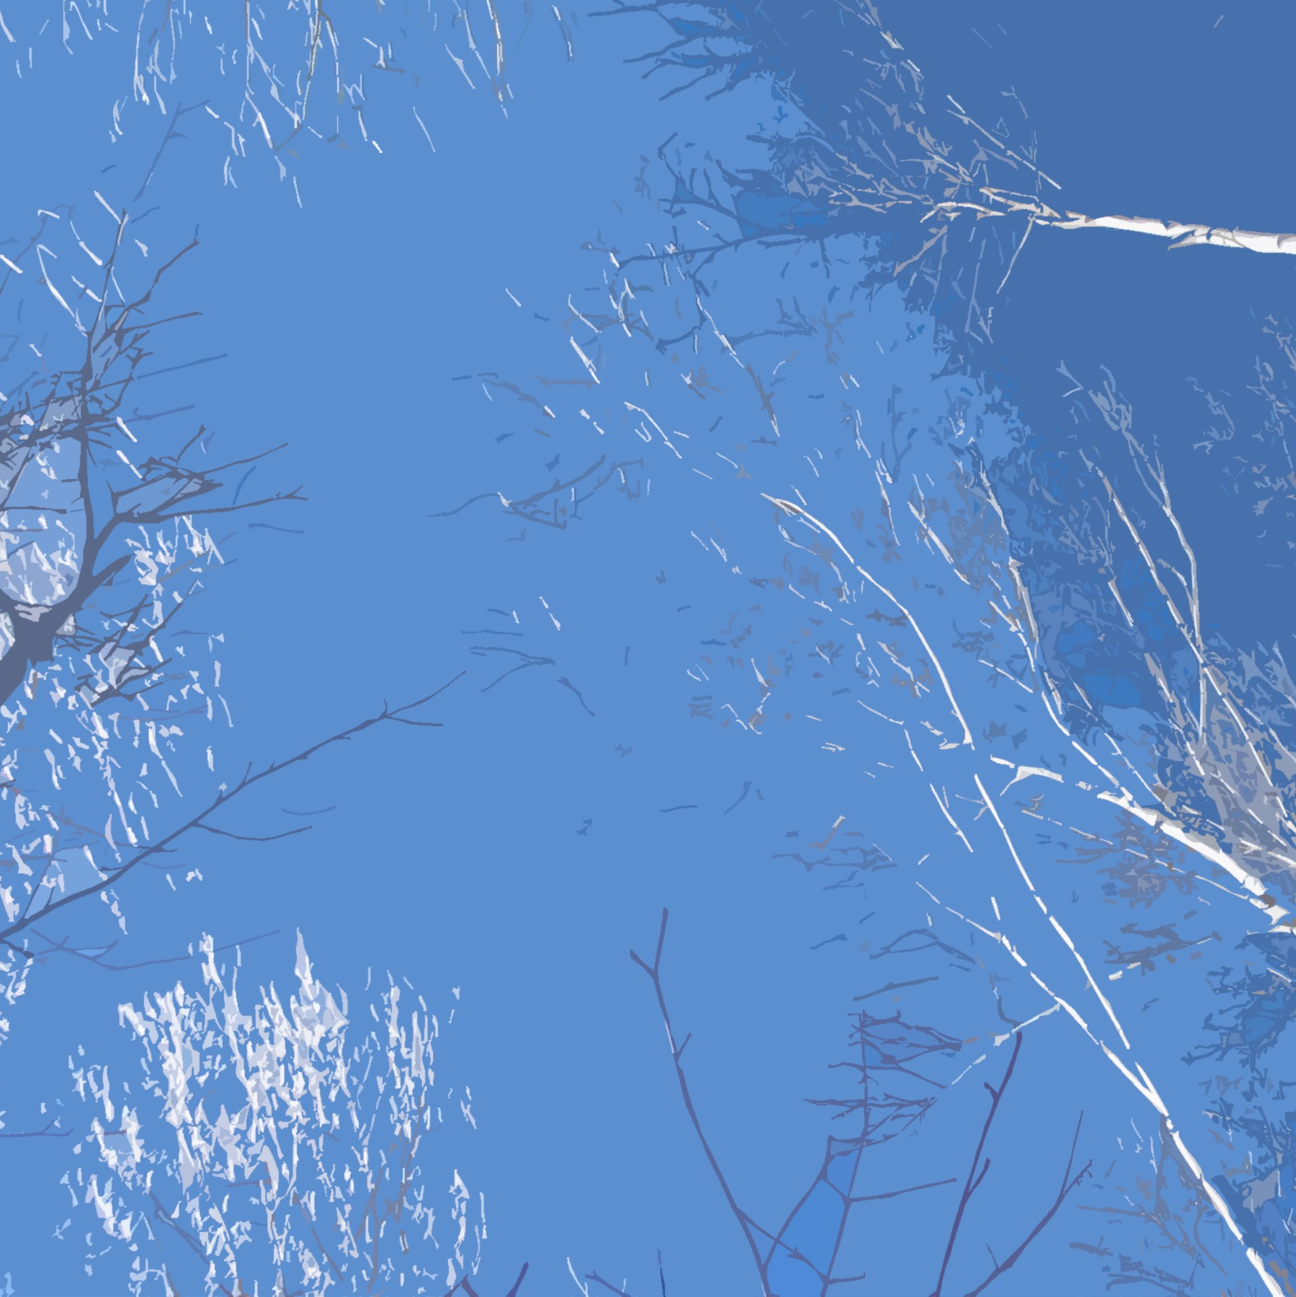
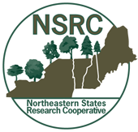
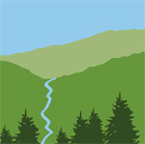
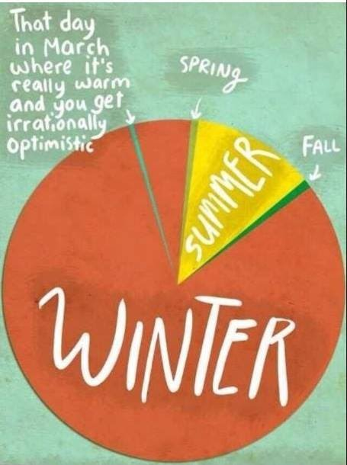
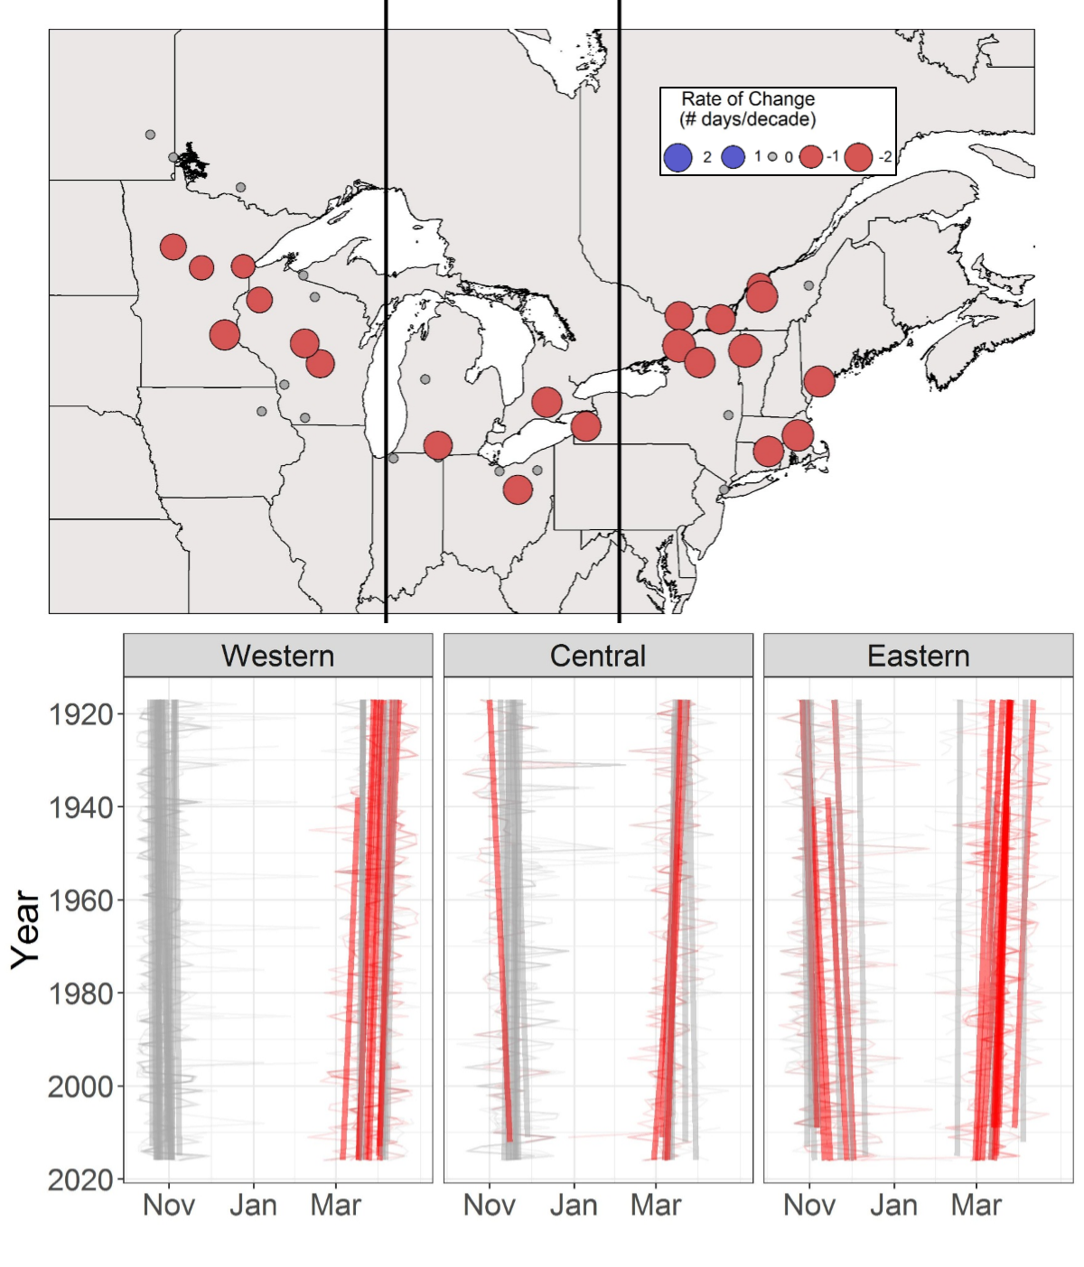
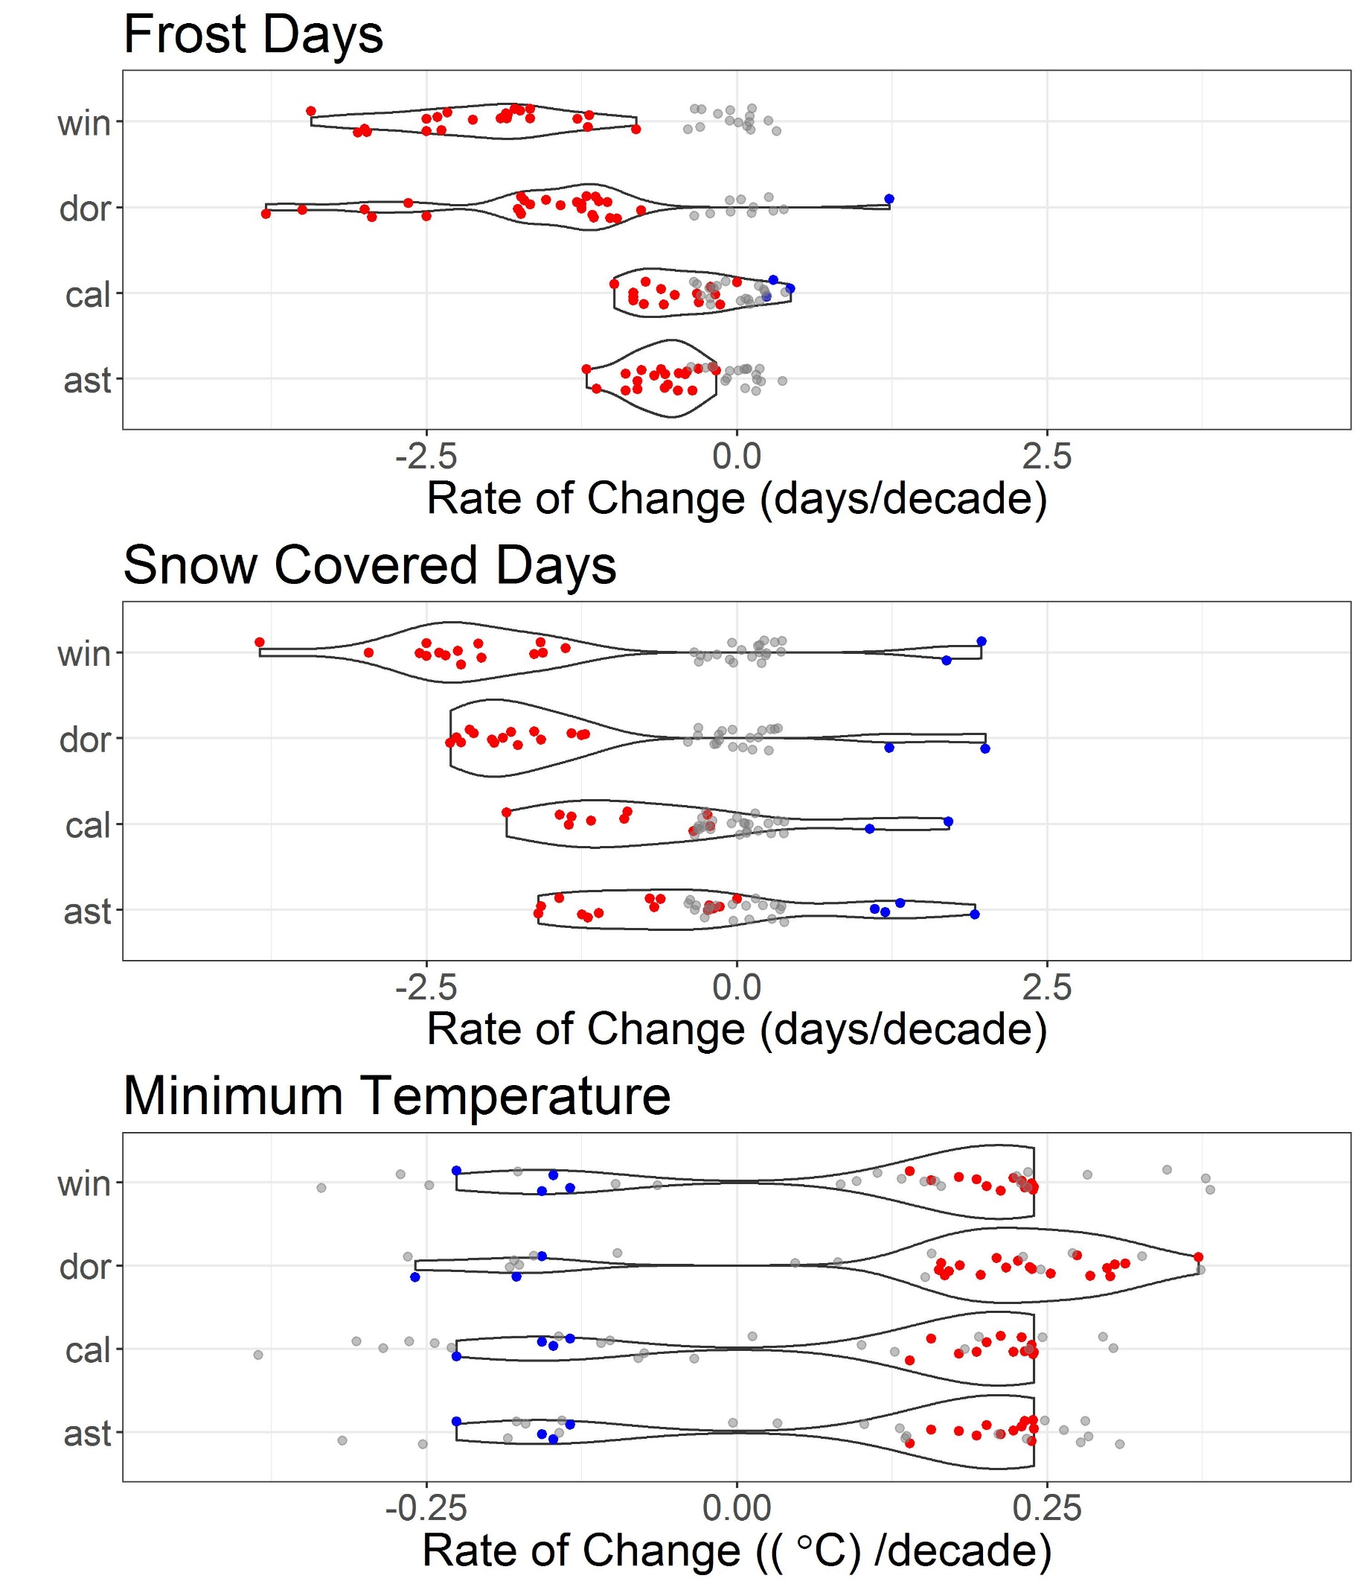
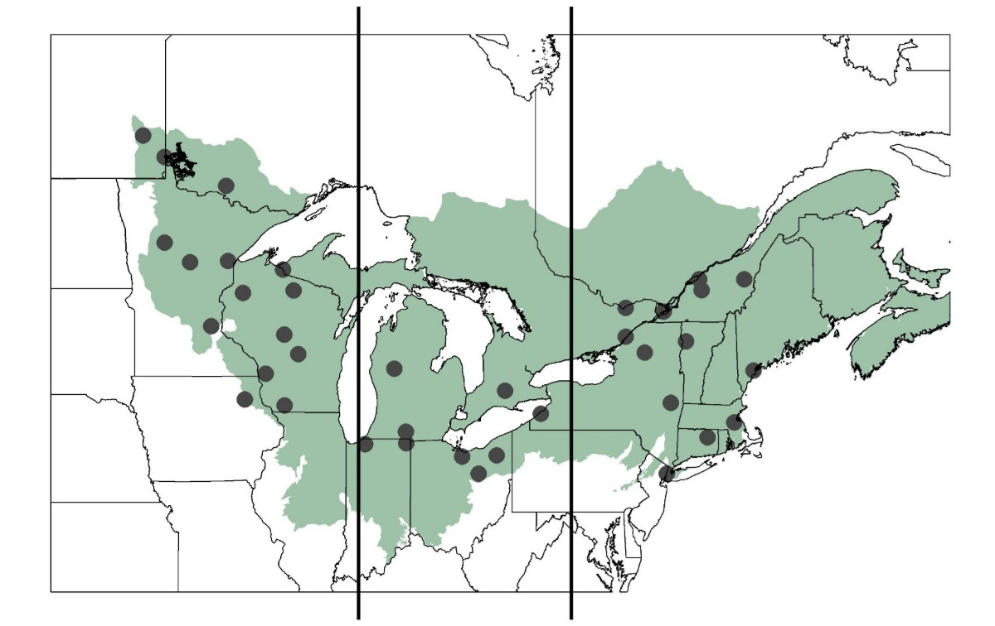
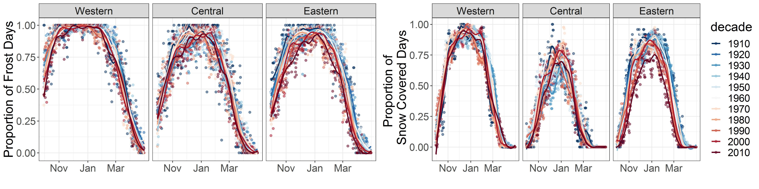
What is winter? A reckoning for seasonally snow-covered, social-ecological systems B33M-2848
Alexandra R. Contosta¹, Nora J. Casson², Sarah J. Nelson³ and Sarah Garlick⁴
¹ Earth Systems Research Center, University of New Hampshire, Durham, NH 03824, USA; ² Department of
Geography, University of Winnipeg, Winnipeg, MB, R3B 2E9, Canada; ³ School of Forest Resources, University
of Maine, Orono, ME 04469; ⁴ Hubbard Brook Research Foundation, North Woodstock, NH 03824, USA
What is Winter? Some Reckonings
Astronomical: winter solstice to vernal equinox
Meteorological: three coldest months of year (DJF)
Cultural: All Hallows to Candlemas, ski season
Ecological: hibernal period of biological dormancy
All of the Above?
Traditional reckonings that delineate seasons are out of sync with the social-ecological experience of weather in seasonally snow-covered areas and do not capture how winter might vary with climate change. We propose a new reckoning for “frigid” winters that can better represent what it means to lose the cold and the snow.
We define a frigid winter as a period of sustained low temperatures below freezing and snow accumulation that together regulate ecological processes and their services, both during winter and the rest of the year.
Results and Discussion
The rate at which winter conditions change depends on the reckoning you choose. Larger magnitudes of change during dormant season and frigid winter (Figure 4) show that shifts in winter conditions may not be captured in the scientific literature even if they are experienced by people and ecosystems.
The Cold, Snowy Season is Shortening. Trend analysis shows that frigid winters have become shorter, at a rate of -2 days per decade. This is largely due to an earlier spring onset, though some sites show later end to autumn (Figure 2).
Methods: We examined changes in frigid winter timing and duration across the Northern Forest of the U.S. and Canada (Figure 1) and determined how indicators of changing winter conditions vary among reckonings.
Figure 1. Stations within the Northern Forest divided into three geographic areas: west, central, and east.
Data Sources
National Climatic Data of Environment Canada and USHCN with ≥ 100 years of records
Daily temperature, total precipitation
Indicators
Timing: start, end
Duration: number of days
Condition: frost and snow-covered days
Trend Analysis: Mann Kendall and Sen slope
Figure 2. (a) Rates of change (days per decade) in frigid winter duration defined by daily air temperature. Red dots = significant decreases; gray dots = no change. (b) Onset and end of frigid winter from 1917 to 2016. Faint background lines are time series for each site. Straight foreground lines are trends in winter start and end. Red lines = later onset (autumn) and earlier end (spring); gray lines = lack of significant change.
Figure 4. Violin plots of distributions of rates of change in: (a) number of Frost Days; (b) Snow Covered Days; and (c) daily minimum temperature each of four reckonings: dormant season (dor), frigid winter (win), astronomical (ast), and meteorological (met).
Winters are becoming more discontinuous. Even within frigid winter, temperatures below 0°C and sustained snow cover have become more intermittent (Figure 3).
Figure 3. Proportion of sites meeting winter condition criteria for each day of the dormant season (November 1 – May 31) over the entire measurement record (1917–2016). Lines are LOESS curves for each decade. (a) sites with Frost Days (daily maximum temperature is < 0°C). (b) sites with snow covered days (snow depth > 0 cm).
One of the hardest physical thresholds in nature, 0 °C, is disappearing from seasonally-snow covered areas. Failure to explicitly consider the loss of below freezing temperatures and resulting snow cover may obscure the impacts of changing winter conditions on ecosystems and society.
Acknowledgements
This project, “Winter Climate Change in the Northern Forest: Scientific Synthesis and Practical Solutions”, was funded by the Northeastern States Research Cooperative (NSRC), with support from the Hubbard Brook Research Foundation (HBRF). A team of over 30 scientists across the northeastern US and eastern Canada participated in this effort through the Winter Biogeochemistry Workgroup of the Northeastern Ecosystem Research Cooperative (NERC).
For more information, visit: changingwinters.wordpress.com

