Slide 1

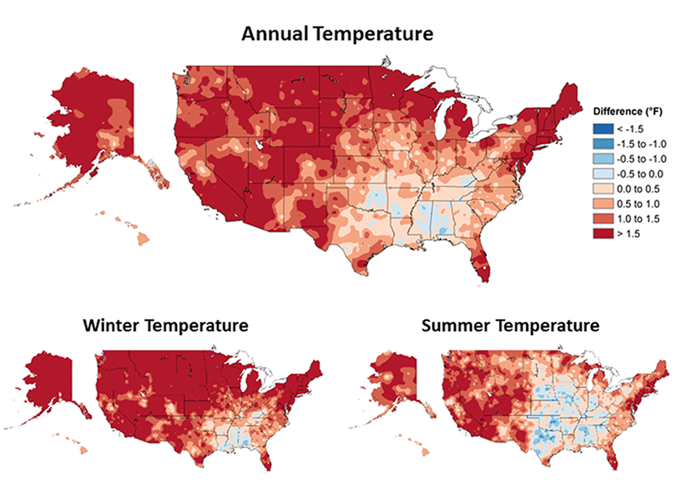
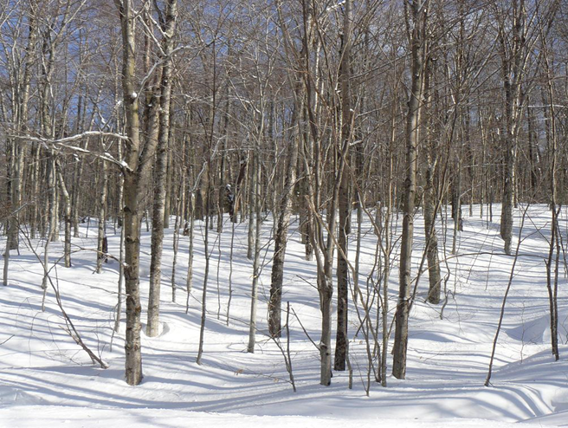
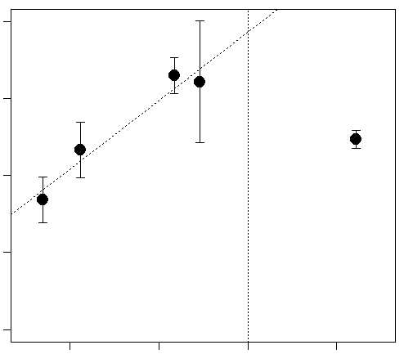
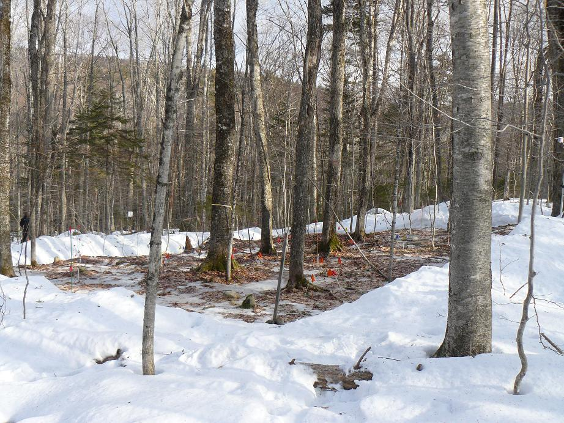
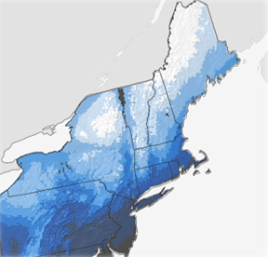
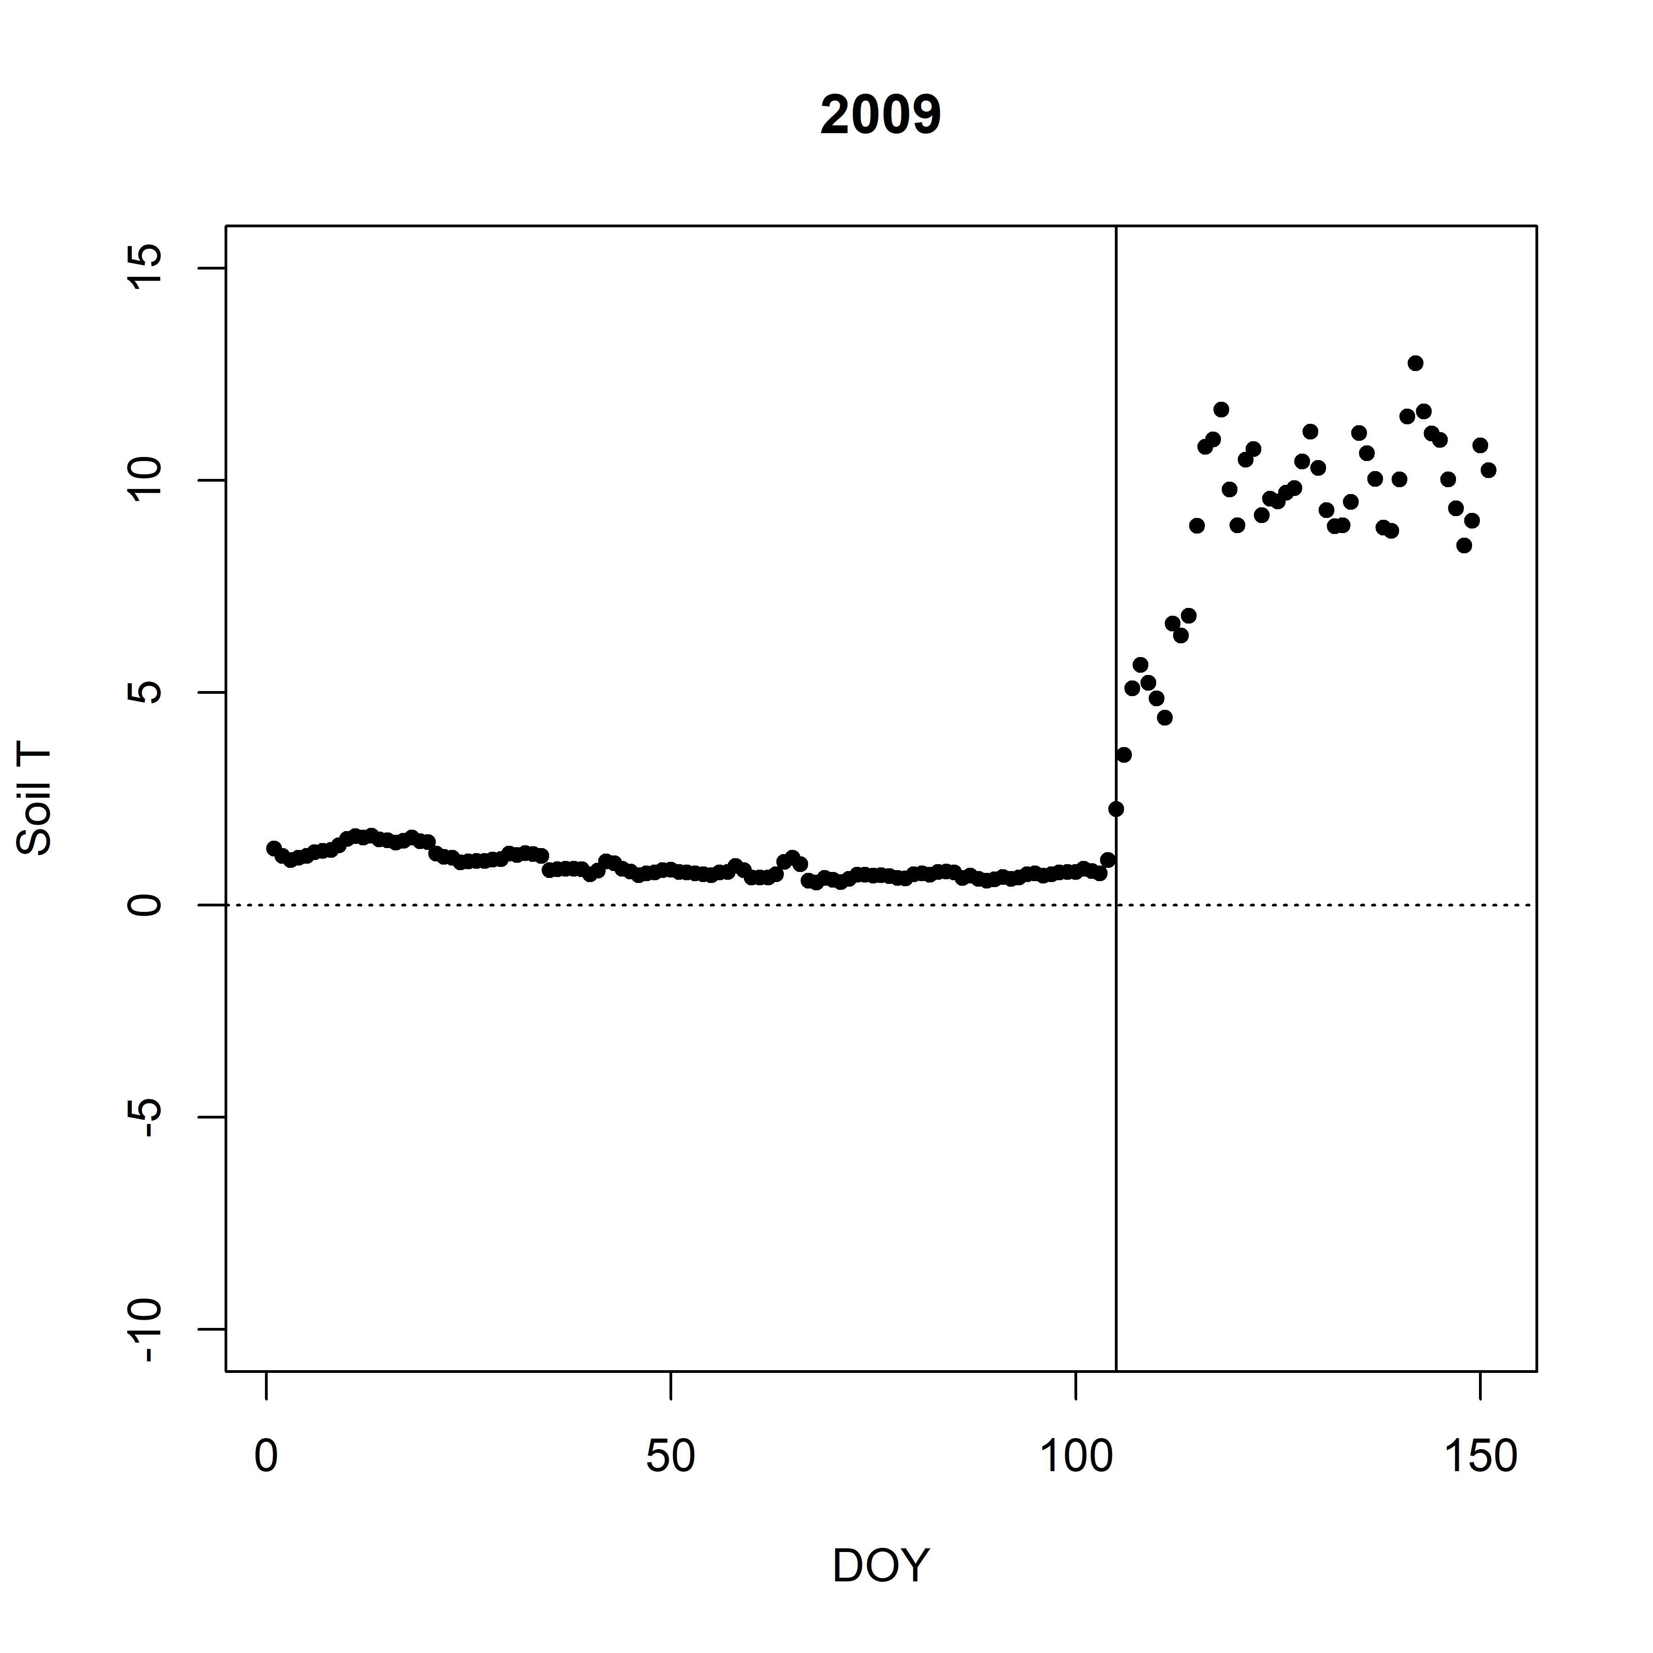
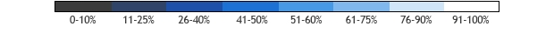
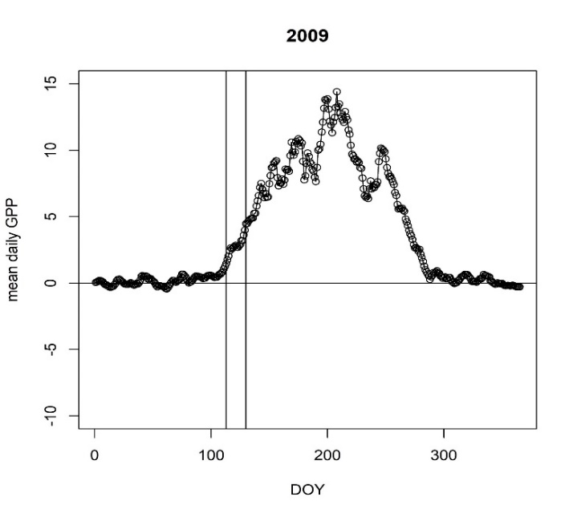
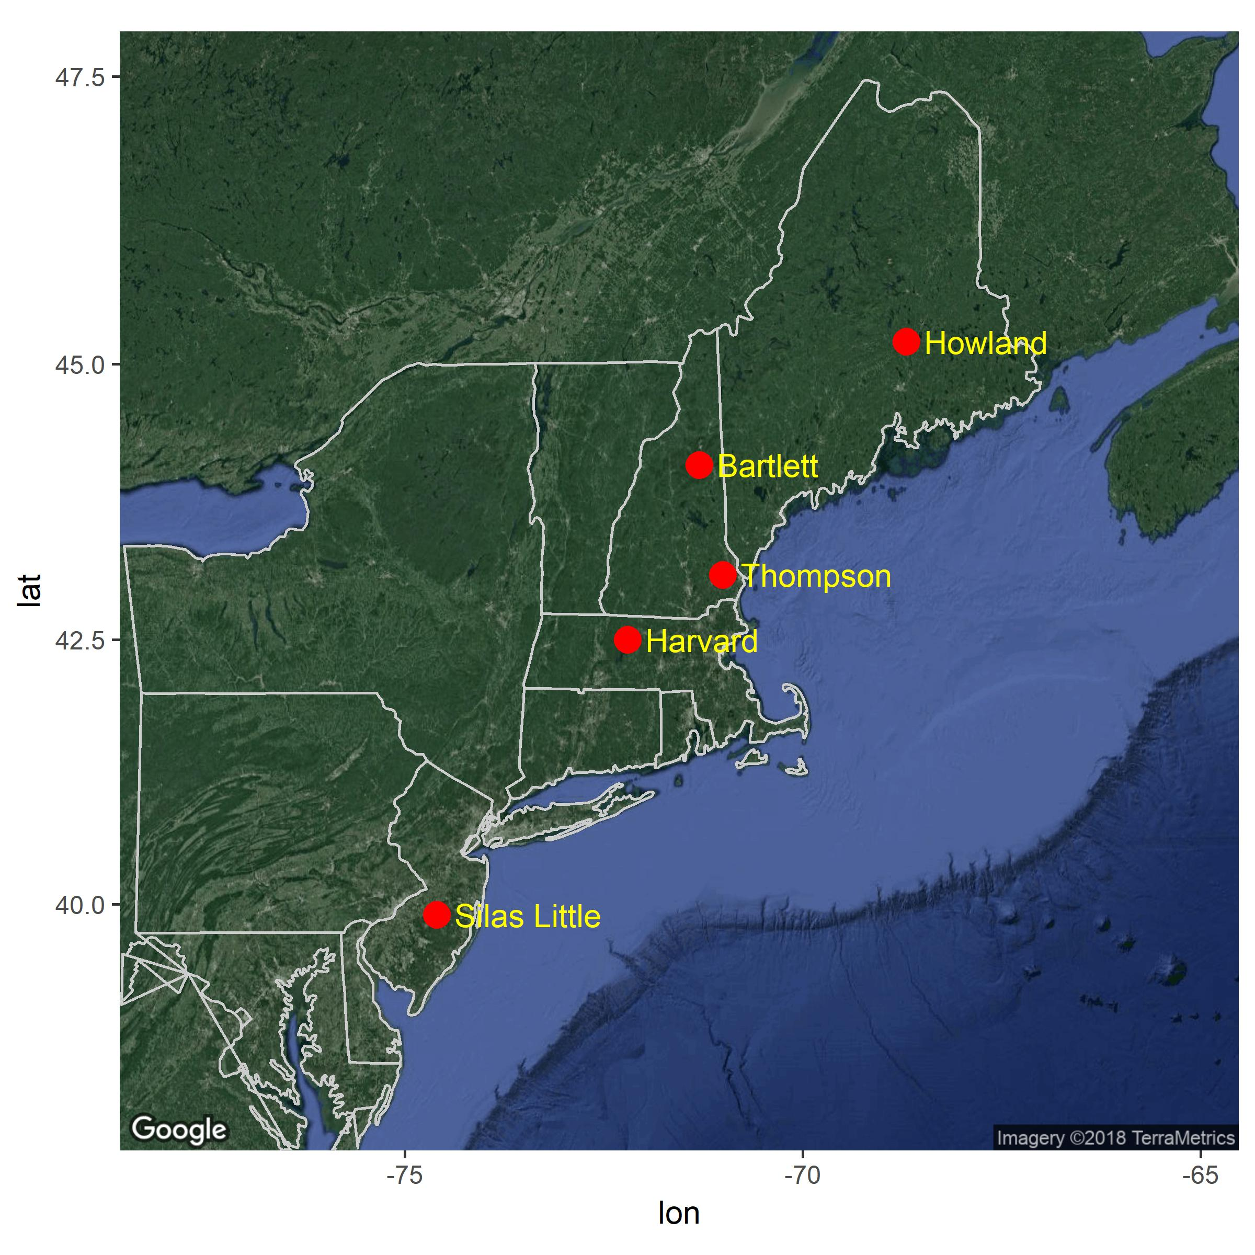
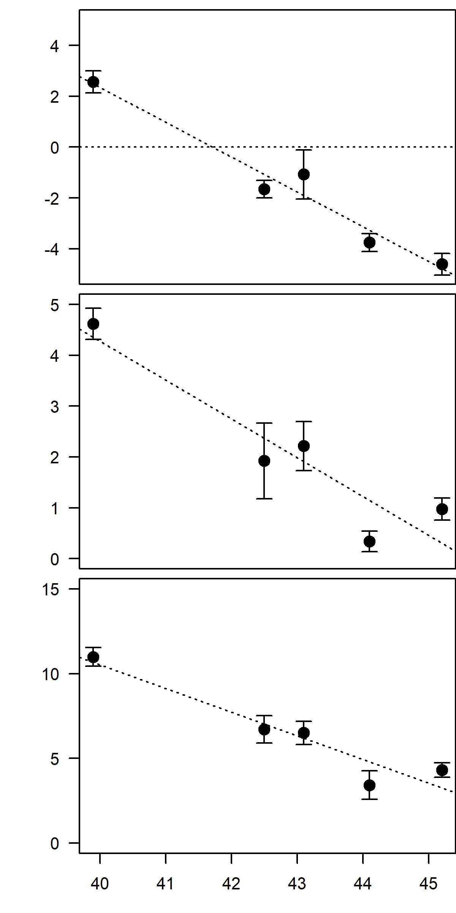
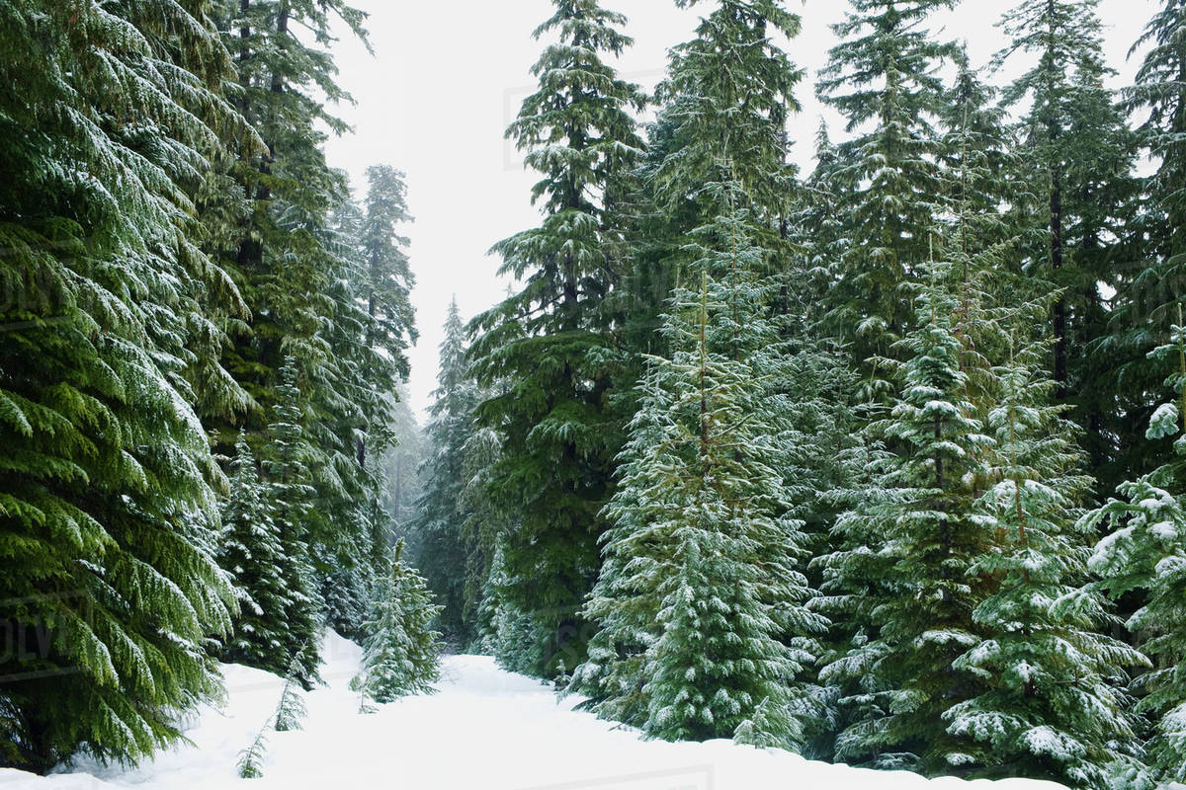
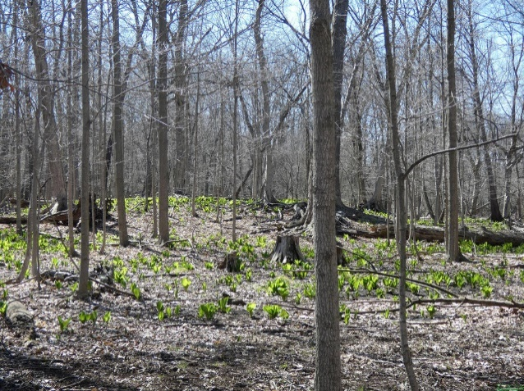
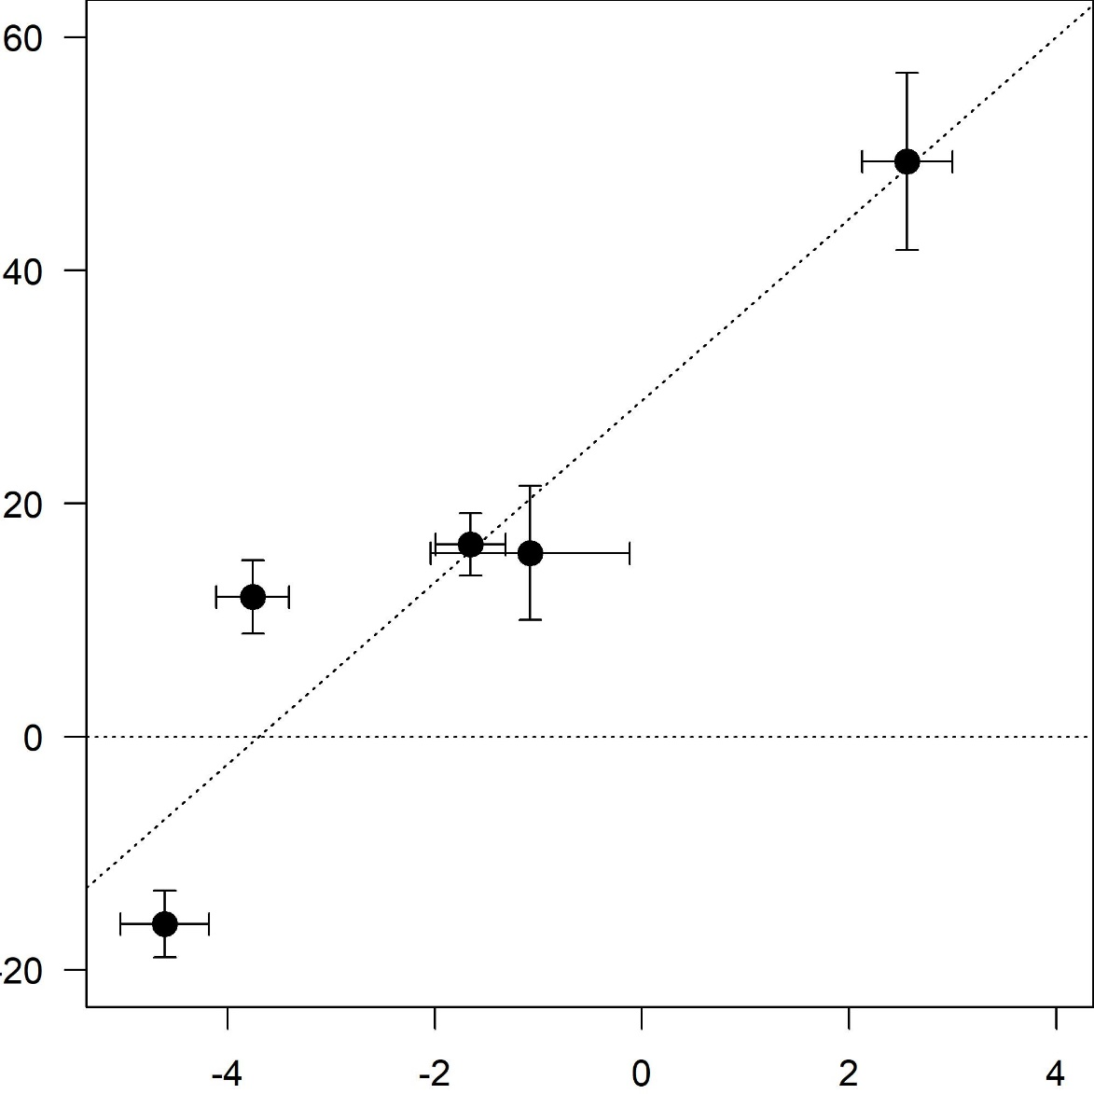







Determining the Influence of Winter on Ecosystem
Carbon Metabolism Across the Northeast U.S.
Rebecca Sanders-DeMott^{1,2}, Andrew Ouimette², Scott Ollinger^{1,2}
1. Department of Natural Resources and the Environment, 2. Earth Systems Research Center, University of New Hampshire
B33M-2299
BACKGROUND
RELATIVE MAGNITUDE OF WINTER CARBON FLUXES
SITE EFFECTS OF WINTER ON VERNAL TRANSITION
Northern temperate ecosystems in northeastern North America are experiencing warmer winters (Figure 1) and declining seasonal snowpack.
Site-level experimental and observational evidence from this region indicate that altered winter conditions with continued climate change will lead to a complex suite of changes to forest nutrient and carbon cycling, but these studies are limited in spatial and temporal extent.
There is high variability in winter conditions across a relatively small latitudinal gradient (Figure 2), and it is likely that responses to winter climate change depend on the historic winter climate patterns to which plants and soil organisms are adapted.
We used eddy covariance data from forested sites spanning a latitudinal gradient across the northeastern US to assess the influence of winter of ecosystem carbon metabolism.
20
15
10
5
0
Plot-level experimental results (e.g. Sorensen et al. 2018) demonstrate interannual variation in snow and soil frost affect carbon cycling during the vernal transition period.
We employed the Simultaneous Heat and Water Flux (SHAW) model (Flerchinger & Saxton 1989) to simulate snow and soil frost at Harvard Forest.
Annual Ecosystem Respiration Occurring
in Winter
(%)
R² = 0.92
p < 0.05
Figure 1. Observed changes winter temperatures from the early 1900s to present day (1986-2016) for the eastern United States (NOAA/NCEI)
R² = 0.92
p < 0.05
Photo: P Templer
Photo: P Templer
-4 -2 0 2
Proportion of total annual ecosystem respiration occurring in winter increases with increasing mean winter air temperatures, when winter mean winter air is below 0° C.
Mean Winter Air Temperature (°C)
Harvard Forest
US-Ha1
Increasing freeze-thaw cycles in winter reduce daily ecosystem respiration during the vernal transition period at flux footprint scale at Harvard Forest.
High Latitude
Low Latitude
Figure 5. Proportion of annual respiration (carbon loss) in winter by mean winter air temperature.
Daily
Ecosystem
Respiration
During
Vernal Transition
(µmol CO₂ m⁻² sec⁻¹)
WINTER CLIMATE AFFECTS SEASONAL TRANSITIONS
Vernal Transition Period
15
10
5
0
-5
-10
Soil Temperature Ramp Up
Soil Temperature
(⁰C)
Winter Soil Freeze-Thaw Events
Less Snow
NEE
breakpoint
analysis
More Snow
Figure 2. Probability of a “White Christmas” (snowpack >2.5 cm present on December 25) for the northeastern United States varies widely across small variation in latitude (NOAA/NCEI)
0 50 100 150
Figure 9. Daily ecosystem respiration occurring during the vernal transition period by estimated number of soil freeze-thaw cycles during preceding winter at Harvard Forest.
15
10
5
0
-5
-10
Start of Carbon Uptake
CONCLUSIONS
Gross C Uptake
(μmol CO₂ m⁻² sec ⁻¹ )
Climate affects proportion of annual C lost in winter
Warmer winters related to longer vernal transitions
Winter climate effect on carbon is observable at flux footprint scale
  At Harvard Forest, increased freeze-thaw cycles reduce ecosystem respiration during vernal transition
Future work
Extend modeling and hypothesis testing to all sites
Include more evergreen sites where vernal transitions vary
SITE LOCATIONS
Figure 6. Stylized representation of ecosystem vernal transitions and lags (from Contosta et al. 2017 Fig. 1a) adapted to include net ecosystem exchange (NEE) and “vernal transition period” between soil temperature ramp up and the start of carbon uptake.
10% Max Gross
C Uptake
47.5
45.0
42.5
40.0
0 100 200 300
Winter Air Temperature
Day of Year
Figure 7. Definition of vernal transition points extracted from flux tower data for soil temperature (top) and start of carbon uptake (bottom) from one representative sample year.
Howland
R² = 0.94
p < 0.01
Bartlett
REFERENCES AND ACKNOWLDEGEMENTS
Harvard
Thompson
Winter Soil Temperature
Contosta AR et al. 2017. Global Change Biology 23, 1610–1625
Flerchinger GN & KE Saxton. 1989. Transactions of American Society of Agricultural Engineers 32, 573–578
NOAA National Centers for Environmental Information. https://www.ncdc.noaa.gov/sotc/national/201613.
Ouimette, AP et al. 2018. Agricultural and Forest Meteorology 256–257, 420–430
Sorensen PO et al. 2018. Soil Biology and Biochemistry. 116, 39-47
Datasets:
David Hollinger AmeriFlux US-Ho1 Howland Forest (main tower), doi:10.17190/AMF/1246061
Andrew Richardson AmeriFlux US-Bar Bartlett Experimental Forest, doi:10.17190/AMF/1246030
J. William Munger AmeriFlux US-Ha1 Harvard Forest EMS Tower (HFR1), doi:10.17190/AMF/1246059
Ken Clark AmeriFlux US-Slt Silas Little- New Jersey, doi:10.17190/AMF/1246096
Funding for AmeriFlux data resources was provided by the U.S. Department of Energy’s Office of Science.
Photo: https://bit.ly/2ScijBE
Photo: A Merenov
60
40
20
0
-20
Temperature (°C)
Length of vernal transition period increases with increasing winter air temperature.
In deciduous ecosystems, temperature soil temperature ramp up precedes carbon uptake, while in evergreen systems the reverse is true.
Length of the vernal transition has been linked to springtime carbon losses and maximum canopy carbon uptake capacity in the growing season (Ouimette et al. 2018).
60
40
20
0
-20
R² = 0.84
p < 0.05
Silas Little
R² = 0.82
p < 0.05
Vernal
Transition
Period
Length
(days)
-75 -70 -65
Winter Soil Temperature
Variability
Figure 3. Locations of forest flux tower sites across latitudinal gradient.
Table 1. Site characteristics, including Ameriflux site code, mean annual temperature (MAT), mean annual precipitation (MAP), and forest type.
R² = 0.87
p < 0.05
In evergreen forest, start of carbon uptake precedes soil temperature ramp up
This project is supported by NSF NH EPSCoR Program (EPS 11011245), USDA UNH Agricultural Experiment Station (Hatch NH00634), NASA Carbon Cycle Science (NNX14AJ18) and NSF Macrosystems (1638688).
Howland
US-Ho1
Site Name | Ameriflux Site Code | Latitude (°N) | MAT (°C) | MAP (mm) | Forest Type
Howland Forest | US-Ho1 | 45.2 | 5.3 | 1070 | ENF
Bartlett Forest | US-Bar | 44.1 | 5.6 | 1246 | DBF
Thompson Farm |  | 43.1 | 8.9 | 1170 | MF
Harvard Forest | US-Ha1 | 42.5 | 6.6 | 1071 | DBF
Silas Little | US-Slt | 39.9 | 11.0 | 1138 | DBF
Latitude (°N)
Mean Winter Air Temperature (°C)
Contact Information:
Rebecca Sanders-DeMott
Postdoctoral Research Associate
rebecca.sanders-demott@unh.edu
@rsdemott • rebeccasanders-demott.weebly.com
Figure 4. Winter air and soil temperatures indices by latitude at flux tower locations.
High Latitude
Low Latitude
Figure 8. Length of vernal transition between soil temperature ramp up and initiation of carbon uptake by winter air temperature.
ORCID

