Slide 1

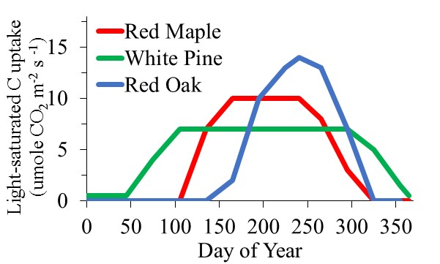
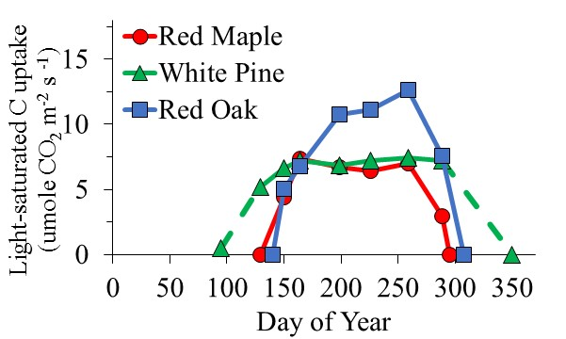
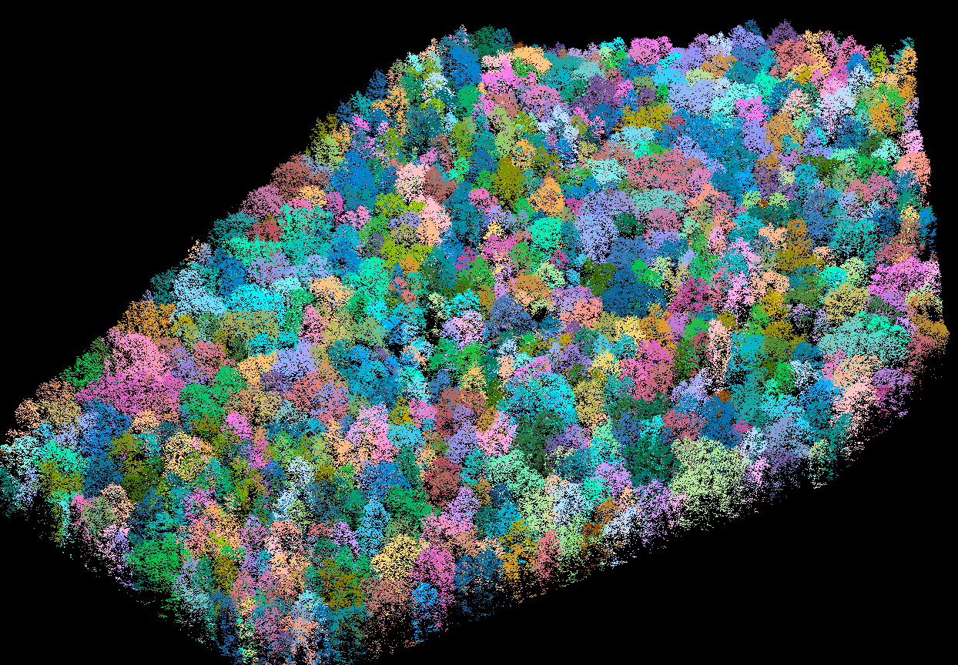
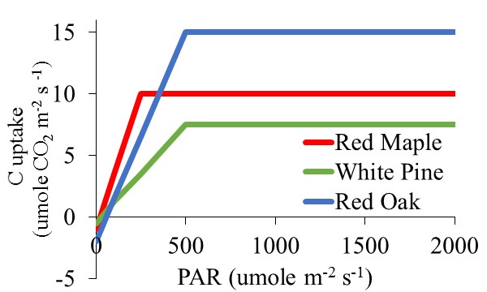
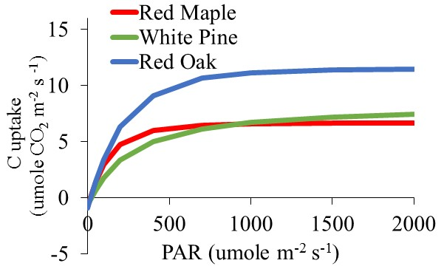
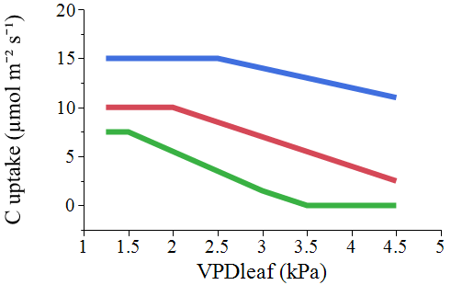
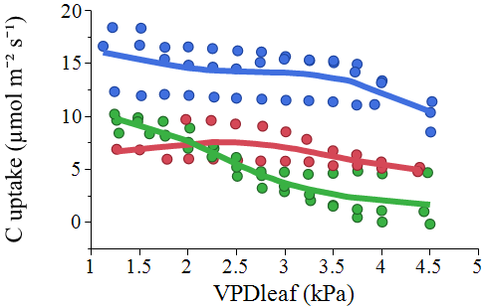
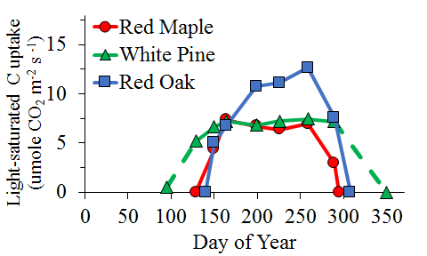
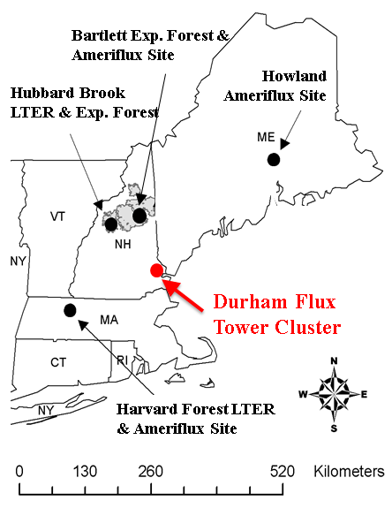
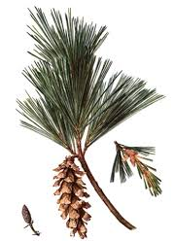
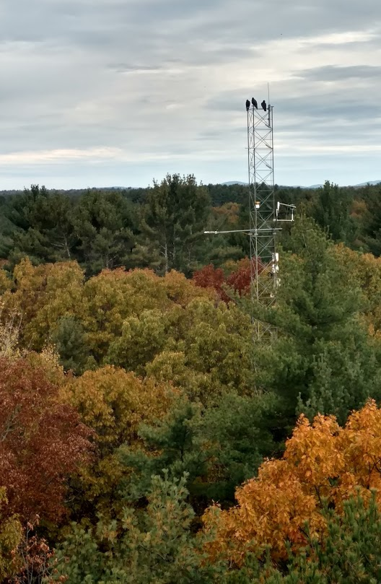

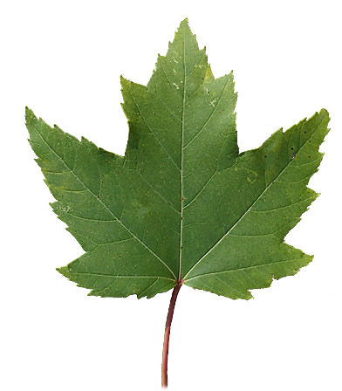
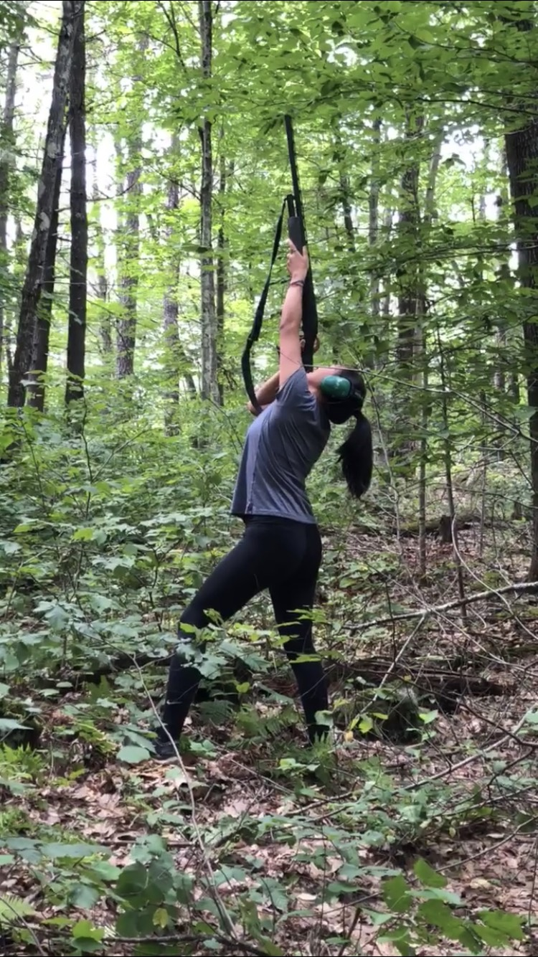
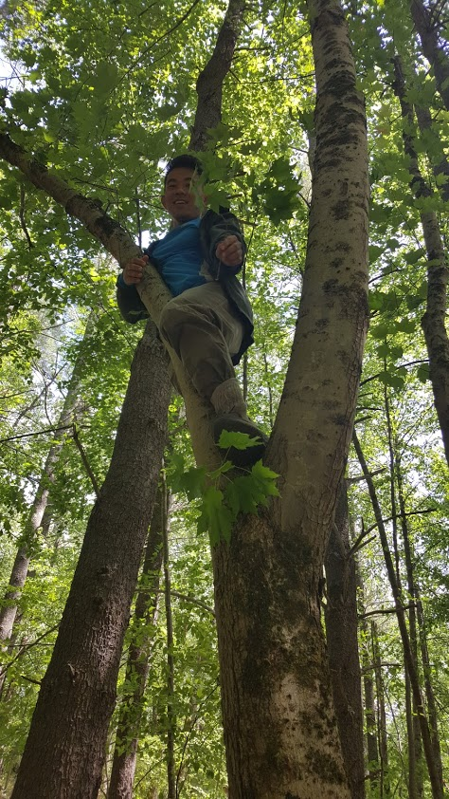





2018 AGU
Does Diversity in Species Specific Leaf Traits Promote Stability of Forest Ecosystem Carbon and Water Fluxes?
2243
Andrew P. Ouimetteª, Rebecca Sanders-DeMottª, Jack Hastingsª, Kaitlyn Baillargeonª, Scott V. Ollingerª
ª University of New Hampshire, Earth Systems Research Center, Durham, NH
Andrew.Ouimette@unh.edu
Abstract
Species Physiological Differences at the Leaf Level
Complementarity in the Canopy
Numerous studies have demonstrated a positive relationship between diversity and productivity in terrestrial ecosystems. Because leaf functional traits exert strong controls on the exchange of carbon (C) and water between terrestrial ecosystems and the atmosphere, it is often assumed that diversity in leaf traits leads to an increase in ecosystem C fluxes. However, appropriate characterization of leaf functional traits to test this assumption in forests remains a challenge, because leaf traits vary across species as well as through time and space within forest canopies. To assess the influence of functional trait diversity on ecosystem carbon and water fluxes, we measured leaf structural, chemical, and physiological traits for three codominant species (Acer rubrum, Quercus rubra, Pinus strobus) in a temperate forest stand within the footprint of an eddy covariance flux tower in southern New Hampshire, USA. Leaf traits were measured vertically through the canopy and temporally across the growing season and compared to eddy covariance derived estimates of stand C fluxes. Leaf structural and physiological traits varied across species, space, and time, however there was no clear evidence that higher species diversity would lead to higher ecosystem productivity. We are continuing to explore this in a modelling framework while including the influence of differences in crown shape, canopy space filling, acquisition of soil N, C allocation patterns, and N requirements on diversity-productivity relationships.
What we expected
What we found
A
B
Temporal Variation
C
D
Goals
Response to Environmental Variables
Figure 3: (let) Crown delineation of trees within the eddy flux tower footprint at Thompson Farm using data collected from NASA’s G-LiHT platform. Randomized colors represent individual crowns. (upper right) Hypothetical depiction of differences in crown shape and position for red maple (red), red oak (blue), and white pine (green) that would allow for more complete canopy space filling with a diverse array of species. (lower right) point cloud of trees from the G-LiHT data showing differences in crown shape.
Goal:
Quantify mechanisms that could explain a positive relationship between diversity and productivity.
E
F
Study Site
Complementarity Belowground
Species distribution by height in the canopy
Figure 2: Expected (A, C, E) and measured (B, D, F) variations in leaf-level net carbon exchange collected throughout the growing season (A, B), at varying light levels (C, D), and over a range of leaf vapor pressure deficit (E, F). Measurements generally agree with expectations, but highlight the higher photosynthetic rates of red oak under a range of environmental conditions.
Tower
LAI m² m⁻²
Depth (cm)
Stand-Level Fluxes
Plant δ¹⁵N (‰)
Depth of N uptake (cm)
Canopy net C exchange
(umole CO₂ m⁻² s⁻¹)
Figure 5: (top) Daily maximum net carbon exchange estimated using eddy covariance during 2018. (bottom left) Canopy scale light response curve during June-September 2018. (bottom right) Response of canopy net carbon exchange to variations in atmospheric vapor pressure deficit (VPD).
Soil δ¹⁵N (‰)
Height (m)
Figure 4: (left) Soil nitrogen isotopes (δ¹⁵N) by depth. (center) Distribution of foliar δ¹⁵N for red maple, white pine, and red oak. (right) hypothetical depth of uptake of soil nitrogen for each species based on foliar and soil isotopes. The 3 dominant species differ in δ¹⁵N and likely acquire nitrogen predominantly from different soil depths.
Canopy net C exchange
(umole CO₂ m⁻² s⁻¹)
Canopy net C exchange
(umole CO₂ m⁻² s⁻¹)
Conclusions and Future Directions
The timing and rate of leaf-level carbon exchange varied by species as expected, with white pine red maple reaching peak photosynthetic capacity roughly 6 weeks prior to red oak. Photosynthetic rates parallel leaf structural development (e.g. seasonal changes in leaf mass per area, etc).
Given the significantly higher photosynthetic rate of red oak under a range of incident light and atmospheric humidity, there is no clear evidence from leaf-level photosynthetic measurements that diversity would lead to higher productivity on annual time scales.
Future modelling efforts will attempt to include the role of crown shape, canopy space filling, differences in acquisition of soil N, C allocation patterns, and N requirements as controls on the relationship between diversity and productivity at multiple spatial and temporal scales.
Figure 1: (left) photo of Thompson Farm study site and eddy flux tower, with inset map showing location relative to other flux towers in the northeastern US. (center) From top to bottom photos of the foliage of white pine, red oak, and red maple. (right) Species distribution of foliage by height within the canopy at Thompson Farm.
PAR (umole m⁻² s⁻¹)
VPD (kPa)
Methods
Differences in Carbon Allocation and Nitrogen Demand
Measurements of leaf-level (multiple heights) and stand-level physiology and structure including:
High relative leaf area
Acknowledgements
Foliar area:basal area
N budget
Near continuous: Canopy measurements of carbon, water, and energy exchange from eddy covariance, phenology (Phenocam)
Biweekly: leaf area index, litterfall collection
Monthly: (at multiple canopy positions) leaf-level photosynthesis, percent nitrogen, stable isotopes, chlorophyll, leaf size, leaf mass per area, petiole length
Single collection: point quadrant observations of the distribution of foliage across height in the canopy by species; hyperspectral reflectance (UAV drones and G-LiHT) and LiDAR measurements (G-LiHT), stem diameter.
Red Maple
Red Oak
White Pine
This project is supported by NSF NH EPSCoR Program (EPS 11011245), USDA UNH Agricultural Experiment Station (Hatch NH00634), NASA Carbon Cycle Science (NNX14AJ18), NSF Macrosystems (1638688), and the Harvard Forest LTER.
We also are grateful Emily Perry, Emily Wilcox, and Sarah Cantwell (University of New Hampshire undergraduate students), Dr. Zaixing Zhou, and visiting scientist Dr. Jie Wei for assistance in collecting field data during the summer of 2018.
Other Species
UNH undergrad Emily Perry
Visiting scientist Jie Wei
Figure 6: (left) Relationship between the fraction of total leaf area and total basal area by species at the stand-level. (right) Theoretical estimates of annual N uptake needed to support an stand leaf area index (LAI) of 5, and the LAI that could be supported with current rates of N uptake (based on measurements of foliar and litter %N and LMA).

