Slide 1




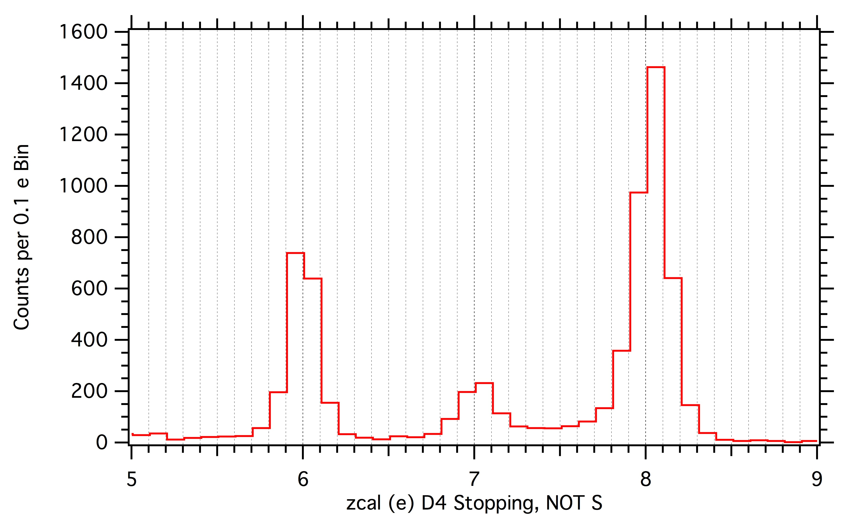
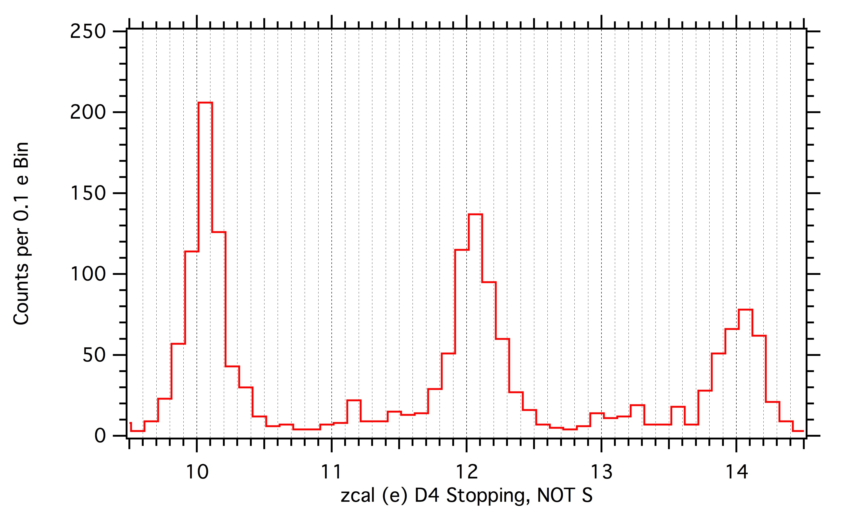
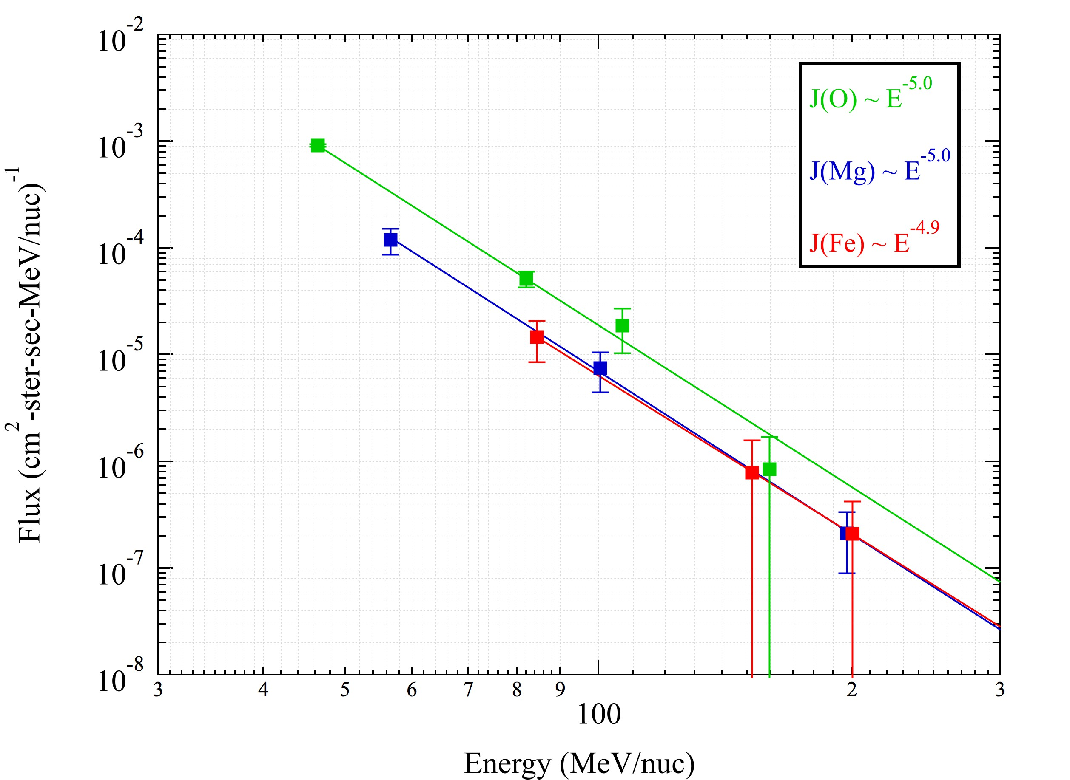
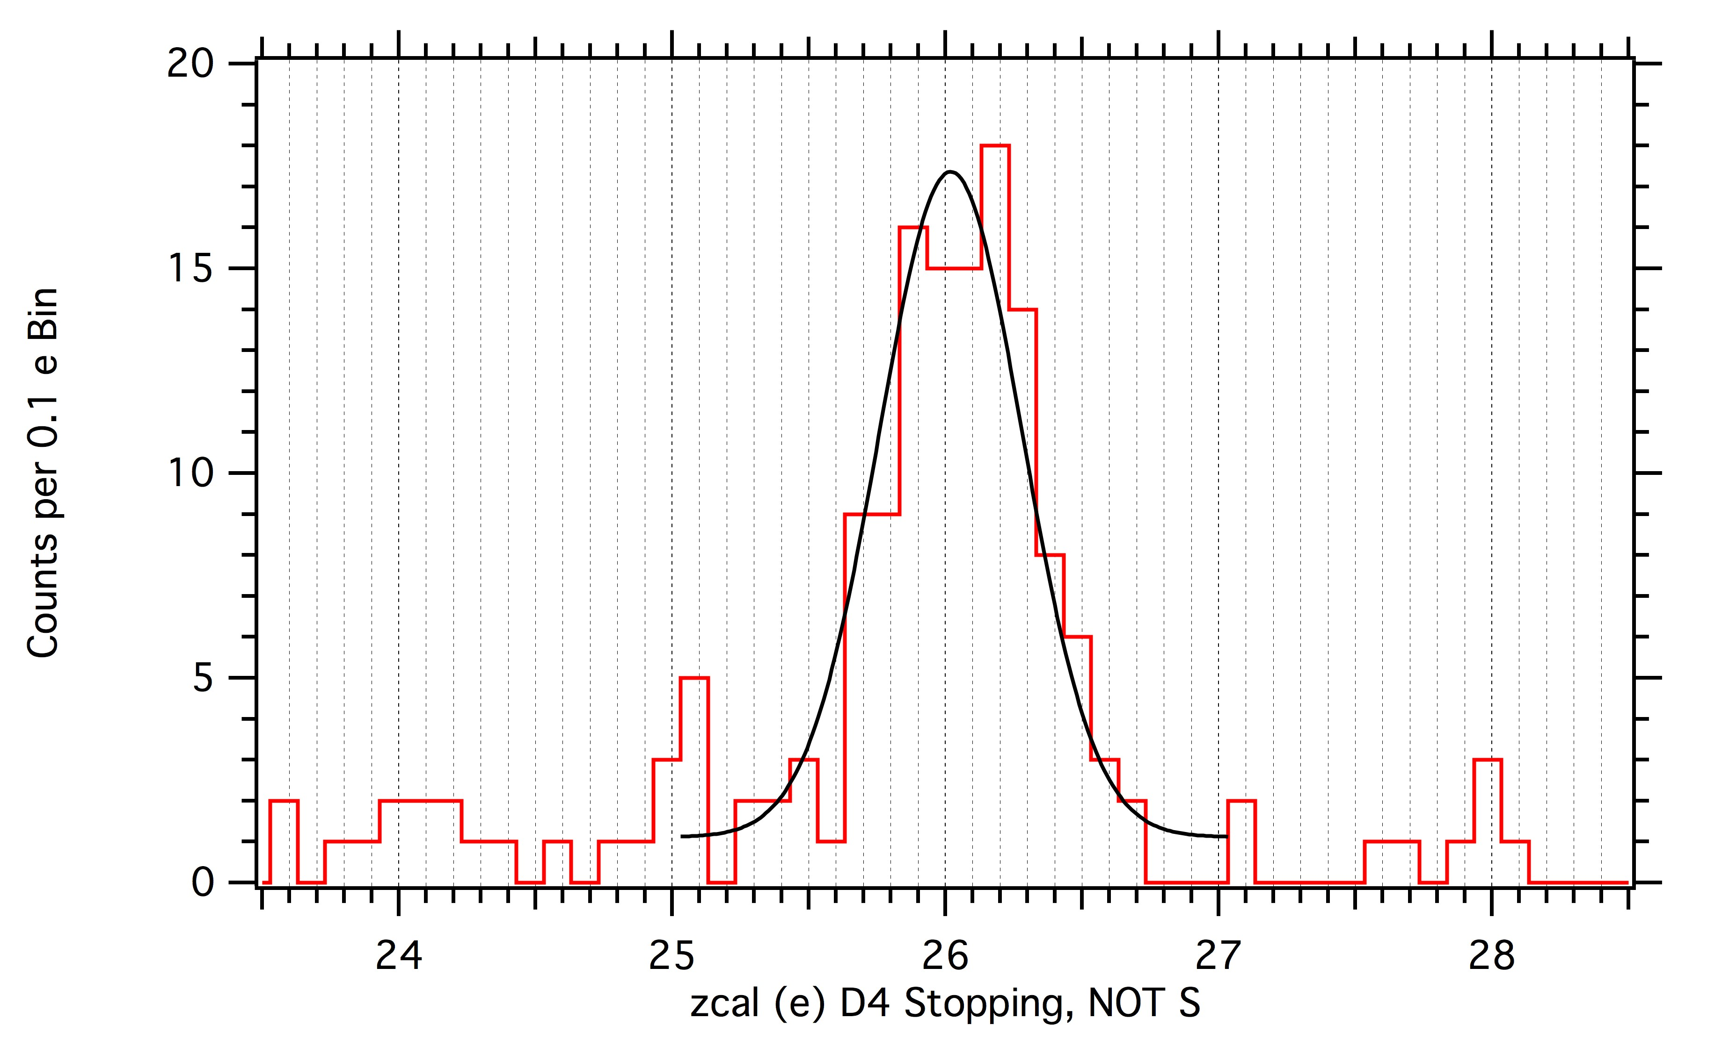
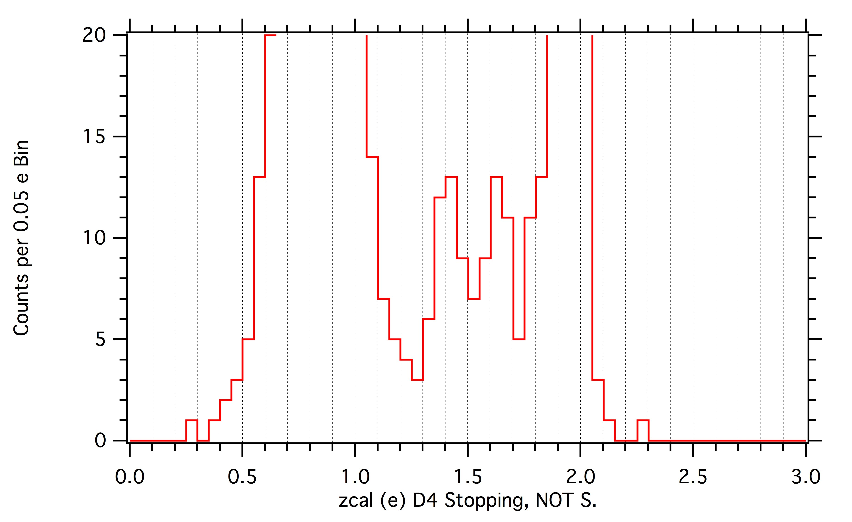
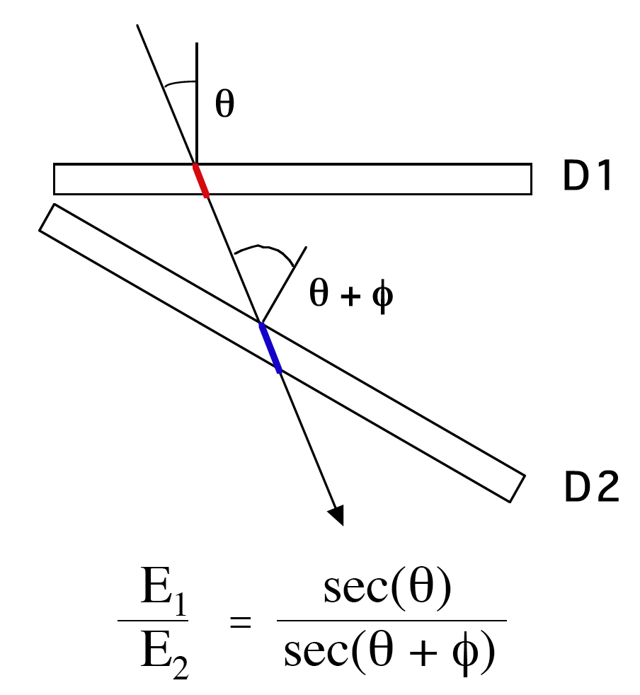
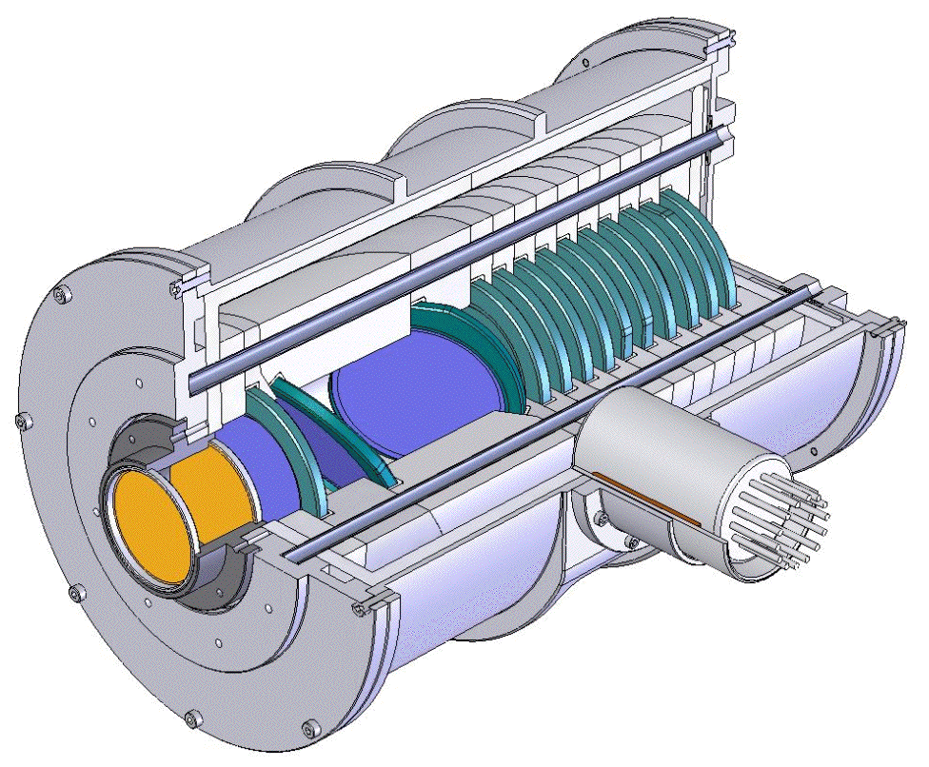
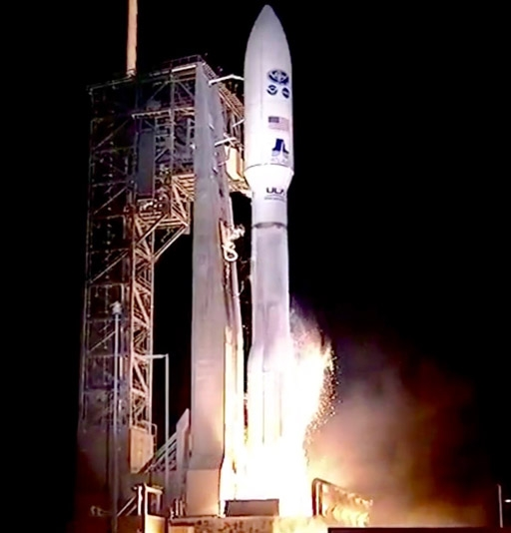
Composition and Flux Measurements as a New, Sustainable Window on Space Weather: Observations From the GOES-16 Energetic Heavy Ion Sensor (EHIS)
J. J. Connell and C. Lopate, University of New Hampshire, Department of Physics and Space Science Center
Abstract
GOES-16/EHIS On-Orbit Data
EHIS Heavy-Ion F;ux Measureement
Energetic heavy ions measurement are a new window on Space Weather. Energetic heavy ions are a particular concern for single event effects (SSE’s) in electronics, and for radiation exposure for humans in space because energy deposition increases with the nuclear charge (Z) squared. Thus an iron (Fe) ion deposits energy at 676 times the rate of a proton with the same energy/nucleon. The high quality factor (relative biological effectiveness) of heavy ions further increases their import for human radiation exposure. An Energetic Heavy Ion Sensor (EHIS) was launched on the GOES-16 satellite (formerly, GOES-R) on 10 November, 2016 and is now operational in geostationary orbit. The second EHIS was launched on GOES-17 (formerly, GOES-S) on 1 March 2018. These are two of four EHIS instruments built by the University of New Hampshire, subcontracted to Assurance Technology Corporation, with a fifth unit currently being built, as part of the Space Environmental In-Situ Suite (SEISS) for GOES-R, -S, -T and -U. EHIS is the first heavy ion instrument to fly on a GOES satellite. EHIS measures energetic ions over the range 10-200 MeV for protons, and corresponding stopping ranges for heavy ions (19-374 MeV/u for C and 38-975 MeV/u for Fe). Heavy ions are distinguished in EHIS using pulse-height analysis with on-board processing producing charge histograms for five energy bands. With a high rate of on-board processing (~2000 events/s), EHIS provides exceptional statistics for ion composition measurements in large SPEs. Fits to these data are normalized to priority rate data on the ground. We discuss the EHIS heavy ion data which show elemental peaks from H to Fe.
Note, these results are from GOES-16 Preliminary Data, Non-Operational Data.
A
Ne
B
O
Mg
C
Si
N
C
Fe
D
²H
³He
EHIS is an operational instrument capable of providing science-mission quality data.
NOAA requirements included measuring fluxes in the largest of Solar Particle Events, achieved by using active baseline restore and modest geometrical factors. Extensive accelerator calibrations provided dead-time corrections and effective geometrical factors. A detailed analysis of systematics was also required.
To determine absolute fluxes, a maximum-likelihood fit is made to the charge histograms. The peak areas are normalized to dead-time corrected priority rates. Effective geometrical factors and energy bin widths are applied. Statistical and systematic error estimates are included.
The plot shows differential energy spectra for C, Mg and Fe using six hours of data during the September events (11 September 2017 00:01:18 - 06:01:18 UTC) with statistical errors only. Power-law fits are also shown, and show spectral indices typical of SEP’s.
EHIS produces two major science data products: event rate counts and pulse-height analysis (PHA) data.
Rates are used directly to determine H and He fluxes. A priority scheme, lowest (P3) for H ions, intermediate (P2) for He, and highest (P1) for heavier ions, governs PHA event processing. PHA events constitute an unbiased sample that can be normalized to priority rate data to determine fluxes. Because of the simplicity of the ADIS system, energetic ion charges are calculated on-board by the EHIS processor and complied into histograms telemetered on a 1-minute cadence. The EHIS microprocessor can analyze ~2000 events/s, providing unprecedented statistics in high flux conditions.
Above plots A, B, and C, show charge histograms of PHA data for heavy ions stopping in D4 from 1/8/2017 to 9/26/2017. These data are dominated by Solar energetic particles from the 9/7/2017 to 9/15/2017 active period. Elemental peaks are clearly seen. Fit to Fe (plot C) has σ = 0.26±0.03 e charge resolution.
Plot D shows data 1/8/2017 to 3/23/2017 which is dominated by Galactic Cosmic Rays (GCR’s). The charge calculation assumes the mass number (A) is twice the charge (Z). Deviations from A = 2Z result in slightly different values of calculated charge. The isotopes ²H (D) and ³He are apparent, with abundancies consistent with GCR’s. ³He is of considerable interest in Solar events as it is often enhanced.
Angle Detecting Inclined Sensors (ADIS) and EHIS
Telescopes of stacked silicon Solid State Detectors (SSDs) are the most common method to measure ions in the energy range of 10-100s MeV/u. Measuring ion composition with good (single element) resolution requires the angle of incidence be determined. The most common method to obtain angle corrections is to use complex Position Detectors (PSD’s).
The Angle Detecting Inclined Sensor (ADIS) system [1] uses detectors inclined to the instrument axis to determine the angle of incidence. Consider an ion traversing a solid state detector (D1 left). The signal from that detector depends upon the detector material traversed (red), which increases with the angle of incidence — exactly the effect that degrades charge resolution. If a second detector, inclined to the first is added (D2), the particle pathlength (blue) will vary with the sum of angle of incidence plus the (known) angle of inclination. By inverting the equation, the angle of incidence in a plane can be determined.
For a full ADIS system, at least one more inclined detector is added. For EHIS, right, a third detector (D3) below D2, inclined at the same angle (30º) to the axis, but rotated 90º about the axis, is used. With D1, D2 and D3, the angle of incidence (and also the azimuthal angle) are determined.
Space Weather and Science
EHIS General Characteristics
GOES-16 Launch
NOAA ground processing is for Space Weather applications and does not make full use of EHIS’s capabilities (capabilities that are not needed to meet NOAA requirements). An example of this is that NOAA proton and He analysis is entirely rate based, excluding analysis of D and ³He. NOAA also operates on a fixed 5-minute cadences, whereas a science analysis would choose a cadence based upon the species of interest, the flux and and time scales of the phenomena under study. (As was done above.)
We plan to seek funding from NASA, or other science agency, to develop and implement an upgraded analysis system that would provide the science community with web-based access to enhanced data products.
The EHIS instrument development project was funded by NASA under contract NNG06HX01C.
EHIS provides data for flux measurements by element for H through Cu in five semi-logarithmic energy bands.
The detector stack is surrounded by a plastic scintillator system viewed by a PMT.
Telescope Stack Si SSDs:
D1-3: 50 μm
D4-D6: 3 x 1500 μm (total 4.5 mm) each
R, 1500 μm tagging penetrating events.
Mass: 9.2 kg Power: 4.9 W (avg.)
Telemetry: 1536 bps
FOV: 28º (half-angle)
Geometrical factor: 1.5 to 0.5 cm²
[1] J. J. Connell, C. Lopate and K. R. McLaughlin, “Accelerator Test of an Improved Angle Detecting Inclined Sensor (ADIS) Prototype with Beams of ⁷⁸Kr and Fragments,” Nuclear Instruments and Methods in Physics Research A 837, 11-15 (2016) and references therein.

