Slide 1

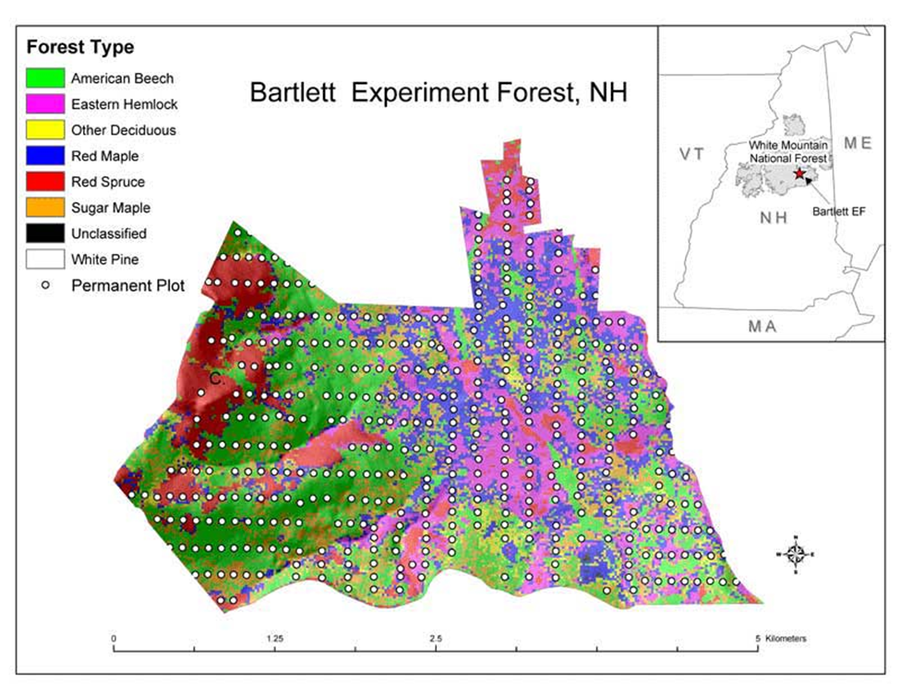
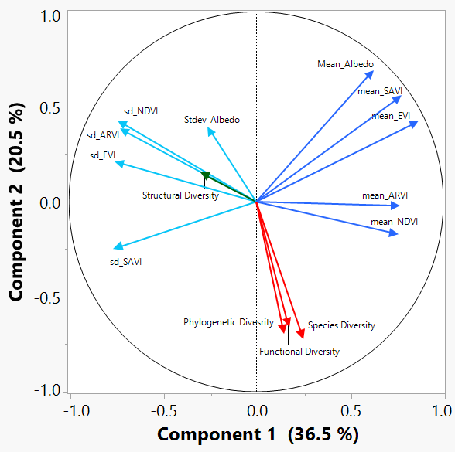
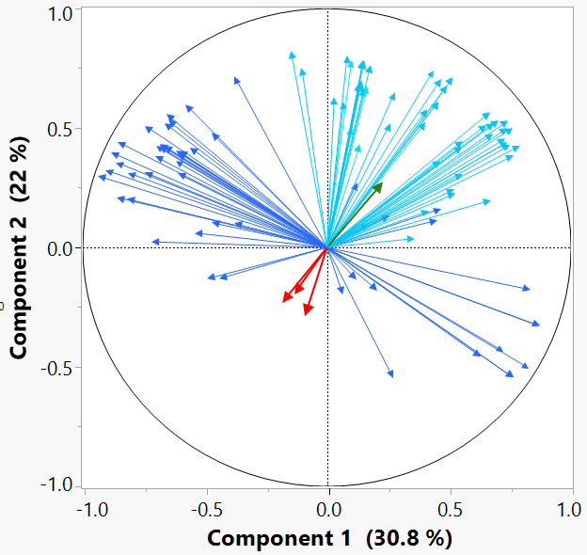
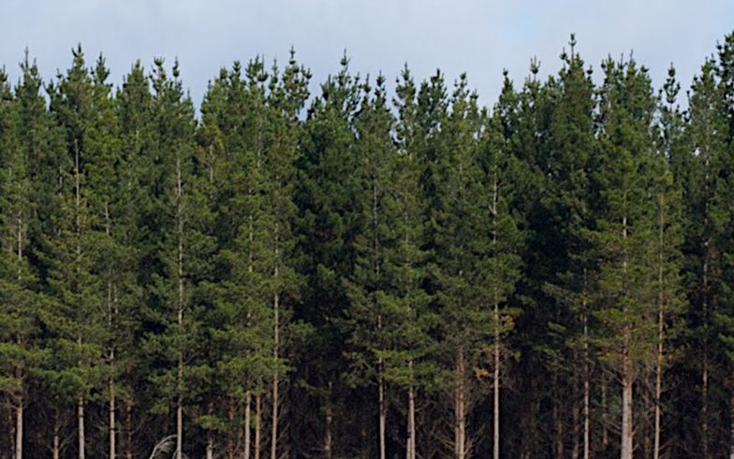
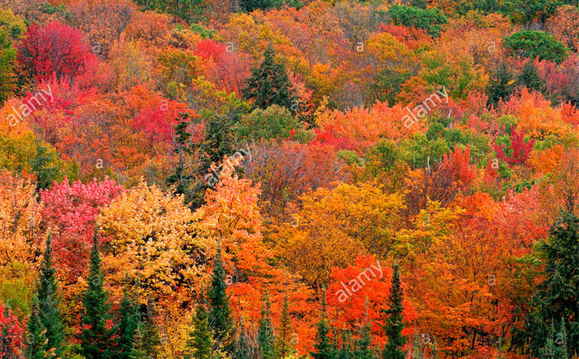
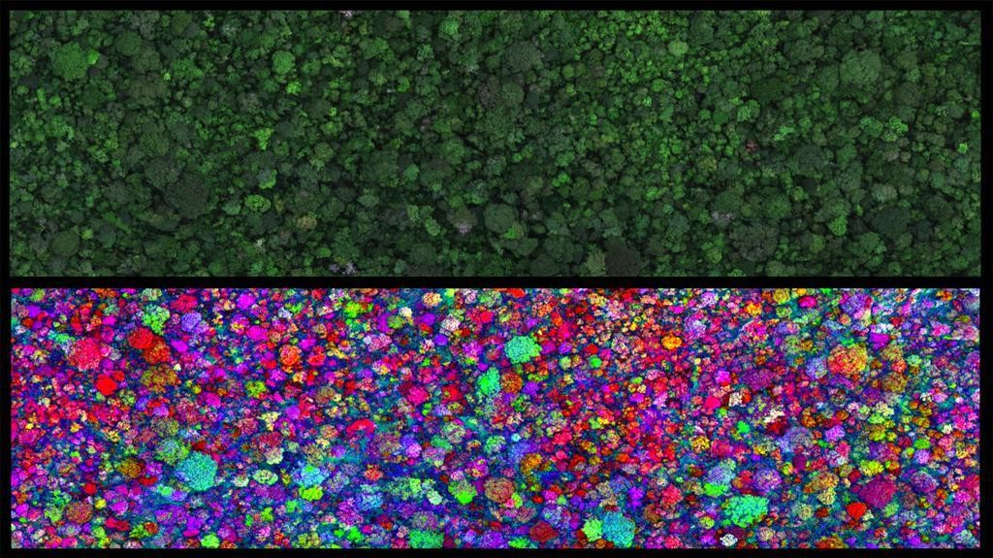
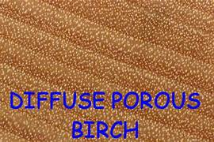
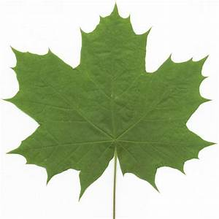
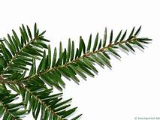
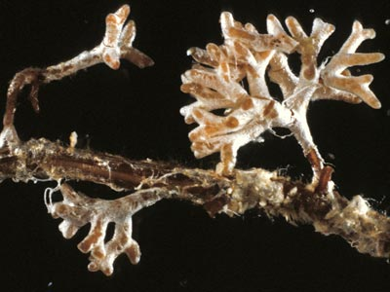
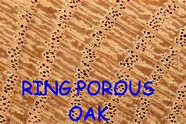
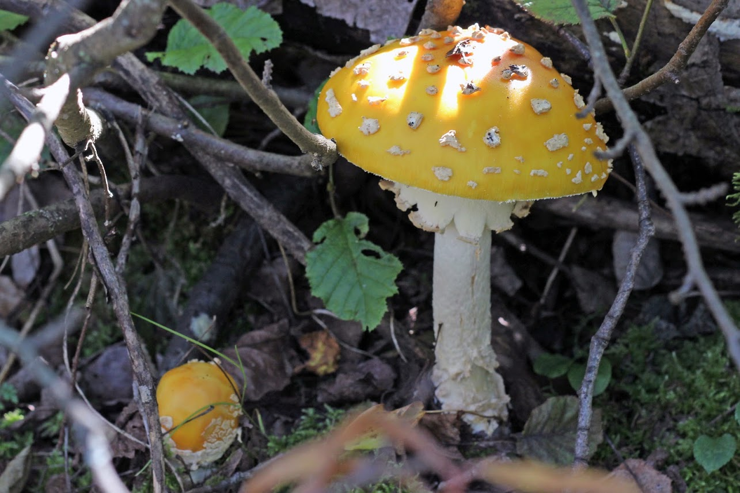
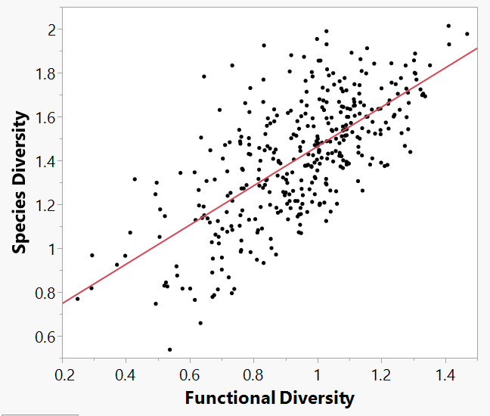
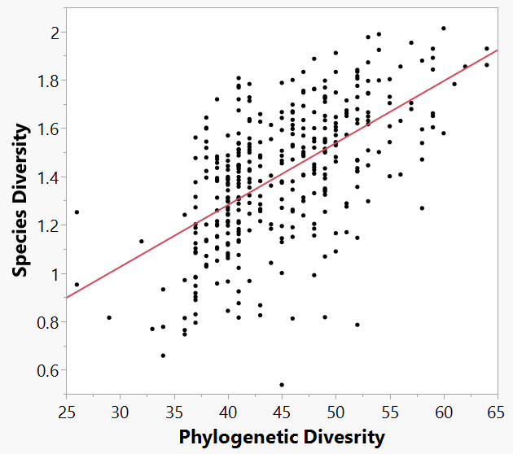
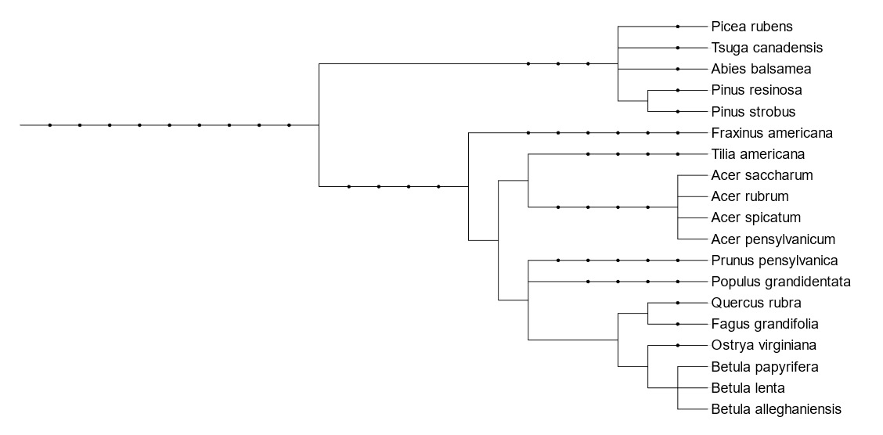
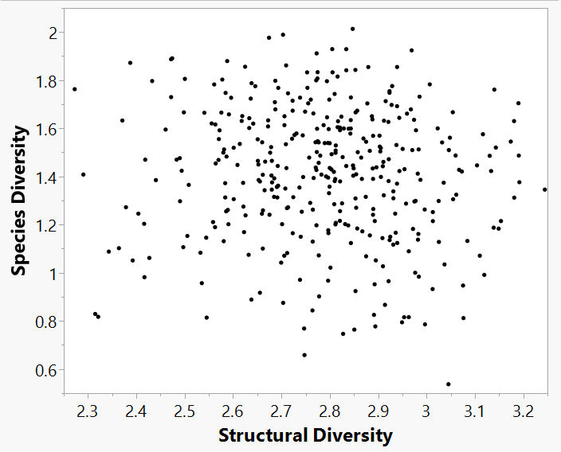
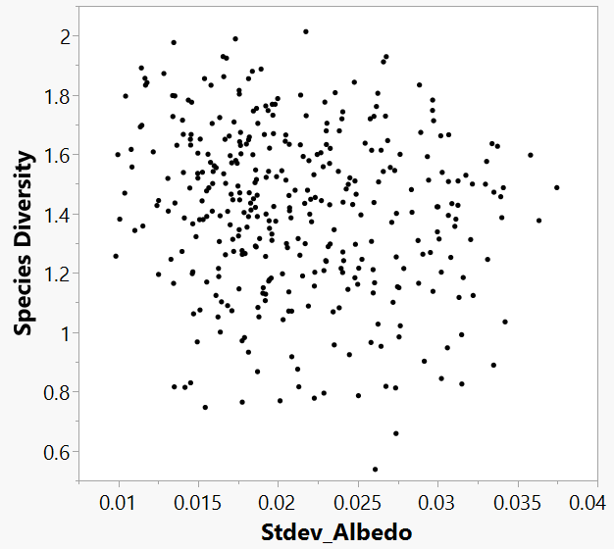
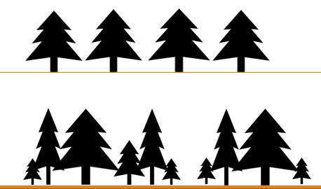




A Comparison of Forest Biodiversity Metrics Using Field Measurements and Aircraft Remote Sensing
Kaitlyn Baillargeon (kab2014@wildcats.unh.edu)
Scott Ollinger, Andrew Ouimette, Rebecca Sanders-DeMott, Franklin Sullivan, Zaixing Zhou
Department of Natural Resources and the Environment, University of New Hampshire, Durham, NH
Institute for the Study of Earth, Oceans, and Space and Department of Earth Sciences, University of New Hampshire, Durham, NH
B41L-2874
Background:
Methods:
Estimating Diversity with Remote Sensing:
Quantifying forest biodiversity is an important way to evaluate forests health, ecosystem services, and management priorities. An array of metrics have been used to define forest biodiversity using both ground and remote sensing based measurements.
It is unclear to what degree different metrics of diversity are related and to what degree can they be estimated from remote sensing data.
Here we evaluate the relatedness of four metrics of biodiversity and test our ability to estimate these through remote sensing in a northern temperate forest at Bartlett Experimental Forest in New Hampshire, USA.
Study Site
Bartlett Experimental Forest (BEF) in Bartlett, New Hampshire, USA.
Figure 5: 400⁺ inventory plots found at BEF overlaid with species composition gradient of the major tree species.
Figure 10: Principal components analysis (PCA) of relationships between diversity metrics compared against select vegetation indices
Means of Vegetation Indices
Standard deviations of Vegetation Indices
Metrics of Diversity:
Figure 11: PCA of means and standard deviations of all vegetation indices to the diversity metrics.
Diversity Metrics
1) Species Diversity: Variation in species composition
Diversity Calculations
Shannon H Index: H = -∑(Pi * ln Pi)
  Pi = proportional number of species, groups, classes: Pi = ni/N
  Used for calculation of species, functional, structural diversity
Faith’s PD: sum of the branch lengths in the minimum spanning path
  Used for calculation of phylogenetic diversity
A
B
Legend:
Species Derived Diversity Metrics:
LiDAR Structural Diversity:
Vegetation Indexes
  Mean:
  Standard Deviation:
Table 1: The percent variation in each diversity metric described by all the vegetation indices when run through a bootstrapping and partial least squares analysis.
Figure 1: (A) Example of a low diversity forest with only conifer species present (B) Example of a high diversity forest with a mixture of tree species
 | Bootstrap – Forest (%) | Partial Least Squares (%)
Species Diversity | 23.4 | 42.0
Functional Diversity | 25.9 | 34.2
Phylogenetic Diversity | 16.3 | 24.5
Structural Diversity | 6.7 | 23.7
2) Functional Diversity: Variation in species traits that describe their ability to acquire light, water, and nutrients.
Vegetation Indices
Vegetation indices (e.g. NDVI, EVI, ARVI, SAVI, etc.) were calculated from multispectral data. Those selected were shown in previous studies to correlate with biodiversity under the assumption that increased spectral heterogeneity infers increased diversity.
(A) Wood anatomy
(B) Leaf Types
(C) Mycorrhizae Fungi
Figure 2: Selected functional traits to derive functional diversity
Relationships Among Diversity Metrics:
Conclusions and Future Directions:
R² = 0.47
R² = 0.35
Although functional and phylogenetic diversity are both derived from species presence, only about half of the variation seen can be explained by species diversity. This could be caused by:
  Not capturing other potential functional traits that contribute to functional diversity
  Even though there may be a high species diversity, similarities in functional traits and evolutionary history could influence the relationship seen between species diversity with functional and phylogenetic diversity.
Lack of relationship between diversity metrics and vegetation indices possibly from:
  Pixel resolution being too small or too large
  Too simple of a method used to compare diversity metrics and indices
To take this research further, things to consider would include:
  Assessing the influence of spatial and pixel resolution on index calculations
  Apply other methods of calculating diversity from remote sensing imagery
  See how more complex comparisons would influence results
  Analyze whether methods can be applied over broad scale areas or if they are site specific
  Test against broadband and narrow band spectral imagery
3) Phylogenetic Diversity: Variation in taxonomic groups derived from evolutionary connectedness
Figures 6-9: Through simple regression plots, no correlations could be found between any of the vegetation indices from remote sensing imagery and diversity metrics (Fig. 9). Only relationships discovered were between species diversity with functional and phylogenetic diversity (Fig. 6 and 7).
Figure 3: Cladogram displaying common species found in the White Mountains of NH
4) Structural Diversity: Variation in tree shape, size, and arrangement.
Low
Figure 4: Depiction of a forest with low structural diversity (top) and high structural diversity (bottom) showing variations in height, width, and spatial arrangement.
Acknowledgments:
High
This material is based upon work supported by the National Science Foundation under Grant Number (1638688). Partial funding was also provided by the New Hampshire Agricultural Experiment Station, the Hubbard Brook Long Term Ecological Research program (NSF 1114804), the Harvard Forest Long Term Ecological Research program, and the University of New Hampshire graduate school. We also acknowledge the help and support of infrastructure and staff at Bartlett Experimental Forest. Inventory data of species compositions at BEF was collected by the University of New Hampshire. LiDAR data was obtained from the National Ecological Observatory Network and hyperspectral reflectance imagery was obtained from SpecTIR with a spatial resolution of 5m.
R² = 0.0053
R² = 0.026

