Slide 1


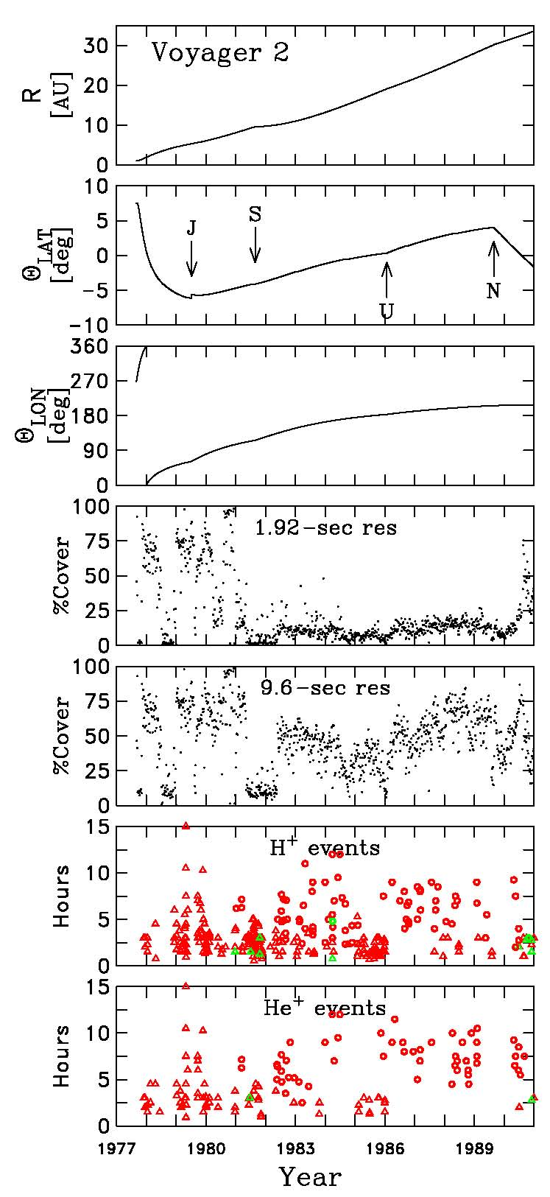
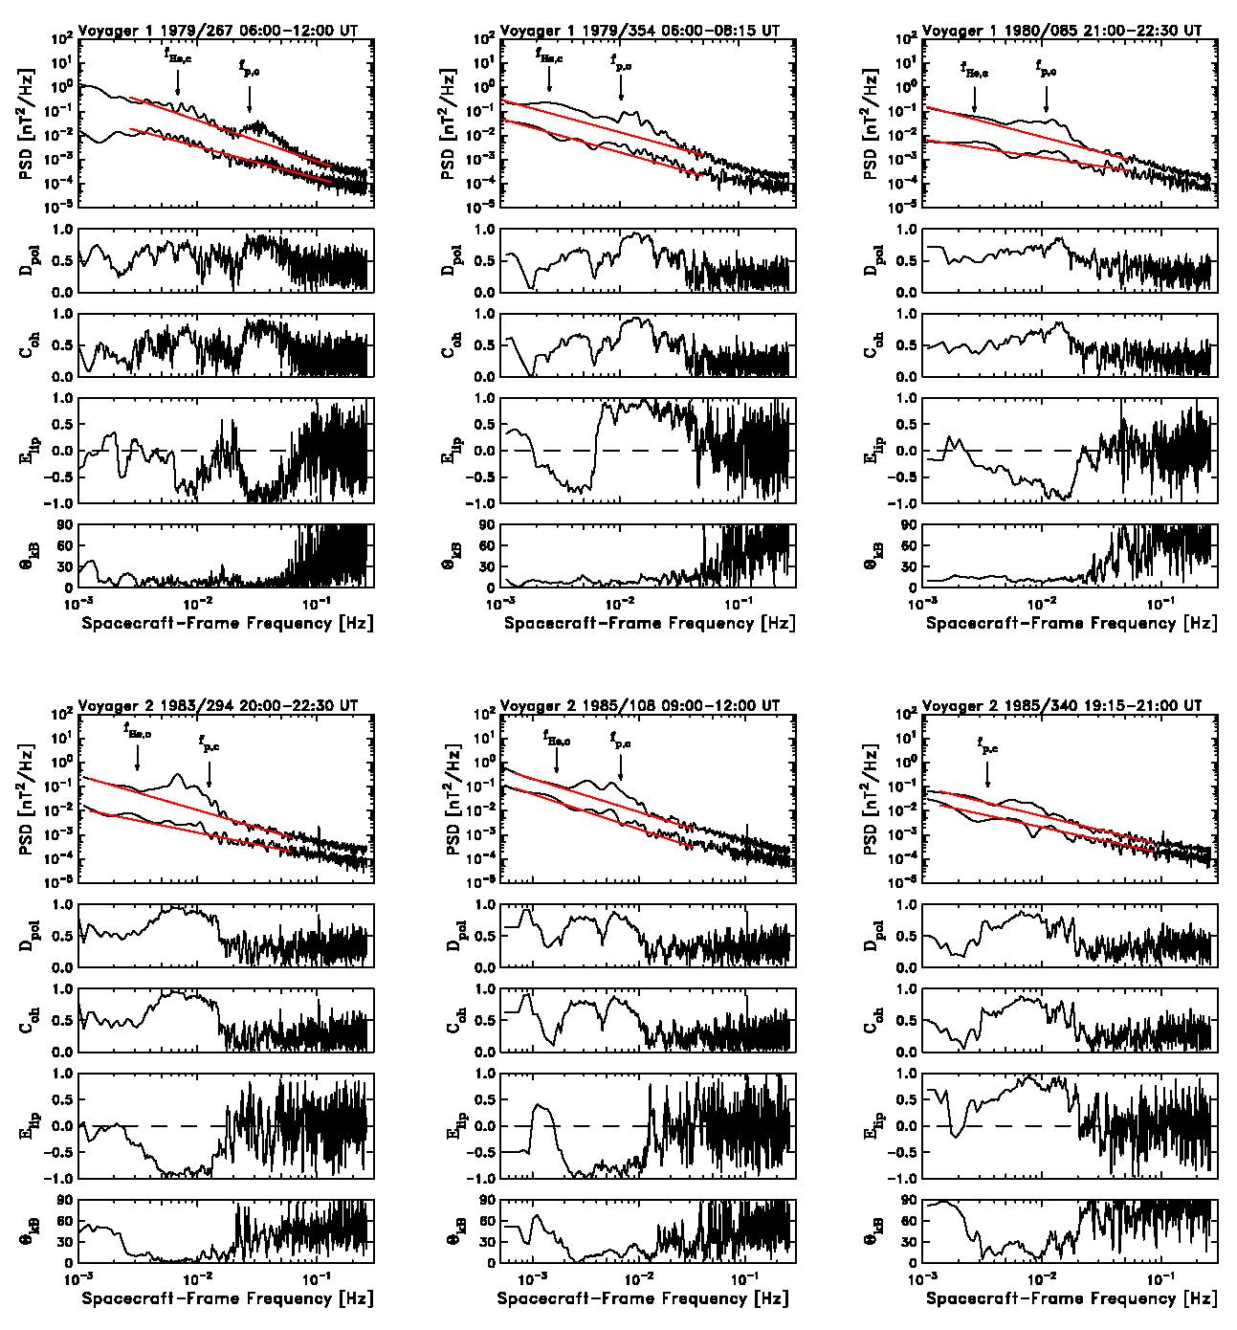
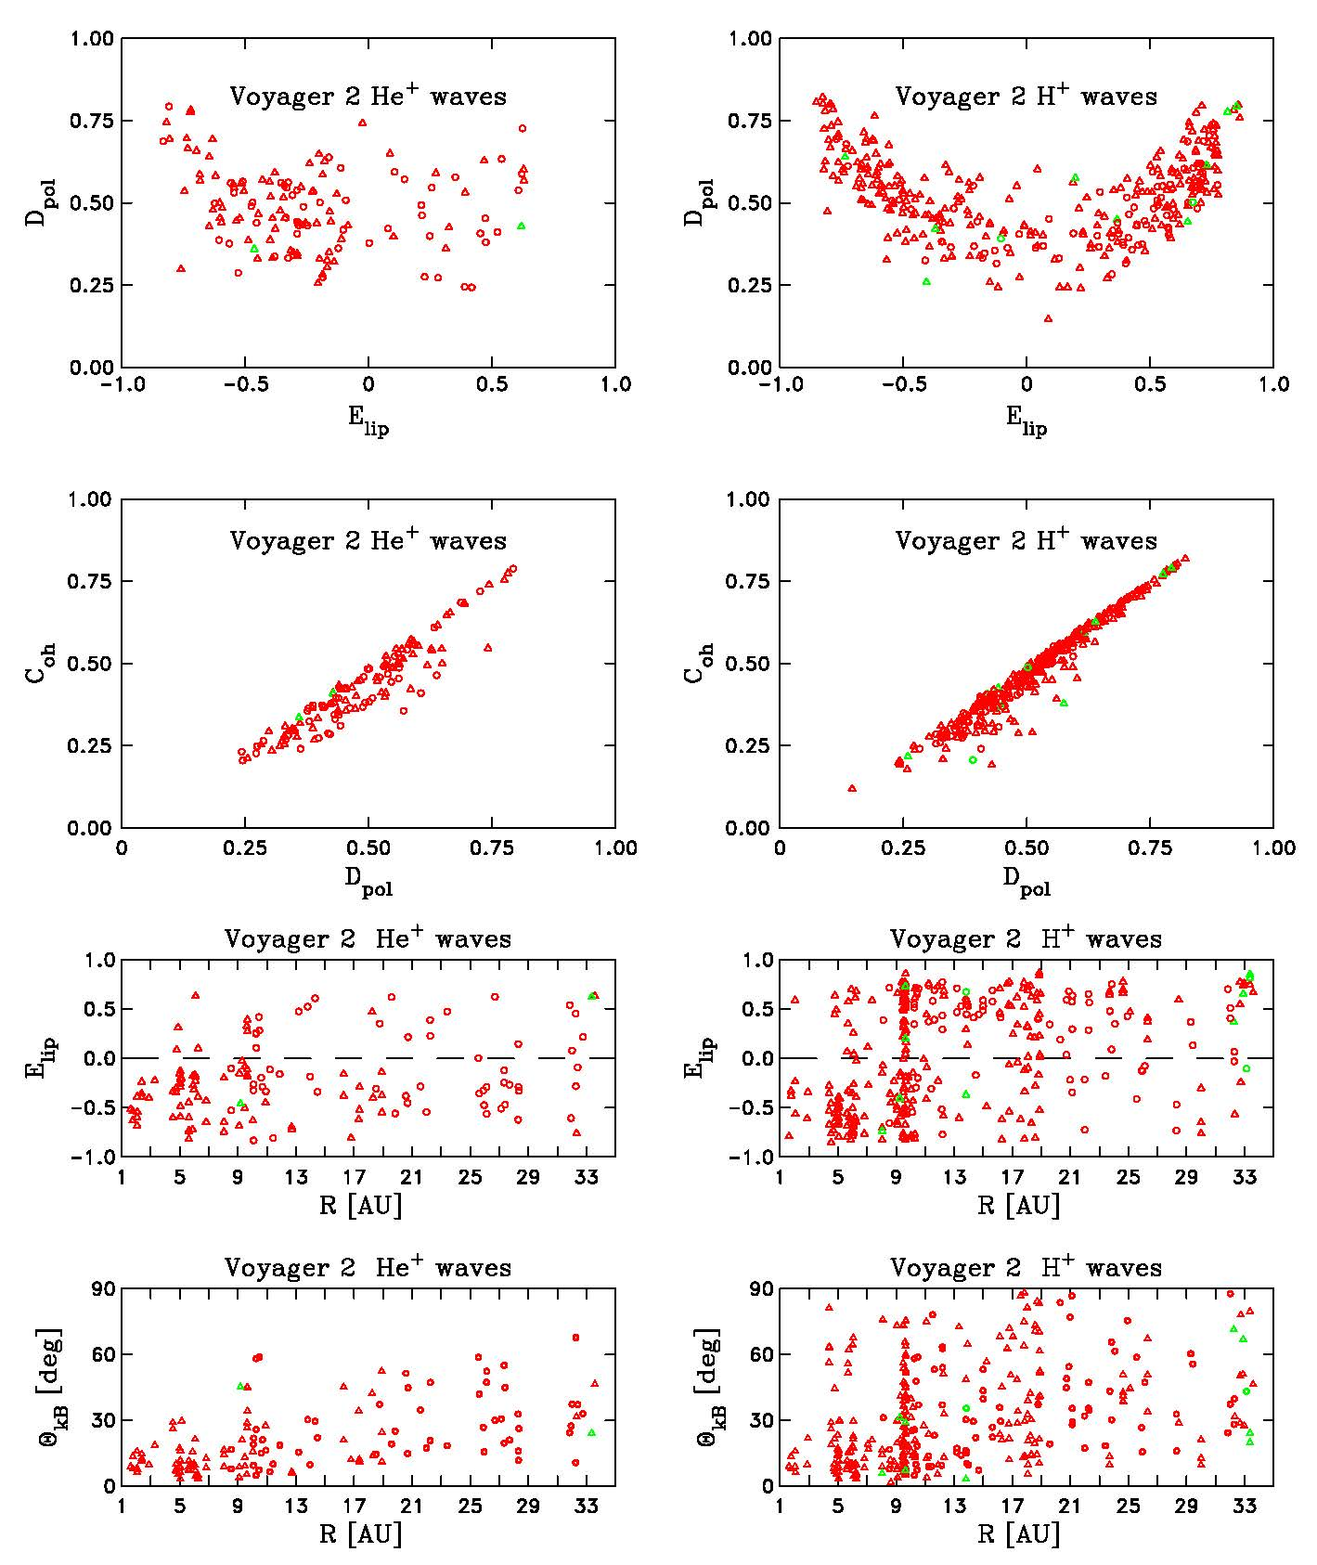
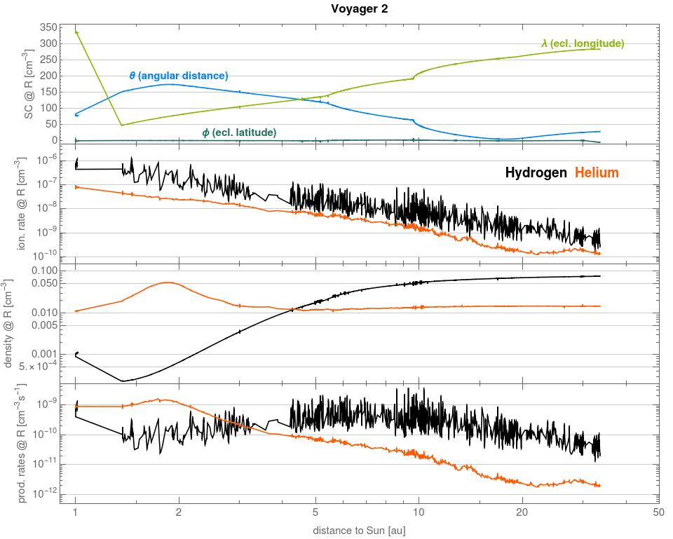
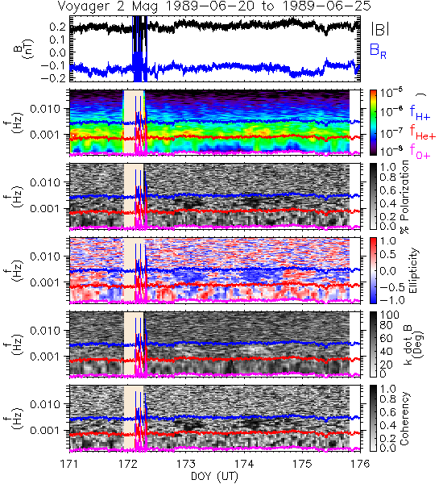
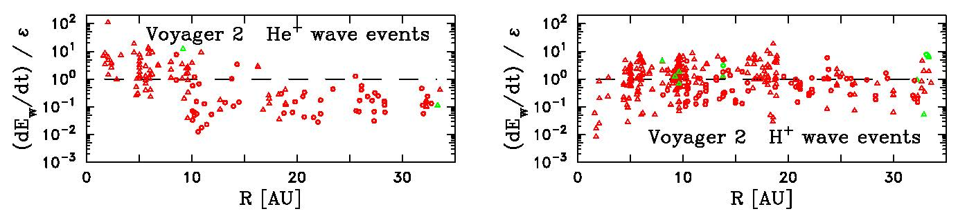
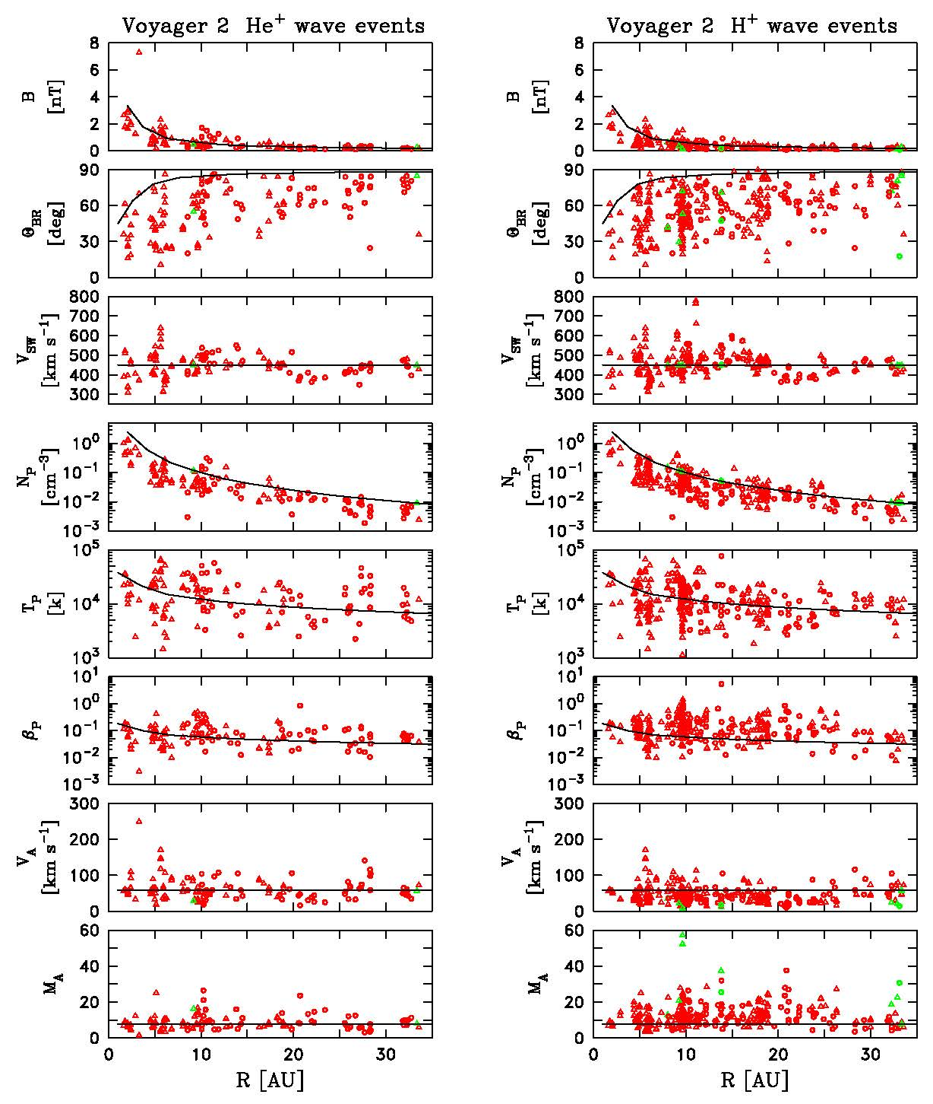
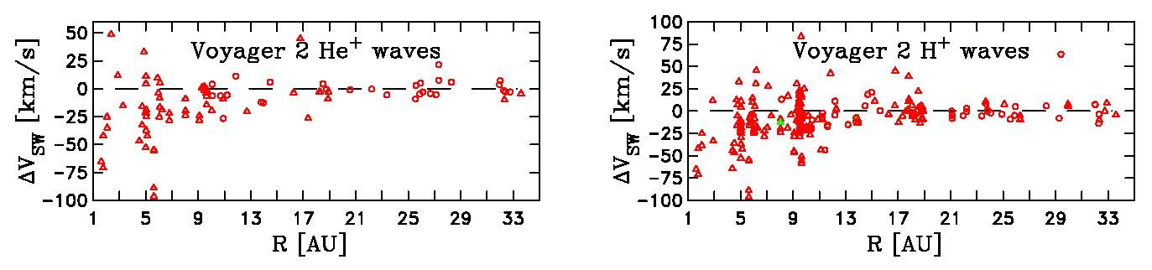
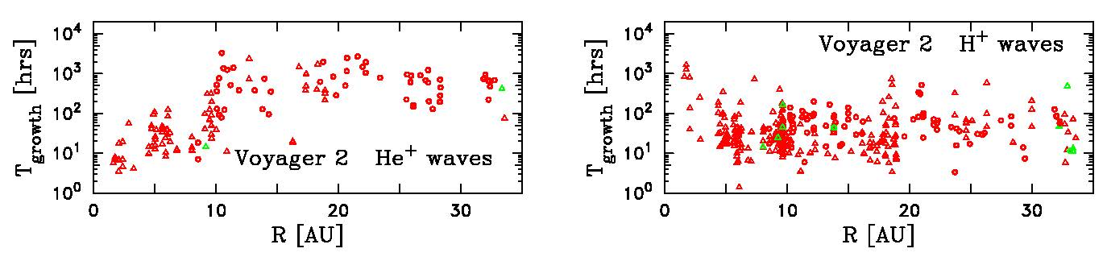
Magnetic Waves Excited by Newborn Interstellar Pickup Ions
Measured by the Voyager Spacecraft From 1 to 45 AU
Sophia J. Hollick, Charles W. Smith, Zackary B. Pine, Matthew R. Argall, Colin J. Joyce,
Philip A. Isenberg, Bernard J. Vasquez, Nathan A. Schwadron, Justyna M. Sokół, Maciej Bzowski, Marzena A. Kubiak
Abstract: We have surveyed the Voyager magnetic field data from launch through 1990 in search of low-frequency waves that are excited by newborn interstellar pickup ions. During this time the Voyager 1 and 2 spacecraft reach 43.5 AU and 33.6 AU, respectively. The use of daily spectrograms permits us to perform a thorough search of the data. We have identified 637 different data intervals that show evidence of waves excited by either pickup He₊, H⁺ or both and these intervals extend to the furthest distances in the years studied. To compare wave features against more typical interplanetary observations, we also employ 1675 data intervals spanning the same years that do not contain wave signatures and use these as control intervals. While the majority of wave events display the classic spectral characteristics of waves due to pickup ions, including left-hand polarization in the spacecraft frame, a significant number of the events are right-hand polarized in the spacecraft frame. We have no complete explanation for this result, but we do show that right-handed waves are seen when the local magnetic field is non-radial. We follow the idea put forward by Cannon et al. [2014] and followed by Fisher et al. [2016] and Aggarwal et al. [2016] wherein the necessary condition for the observation of the waves is that the wave growth rate exceeds the background turbulence rate. We explore this idea and build on the conclusions of our previous papers using data from ACE and Ulysses that the waves are typically observed in rarefaction regions where the turbulence level is low and noise-dominated signals sometimes distort the computed background turbulence spectra.
(left) We have examined Voyager 1 & 2 magnetic field data in search of waves due to newborn interstellar pickup He⁺ and H⁺. We found 637 instances of wave activity that is attributed to one or both of these sources by examining both the 1.92s and the 9.6s data products.
We avoided observations that are close enough to the planets as to be possibly attributed to these sources.
We will focus on the Voyager 2 results. Voyage 1 is similar.
(left) Average wave polarizations over the range f_{ic} < f_{sc} < 2f_{ic} for the two ion sources in the Voyager 2 observations. The ellipticity carries the sign of the polarization so that E_{lip} > 0 (< 0) denotes right- (left-) hand polarization in the spacecraft frame. Waves are characterized by elevated degree of polarization, D_{pol}, elevated coherence, C_{oh}, and E_{lip} ≠ 0. The wave power is not always enhanced above background levels.
(left) We use the Warsaw Test Particle Model codes (Sokół et al., 2015) to model the rate of He⁺ (H⁺) pickup ion production with standard per neutral ionization rates (Sokół et al., 2016). The Voyager 1 analyses are similar.
We also use the wave generation theory of Lee & Ip (1987) by taking the derivative with respect to pickup ion density to obtain a rate of wave energy generation. This is valid so long as the scattering time is short compared with the wave growth time so that the distribution is assumed to pass through a series of equilibria.
We use the MHD extensions of the Kolmogorov formalism to represent the rate of turbulent energy cascade through the spectrum.
(above) Our primary means of finding the waves is the examination of daily spectro-grams. An example is given above.
(above) Six examples of the type of wave observations we found in our search. Waves should be sunward propagating fast-mode waves and right-hand polarized in the plasma frame. The pickup ions have very little energy in the Sun’s frame of reference (moving at 24 km/s) so their speed in the plasma frame is the solar wind speed. The resulting wave signature exists only at f_{sc} ≥ f_{ic}. The Doppler shift will make these waves left-hand polarized in the spacecraft frame.
Some wave intervals show only indications of waves due to He⁺ or H⁺ while some show both and some are difficult to resolve. There may be evidence of particle acceleration in some events and enhanced particle scattering in others.
Some wave intervals have the “wrong” polarization and are right-hand polarized in the spacecraft frame. This was seen in the ACE and Ulysses observations at about the 10% level (Cannon 2014a, Aggarwal 2016, Fisher 2016). Here, the rate is much higher.
(above) When waves are observed, the local rate of wave excitation compares to the turbulence rate as (dE_{W}/dt)/ε > 0.1 where > 1 would be desired. Still, the ratio of rates for the control intervals is < 0.01.
(left) The mean solar wind parameters for each of the 637 wave events found in this study.
The mean field strength, B, the solar wind speed, V_{SW}, and the proton temperature, T_{P}, are typical of solar wind conditions.
However, the mean field is more radial than expected; the proton density, N_{P}, and Alfven speed, V_{A}, are lower than expected; and the proton beta, β_{P}, and Alfven Mach number, M_{A}, are higher.
(above) To better identify the ambient conditions when waves are found, we subtract the average wind speed computed 12 to 24 hours before the start of the wave event from the average wind speed computed 12 to 24 hours after the wave event. Negative values indicate that the waves are found within rarefaction intervals. Rarefactions are not essential to finding the waves – low turbulence levels are essential to finding the waves. Rarefaction regions are a good place to find weak turbulence rates.
References:
Argall et al., The Astrophysical Journal, 849, 61, 2017.
(Erratum: The Astrophysical Journal, 854, 77, 2018.)
Hollick et al., The Astrophysical Journal, 863, 75, 2018.
Hollick et al., The Astrophysical Journal, 863, 76, 2018.
Hollick et al., The Astrophysical Journal Supplement, 237, 34, 2018.
Lee & Ip, Journal of Geophysical Research, 92, 11041, 1987.
Sokół, et al., The Astrophysical Journal Supplement, 220, 27, 2015.
Sokół, et al., MNRAS, 458(4), 3691-3704, 10.1093/mnras/stw515, 2016.
Acknowledgements: C.W.S., P.A.I., S.H., and Z.B.P. are supported by NASA grant NNX17AB86G. B.J.V. is supported by NSF grant AGS1357893. C.J.J. and N.A.S. are supported by the Interstellar Boundary Explorer mission as a part of NASA’s Explorer Program, partially by NASA SR&T Grant NNG06GD55G, and the Sun-2-Ice (NSF grant number AGS1135432) project. C.W.S., B.J.V., P.A.I., and N.A.S. were partially supported by NASA grant 80NSSC17K0009. J.M.S., M.B., and M.A.K. acknowledge the support by the Polish National Science Center grant 2015/19/B/ST9/01328. The data used in this analysis are available from the NSSDC. S.H. is now a sophomore undergraduate at Rensselaer Polytechnic Institute. Z.B.P. is now a sophomore undergraduate at Boston University.
(above) Growth times computed as the time required for the instability to reach the observed wave energy. The He⁺ resonance requires many AU at distances R > 10 AU while the H⁺ resonance requires ≤ 1 AU.
There is no indication that the excitation and observation of low-frequency magnetic waves by newborn interstellar pickup ions should cease beyond 35 AU.

