Slide 1


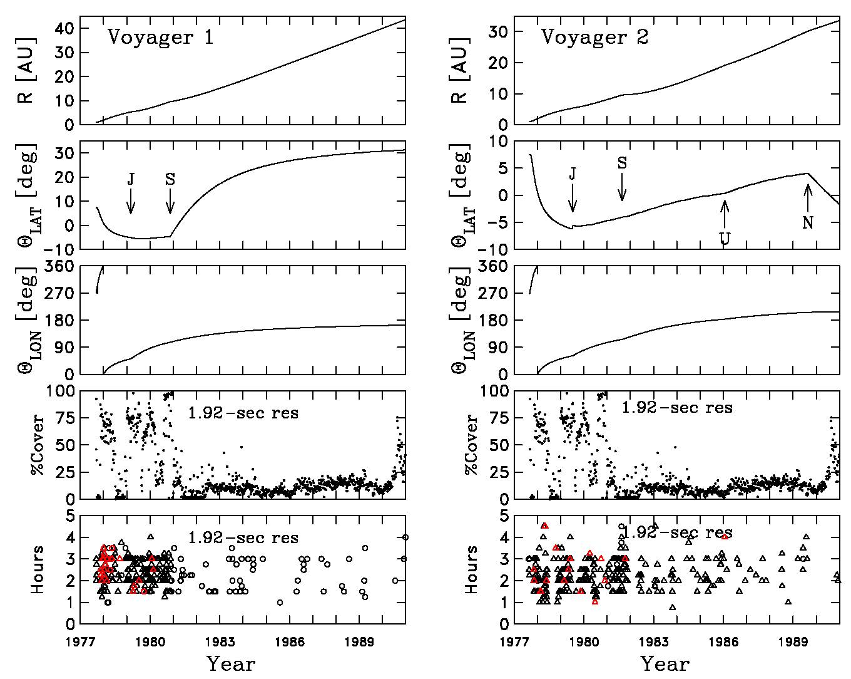
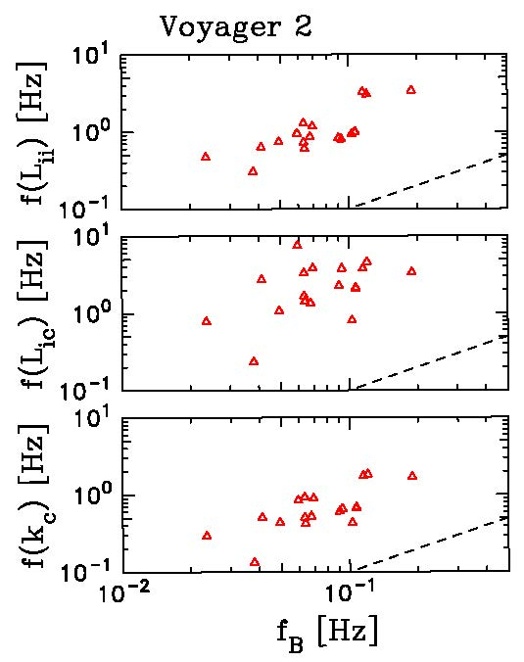
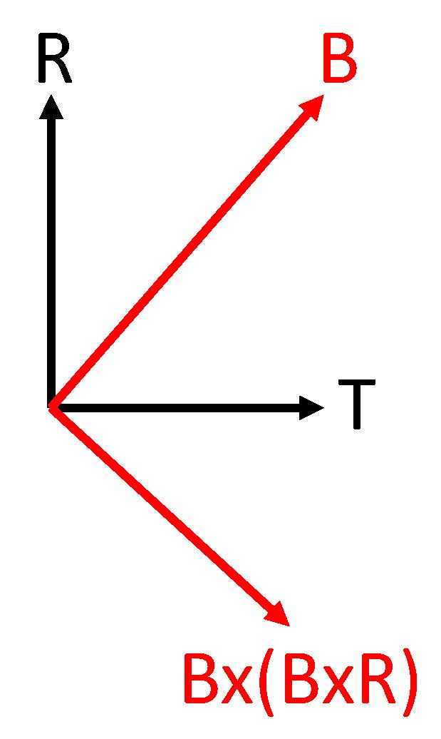
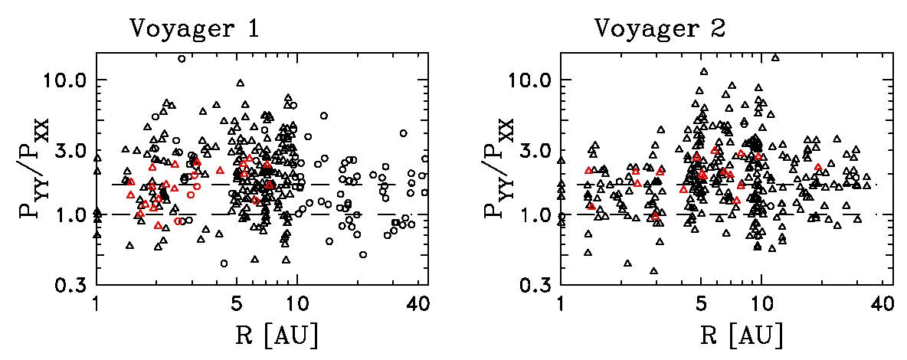
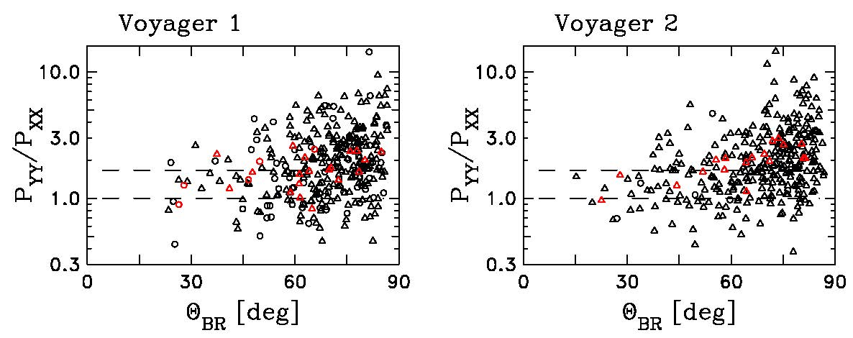
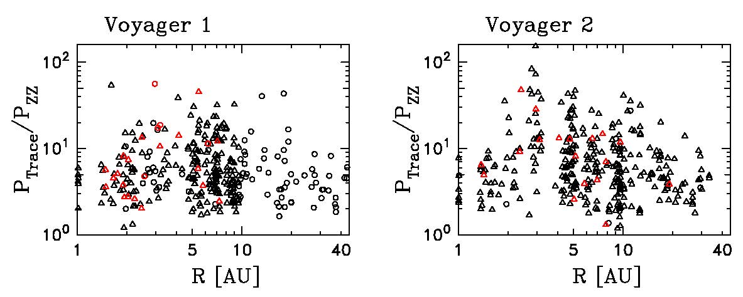
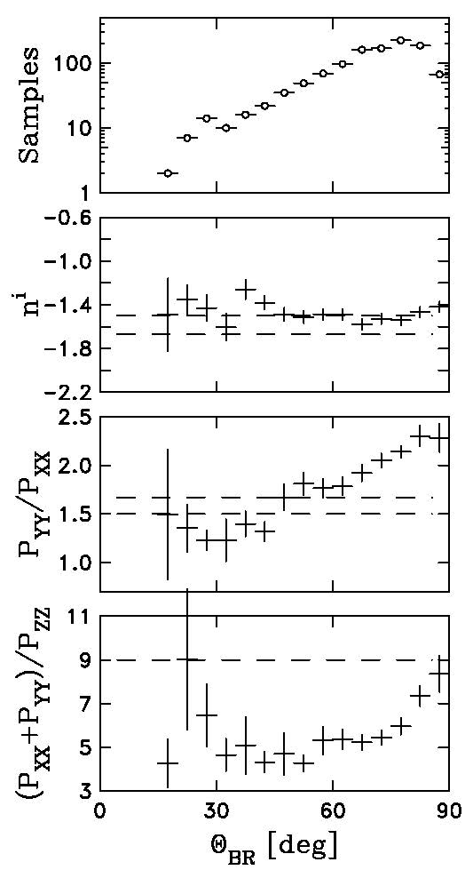
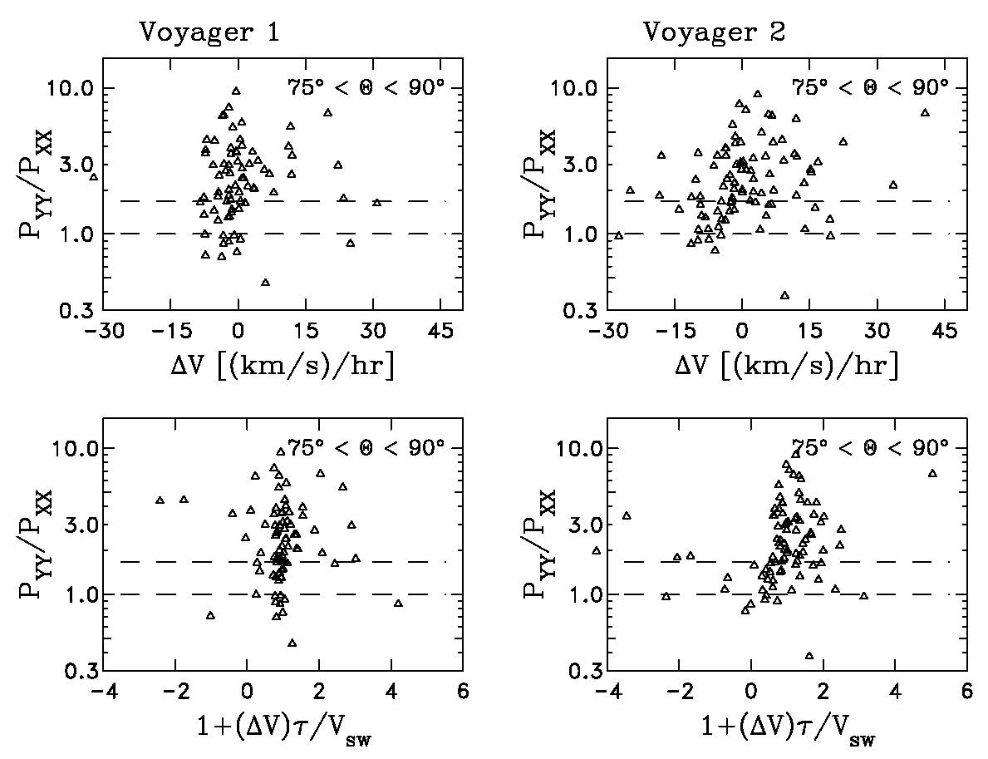
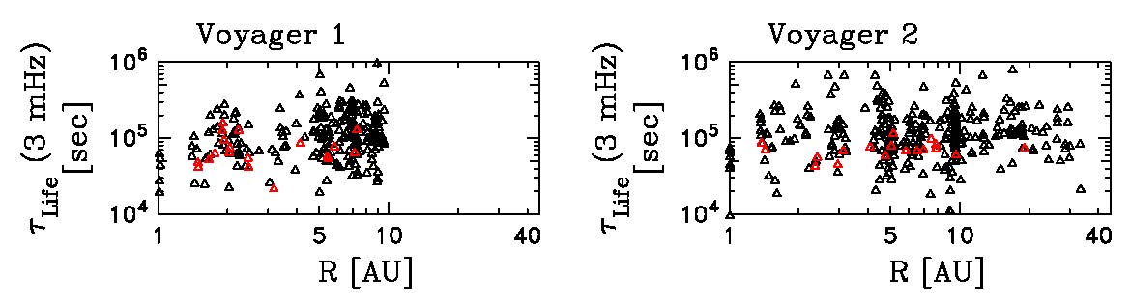
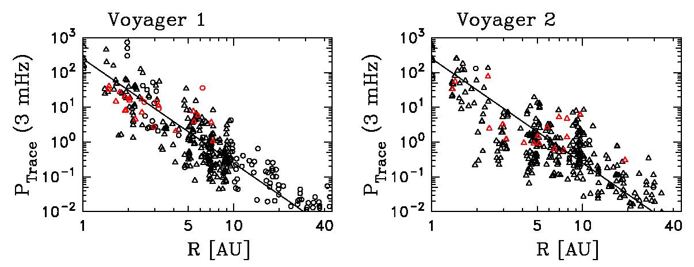
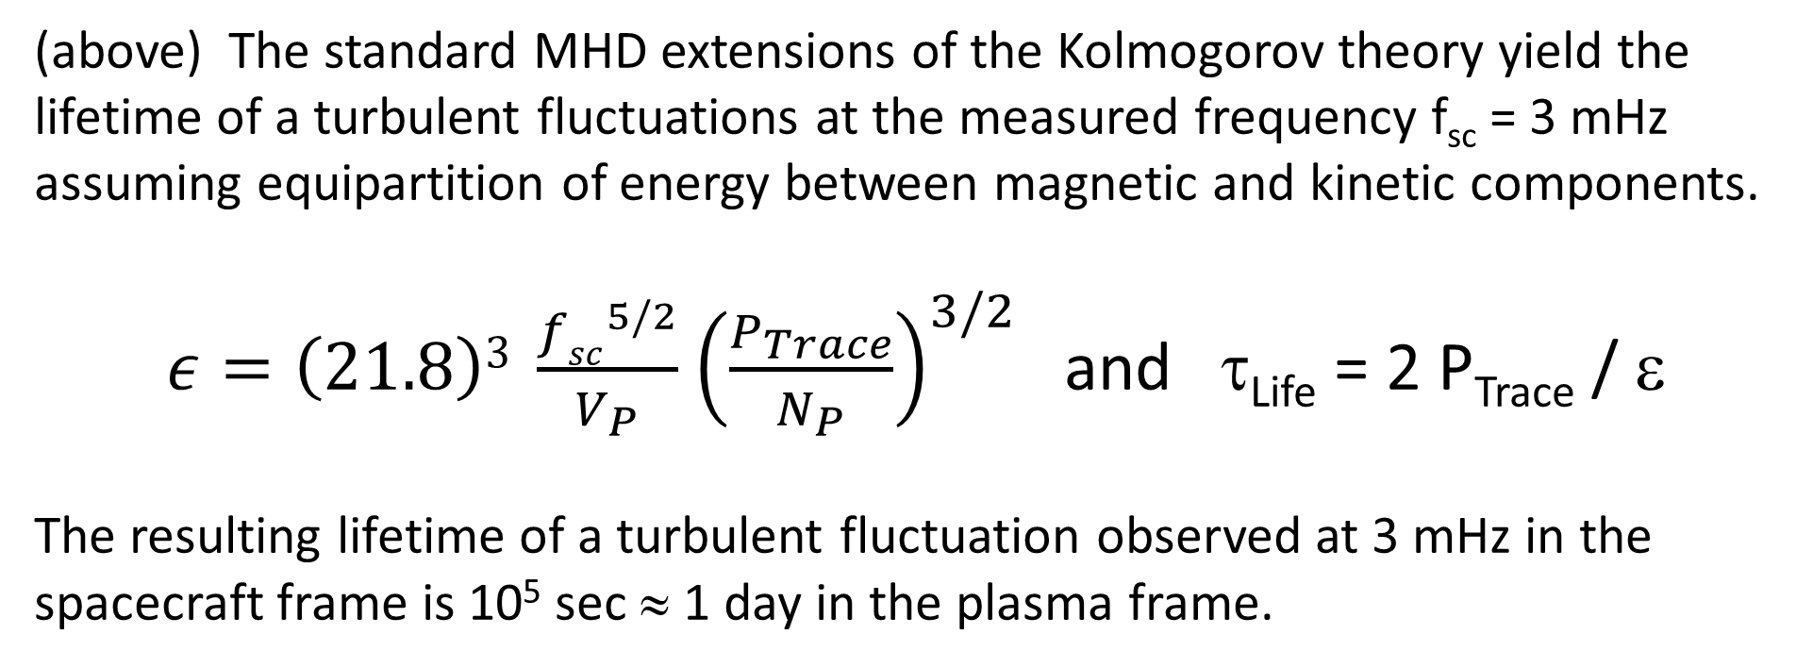
Expansion Effects in Voyager Magnetic Field Spectra
Zackary B. Pine, Charles W. Smith, Sophia J. Hollick, Colin J. Joyce, Bernard J. Vasquez,
Philip A. Isenberg, Matthew R. Argall, and Megan L. McLaurin
Abstract: Analysis of Voyager 1 & 2 magnetic field data from 1 to 15 AU reveals an unexpected anisotropy within the inertial range of the power spectrum. Unlike the results from 1 AU presented by Belcher & Davis [JGR, 76, 3534, 1971], which revealed a variance anisotropy that is essentially isotropic in the 2D plane perpendicular to the mean magnetic field and which was further addressed by Bieber et al. [JGR, 101, 2511, 1996] as arising from an admixture of 1D and 2D wave vector anisotropies, we find a highly anisotropic variance anisotropy in the perpendicular plane. We account for this by considering expansion effects which reduce the fluctuation energy for the magnetic component in the Radial direction. We explore the possibility that expansion at heliocentric distances less than 15 AU results in this new form of variance anisotropy and we raise the suggestion that the same effect may be contributing to the earlier observations of Belcher & Davis.
(left) We have examined the spectra for the 42 intervals with spectral breaks associated with dissipation. The 24 intervals observed by Voyager 1 show insufficient variability to demonstrate scaling with ambient plasma parameters. The 18 intervals observed by Voyager 2 (all of which have PLS data) produced the above scaling which suggests that dissipation scales with the ion inertial length, L_{ii}. The values of L_{ii} computed across the data set studied here indicates that the frequency range 3 mHz < f_{sc} < 10 mHz provides a suitable characterization of the inertial range dynamics.
We compute two forms of anisotropy for the fluctuating magnetic field using the definitions to the left where
Y ≡ (BxR), X ≡ Bx(BxR), Z = B.
The anisotropy between the trace elements of the power spectral density matrix,
1 < P_{YY}/P_{XX} < |n_{i}|,
was shown by Bieber et al. (1996) to describe the ratio of perpendicular to field-aligned wave vector energy in a uniform solar wind.
The anisotropy (P_{XX}+P_{YY})/P_{ZZ} describes the degree of compression.
(right) The P_{YY}/P_{XX} anisotropy computed over the range 3 to 10 mHz is shown as a function of heliocentric distance, R, and angle between the mean field and radial direction. The values greatly exceed the upper limit given by the spectral index, n_{i}, and cannot be explained by the Bieber et al. analysis.
We explored the possibility that expansion affects the power spectrum under the assumption that the time available to alter the spectrum is the turbulent lifetime of the fluctuations.
Uniform spherical expansion acts to increase the anisotropy, but the lifetime is inadequate to achieve the observed anisotropies.
(above) Trajectory of the Voyager 1 & 2 spacecraft along with data coverage, times and durations of the turbulence intervals used in this analysis. Planetary encounters are marked (J, S, U, N). Only 1.92s magnetic field data (MAG instrument) along with hourly averages of the thermal proton data (PLS instrument) are used in this study. Note loss of data coverage following the Saturn encounters. The Voyager 1 PLS instrument also failed shortly after Saturn. Red (black) triangles represent times when the power spectra show (do not show) a clear spectral break in association with dissipation. Circles represent times when the PLS data are not available. In total, 860 data intervals were used in this study. Of those, only 42 have clear spectral breaks and 766 have PLS data available at the same time.
(above) Ratio of total power to field-aligned component for the fit spectra evaluated at 3 mHz. The conclusion is that the magnetic fluctuations remain highly transverse to the mean field and are therefore largely non-compressive.
(above) The standard MHD extensions of the Kolmogorov theory yield the lifetime of a turbulent fluctuations at the measured frequency f_{sc} = 3 mHz assuming equipartition of energy between magnetic and kinetic components.
$ε=\left(21.8\right)3 \frac{{fsc}^{5/2}}{V_{P}}$ ${\left(\frac{P_{Trace}}{N_{P}}\right)}^{3/2}$ and τ_{Life} = 2 P_{Trace} / ε
The resulting lifetime of a turbulent fluctuation observed at 3 mHz in the spacecraft frame is 10⁵ sec ≈ 1 day in the plasma frame.
(above) Statistics of the measured anisotropy as a function of the angle between the mean field and radial direction. (top to bottom) The number of data intervals used that also have PLS data available, the average index of the trace spectra computed over the range 3 to 10 mHz, the ratio of power in the two perpendicular components, and the ratio of the power in the perpendicular to parallel components.
We explore the possible explanation due to uniform spherical expansion, compression and rarefaction flows. Uniform spherical expression yields the correct sense of anisotropy, but is only a 10% effect.
In our compression and rarefaction analysis, ΔV is the difference in the wind speed from one hour before minus one hour after the analysis interval. Negative values indicate rarefaction while positive values are compression.
Rarefaction decreases P_{YY} while leaving P_{XX} unchanged, thereby reducing the anisotropy P_{YY}/P_{XX}.
Compression increases P_{YY} while leaving P_{XX} unchanged, thereby increasing the anisotropy P_{YY}/P_{XX}.
The value of 1 + (ΔV)τ/V_{SW} represents the fractional volume change due to rarefaction or compression flow and should equal the ratio P_{YY}/P_{XX}. The trend does not show good agreement with expectation even though the elevated values of the anisotropy are associated with compressive flow.
(above) We fit a power law to the measured trace of the power spectral density matrix and evaluate the resulting power at 3 mHz. The radial variation of the resulting power level is shown above. The fit curve is determined by WKB theory which is in close agreement with turbulent transport predictions.
References:
Belcher and Davis, Large-amplitude Alfven waves in the interplanetary medium, 2, J. Geophys. Res., 76, 3534-3563, 1971.
Bieber et al., Dominant two-dimensional solar wind turbulence with implications for cosmic ray transport, J. Geophys., Res., 101, 2511-2522, 1996.
Pine et al., Voyager Observations of Turbulence from 1 to 45AU: Evidence of Dissipation of Magnetic Fluctuations, in preparation.
Pine et al., Voyager Observations of Turbulence from 1 to 45AU: Evidence of Expansion Effects in Magnetic Fluctuations, in preparation.
Acknowledgments: S.H., P.A.I., Z.B.P., and C.W.S. and are supported by NASA grant NNX17AB86G. B.J.V. is supported by NSF grant AGS1357893. C.J.J. is supported by the Interstellar Boundary Explorer mission as a part of NASAs Explorer Program, partially by NASA SR&T Grant NNG06GD55G, and the Sun-2-Ice (NSF grant number GS1135432) project. C.W.S., B.J.V., and P.A.I. are partially supported by NASA grant 80NSSC17K0009.
The data used in this analysis are available from the NSSDC.

