Slide 1


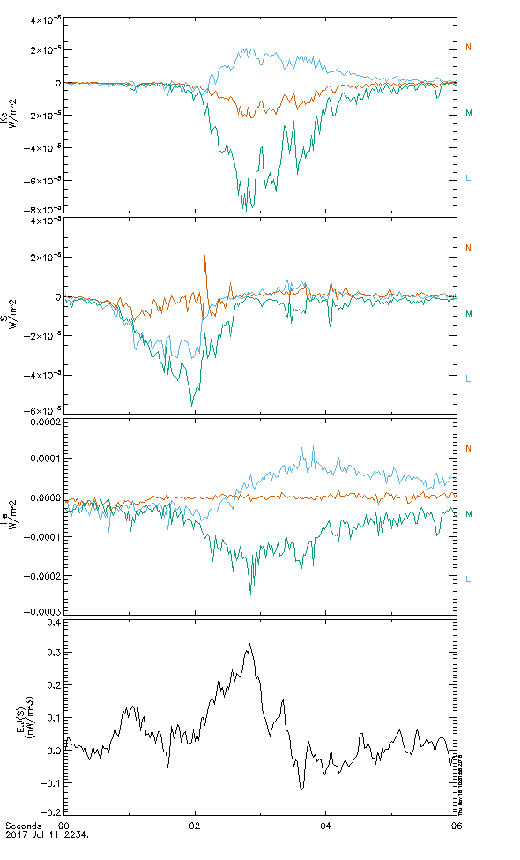
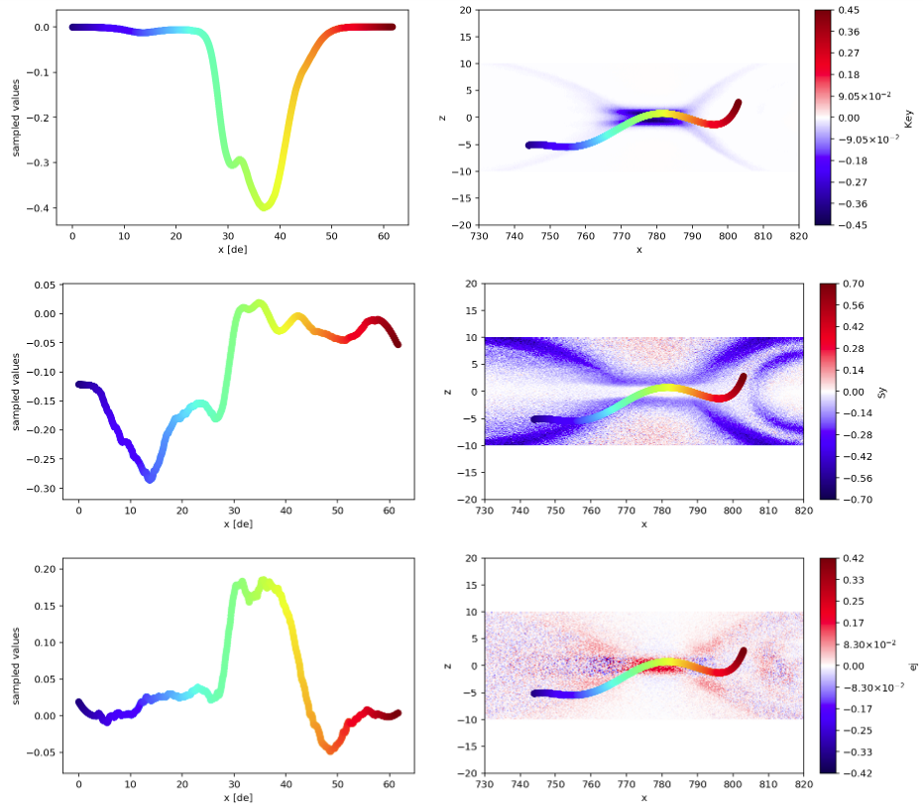
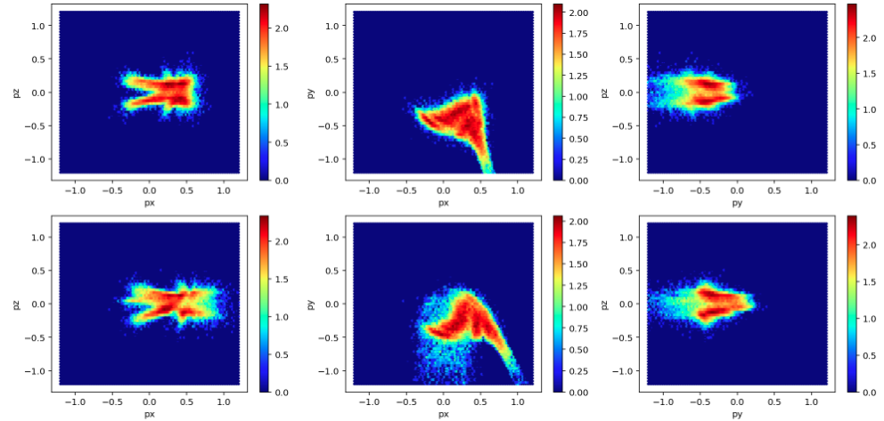
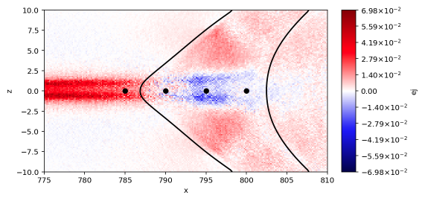
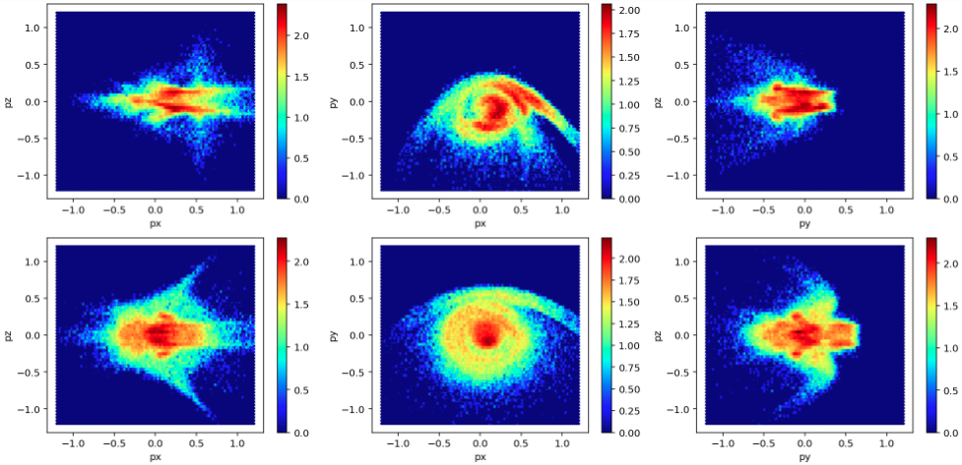
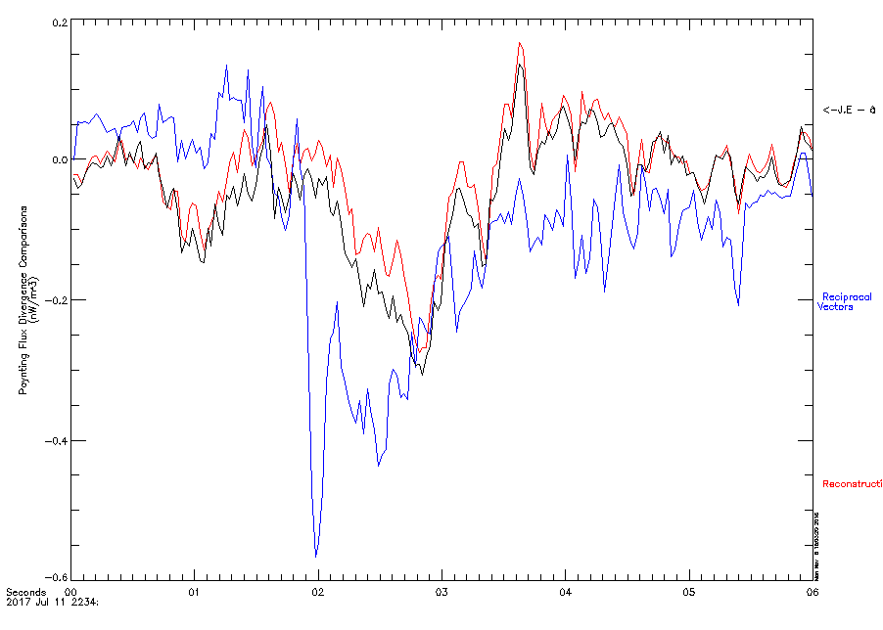
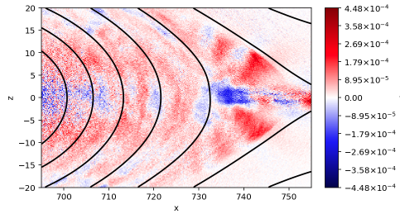
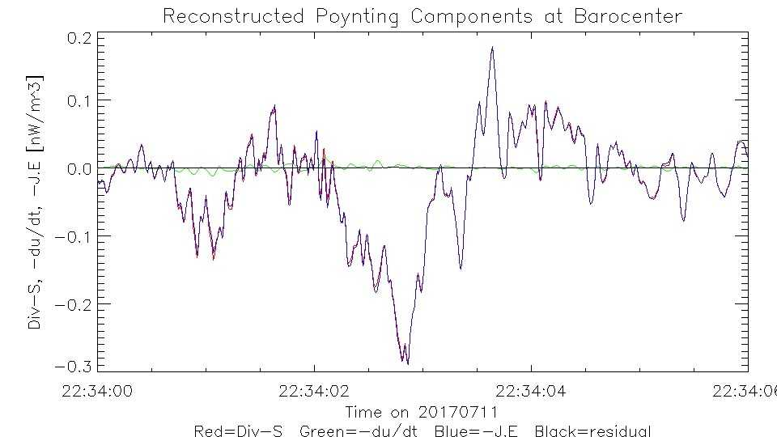
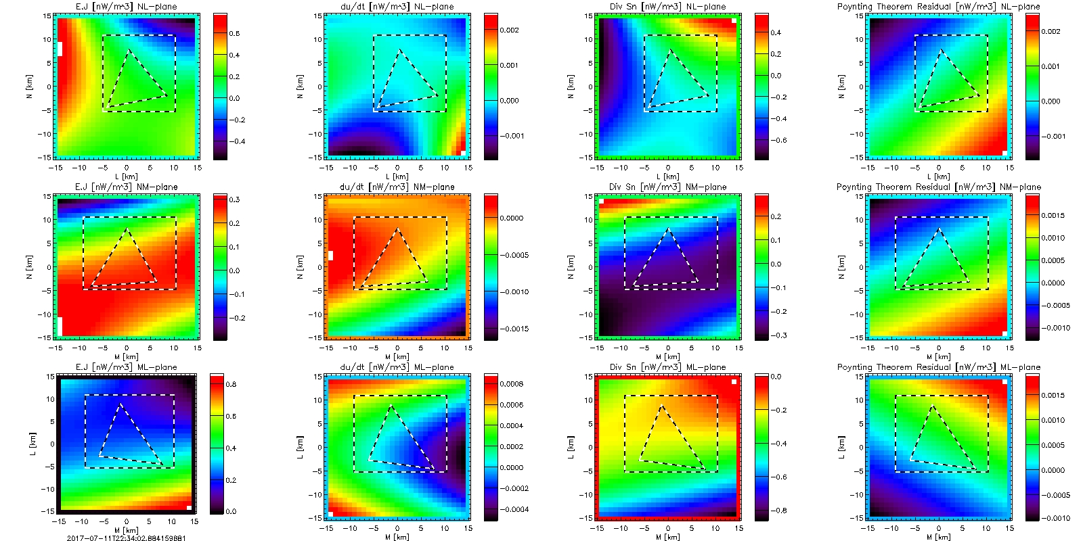
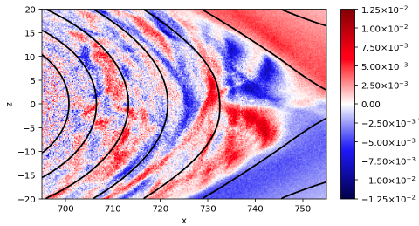
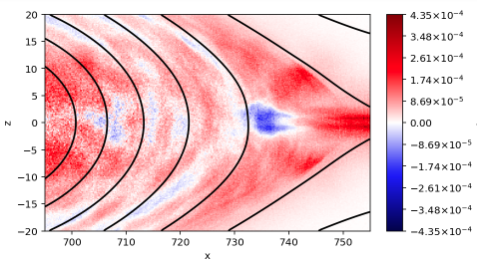
Particle Dynamics in Regions of Energy Transfer During Magnetic Reconnection
D.S. Payne¹, M. Argall¹, I. Dors¹, K. Genestreti¹, R. Torbert¹
1) University of New Hampshire
Abstract
Energy Flux in the EDR
With the use of 2D particle in cell (PIC) simulations as well as Magnetospheric Multiscale (MMS) data, we investigate how energy manifests itself inside of and near the electron diffusion region (EDR). We look at the spatial and temporal evolution of the electromagnetic energy dissipation J∙E’, which has been found to be negative in some regions, indicating a transfer of energy from the plasma back into the surrounding magnetic field. As an aid to this study, we also look at the energy flux associated with mechanical energy in the plasmas, such as kinetic energy flux and enthalpy flux, as well as Poynting flux, which describes the flow of electromagnetic energy. Along with identifying the mechanisms of energy transfer in these regions, we also examine the electron velocity distribution functions (vDFs) to investigate the particle dynamics involved in these processes. This information contributes to a better understanding of the overall energy transfer and flow between magnetic fields and plasmas during magnetic reconnection.
Three regions of energy transfer were observed along the spacecraft trajectory while crossing through the EDR:
Ke_{y}
Energy Buildup (blue)
  A slight drop in J∙E is observed corresponding to an increase in Poynting Flux
Energy transfer to electrons (red)
  A sharp increase in J∙E and a decrease in Poynting flux as enthalpy and kinetic energy flux increase
Relaxation (green)
  J∙E and kinetic energy flux drop back to zero, while enthalpy flux starts to steadily diminish
Energy Dissipation in a PIC Simulation
S_{y}
1
1
2
3
4
J∙E
2
J∙E
3
Toward the edge of the current sheet, there are regions of - J∙E
In these regions, swirl structures in V_{x}-V_{y} begin to emerge
This is where electrons are partially remagnetized, accelerating in y due to E_{y} and gyrating about B_{z} (Bessho et. Al.)
Just beyond this exhaust region, ring structures begin to emerge indicating remagnetization
Poynting’s Theorem and Field Reconstruction
4
Poynting’s Theorem: ∇∙ S = -∂u/∂t – J∙E
Poynting’s theorem, essentially the conservation of energy, says that the rate of energy transfer per unit volume is equal to the rate of work done on the plasma plus the energy flux leaving the volume
v_{z}
v_{y}
v_{z}
nW/m³
Three methods of calculating ∇∙ S at the barycenter :
v_{x}
v_{x}
v_{y}
⟨-∂u/∂t – J∙E⟩
Spacecraft averaged ⟨-∂u/∂t – J∙E⟩
reciprocal vector method
New field reconstruction technique
On this event, the reciprocal vector method overestimates ∂S_{M}/∂M
Reconstruction ∇∙ S closely matches the spacecraft averaged ⟨-∂u/∂t – J∙E⟩
J∙E
Reciprocal Vector
Reconstruction
Along the separatrix, regions can briefly develop where J∙E becomes patchy
This is indicative of energy transfer back and forth from the fields to the electrons and vice versa
This pattern seems to come predominantly from the electron J_{z}
This pattern seems to become less ordered and more turbulent for regions further from the x-line and is not sustained over time (not shown)
There is a similar pattern that develops along z = 0 where regions of - J∙E develop
This seems to come partially from the electron J_{y}, but this is not as obvious as the pattern along the separatrix
Reconstruction
J∙E
∂u/∂t
∇∙ S
Residual
J_{z}
Uses MMS measurements and finds solutions that satisfy Maxwell’s equations in all space
Closure of terms from Poynting’s theorem (left) shows the method is self-consistent
These terms can also be evaluated away from the barycenter (right)
nW/m³
- J∙E
-∂u/∂t
∇∙ S
Residual
J_{y}
Conclusions
Regions of - J∙E in the exhaust occur as swirl structures in the VDFs emerge.
Regions of patchy - J∙E along the separatrix, where particle energy is converted back into the fields, seem to come from the varying electron J_{z.}. This could be a result of the varying electron v_{z} as electrons gyrate along fields at the separatrix.
Along the spacecraft trajectory, the conversion of poynting flux to mechanical energy flux appears in and immediately near the current sheet
Using the spacecraft averaged ⟨-∂u/∂t – J∙E⟩ as a reference, the calculation of ∇∙ S via the reciprocal vector method doesn’t quite match, indicating that the linear gradient assumption is invalid here
With the new field reconstruction technique, the calculation of ∇∙ S at the barycenter is greatly improved
Reconstruction technique also allows for evaluation of similar quantities away from the barycenter and even outside of the MMS tetrahedron
Acknowledgements
FPI, EDP, and FGM teams for use of their data
We thank the successful MMS team for such wonderful data and NASA support via contract NNG04EB99C
Email: dsp1007@wildcats.unh.edu

