Slide 1


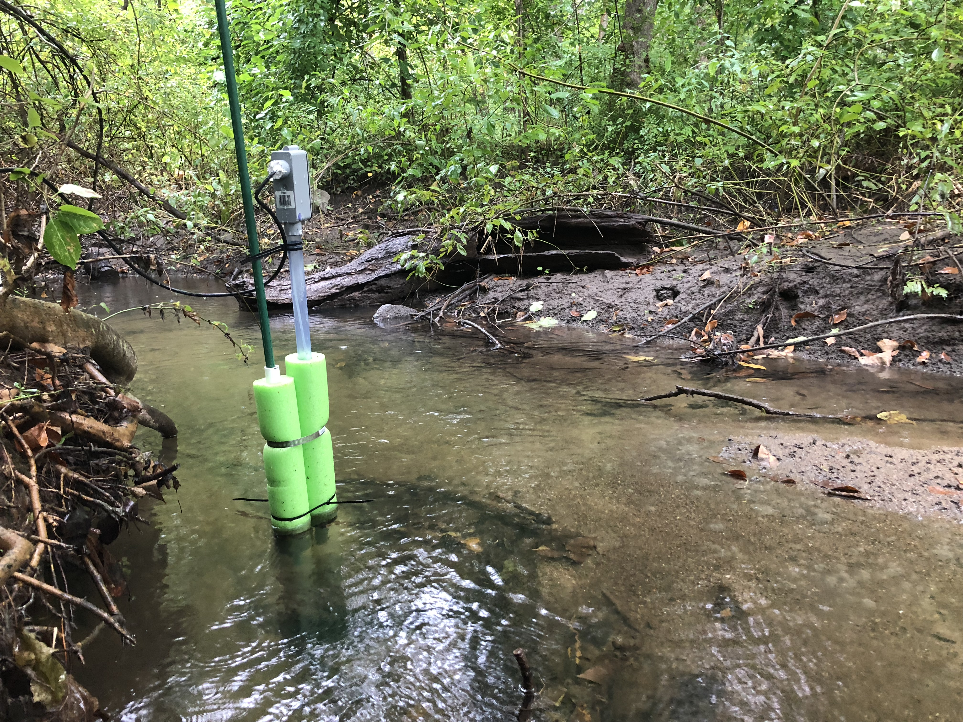
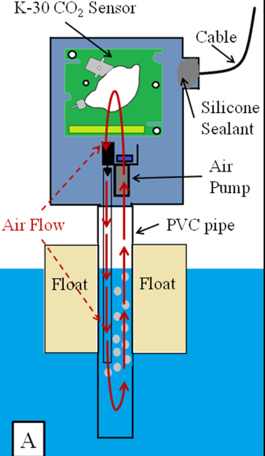

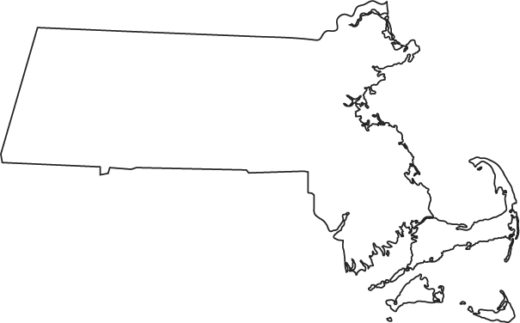
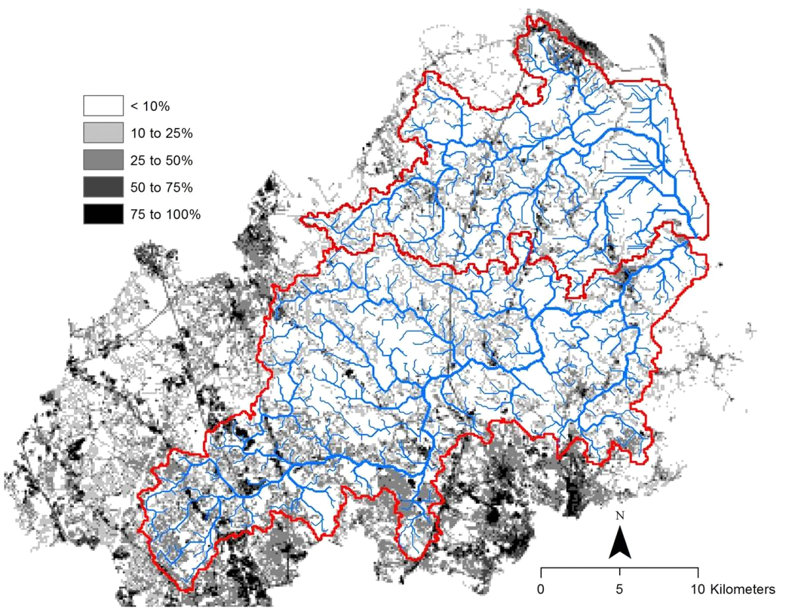
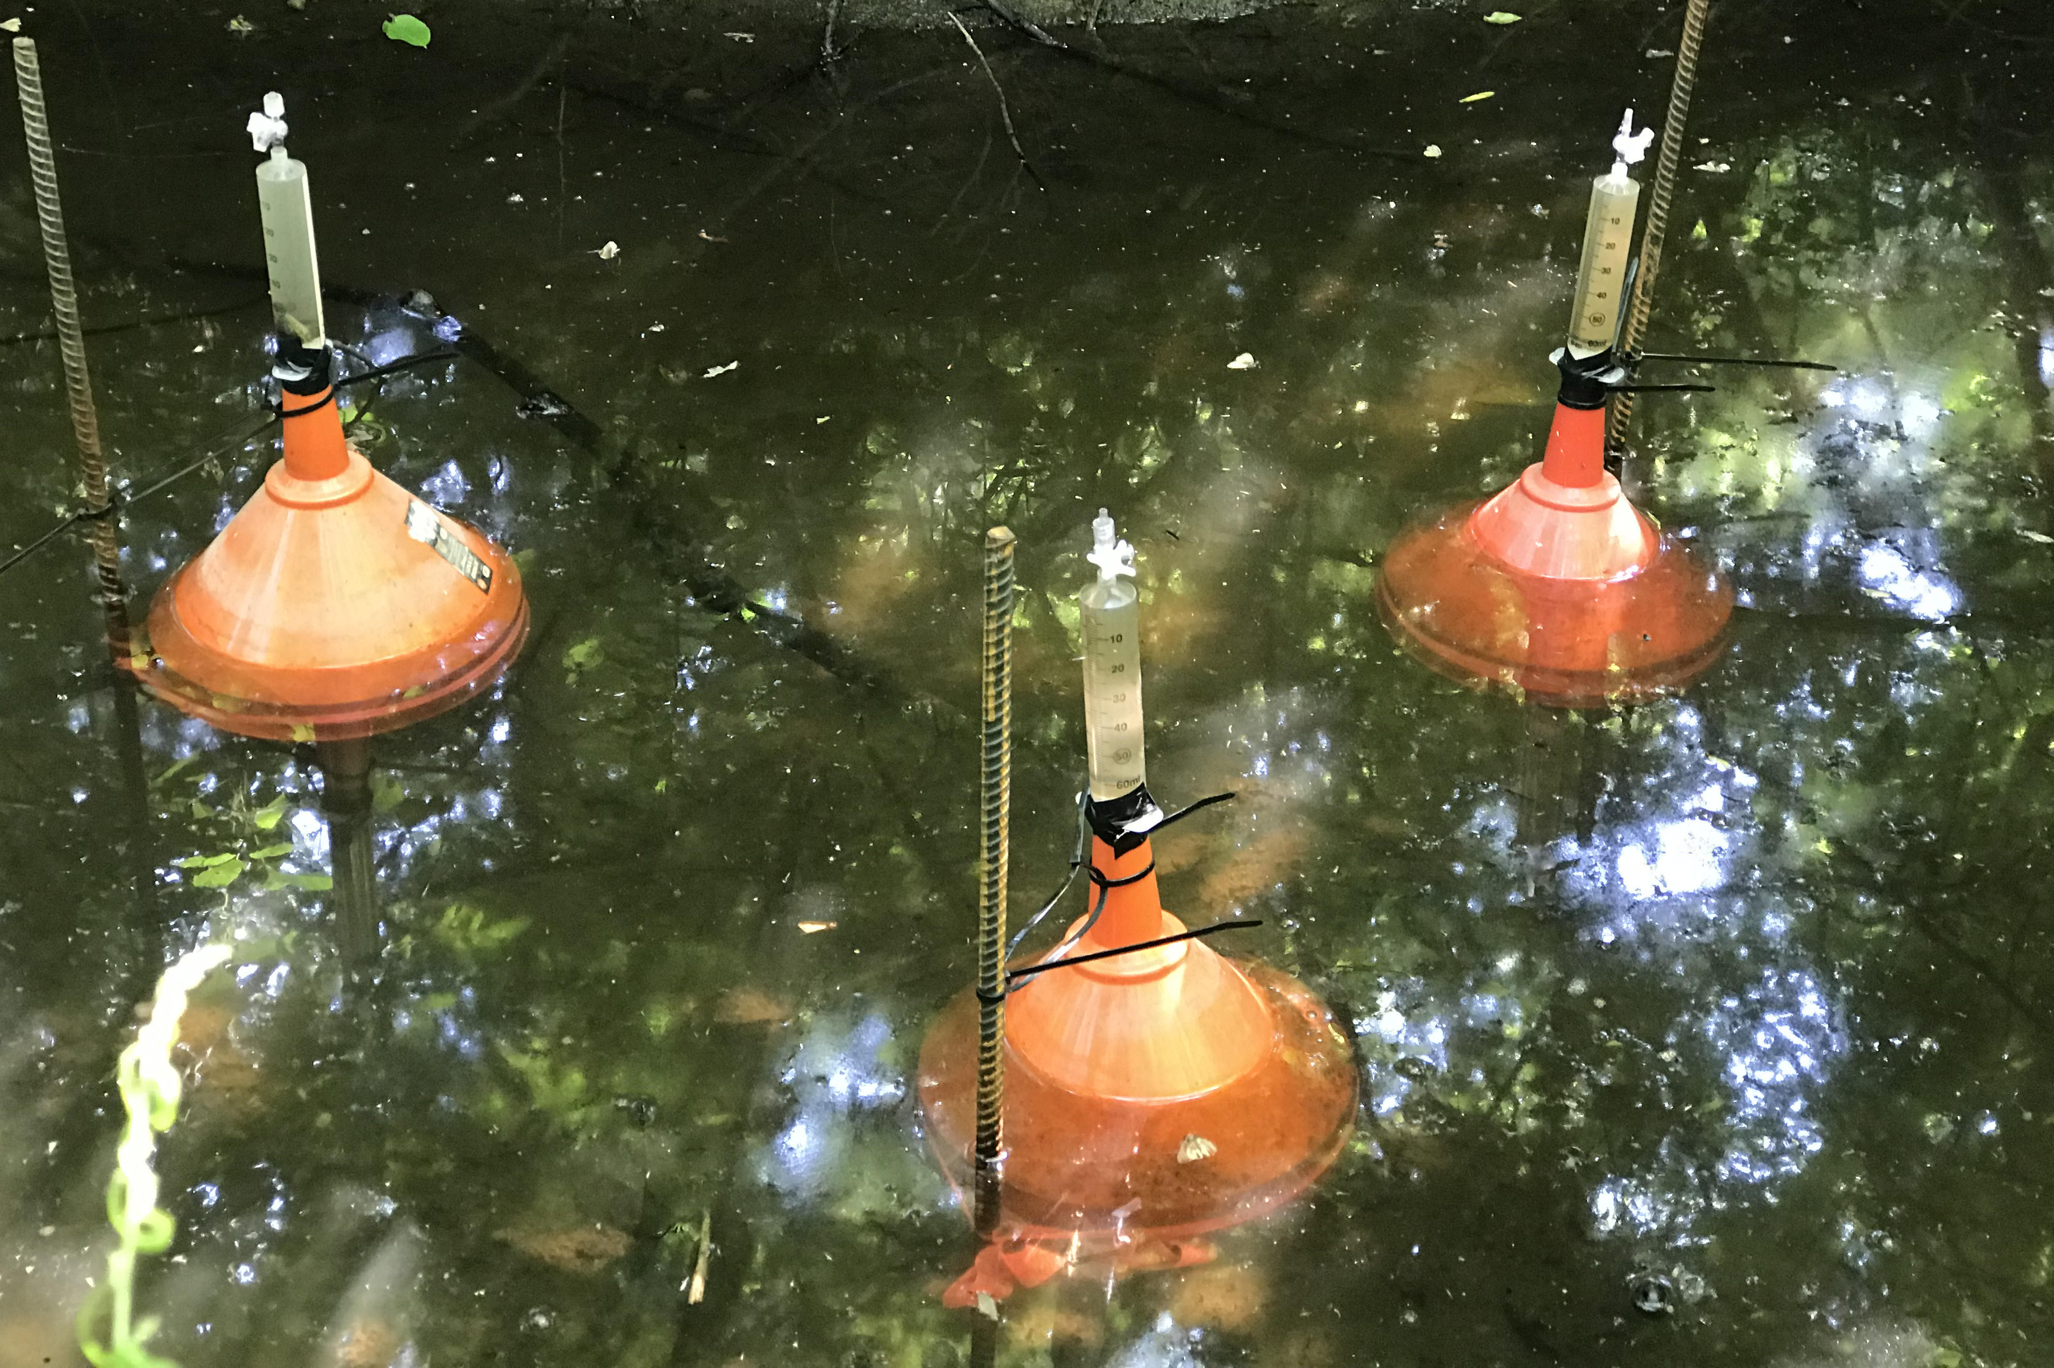
Examining the influence of land use and flow variability on
carbon emissions from headwater streams - H21K-1813
Andrew Robison*, Wilfred Wollheim, Bonnie Turek
University of New Hampshire *Contact email: andrew.robison@unh.edu
Motivation
High-Frequency pCO₂ Sensors
Hysteresis and Flux Estimates
Rivers are most often sources of CO₂ and CH₄ to the atmosphere (Drake et al., 2017), yet we lack a robust understanding of what drives the spatial and temporal variability of these emissions (Kaushal et al., 2014).
We have begun monitoring CO₂ and CH₄ dynamics within the Plum Island Ecosystems LTER river networks using high frequency pCO₂ sensors and bubble traps to address the question:
How do alterations in the hydrologic and nutrient regimes caused by urbanization alter CO₂ and CH₄ production and emissions within a river network?
In-stream pCO₂ sensors (SIPCO2; Hunt et al., 2017) were deployed to examine the influence of land use, flow, nutrients, light, and temperature on CO₂ dynamics. Key differences in diurnal, event, and longer-scale patterns have been observed.
Diluting,
counterclockwise
Flushing, clockwise
Characteristics of hystere-sis (Vaughan et al., 2017), are variable across sites and individual storms (left). Despite these differences, evasion of CO₂ is dominated by efflux during higher flow periods (below).
CC
DB
SB
CB
Hunt et al. 2017
Forested site with closed canopy (CC)
Diluting, counterclockwise
Flushing, counterclockwise
Discharge events alter pCO₂
The estimated mean evasion rate at SB was 4.5 g C m⁻² d⁻¹, compared to the 6.5 g C m⁻² d⁻¹ reported by Butman and Raymond (2011) for streams in the U.S.
4800
pCO₂ (ppm)
2400
Q (L s⁻¹)
0
1500
Discharge (L s⁻¹)
Urbanization in the Watershed
pCO₂ (ppm)
750
pCO₂ (ppm)
Temperature affects longer-term variability
0
Est. CO₂ evasion rate (g m⁻² hr⁻¹)
2
Temp (ºC)
1
Forested site with open canopy (DB) displays stronger diurnal signal
0
10-Sep
11-Sep
12-Sep
Impervious Surface
Parker River
watershed
27-Aug
03-Sep
10-Sep
05-Sep
09-Sep
13-Sep
Discussion
Ebullitive Fluxes Significant for CH₄
The resolution provided by pCO₂ sensors is critical in identifying process controls, and some broad-scale patterns are emerging in our initial monitoring.
A strong hydrological influence on pCO₂ is clear, particularly the relationship between emissions and flow. Incorporating gas exchange measurements will improve emission estimates across flow conditions and sites.
Ebullition of CH₄ is a major pathway of GHG emission. Constraining the spatial variability of ebullitive fluxes will be key to scaling to the reach and network scale.
This work will help in constraining the carbon balance of aquatic systems within a land use context.
Ipswich River
watershed
Ebullitive, or bubble-mediated, fluxes of GHGs were monitored at CC and SB, with 12 bubble traps at each site. Significantly more CH₄ was emitted at SB via ebullition, comparable to the average reported for fluvial systems (Stanley et al. 2016).
The Plum Island Ecosystems LTER (PIE-LTER), located in northeastern Massachusetts, contains the Ipswich and Parker River watersheds. This study focuses on four headwater streams of contrasting land use: Cart Creek (CC), College Brook (CB), Dube Brook (DB), and Sawmill Brook (SB). The land use characteristics of these streams is displayed below.
30
 | CC | SB
Mean | 0.35 | 1.87
Median | 0.02 | 0.17
Max | 3.61 | 25.6
Variable | Coefficient of determination (r²) | Comparative dimension
Sediment % organic | 0.25 | Spatial
Sediment % silt/clay | 0.00
Canopy cover | 0.00
Depth | 0.22
Mean Q | 0.50 | Temporal
Mean temperature | 0.41
Minimum barometric pressure | 0.30
20
CH₄ Flux via Ebullition (mmol m⁻² day⁻¹)
References
Stream | Area (km²) | % Forest | % Developed | % Wetland | Ebullition monitoring
CC | 4.64 | 77.2 | 10.4 | 19.2 | Yes
CB | 3.03 | 11.8 | 64.6 | 1.3
DB | 3.32 | 55.3 | 8.2 | 9.1
SB | 4.01 | 10.6 | 88.3 | 4.1 | Yes
10
Butman, D., & Raymond, P.A. (2011). Nature Geoscience, 4(12), 839–842.
Drake, T.W., Raymond, P.A., & Spencer, R.G.M. (2017). Limnology and Oceanography Letters, 3(3), 132-142.
Hunt, C.W., Snyder, L., Salisbury, J.E., Vandemark, D., & McDowell, W.H. (2017). Limnology and Oceanography: Methods, 15(3) 291-301.
Kaushal, S.S., et al. (2014). Journal of the American Water Resources Association, 50(3), 585–614.
Stanley, E.H., et al. (2016). Ecological Monographs, 86(2), 146–171.
Vaughan, M.C.H., et al. (2017). Water Resources Research, 53(7), 5345–5363.
0
CC
SB
Totals

