Slide 1
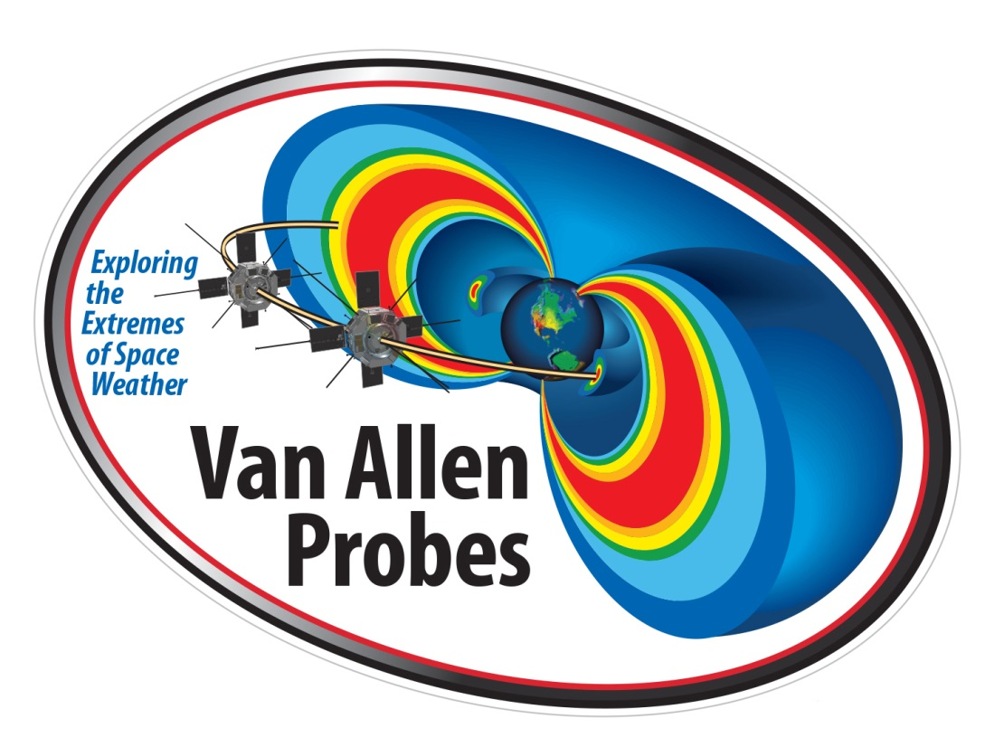
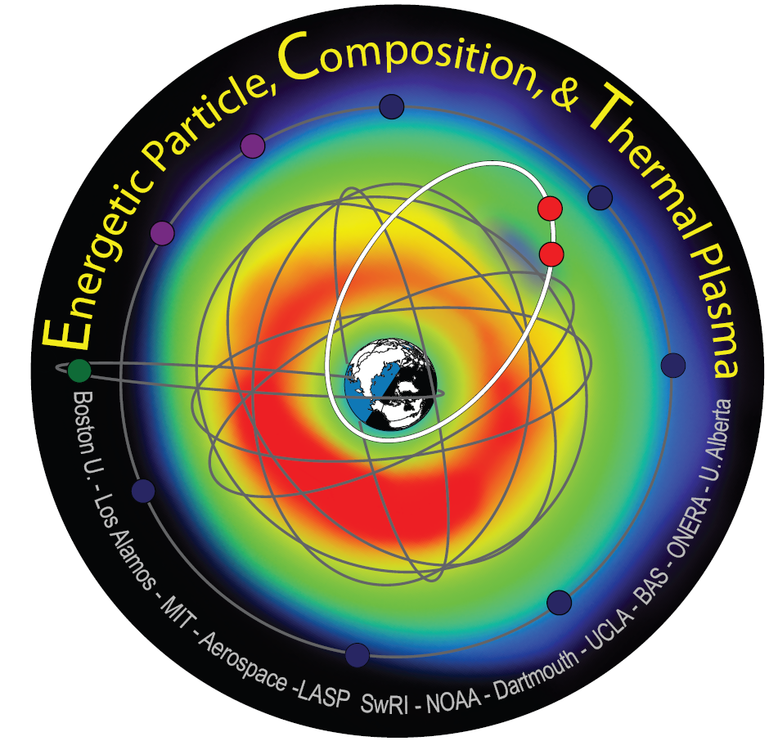


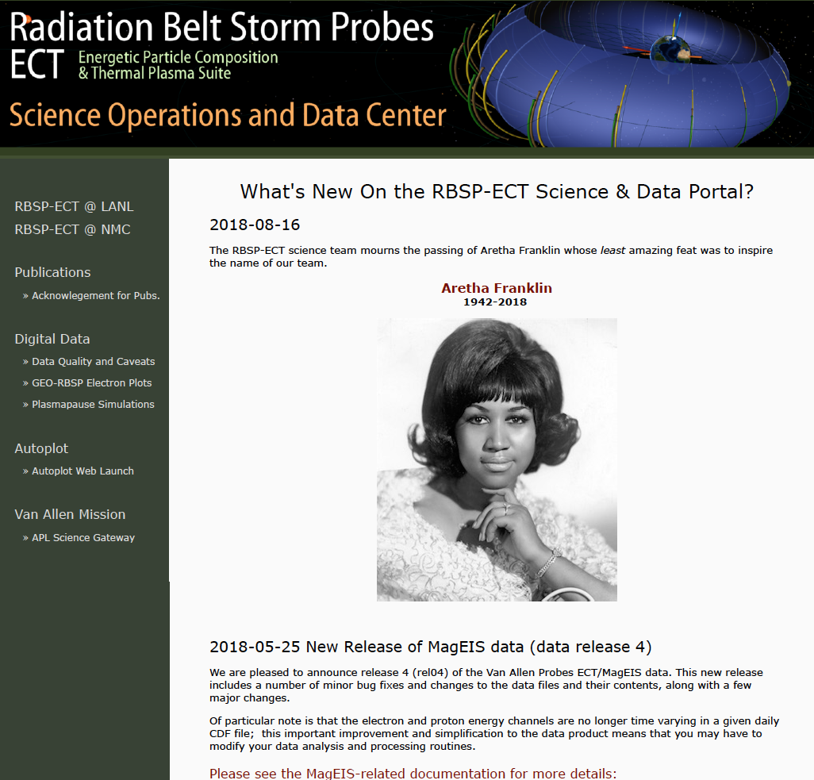
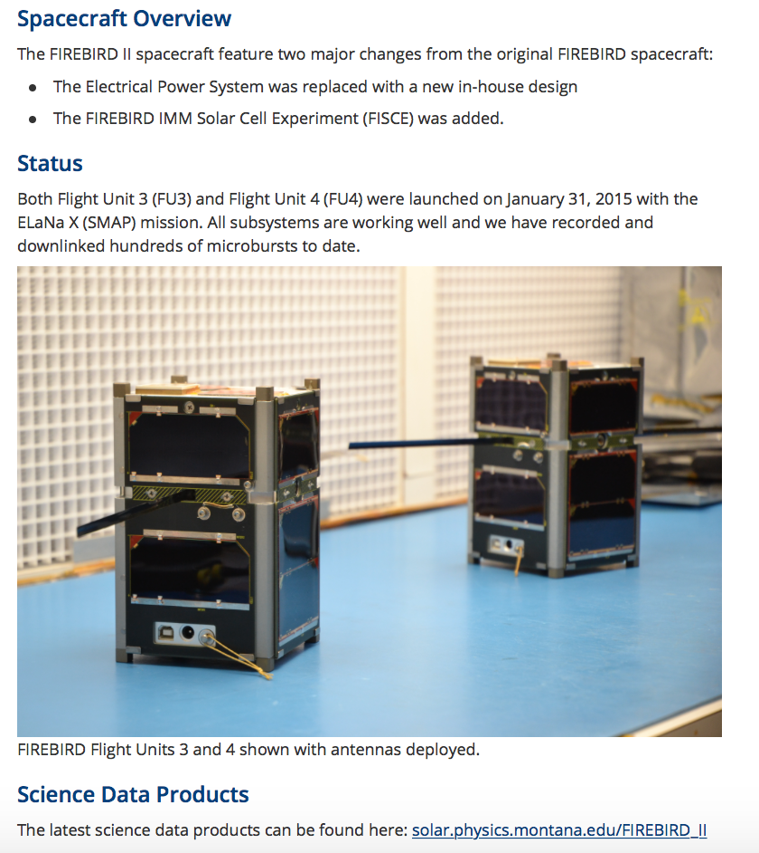
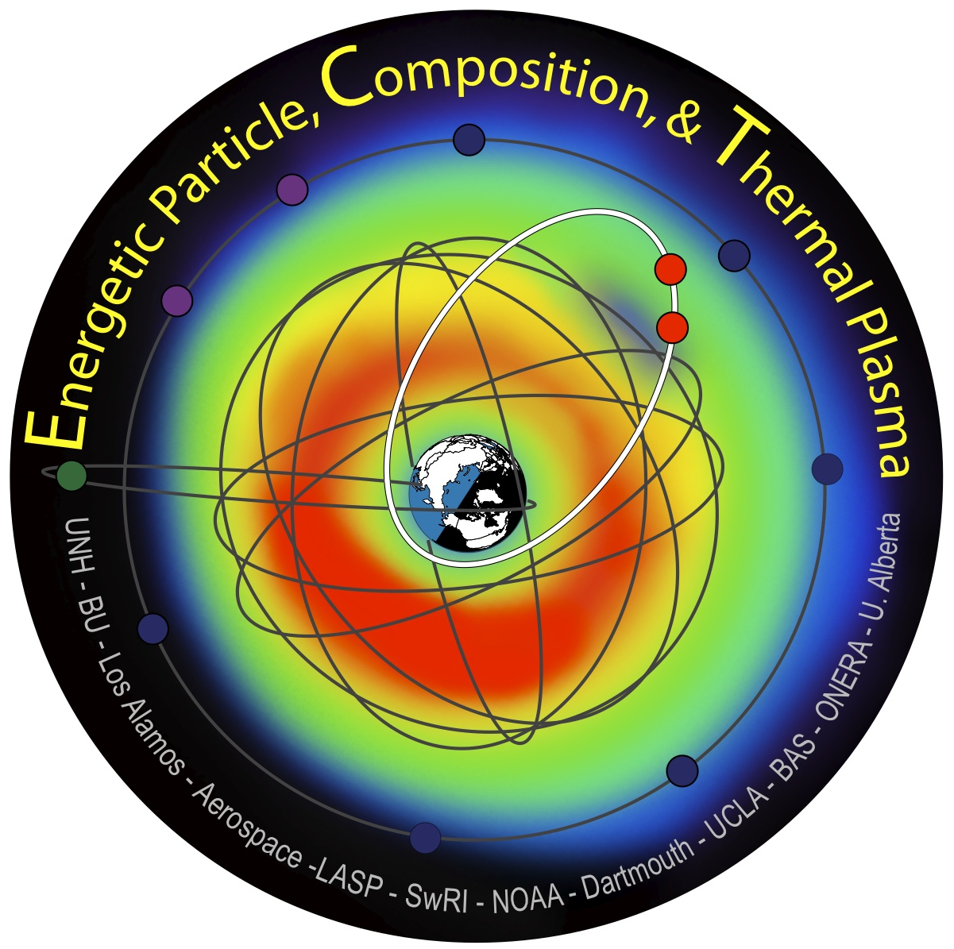
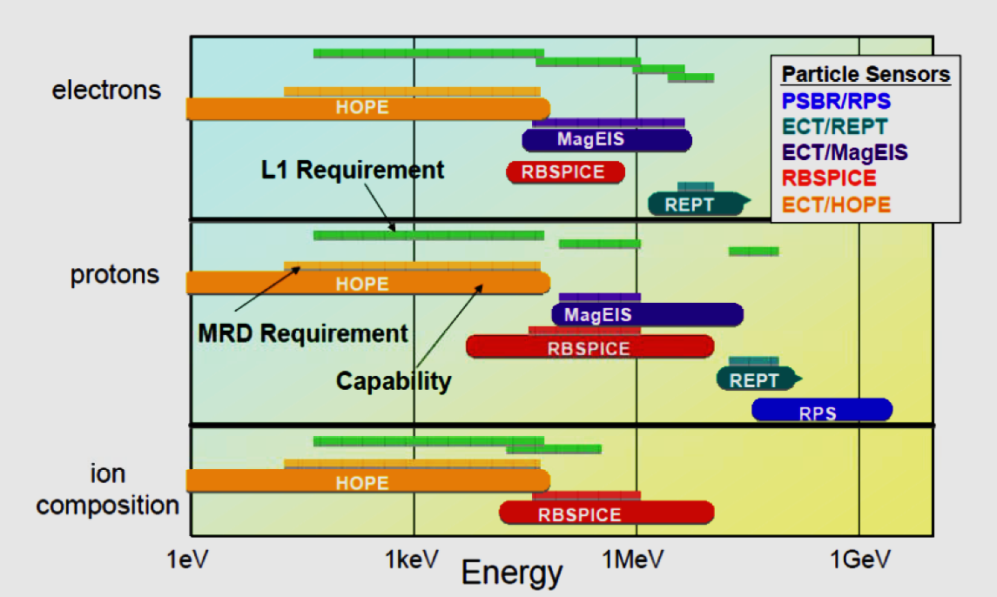
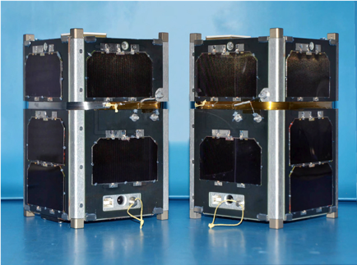
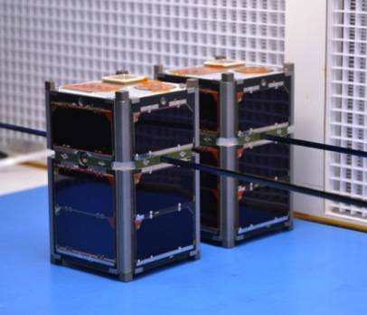





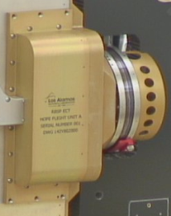
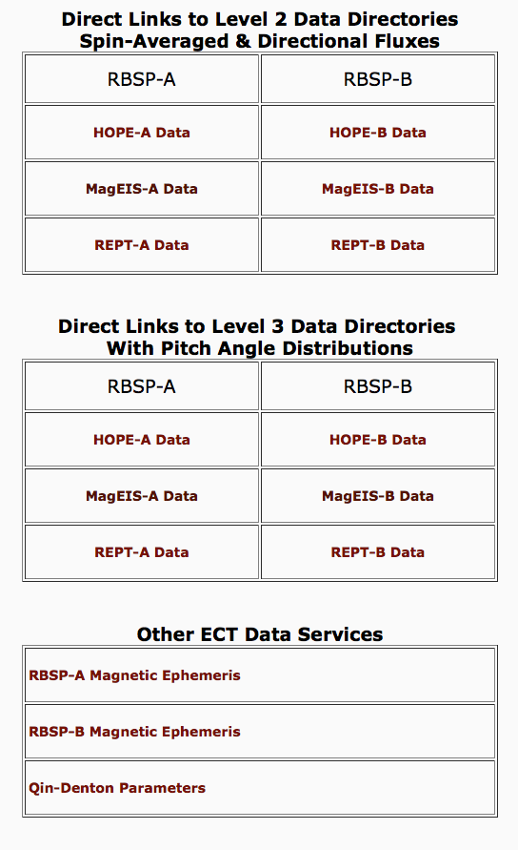
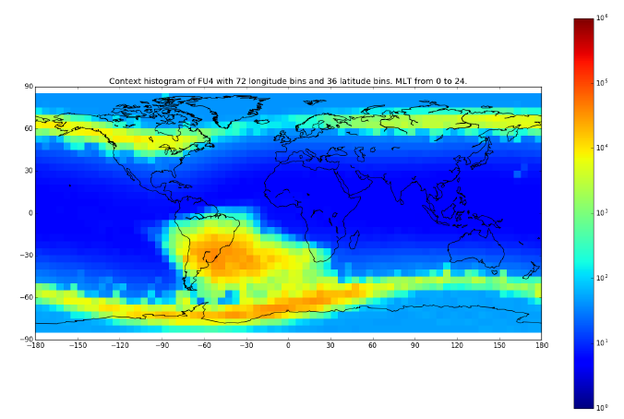
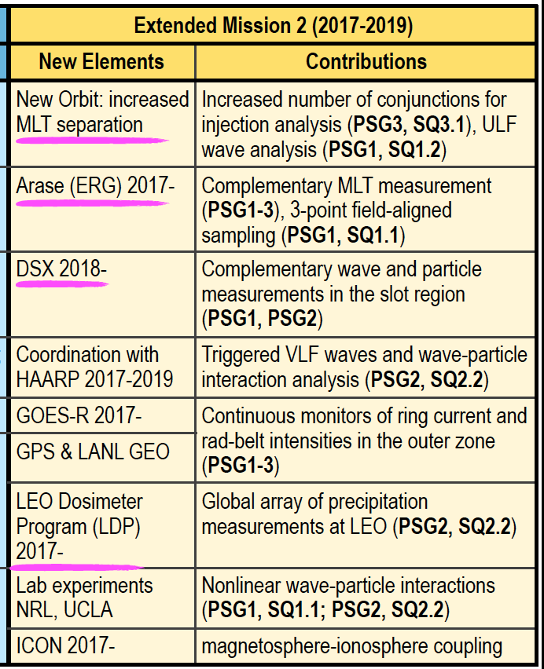
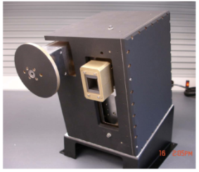
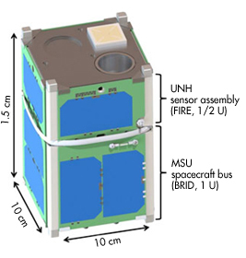
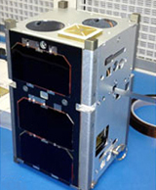
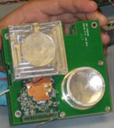
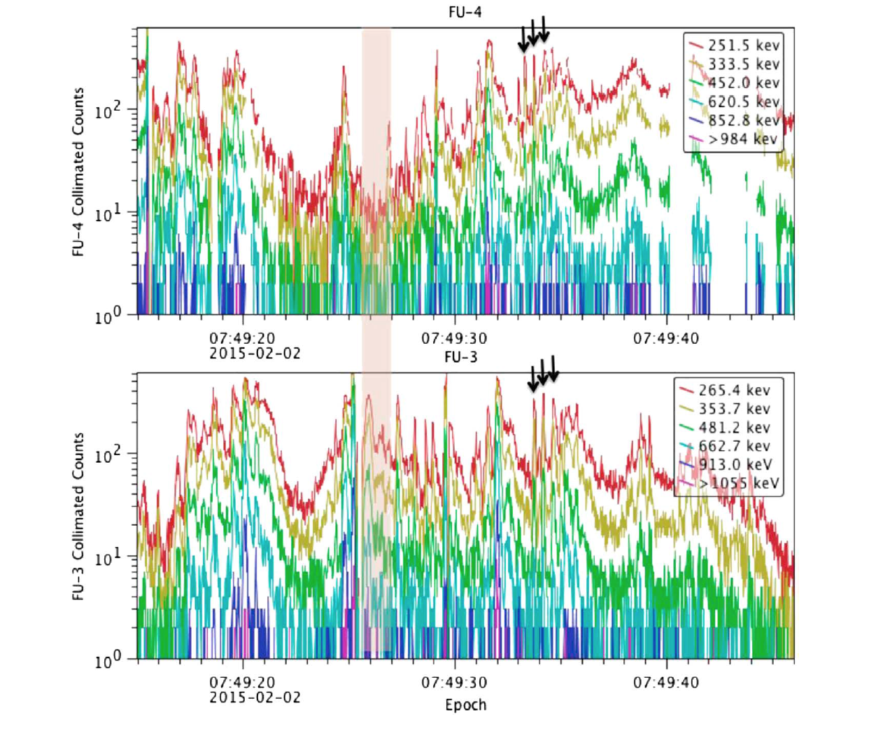
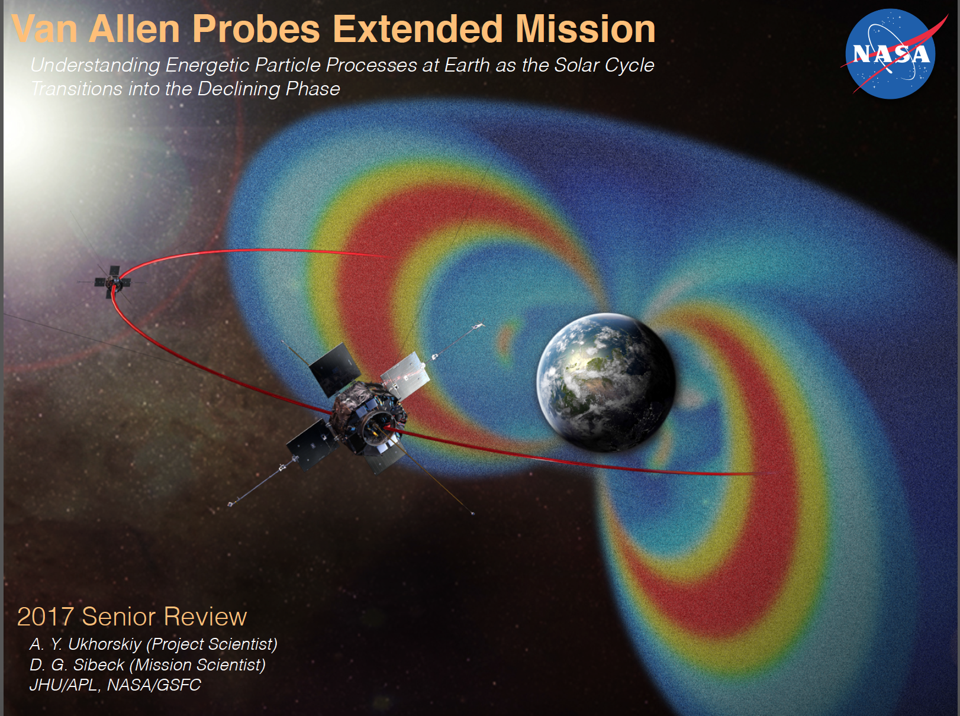
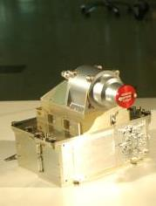
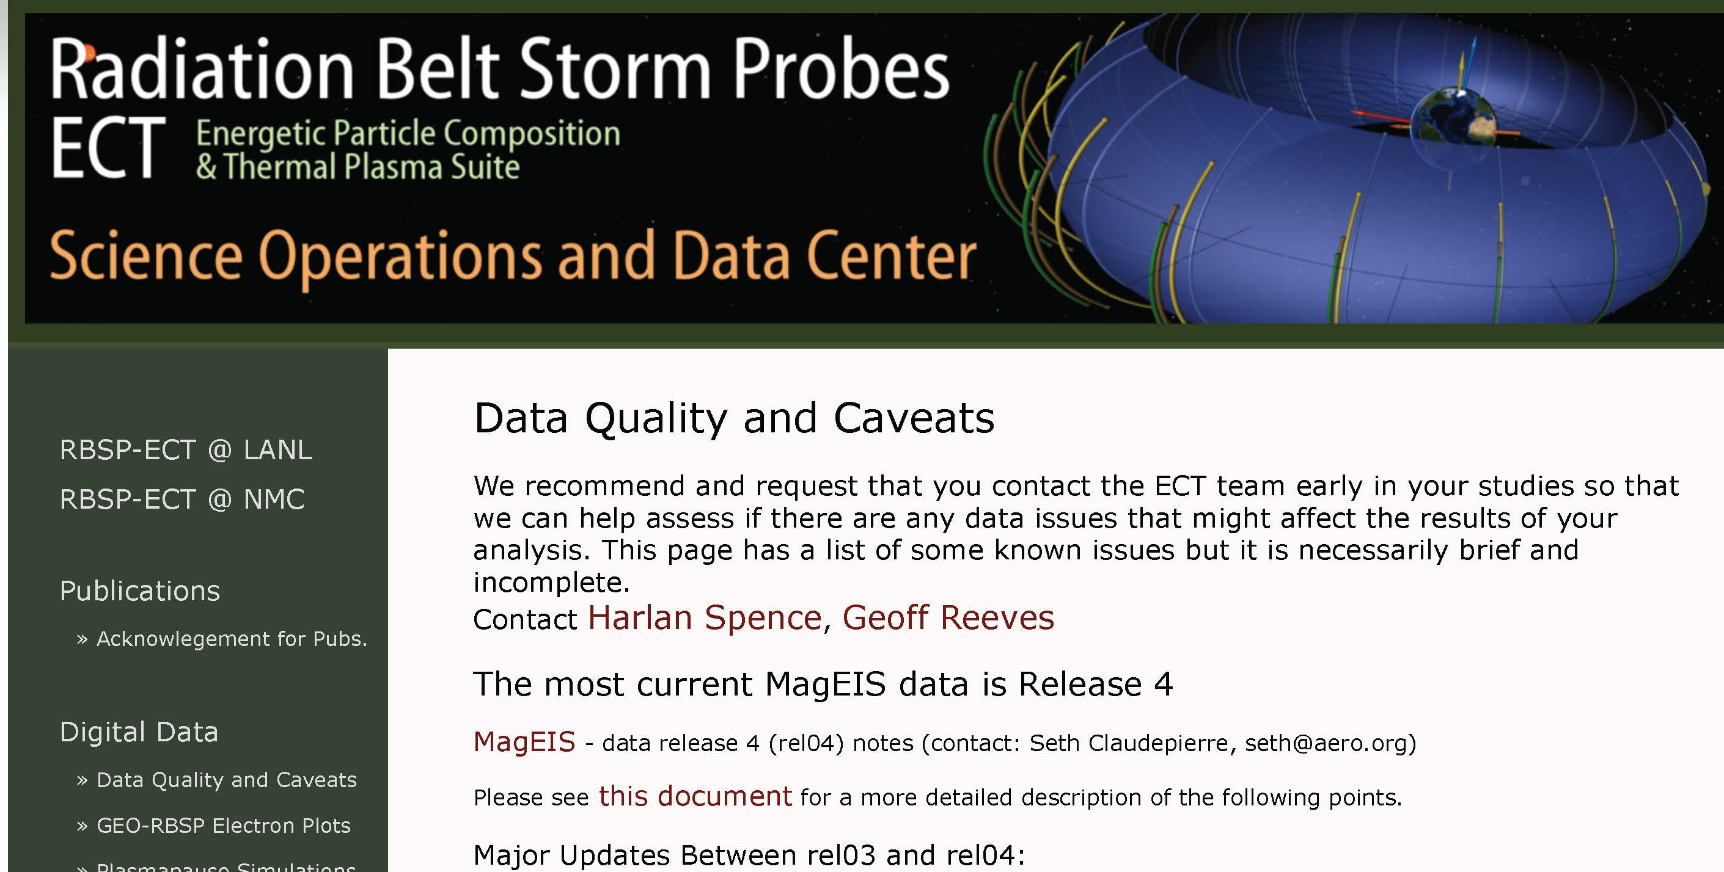
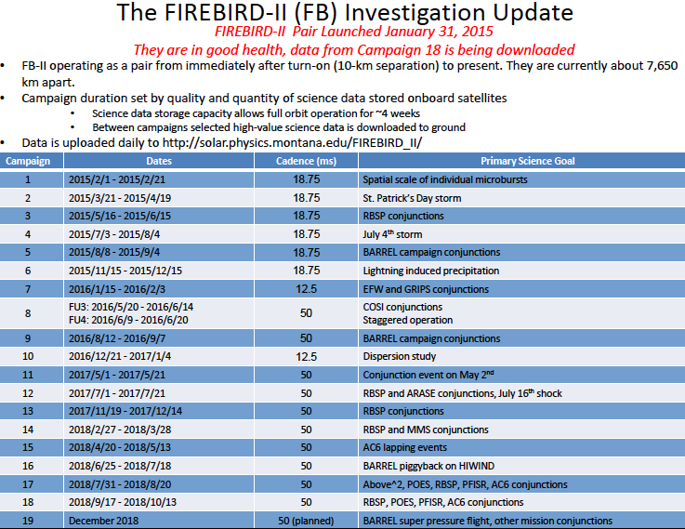
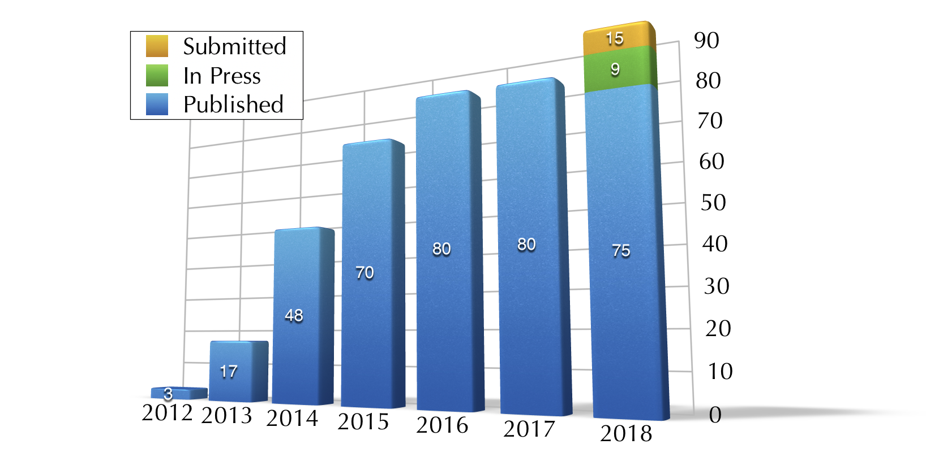
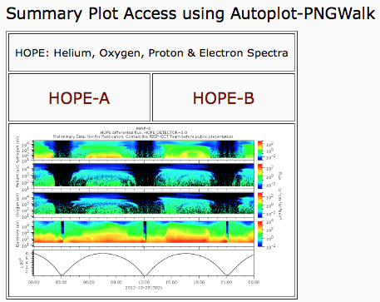
NASA’s Van Allen Probes RBSP-ECT and NSF’s FIREBIRD Data Products and Access to Them: An Insider’s Outlook on the Inner and Outer Belts
Sonya Smith¹, Harlan Spence¹, Geoff Reeves², Dave Klumpar³ on behalf of the entire RBSP-ECT and FIREBIRD II Team
¹UNH/Space Science Center, ²New Mexico Consortium Science Operations Center, ³Montana State University
RBSP-ECT Instrument Suite Overview
RBSP-ECT Science Operation Center
FIREBIRD-I, -II Mission Summary
FIREBIRD-I and –II Data Access
Radiation Belt Storm Probes Energetic Particle, Composition, and Thermal Plasma Suite
(RBSP-ECT) on NASA’s Van Allen Probes mission
All RBSP-ECT Data, Documentation, and Science Activity Available Through Single Suite SOC
Focused Investigations of Relativistic Electron Bursts: Intensity, Range, and Dynamics
NSF CubeSat missions PIs: Harlan Spence (UNH),David Klumpar (MSU)
All FIREBIRD Data Available Through Science Operations Center at MSU
RBSP-ECT SOC at NMC provides access to:
Public data including summary plots, digital data directories, as well as data descriptions
Autoplot for ECT
Publications and Rules of the Road
FB-I LAUNCHED: Dec 6, 2013
VAFB Atlas-5 NROL-39
FB-II Launched early 2015
VAFB Delta-II 7320 NASA SMAP (ELaNA-10)
FIREBIRD-II:
Klumpar et al., 2015
FIREBIRD site at MSU provides access to:
All FIREBIRD-I and –II data (context and hi-res) as well as ephemeris files
FIREBIRD Rules of the Road for data usage and co-authorship
Please contact the FIREBIRD team if you plan to use the data!
FIREBIRD-I:
Spence et al., 2012
Spence et al., 2013
FIREBIRD- I: Flight Units 1 and 2
Provided excellent science results; FU1: 12/13 - 1/14, FU2: 4/14 – 9/14
FIREBIRD-II: Flight Units 3 and 4
Improved version of FB-I mission;
Launched and beautiful data since 1/2015
Making Definitive Particle Measurements in a Harsh Radiation Environment
https://rbsp-ect.newmexicoconsortium.org/rbsp_ect.php
https://ssel.montana.edu/firebird2.html
RBSP-ECT Instrument Overview
RBSP-ECT Data Access Overview
FIREBIRD Mission and Data Products
2nd (Final!) Extended Mission Phase
ECT In-flight Instrument Performance Meets or Exceeds all Requirements
The RBSP-ECT SOC Provides Links to Level 2 and Level 3 RBSP-ECT Data and Ancillary Data
FIREBIRD-II continues to exceed all wildest expectations: 3 month mission now in year 3!
Van Allen Probes Science Plan Articulated in 2017 Senior Review Traceability Matrix
Helium Oxygen Proton Electron (HOPE)
Funsten et al., 2013
All 12 ECT instrument packages performing beautifully: 1 HOPE, 4 MagEIS (1 “Lo”, 2 “Meds”, 1 “Hi” , 1 REPT per s/c)
Inflight performance meets or exceeds L1 measurement requirements
Background rejection techniques successful on all instruments
Continuous Cross-cal improvements
Public access to Level 2 and 3 data from each ECT instrument on both spacecraft
SOC provides extensive ephemeris information for both spacecraft
Access to ancillary data (such as Qin-Denton parameter files)
Please refer to “Data Quality and Caveats” section before using data!
650 x 430km orbit, 99° inclination
CubeSats aligned near B-field direction with two large FOV energetic particle detectors to measure precipitating electrons in 6 channels from 200 keV to >1 MeV
Samples bounce/drift loss cones
“Context” data – low time/energy resolution”HiRes” data sampled at 18.75 or 12.5ms resolution to resolve microbursts
Limited HiRes data; event/campaign driven
FU4 Context Data (Campaigns 1-9)
~ 1 MeV electrons
RBSP-ECT contributes strongly to 2nd Extended Science Mission Phase goals with the overarching objective of “Understanding Energetic Particle Processes at Earth as the Solar Cycle Transitions into the Declining Phase”
Magnetic Electron Ion Spectrometer (MagEIS)
Blake et al., 2013
Collimated SSD
Relativistic Electron Proton Telescope (REPT)
Baker et al, 2013
Surface
SSD
From Crew et al., 2016
Opportunities to Collaborate
RBSP-ECT Publication Summary
RBSP-ECT Data Overview
FIREBIRD-II Campaign Summary
A Hearty Thank You to All Who Contributed to a Growing List of High Impact Publications
RBSP-ECT Data Available on SOC Site Once Data Verification and Validation is Complete
Campaign #19 presently underway
Please Join Us in the Continuing Excitement of Radiation Belt Discoveries!
As of 1 December 2018, a total of ~400 (*) papers including ECT data as a significant element, many in high impact journals:
Submitted and in review: 15
In press: 9
Published in 2017: 75
Published in 2017: 80
Published in 2016: 80
Published in 2015: 70
Published in 2014: 48
Published in 2013: 17
Published in 2012: 3
Level 2 and Level 3 data Availability as of December 2018
Increased Van Allen Probes T/M capability during Prime and Extended Mission Phases has already and will allow us to produce better and new science into 2nd Extended Phase
Continued FIREBIRD-II mission is focusing on joint operations with other missions (Van Allen Probes, Arase, etc.) and can tailor operations during future campaigns to optimize science goals
We encourage you to participate in accomplishing radiation belt science during the coming few years by using our high quality mission data but ask that you abide by our “Rules of the Road” (links for both missions provided above) so that we may:
Maintain the high quality of publications by ensuing consultation with members of the teams who are familiar with the operation of the instruments, subtleties in the instrument response, and any potential pitfalls;
Acknowledge work put into design and development of mission instruments to produce the capable and calibrated instruments now available for science;
Coordinate the efforts across the team to avoid duplication of effort and maximize science return.
 | HOPE-A | HOPE-B | MagEIS-A | MagEIS-B | REPT-A | REPT-B
Level 2 | 2018-10-30 | 2018-10-30 | 2018-11-23 | 2018-12-03 | 2018-12-03 | 2018-11-23
Level 3 | 2018-10-30 | 2018-10-30 | 2018-11-23 | 2018-12-03 | 2018-12-03 | 2018-11-23
Summary plots of Level 2 and Level 3 also available through Autoplot interface
Access to Autoplot provided for easy access
https://rbsp-ect.newmexicoconsortium.org/publications/Publications_Journals.php
(*) Please help us accurately credit your contributions by letting us know about your papers at the RBSP-ECT website noted above
Acknowledgement: This research supported by RBSP-ECT funding under NASA’s prime contract number NNN06AA01C and by FIREBIRD under NSF grants ATM-0838034 and 1339414 (MSU) and under grants 1339534 and 1035642 (UNH).
Notes:
I should add the APL SCIENCE GATEWAY. You can use that to plot also.
Once you plot you can hit button and sent the URL/QR Code

