Slide 1
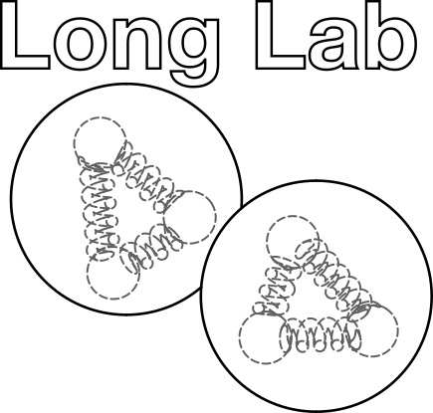

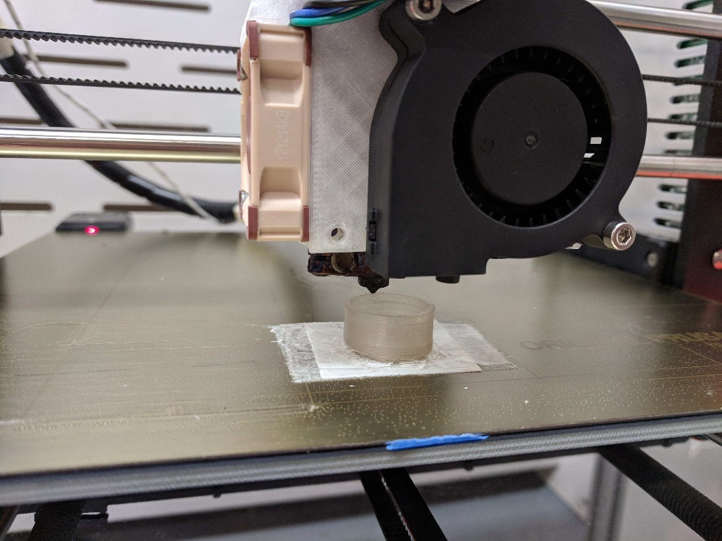
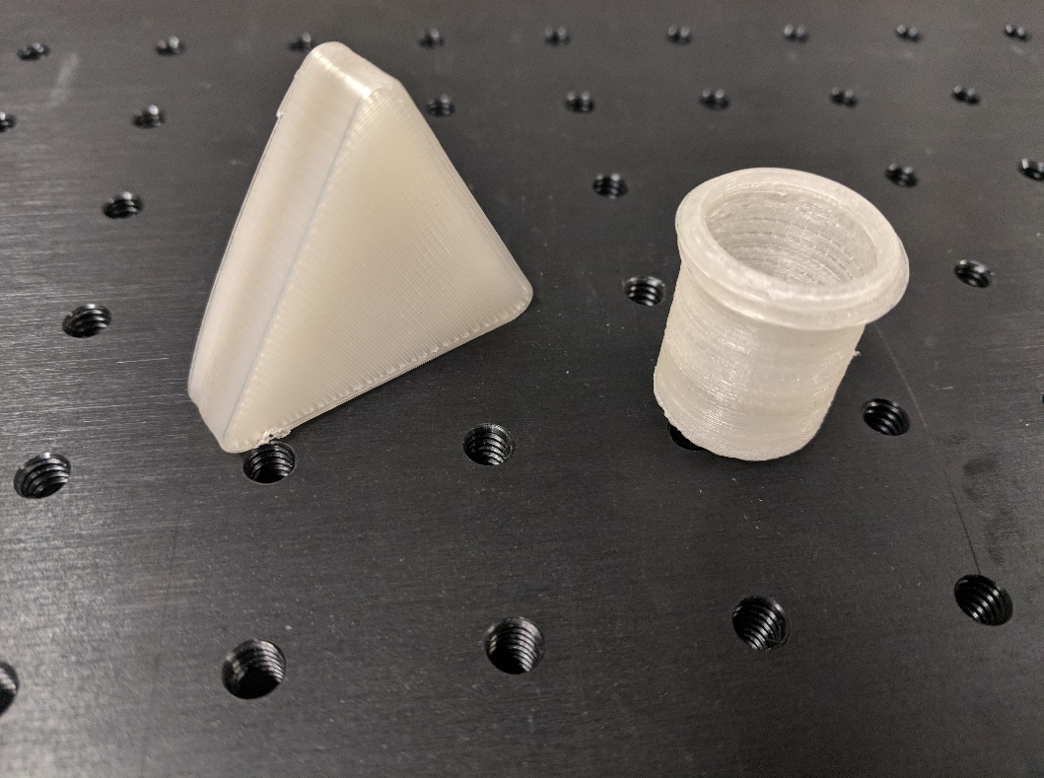
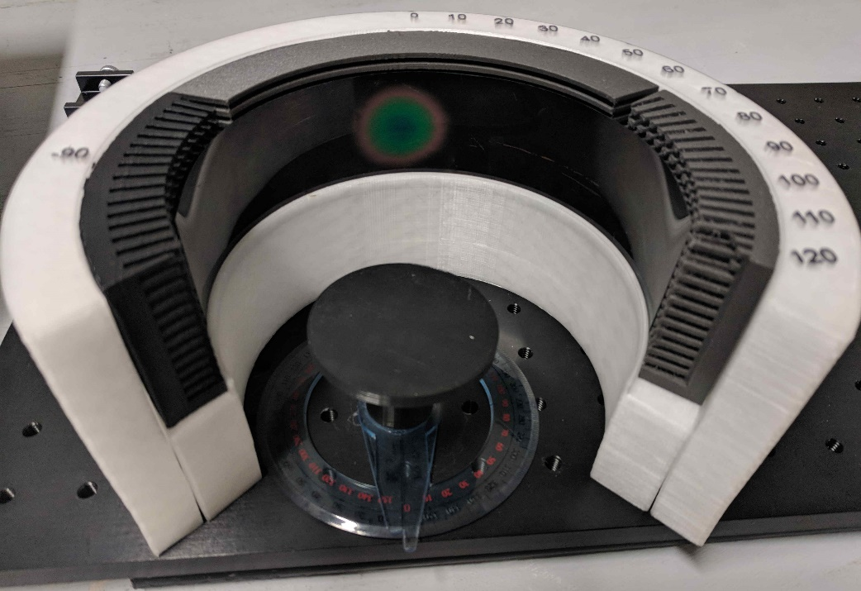
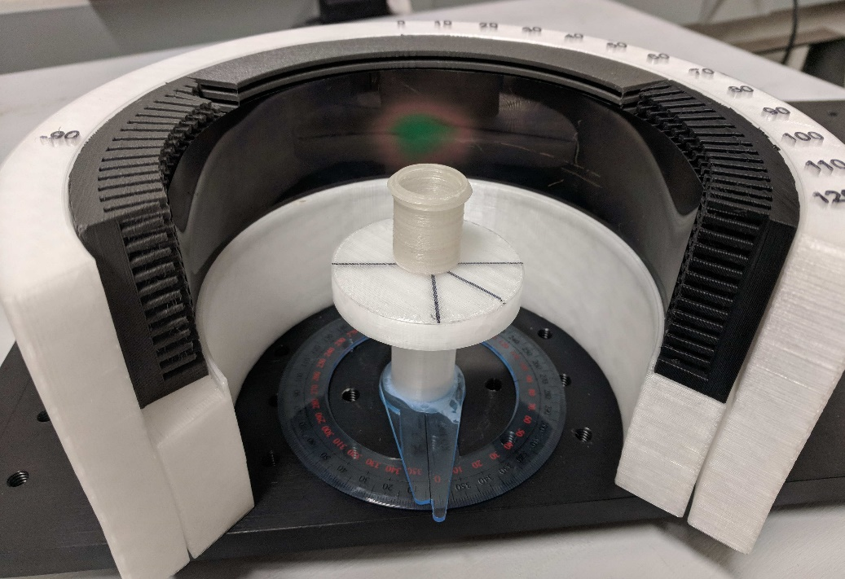
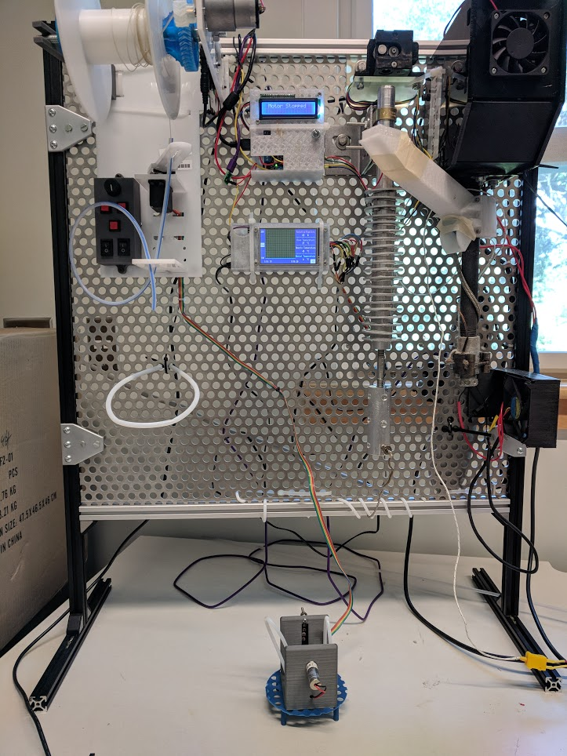
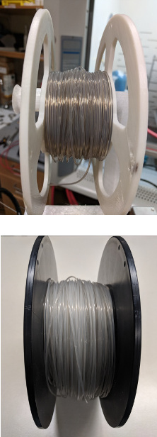
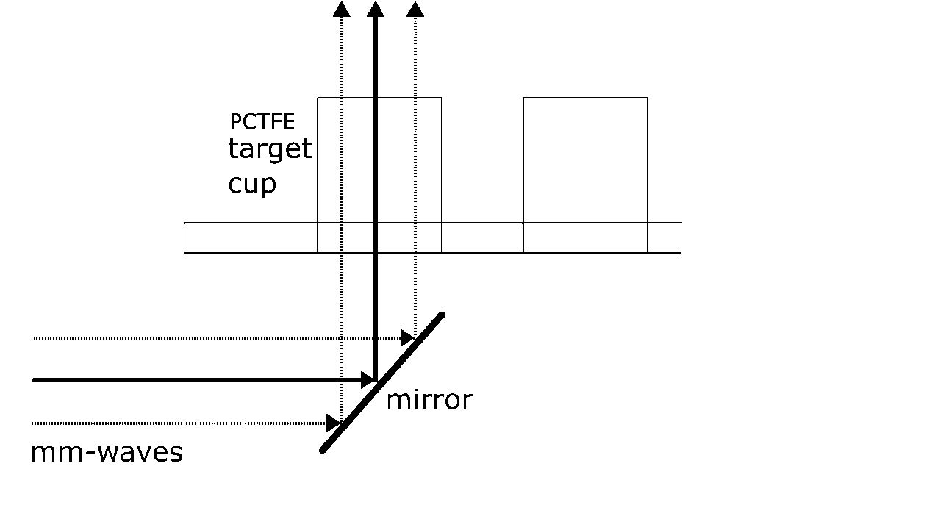
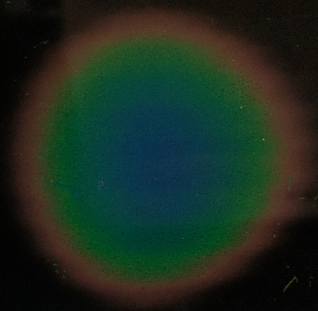

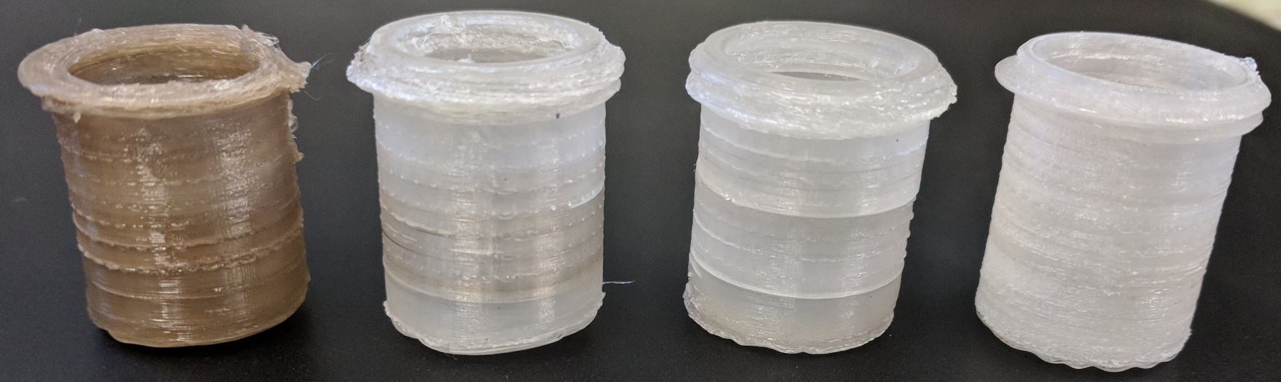
3D-Printed mm-Wave Lenses for DNP Target System
Kellie McGuire
Advisor: Prof. Elena Long
University of New Hampshire Physics
Background
The University of New Hampshire’s Long Lab¹ is at the forefront of 3D-printing technology, developing new techniques and materials for nuclear physics experiments.
Included in this work is a method of 3D-printing with the fluoroplastics FEP and PCTFE (Kel-F®). This technology is being used to manufacture mm-wave lenses for a dynamic nuclear polarization (DNP) target system.
In DNP, a target material doped with free radicals is placed in a strong magnetic field and exposed to mm-wave radiation, inducing electron-to-nucleon spin transfer. 3D-printed lenses will be used to evenly distribute the mm-wave radiation and thus drive up the degree of nucleon spin polarization.
This work is part of the UNH Nuclear Physics Group’s tensor-polarized target project.² To date, deuteron polarization of 15-20% has been achieved,³ and it is a central goal of the group to increase this to > 30%.
3D-Printing with Fluoroplastics
FEP and PCTFE are challenging materials to use in 3D-printing:
Higher processing temperature (380 °C and 360 °C, respectively) than conventional materials, such as PLA (230 °C) and ABS (280 °C).
Low viscosity and self-lubricating; materials will not adhere directly to the print bed.
Must print at a much slower speed than conventional materials.
FEP filament is soft; trouble feeding through printer nozzle.
Small temperature window in which PCTFE can be processed.
Work must be performed in a fume hood to minimize exposure to HF and HCl.
PCTFE printing on a
Prusa i3 MK2.5 printer.
The beam is imaged through the PCTFE components using a custom 3D-printed absorption screen. The absorption screen features thermally isolated “pixels” to minimize heat spread. The intensity of the beam is observed in the color gradient of a liquid crystal sheet.
Printer filament is made in-house, using a custom device, the “Filatizer.” The material tends to develop a brown tint when exposed to heat, so it is necessary to find the right balance between temperature, speed, and processing volume to minimize exposure to heat.
Extruded at 246 °C (nozzle temp.) through stainless steel
3D-printed PCTFE prism and DNP target cup.
Designing mm-Wave Lenses
A direct application of fluoroplastic printing is the development of PCTFE lenses to be implemented into a DNP target system.
The polarizing radiation comes in the form of a 140 GHz Gaussian beam incident on the PCTFE target cups. The lenses will be designed to evenly distribute the beam to uniformly saturate the target and drive up the degree of polarization.
Absorption screen showing an
unobstructed mm-wave beam.
Absorption screen with mm-wave
beam through PCTFE target cup.
Future Work
While highly transparent to mm-wave radiation at short optical path lengths, PCTFE experiences considerable power loss at thicknesses > 1 mm. A critical next step will be to characterize the mm-wave power loss through PCTFE. This data will be used to determine the optimal lens thickness.
Once the lenses have been optimized, they will be implemented into the DNP target cups that hold the target during polarization.
Filament production system, featuring custom-built “Filatizer,” used to produce FEP (top) and PCTFE (bottom) filament.
Motivation
Why PCTFE?
Suitable for use in dynamic nuclear polarization (DNP). PCTFE is ideal because:
It retains its plasticity at 1K, the temperature at which DNP is performed.
It is transparent to the microwave radiation used in DNP.
It contains no free protons that could introduce noise in the NMR signal used to measure polarization.
Why 3D printing?
3D printing offers several benefits over machining:
Rapid prototyping.
Allows for complex geometries that are difficult or impossible to machine.
Less expensive; 3D printing can be done with very little waste.
Illustration of mm-wave beam through DNsP target cup.
Acknowledgments
This research was funded through grants from the U.S. Department of Energy and the University of New Hampshire’s Hamel Center for Undergraduate Research.
Unobstructed mm-wave beam features a Gaussian irradiance pattern with central “hot spot.”
Illustration of an idealized mm-wave beam, showing uniform irradiance and no power loss.
References
www.unhlonglab.com
https://nuclear.unh.edu/
3. W. Meyer, et al., Nucl. Instr. Meth. A 244, 574 (1986).
The lenses can be printed with a layer thickness of
< 0.1 mm, suitable for use with 140 GHz (2 mm) radiation. Measurements using a 3D-printed PCTFE prism at 140 GHz yield an index of refraction consistent with that of solid PCTFE at 1 MHz.
Iterations of 3D-printed PCTFE target cup.
2019 CUWiP at UMass Amherst

