Slide 1


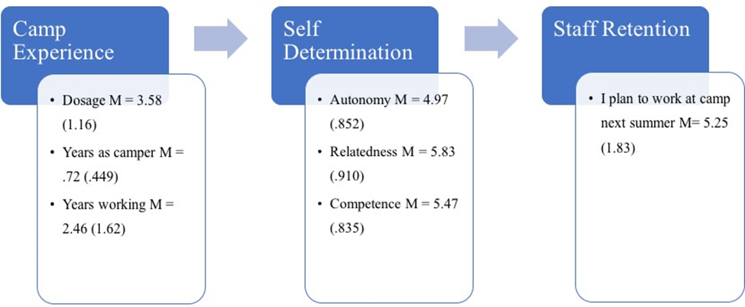
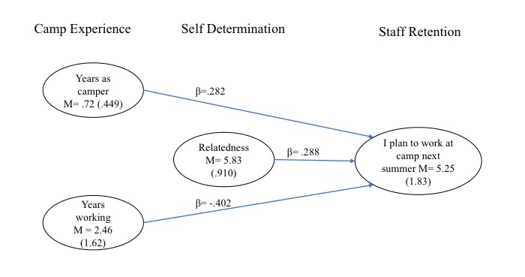
Autonomy, competence, and relatedness among residential camp staff: Using Self Determination Theory to understand the relationship between basic need fulfillment and willingness to return
Introduction
Results
For camp directors, hiring and recruiting new staff is both time consuming and expensive. Self Determination Theory explains overall motivation and need fulfillment in relation to a person’s willingness to be engaged and self-regulate positive behavior (Ryan & Deci, 2000). This study addressed how basic need fulfillment, as well as camp experience variables, may help explain a staff members willingness to return the following summer. 114 staff (Mean age = 20.5, SD=2.07) participated in the current study. Participants included 36% female and 62% males primarily enrolled in college (70%). The 21 item Work Basic Needs Satisfaction Scale (W-BNS) was administered to understand the fulfillment of autonomy, competence, and relatedness. Example items include: ‘There are not many people at work I am close to’ (relatedness) and ‘I am free to express my ideas and opinions on the job’ (autonomy).
Autonomy stayed the same, competence significantly decreased, and relatedness significantly increased. Regression analysis was used to create a process and final model for the predictors of camp experiences and basic need constructs. Camp experience predictors indicated dosage was not a significant predictor, however number of years working at camp negatively related to staff retention (β=-.402) and camper years positively predicted retention (β=.282).
Pre-Post Self Determination Theory (N =114)
SDT Construct | Overall mean (SD) | Pre (SD) | Post (SD) |  | T | Significance
Autonomy | 4.97 (.852) | 4.95 (.694) | 4.96 (.851) |  | .143 | .887
Relatedness | 5.83 (.910) | 5.62 (.551) | 5.82 (.910) |  | 2.42 | .017*
Competence | 5.47 (.835) | 5.79 (.683) | 5.46 (.834) |  | -4.23 | .000***
Process Model
Methods
Pre-test W-BNS items (autonomy, relatedness, and competence), dosage (weeks worked), camper years, counselor years, and willingness to return to work at camp were compared to post-test responses using independent sample t-tests and analysis of variance. Multiple regression analysis developed the final model on the post test to understand predictors for the dependent variable of willingness to return to camp.
Implications
Final Model
Camp experience and SDT variables were separate and distinct predictors for camp counselor willingness to return to camp.
Competence decreased over the course of the summer. Decrease could be due in part to job familiarity or lack of challenge.
Relatedness was a major finding and is understood in terms of supporting warmth, care, and respect for counselors.
Camps should consider staff autonomy, relatedness, and competence to support motivation, satisfaction, and willingness to return.
Myles Lynch, University of New Hampshire
Nate Trauntvein, Utah State University
Cindy Hartman, University of New Hampshire
Robert ‘Bob’ Barcelona, University of New Hampshire
2019 ACA Camp Research Forum, Nashville, TN

