Slide 1


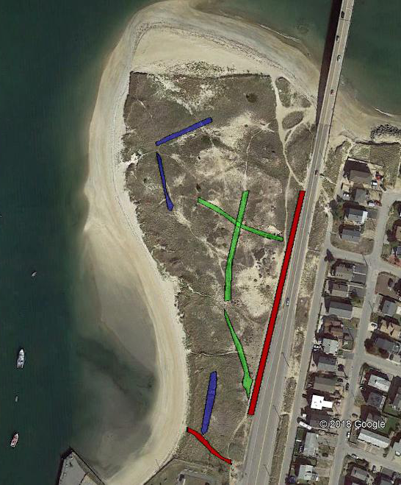
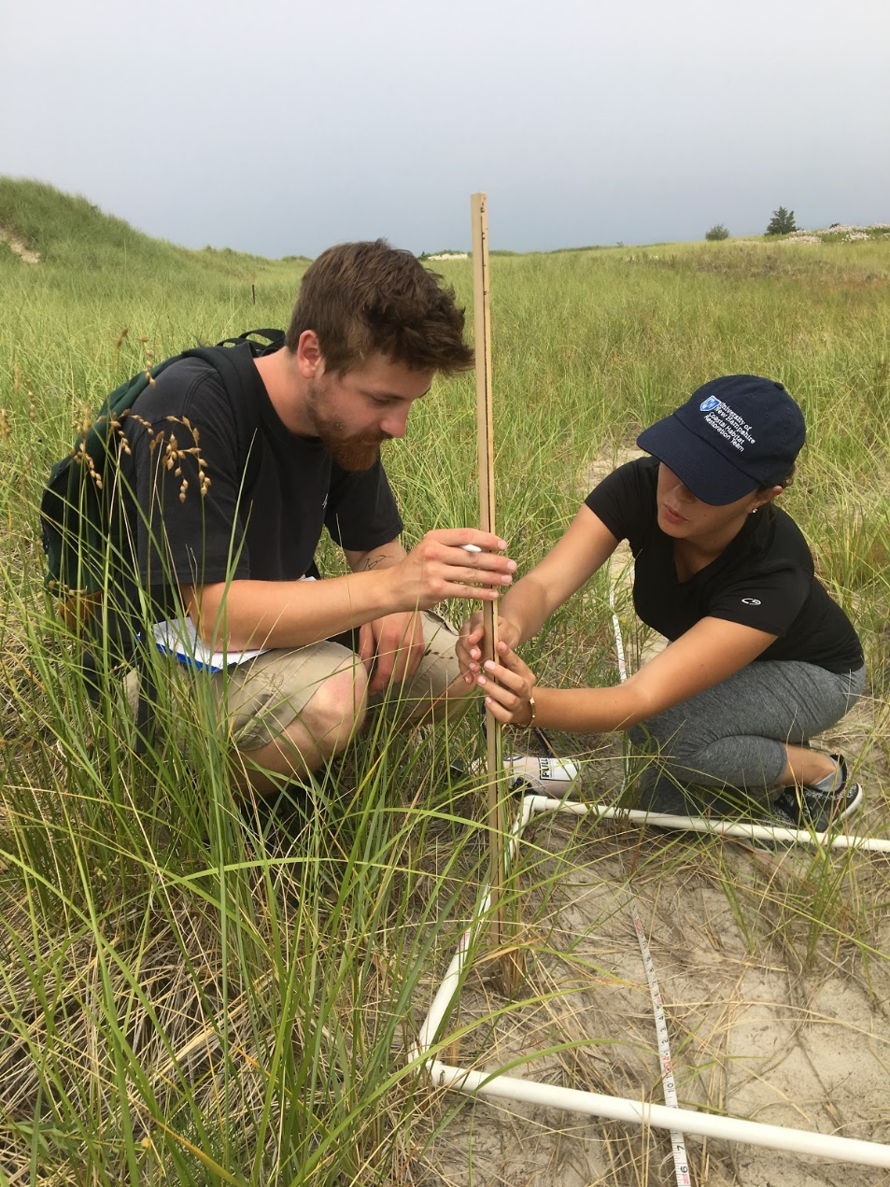
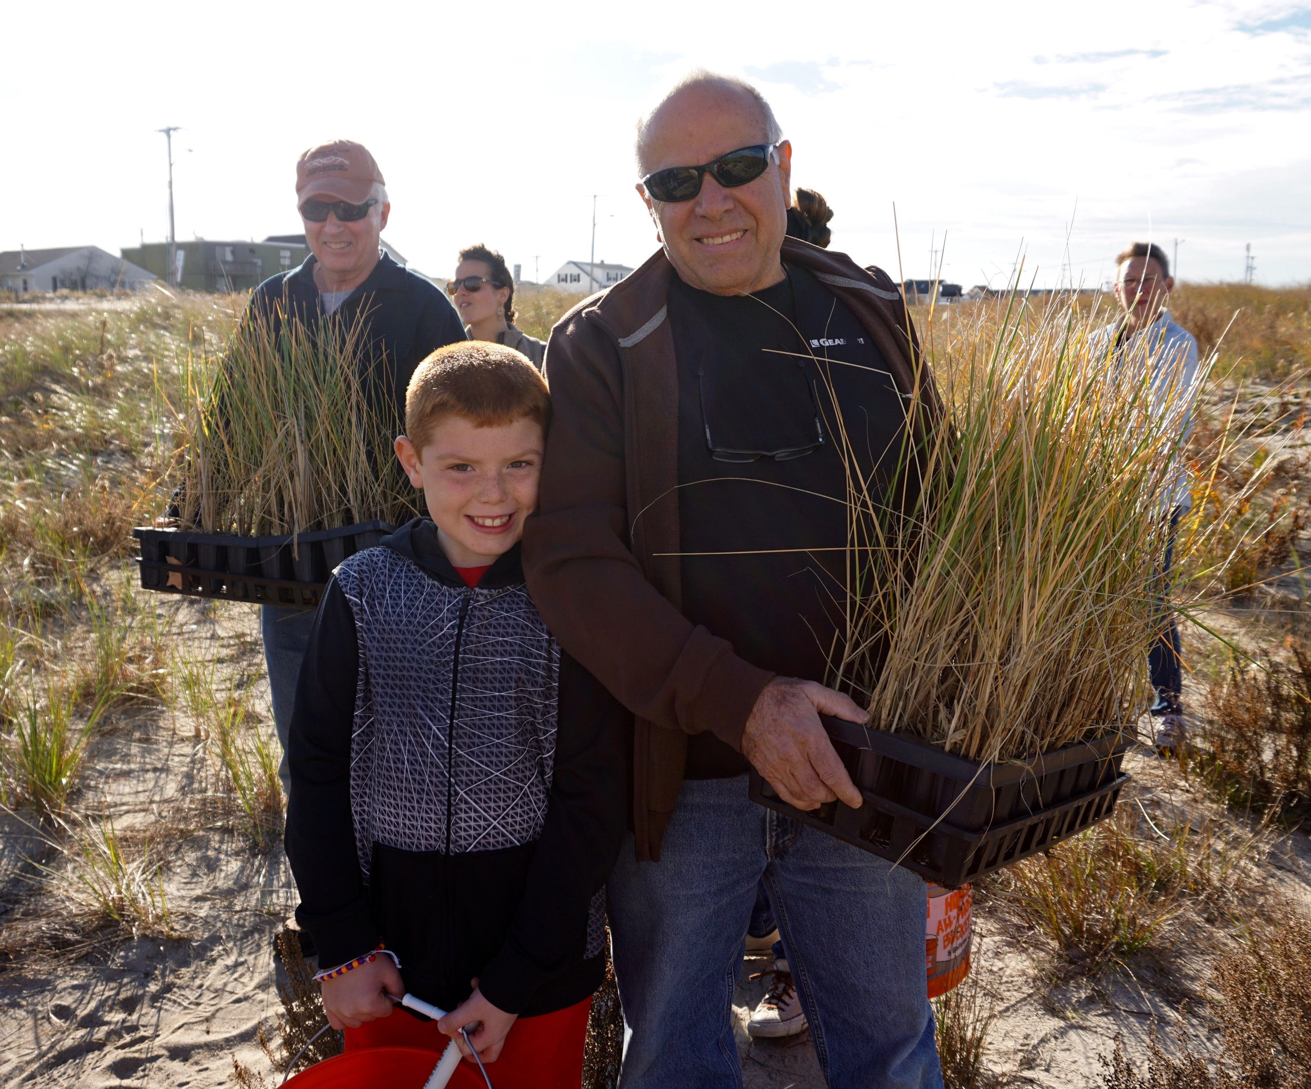
Monitoring the Success of Restored New England Dune Systems;
Results from Harborside Dunes, Seabrook NH
Robert Lafreniere^{1,2}, Alyson Eberhardt^{2,3}
¹ Doyle Fellow ²New Hampshire Sea Grant ³ UNH Cooperative Extension
Project Background
Coastal dune systems are dynamic and play fundamental ecological roles such as providing wildlife habitat and buffering the coastline from storms. However, the health and sustainability of dune systems is threatened by factors such as human use and storm surge. NH Sea Grant and UNH Extension, as part of the UNH Coastal Habitat Restoration Team, have been restoring coastal dune habitats along the NH and northern Massachusetts coasts since 2014. Efforts have included public forums to solicit feedback from community members, the creation of a Common Garden, a free resource of native dune plants for residents to replant dunes in front of their homes, a school-based program, and community-based revegetation and fencing efforts. To date over 200,000 stems of beachgrass (Ammophila bevilgulata) have been planted, in addition to other species, but a comprehensive monitoring effort has not been completed to evaluate the success of these efforts.
Objective
Design and implement a monitoring protocol to measure the success of dune restoration activities
Monitoring Site
Restoration efforts at the Harborside Dunes, in Seabrook, NH were focused on revegetating a dense network of remnant walking paths through the dunes. This area was selected for monitoring to evaluate the condition of the restoration efforts relative to active paths and reference areas.
Results
Beachgrass stem height
ANOVA was significant (F(2,6) = 12.6, p = 0.007)
Tukey Kramer post-hoc test detected a significant difference between reference and active walking paths.
b
ab
a
Species richness:
ANOVA was significant (F(2,6) = 10.9, p = 0.010)
Tukey Kramer post-hoc test detected a significant difference between active walking paths and the other two treatments (reference and restored).
No significant difference was detected in species richness between reference areas and restored paths.
b
b
a
Monitoring sites in Seabrook’s Harborside Dunes: current walking paths, restored walking paths, and reference areas.
Methods
Three treatments: active paths, restored paths, and reference
3 transects per treatment with 6 randomly selected replicates per transect.
A 0.5 meter² quadrat was used to evaluate the following parameters:
    Stem height of the tallest three A. brevigulata plants
    Stem count of A. brevigulata
    Species richness
Stem Density
No significant differences between treatments
Discussion
Stem height
Restored areas had intermediate stems heights relative to active walking paths or reference areas.
Species Diversity
Restored paths support a similar species richness as reference sites; active paths support fewer native dunes species than restore or reference sites.
Native plants (Ammophilla brevigulata, Myrica pennsylvanica, Hudsonia tomentosa and Lathyrus japonicus) were recorded in both restored and reference sites and were often absent from active paths.
Stem Density
Although not significant, active paths had the lowest stem density of A. brevigulata. The lack of significant difference in stem density among all treatments is likely due to the presence of multiple species in restored and reference plots in addition to A. brevigulata.
Conclusion
We are seeing a positive trajectory for the restored paths from a species poor community (such as in the active paths) towards the more diverse community of native dunes.
  Data Analysis
One-way analysis of variance tested for effects of treatment types on stem height, stem density, and species richness.
Replicates for each transect were averaged prior to analysis resulting in 3 samples per treatment.
Residuals were analyzed for normality and homogeneity of variances; all data met the assumptions of ANOVA.
Where ANOVA results were significant at an α of 0.05, data were evaluated with a Tukey-Kramer post hoc test.
Coastal Research Volunteers prepare to plant beachgrass in the Harborside Dunes, Seabrook, NH. (credit: Kiki Evans)
UNH students Robert Lafreniere (left) and Kristina Gjergjaj (Right) measure stem heights of A. brevigulata at the Harborside Dunes
Acknowledgements
This document and ensuing field work was funded by the New Hampshire Sea Grant's Brian E. Doyle Undergraduate Marine Extension Fellowship. I would like to thank my mentors Alyson Eberhardt and Caitlin Mandeville for assistance with experimental design, field work and data analysis. Thank you to Tina Gjergjaj for the many hours of field work and for helping formulate the entire plan. I would also like to thank all of UNH Cooperative Extension and NH Sea Grant staff as well as Coastal Research Volunteers for welcoming me with open arms to many CRV and Extension events throughout the summer.
References
Barker, P. (2001) A Technical Manual for Vegetation Monitoring. Resource Management and Conservation, Department of Primary Industries, Water and Environment., Hobart
Coastal Restoration Trust of New Zealand. Dune Monitoring Design and Analysis
Eberhardt, A., D. Burdick and G. Moore, 2018 Building Capacity for Resilience of Human and Natural Communities in New Hampshire Dune Systems – Phase II. Final Report to the NH Department of Environmental Services Coastal Program.
U.S.D.A. Forest Service National Riparian Technical Team. 2014. U.S.D.A. Forest Service National Riparian Vegetation Monitoring Core Protocol: Conterminous U.S. ( 1-80)
White, Laurence.(1960) Life in the Shifting Dunes

