Slide 1

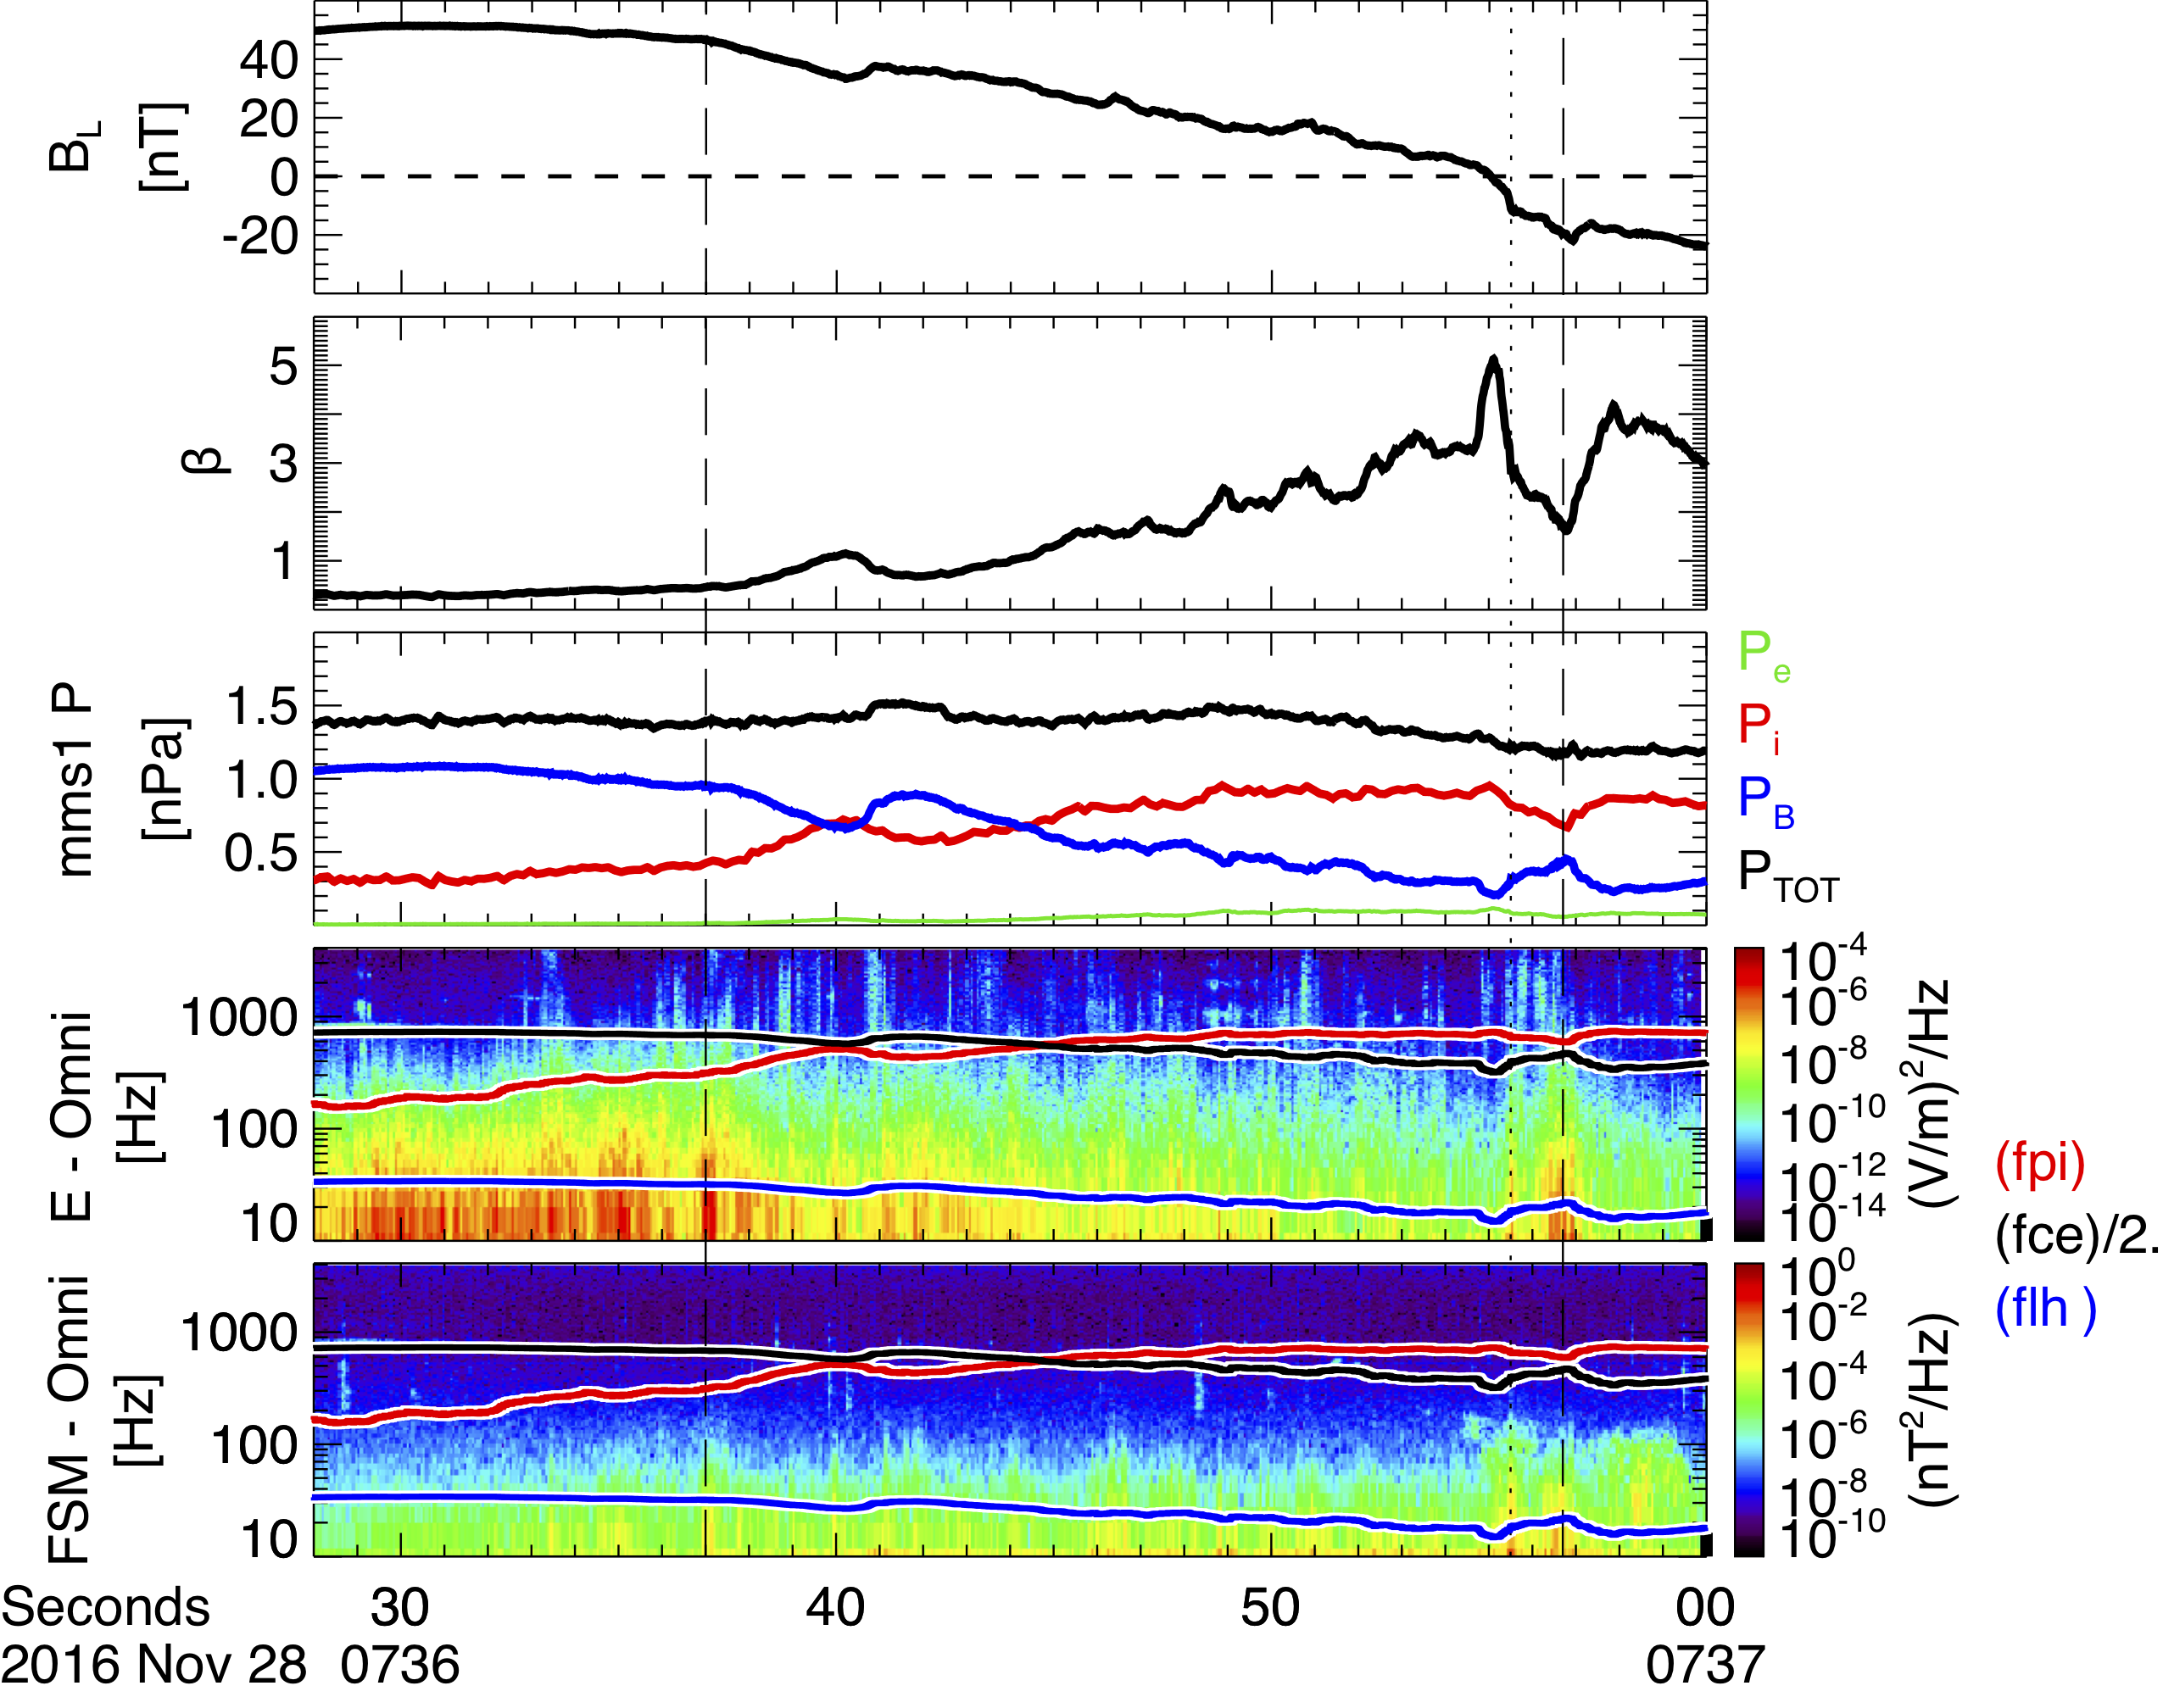
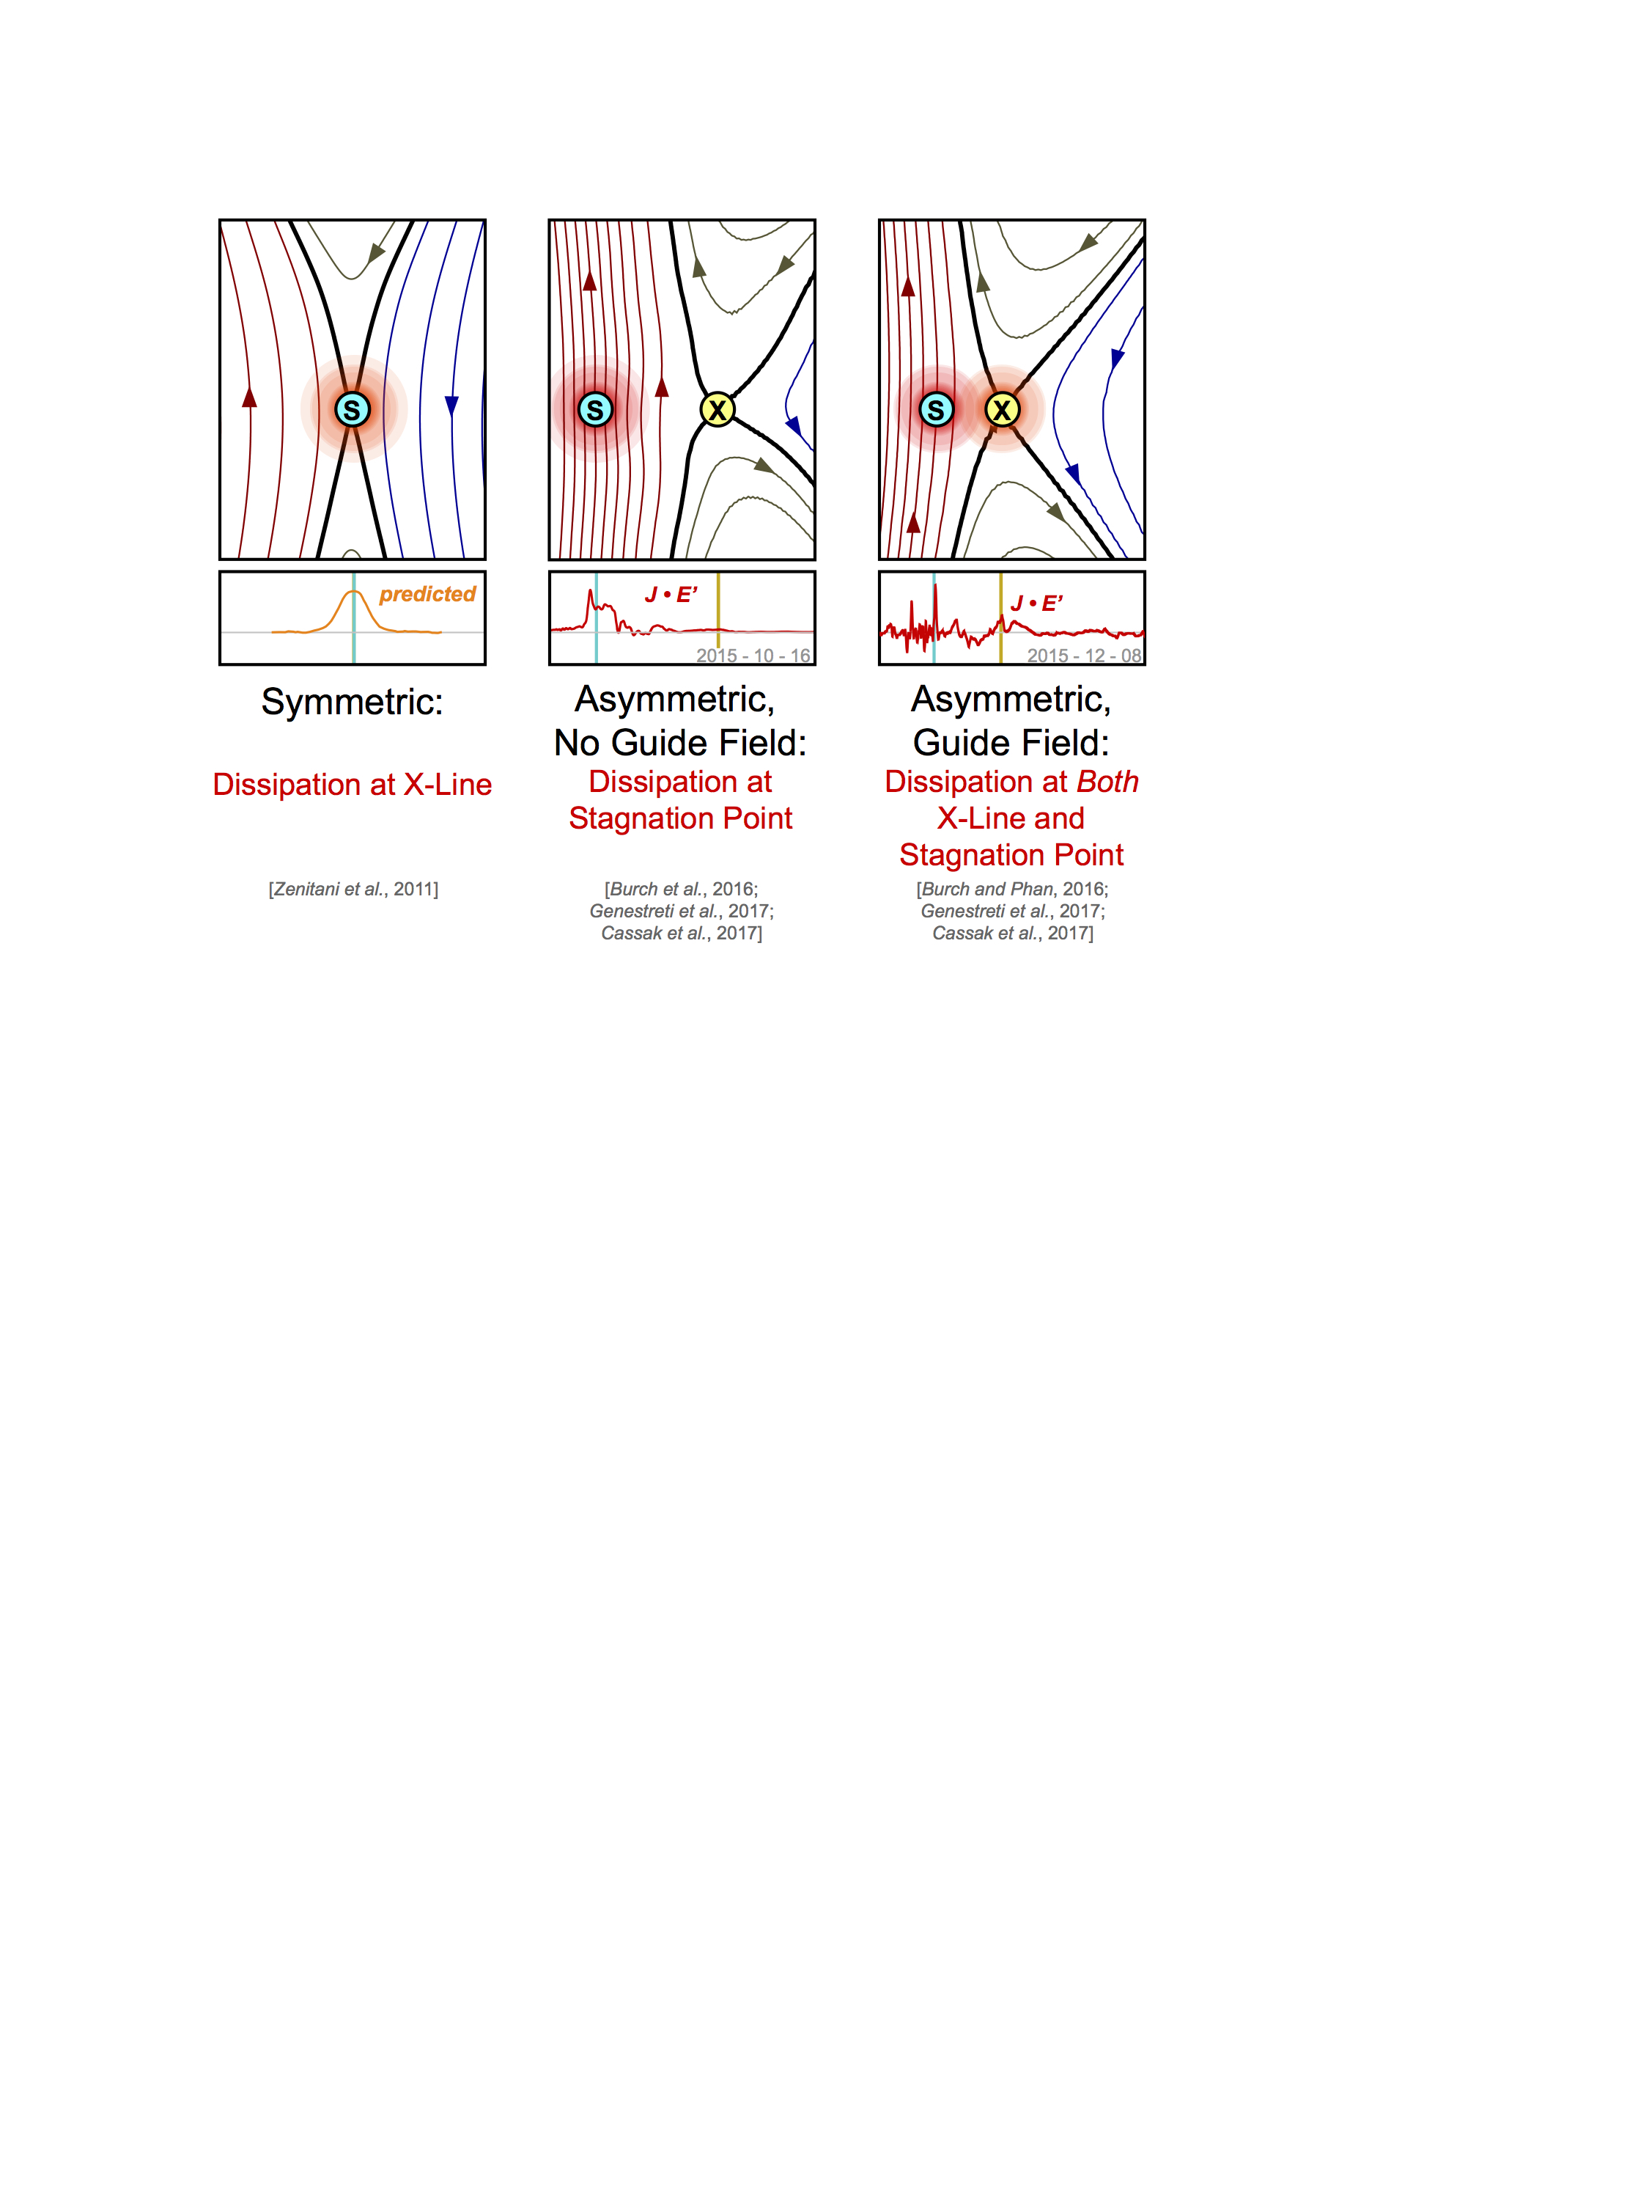
Structure of the electron current layer during magnetopause reconnection with a moderate guide field
Kevin J. Genestreti, R. B. Torbert, I. Dors, R.E. Denton, A. Le, T. K. M. Nakamura, M. R. Argall, A. Varsani,
R. Nakamura, J. L. Burch, T.-D. Phan, R. E. Ergun, P. A. Cassak, S. Toledo-Redondo, B. L. Giles, C. T. Russell
X & sphere-separatrix both active for asymmetric B_{G} > ~ 0.5 reconnection
There’s a large J_{M}, J·E’_{e}>0, p_{e}θ_{e}>0, Pi-D_{e}>0, κ·U_{e⊥}>0 at the X-point.
Dissipation at X-line associated with out-of-plane pressure force
There is no current sheet bifurcation in multiple 2.5-d PIC simulations
What’s causing the bifurcated current?
Right: drift waves causing current at X-pt?
Pros for this LHDI as source:
Low ß possible near X-point for B_{G}≠0
Waves of f<f_{LH} observed near X, & S_{e}
Long thought to be responsible for current sheet reformation
BUT Anomalous terms small at X-pt
Anomalous flux transport
Anomalous energy conversion
Anomalous resistivity
Consistent with Le et al. [2018; PoP]
X
Sun ➔
(From Burch)
⬅ Sun
⬅Sun
S
Event of Burch and Phan [2016; GRL]
J.E’
Below: drift waves causing currents sphere-ward of X-pt, current sheet kinking leading to ∂Pe/∂M.M?
⬅ Sun
2015-12-08
Above: 2.5-d sim of 2015-12-08/11:20 EDR from P. Cassak. Colors: cuts at different downstream distances. No cut through the 2-d EDR reproduces the MMS data.
z/d_{i}
But similar features seen in 3-d sims!
⬅ Sun
Active X-point
x/d_{i}
Sun ➔
Genestreti et al., [2018; JGR]
⬅ Sun
⬅ Sun
X-point
3-d force balance
In 3-d sim of Le et al.: turbulent mixing on sphere-side separatrix, multiple thin field-aligned current layers carried by electrons originating from sheath side.
In MMS data: isolated regions of trapped and streaming and meandering / bouncing electrons. Trapped electrons heated & accelerated into out-of-plane current. Agyrotropy develops in high-energy electrons within trapping regions.
Summary, conclusions, & open questions:
Bifurcated, dissipative C.S. seen in asym. B_{G}~0.5-1 RX with 3-d force balance
Bifurcated C.S. features only appear in 3-d sims, but not 2-d sims
Anomalous transport important at sphere-side filamentary CS’s, not at X
Kinking or other 3-d features responsible for out-of-plane pressure force
⬅ Sun
Active X-point
Event of Chen et al. [2017]
and Ergun et al. [2017]
2.5-d & 3-d PIC sims of 2015-12-08/11:20 EDR from A. Le. Possible bifurcation of J_{M}, E_{N} & activity near X-line seen in 3-d but not in 2-d simulation.

