Slide 1
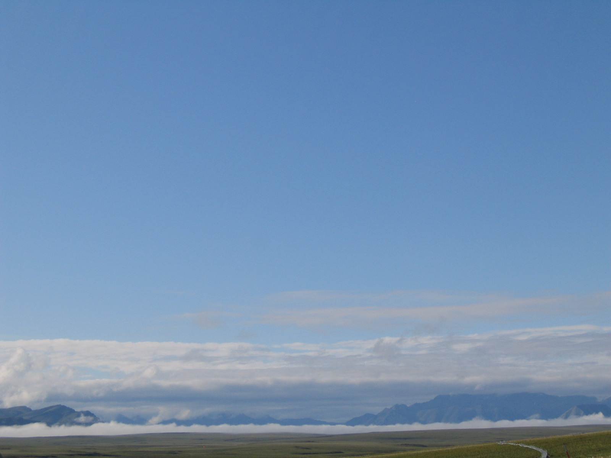
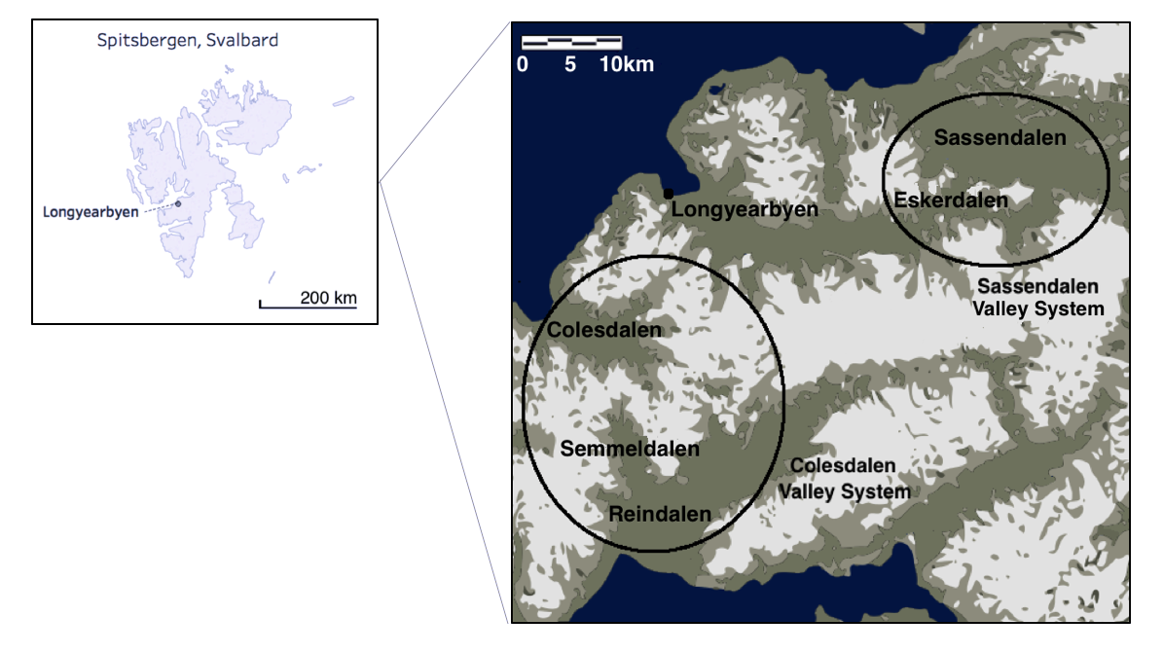
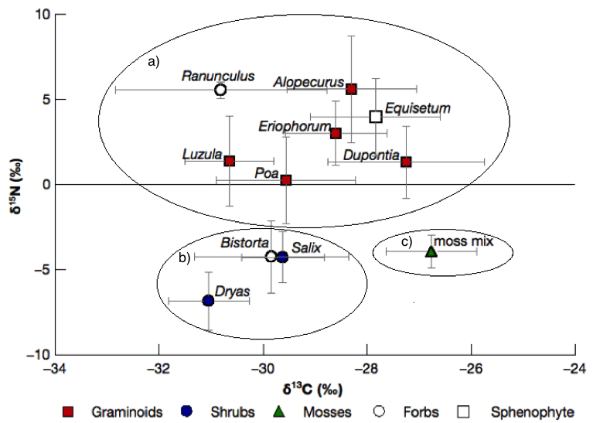
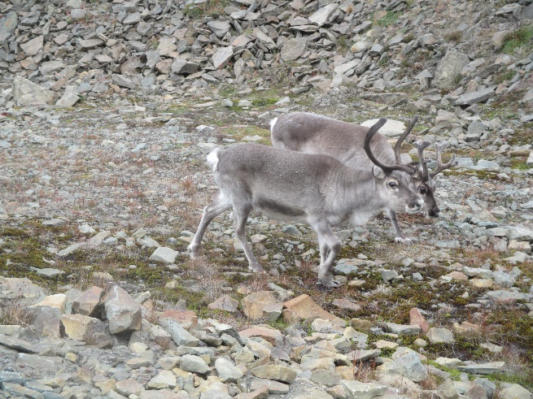
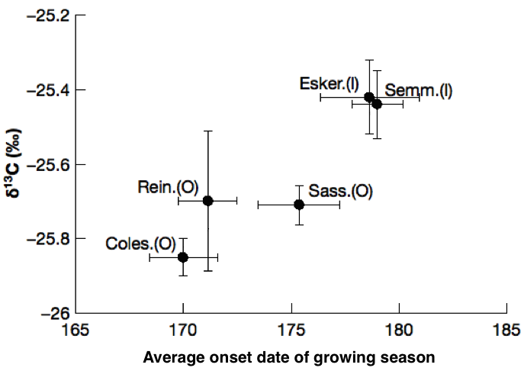
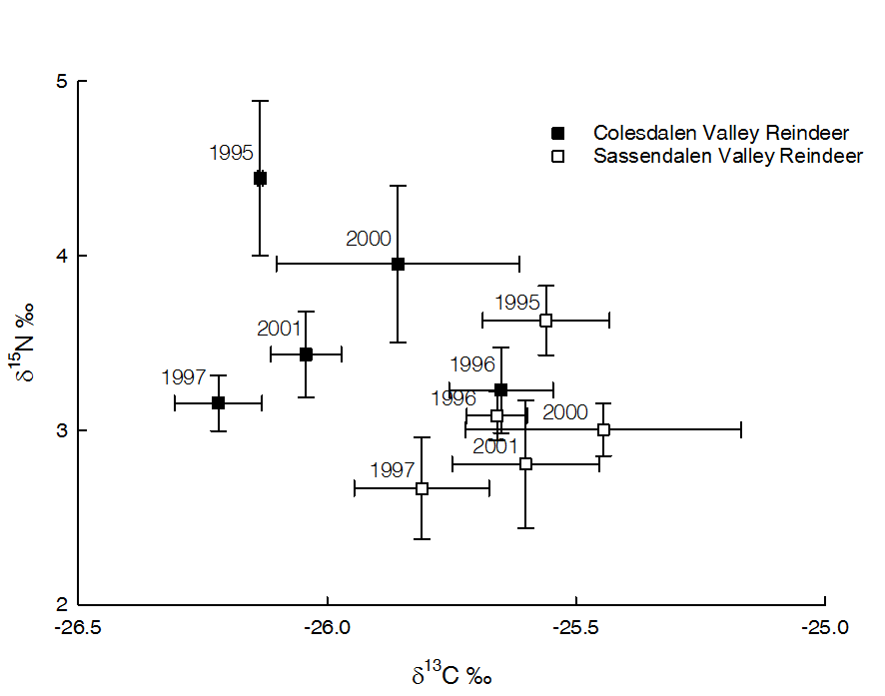
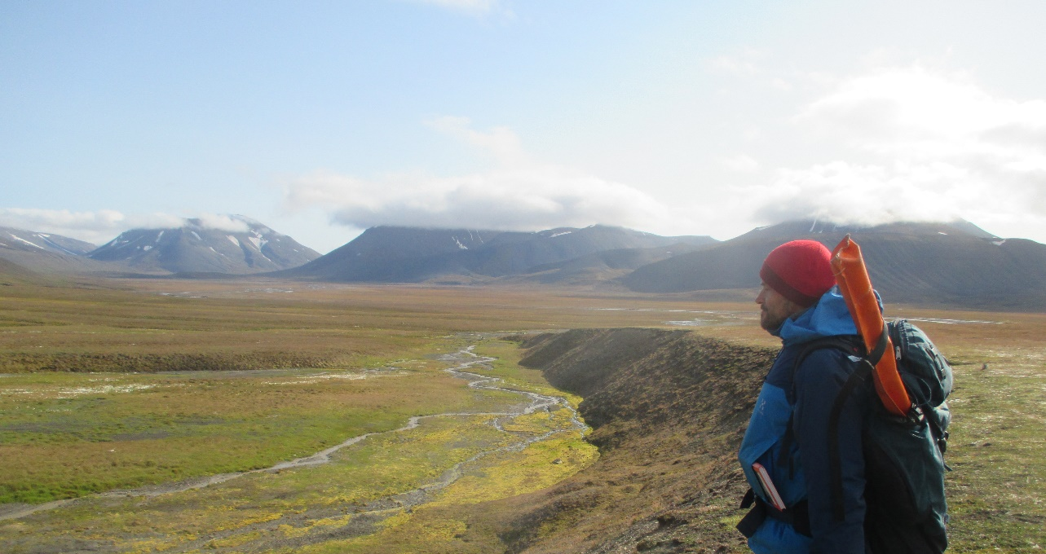
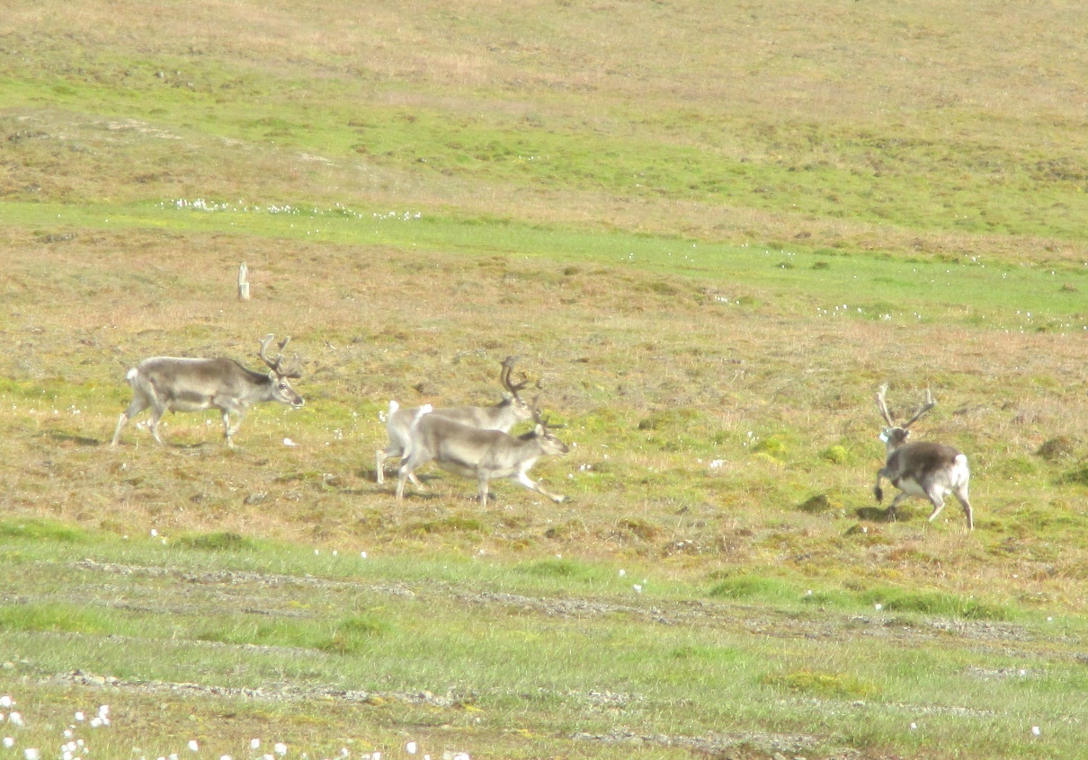

Isotope ecology detects fine-scale variation in Svalbard reindeer diet: implications for monitoring herbivory in the changing Arctic
Lily Zhao¹, Justin Irvine², Stein Rune Karlsen³, Erik Hobbie⁴
¹University of Chicago, ²James Hutton Institute, ³Northern Research Institute-Tromsö, ⁴University of New Hampshire
Introduction
Rapid climatic and environmental changes in the Arctic could alter diets of non-migratory herbivores both within and between populations. Here, we used carbon and nitrogen stable isotope analysis (δ¹³C and δ¹⁵N) in hair to infer summer dietary differences of Rangifer tarandus platyrhynchus (non-migratory reindeer) in Nordenskiöldland, Svalbard (~78° N, ~16° E) (Figure 1) from the Colesdalen and Sassendalen systems (1994-2006 and 2013) and used regression models to: 1) predict how reindeer dietary intake depend on climatic variables and 2) determine how other factors influenced isotopic signatures.
Methods
∙ Reindeer hair collected between October and the following April were assumed to reflect the diet of the previous summer. Plant samples were collected in 2009 & 2013.
∙ After measurement at UChicago, reindeer δ¹³C and δ¹⁵N patterns were analyzed using multiple regression with valley system (Coles/Sassendalen), valley type (coastal/interior), age (adult, yearling, or calf), atmospheric δ¹³C, hair C:N (log_{e}), July temperature and precipitation (lagged 0, 1, or 2 years), and interactions of climatic variables with valley system, valley type, and age.
∙ NDVI (normalized difference vegetation index, a measure of greenness) measurements are from 2000-06 for Colesdalen, 2000-02 & 2012 for Sassendalen.
∙ Cluster analysis on plant isotope signatures was used to assign species to discrete groups.
Results
∙ Forage plants separated into moss, ectomycorrhizal dicots, and graminoids/Equisetum (Fig. 2).
∙ NDVI increased with precip., decreased with 2-yr lag temp., and varied among valleys (Table 1).
∙ Subvalley reindeer δ¹³C correlated with NDVI-estimated onset date of growing season (Fig. 3).
∙ Reindeer δ¹³C and δ¹⁵N varied by year and by valley system (Fig. 4).
∙ Colesdal./coastal reindeer higher in δ¹⁵N, lower in δ¹³C than Sassendal./interior reindeer (Fig. 4).
∙ In linear regression models (Table 2), July temperature positively correlated with reindeer δ¹⁵N (1- & 2-yr lag) and with adult and yearling δ¹³C (0- & 1-yr lag).
∙ Reindeer δ¹³C correlated with atmospheric CO₂ δ¹³C, with a slope of ~2.
. Calves were higher in δ¹³C and δ¹⁵N than adults and yearlings, consistent with a trophic effect.
. Hair δ¹³C correlated negatively with hair C:N.
Discussion/Conclusions
∙ δ¹³C and δ¹⁵N analysis indicated that populations separated by less than 50 km differed in graminoid vs moss consumption.
∙ Milder climates in Colesdalen and outer valleys increased graminoid consumption. Temperature-mediated increases in δ¹⁵N reflect switches to graminoids and multi-year effects.
∙ ¹³C photosynthetic discrimination increased with falling atmospheric δ¹³C (slope of 2) and rising atmospheric pCO₂, indicating that Svalbard plants responded physiologically to rising CO₂ concentrations, possibly by decreasing photorespiration.
∙ Remote sensing (NDVI) and isotopic data suggested an early-season switch from moss to vascular plant dependence in valleys closer to the sea, suggesting both localized differences in forage availability related to the growing season onset and high site fidelity.
∙ Overall, these data provide evidence that δ¹³C and δ¹⁵N measurements can detect dietary shifts over short time periods and fine spatial scales, indicating that isotopic studies can help monitor herbivory in the changing Arctic.
Questions for discussion:
∙ (-) correlation of 2-yr lag July temp. and NDVI reflects increased N immobilization from old litter.
∙ Regressions ok (adj. r2 = 0.50, 0.44) if subvalley used instead of C/S, I/O valleys for d13C, d15N.
∙ (-) correlation of hair C/N and δ¹³C may reflect proportions of essential (low δ¹³C, high C/N) vs non-essential amino acids (high δ¹³C, low C/N).
∙ Does 1-yr JuTemp x Age interaction reflect increased graminoid-derived consumption in calves, decreased woody dicots, or decreased ¹³C discrimination (higher δ¹³C) with increased N in foliage?
;
Figure 1. Valley locations, Svalbard.
Figure 2. Mean δ¹³C and δ¹⁵N of local forage plant species corresponded to three functional groups by cluster analysis: a) non-mycorrhizal vascular plants, b) ectomycorrhizal vascular plants, c) mosses. Ovals designate the same source category. Error bars ± sd.
Mos
Flk
Far
Interior
valleys
Figure 3. Growing season (GR) onset date, 2000-2012, for each study valley versus adult reindeer δ¹³C. Interior valleys (I) had later GR onset dates and higher reindeer δ¹³C than outer (coastal) valleys (O). Error bars ± se.
more moss
Figure 4. Mean δ¹³C and δ¹⁵N of adult reindeer hair from the main valleys of Colesdalen (■) and Sassendalen (□) by year. Error bars ± se.
more graminoid
Table 1. Mean NDVI correlated with climate and valley.
adj. r² = 0.799, n = 107, p < 0.0001
Term %Var. Estimate±se P > |t|
Intercept -- 0.689±0.024 <.0001
July precip. (cm) 6.4 0.0152±0.0032 <.0001
July temp. (2-yr lag) 38.4 -0.045±0.004 <.0001
Valley{Sassen- Esker& 34.2 -0.032±0.003 <.0001
Semmel&Rein&Coles}
Valley{Esker&Semmel 21.1 -0.030±0.003 <.0001
-Rein&Coles}
Table 2. Stepwise regression models with valley location (Inner or Outer), valley system (Colesdalen or Sassendalen) and age class (adult (221), yearling (20), or calf (58)) as nominal variables. Adjusted r² = 0.478 for δ¹³C and 0.434 for δ¹⁵N. n = 299. Temperature in °C and precipitation in mm. %Var. = % of modeled variance explained by a variable. Jutemp = July temperature, Juprecip = July precipitation, Vsys = Valley system, and Vtype = Valley type. Mean July temperature was 6.20, 6.46, and 6.19 °C for no lag (0 yr), one-year lag (1 yr), and two-year lag (2 yr), respectively. Mean July precipitation was 21.50 mm. Nominal variables not given (Sassendalen, interior valleys, and calves) have the negative of the corresponding coefficients.
δ¹³C model δ¹⁵N model
Independent variable %Var. Value±se P %Var. Value±se P
Intercept — -6.44±1.55 <0.001 — -1.12±0.61 0.068
Valley system (Colesdalen)ª 7.0 -0.11±0.03 <0.001 10.9 0.22±0.05 <0.001
Valley type (Outer)^{c} 4.8 -0.11±0.03 <0.001 13.8 0.31±0.06 <0.001
Age class (Adult & Yearling)^{b} 3.2 -0.09±0.03 0.004 18.0 -0.34±0.06 <0.001
Log_{e} C:N 9.0 -2.35±0.48 <0.001 — — —
Atmospheric δ¹³C 38.7 2.16±0.21 <0.001 — — —
July temperature (0 yr) 7.6 0.15±0.03 <0.001 4.3 0.17±0.06 0.003
July temperature (1 yr) — — — 17.1 0.28±0.05 <0.001
July temperature (2 yr) — — — 14.4 0.27±0.05 <0.001
(JuTemp (0 yr) - 6.20) × Vsysª — — — 13.4 0.29±0.05 <0.001
(JuTemp (0 yr) - 6.20) × Vtype^{c} — — — 8.2 -0.24±0.06 <0.001
(JuTemp (1 yr) - 6.46) × Age^{b} 14.9 0.16±0.03 <0.001 — — —
(JuPrecip (0 yr) - 21.50) × Age^{b} 9.5 -0.011±0.002 <0.001 — — —
(JuPrecip (0 yr) - 21.50) × Vsysª 5.2 -0.0071±0.002 <0.001 — — —
Colesdalen reindeer, August 2016
Acknowledgements
We thank Ruth Varner and Richard Lucas for their mentorship, Janet Chen and David Riach for assistance with sample preparation and analysis, Sauli Laaksonen, Daniela Kalthoff, Göran Sjöberg, Berit Inga, and Erik Ropstad for sample collection, Bernt Johansen, Brage Hansen, the REINCLIM project, Leif Egil Loe, Audun Stien, Henry Lee, Ernst Linder, Donald Phillips, Mark Edwards, Matt Sponheimer, and Tim Wootton for technical advice, John Hobbie for his comments on the manuscript, and Jean Polfus for access to raw data. Initial project formulation was made possible by mentorship from the National Science Foundation REU Site - Northern Ecosystems Research for Undergraduates (EAR-1063037). Funding to E.H. for data analysis by the U.S. NSF ARC-1108074. Analyses at U. Chicago were supported by U.S. National Science Foundation grant EAR-0923831, awarded to A.S.C.

