Slide 1
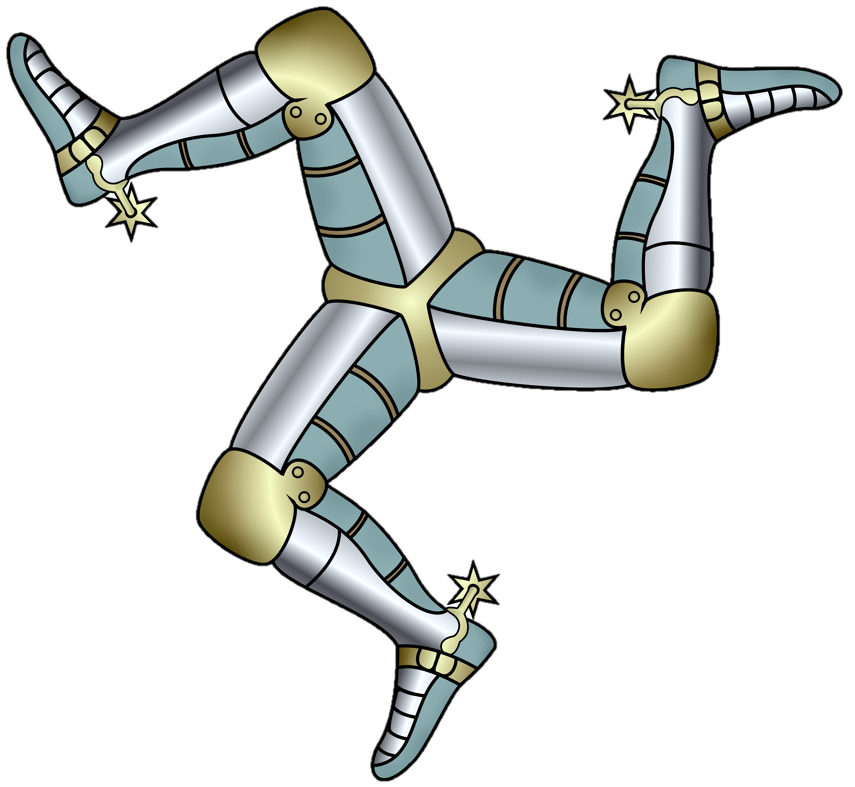

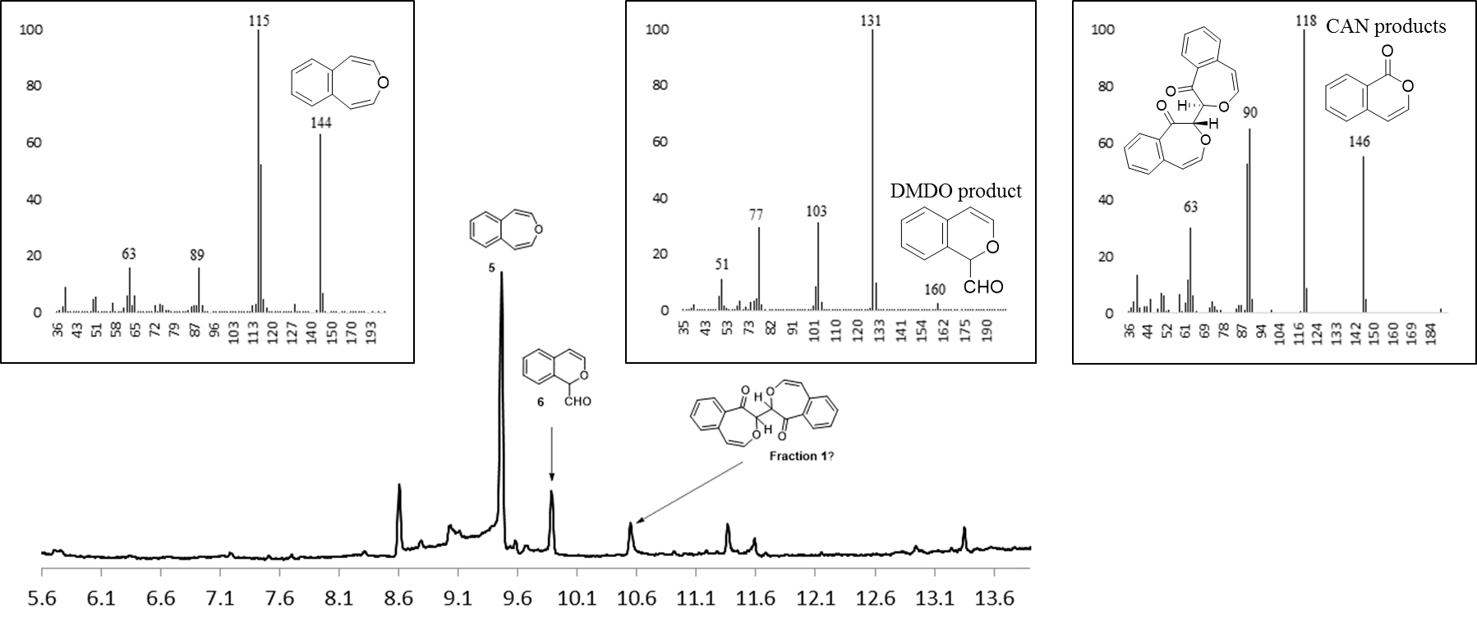

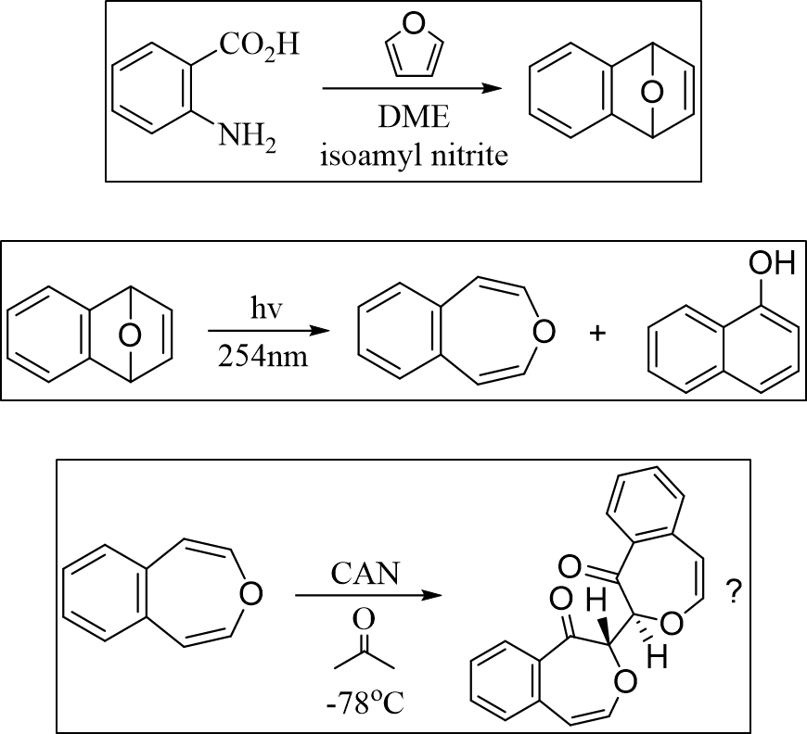


Reasearch in the Greenberg Group
Ryan W. Fitzgerald, Alexa R. Green, Noah A. Cote, Tristan Hart-Bonville, Arthur Greenberg*
rwj9@wildcats.unh.edu, ag1211@wildcats.unh.edu
Department of Chemistry, University of New Hampshire, Durham, NH
2/22/2019
Introduction:
Benzene is a known carcinogen and dangerous chemical used in industry. Knowledge of the mechanistic pathways which potential toxins break down in the body is useful to prevent illnesses and help those ailing presently. Oxepin derivatives are useful models in investigating the ring opening mechanism of oxepin as seen in benzene metabolism. 4,5-Benzoxepin is a suitable substrate for use in enzymatic oxidation studies with cytochrome P450. This project focuses on synthesizing 4,5-benzoxepin and other model oxepins for use in enzymatic reactions by the Greenberg research group at UNH to establish the current metabolic pathway of benzene to E,E-muconaldehyde.
Amides and lactams have a high prevalence and relevance in nature, leading the amide bond to be one of the most extensively studied over the past several decades. The majority of amides possess a planar geometry, which leads to the unique set of properties and reactivity attributed to the functional group. However, non-planar geometries can be found in nature as well and show deviations from their planar analogues due to the resonance of the amide bond becoming distorted. A bicyclic ring system distorts the amide linkage and the inclusion of a bridgehead nitrogen induces additional strain onto the system. At first glance these strained molecules appear unstable, however, due to the resonance of the amide bond the stability is potentially greater than in the corresponding anti-Bredt olefin. The synthesis of bridgehead bicyclic lactams has been achieved in various forms over the years, but the synthesis of the smallest and most strained systems has yet to be accomplished. Using 1-azabicyclo[3.3.3] undecan-2-one as a model system, the group hopes to better understand the unique properties of these highly strained molecules.
A known method to synthesize the parent amine compound 1-azabicyclo[3.3.3] undecane (also known as manxine) is currently being conducted. The synthesis is comprised of seven separate reactions, with the first four having been conducted and characterized by IR and NMR. Future work with the project will include the conclusion of the manxine synthesis, followed by the oxidation to the lactam. It has been proposed that a new oxidation method by Griffiths, Burley, and Talbot be used to achieve this, as well as an oxidation via hydrogen peroxide to synthesize the corresponding amine oxide for comparative purposes.
Results and Discussion:
Experimental Work:

