Slide 1

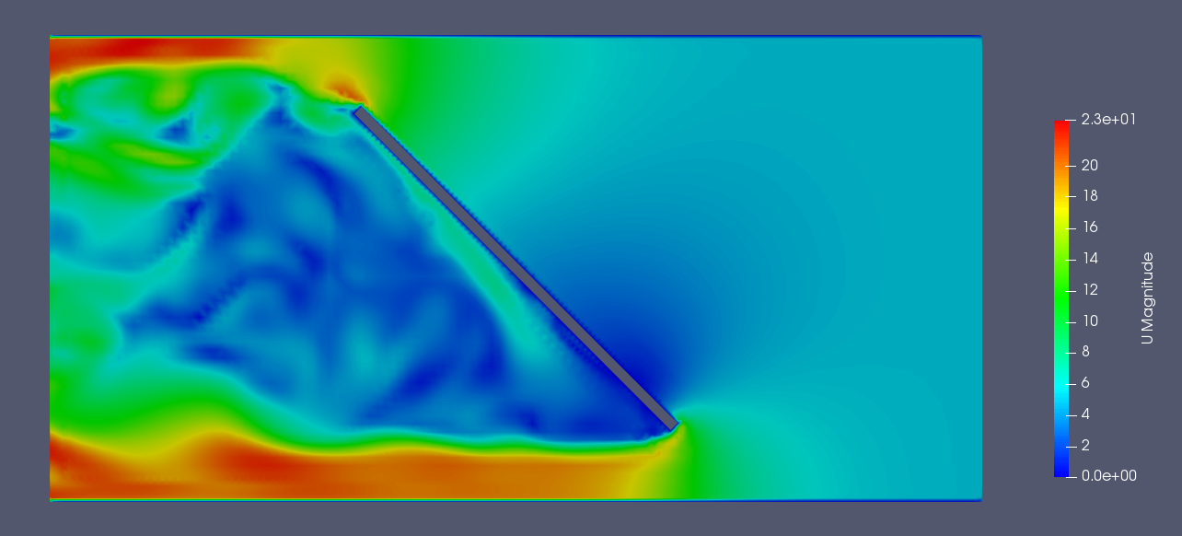
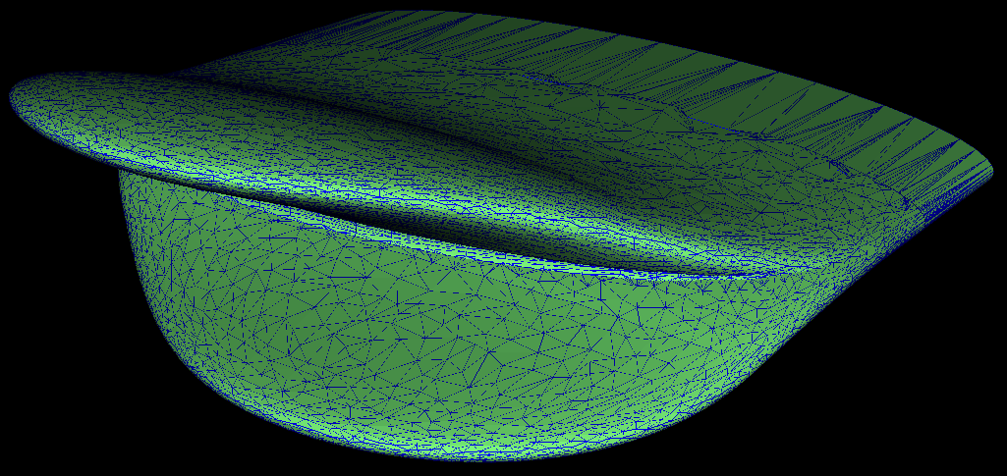
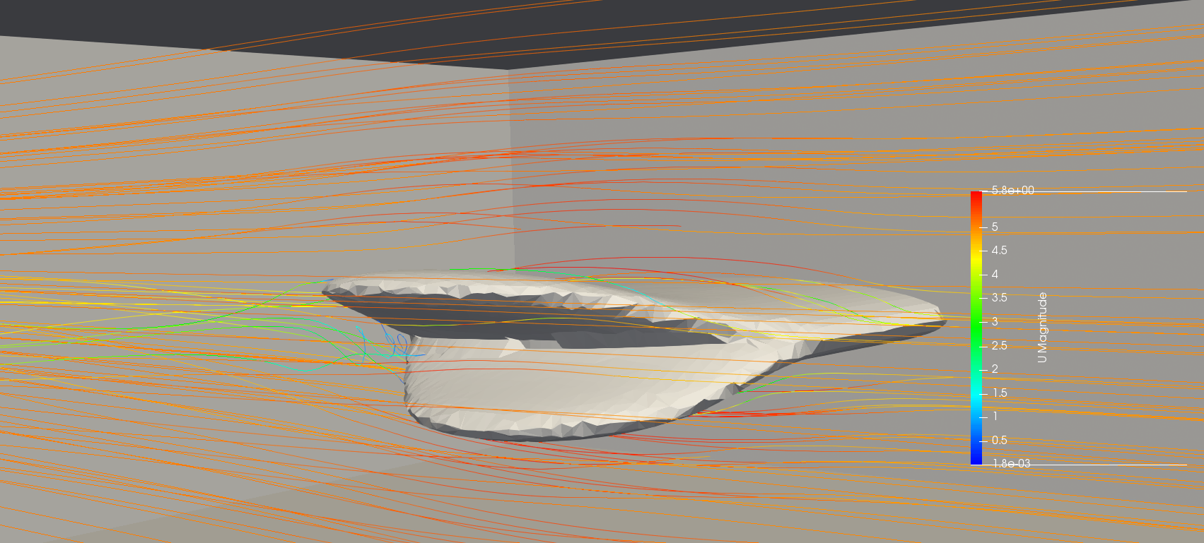
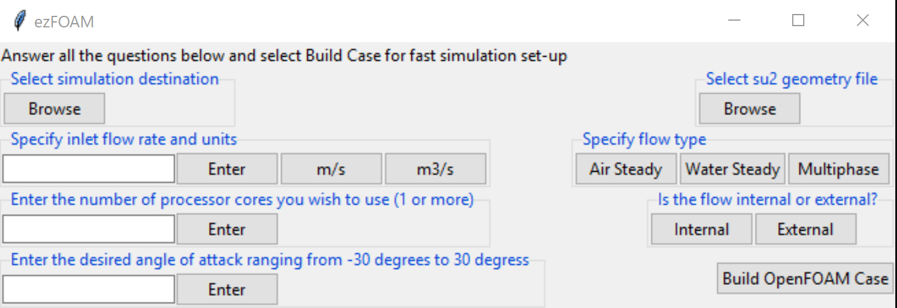
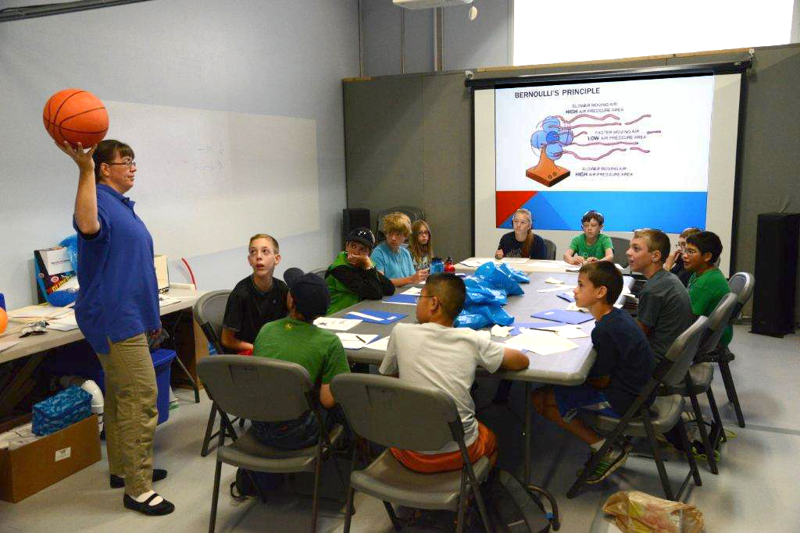

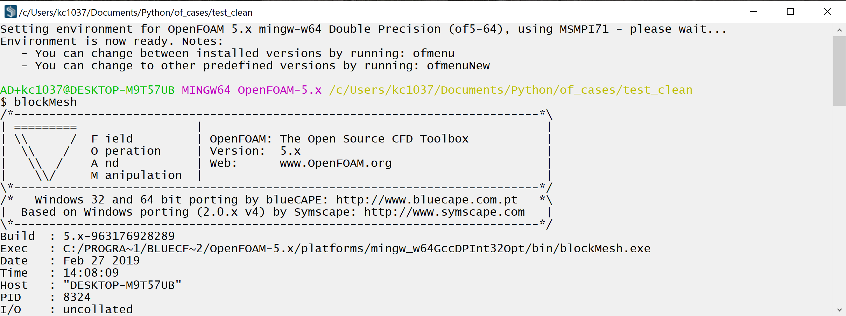
EasyCFD: Automated Open Source Workflow for Computational Fluid Dynamics
Kevin Cole
Faculty Advisor: Dr. Ivaylo Nedyalkov
Objective
To shatter the status-quo in education and industry that computational fluid dynamics (CFD) software is difficult and expensive to use
  SolidWorks Flow Simulation and ANSYS FLUENT are popular yet cost thousands of dollars
  OpenFOAM has a steep learning curve and is time-consuming to operate but is open source
Stage 1: Geometry Preparation through enGrid
Open source mesh generation software features select/save of STL feature faces
Sample Results
Solution
EasyCFD is an automated and open source software workflow which renders CFD simulations no more difficult and expensive than a handheld calculator
Make OpenFOAM easy and accessible
  Maximize work done by computer and minimize work done by human user without sacrificing accuracy
Stage 2: Case Construction through ezFOAM
Graphical user interface gathers input from user to swiftly and automatically generate an OpenFOAM case
  Programmed in Python 3 Tkinter
  6 different functions run in background totaling 1060 lines of code
Potential Benefits
Eliminate need for CFD budget at professional companies
Increase accessibility of CFD at all levels
  Students more marketable to companies and more productive as new hires
  Inspire to study STEM
Stage 3: Simulating through blueCFD-Core
OpenFOAM for Windows
Scripts generated from ezFOAM minimize number of commands user must execute to complete simulation
Next Steps
Automate turbulence modeling
Implement heat transfer simulations
Collaborate with UNH STEMbassadors
Distribute to alpha testers
Photo by Michael Golembesky
Acknowledgements: Sofia Lemons, John Mannisto

