Slide 1

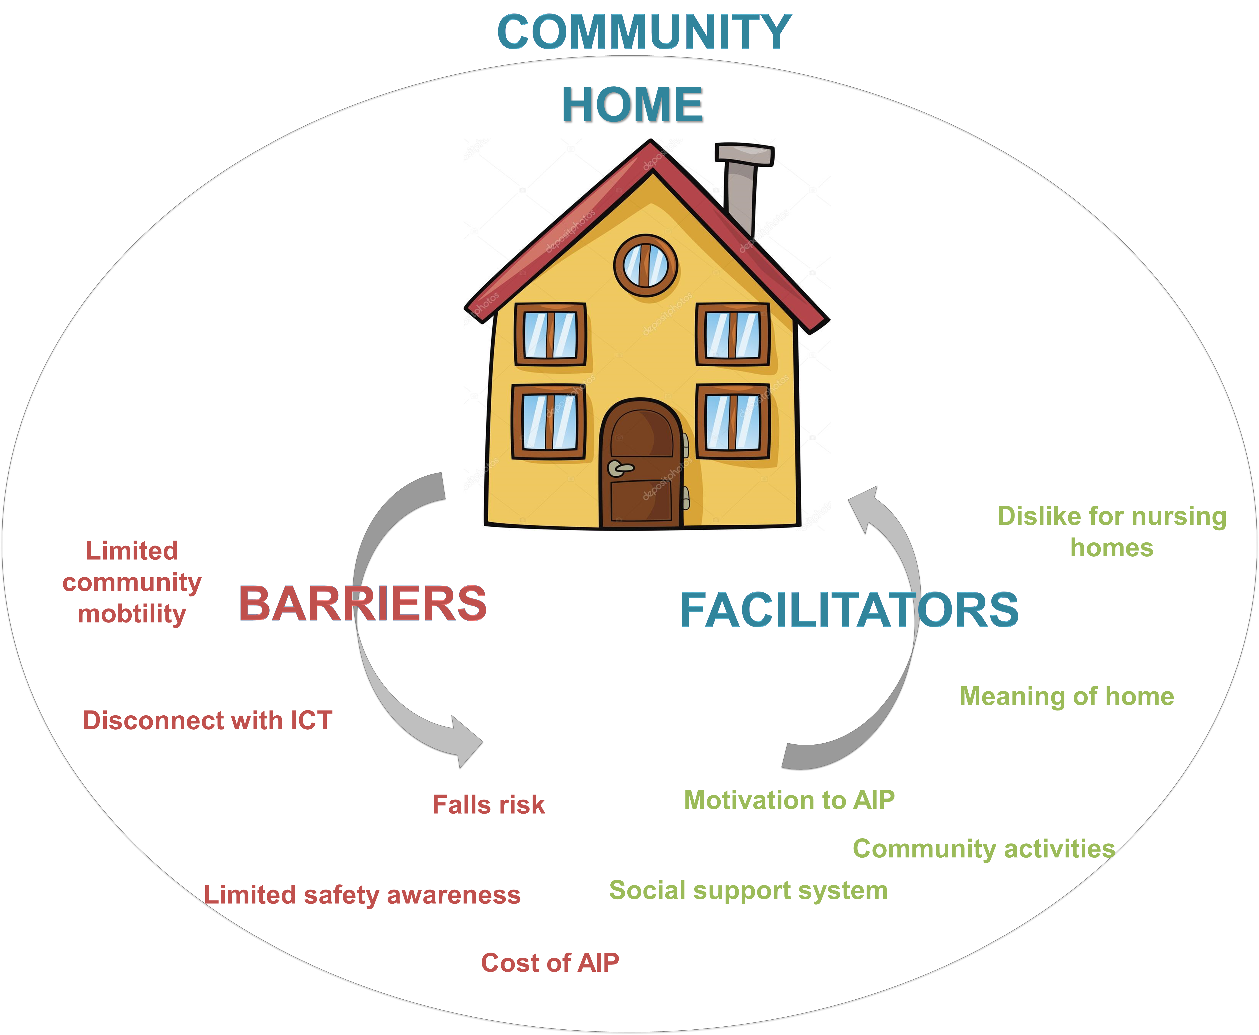
An exploratory study on facilitators and barriers to aging-in-place by seniors in New England
Mackenzie Macuch, OTS, Sajay Arthanat, Ph.D., OTR/L., ATP, & John Wilcox, OTD, OTR/L, CAPS
Department of Occupational Therapy, University of New Hampshire
BACKGROUND
Aging-in-place (AIP) is the ability and potential for individuals to live and age in their own home and community to the maximum extent possible (Stones & Gullifer, 2014).
The vast majority of older adults desire to age-in-place (Vanleerberghe et al., 2017).
The loss of independence and sense of security in one’s home and community usually results in the individual moving to an assisted living facility, or nursing home.
Relocation often creates a financial burden as well as emotional strain on the individual (Wiles et al., 2011).
DATA ANALYSIS
Interview 6
DISCUSSION
Distinct Themes
Interview 9
Distinct Themes
Interview 8
Interview 1
Distinct Themes
Distinct Themes
Interview 7
Interview 3
Interview 2
Distinct Themes
Distinct Themes
Collective Themes
Interview 5
Interview 10
Interview 4
Distinct Themes
PURPOSE
To highlight the barriers and facilitators to an older adult’s implementation for aging in place solutions (AIP).
Distinct Themes
Distinct Themes
Distinct Themes
Data was first analyzed individually by the three researchers using open and axial coding.
The data was then triangluated using constant comparison method to obtain the collective and distinct themes from the interviews.
The themes were member checked by all 10 participants. 8/10 participants reported data collected from the interviews accurately reflected their ability to age in place. 2/10 participants urged greater emphasis on changes in their health, lack of public transportation, and environmental barriers.
All participants acknowledged the influence of AIP in their decision to prolong aging at home. Autonomy meant that the participants structured their day as they see fit and engaged in activities that held meaning to them.
Ability to AIP is influenced by activity engagement- opportunities for social participation with others in the community, the ability to participate in leisure activities outside of their home and the access to a virtual community.
Perspectives on relocation to long term care were dictated by concerns with loss of dignity, social participation, sense of security and familiarity, and autonomy in their everyday routines.
The implementation of technology and participation in a virtual community was valued and prioritized by 9/10 participants. Technology was most utilized as a leisure activity, a resource for information, and a way to keep in touch with friends and family.
Balancing autonomy and safety remains a challenge. Completing household chores, taking care of pets, and self care routines presented high falls risk. 6/10 participants actively spoke of precaution measures.
Participant perception and implementation of smart home technology varied greatly among all participants.
Limitations of study
Small sample that was self selected
Interview responses were influenced by individual demographics
OBJECTIVES
To understand the perspectives of older adults towards AIP
To determine what factors lead to successful AIP and what are best practices to their implementation
To identify the concerns and barriers with implementation of AIP solutions
“I find it very important. Everyone wants to be at home, and that’s independence. I can handle it and I can go, be able to come and go as I please.”-Interviewee 8
RESULTS
Facilitator
THEMES
“I'm just not as strong as I once was. I’m not as limber, it's just hard, and it takes a little more effort.”-Interviewee 1
Value of Independence
Sense of Autonomy
“I am a member at the auxiliary club so I am learning right now how to be a crew member. I inspect boats. I do education as far as boating safety. I am a members of the DAR in New Bedford. I do volunteer. I work in the garden.” -Interviewee 5
Value of Independence
Barrier
METHODS
Design: Qualitative (Grounded Theory) Method
Sampling: Purposive Sampling by age, income and health
Ten older adults living at home in Cape Cod and Plymouth County, MA Invitation flyers were posted in adjoining rehabilitation facilities, senior centers, and senior residential communities.
“Oooooh dear if my license was taken away… that cannot happen!!! Because my independence will be taken away. No, no, no.”-Interviewee 7
Community Participation
Facilitator
Sense of Engagement
“There are people I would talk to there I was friendly with. We would go out for coffee and things like that. We help each other out.” –Interviewee 2
Community Participation
Gender | Age | Housing | Income | Rehabiliation | Location
F | 69 | 2 story home | $20-40,000 | No | Urban
F | 85 | 1 story home | SSI | No | Rural
M | 72 | Condo-2 story | $20-40,000 | No | Urban
F | 78 | Cape-2 story | $60-80,000 | No | Rural
M | 68 | Cape-2 story | $60-80,000 | No | Rural
F | 77 | 1 story home | $24,000 | Yes | Rural
F | 86 | Condo- 1 story | $40-60,000 | No | Rural
F | 85 | 2 story home | N/A | No | Rural
F | 69 | 2 story home | $0-20,000 | Yes | Rural
F | 81 | 1 story home | $20-40,000 | No | Rural
Barrier
“I miss the old fashioned neighborhood, where the one that use to live there, she was like a second mother….They say, people are busy working, but it doesn’t take two minutes to say Hey how are you doing today.” -Interviewee 3
Social Participation
Facilitator
Sense of Community
“When I come down the stairs, I don't carry things. Sometimes I come down backwards. I learned that, like when it is snowing, face backwards so when you fall you don't fall and hit your back.” - Interviewee 2
Social Participation
Barrier
CONCLUSION
This study contributed knowledge of facilitators and barriers that older adults face with AIP.
Facilitators could be reinforced, while several barriers were modifiable.
Home health professions should be cognizant of their client’s definition of autonomy, home access and safety issues, technology competence, and community resources.
Indicators gathered from this research and a subsequent focus group were used to develop and conduct a survey on AIP in New England.
“There are just so many opportunities of hurting yourself if you were to fall. Like hitting your head on the floors or counters.” –Interviewee 6
Fall & Accidents
DATA COLLECTION
Data was collected through 60-120 minute semi-structured interview that were conducted over a 10 week period
The interviews were audio recorded and transcribed verbatim
Facilitator
Sense of Safety
Fall & Accidents
Barrier
Acknowledgements: Hamel Center for Undergraduate Research.

