Slide 1

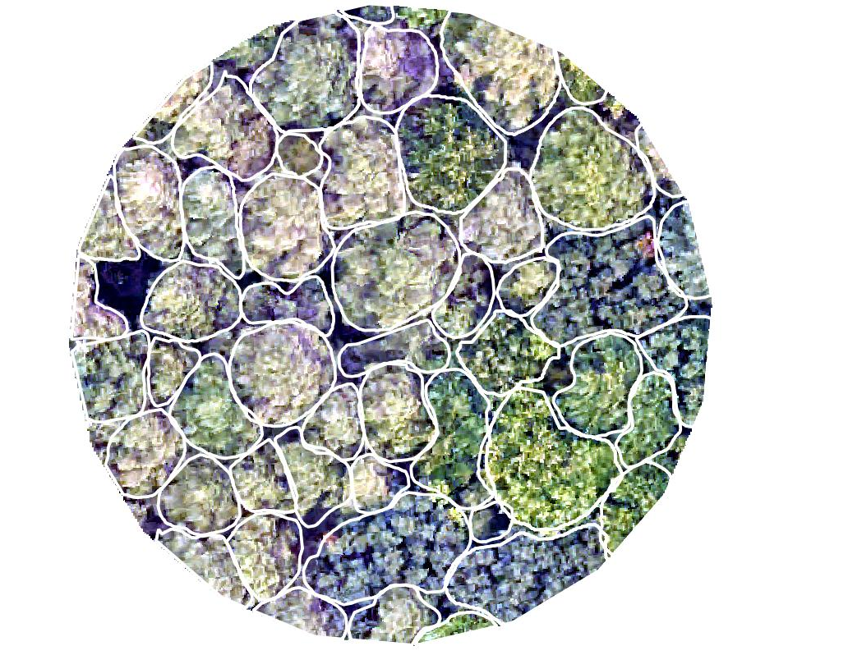
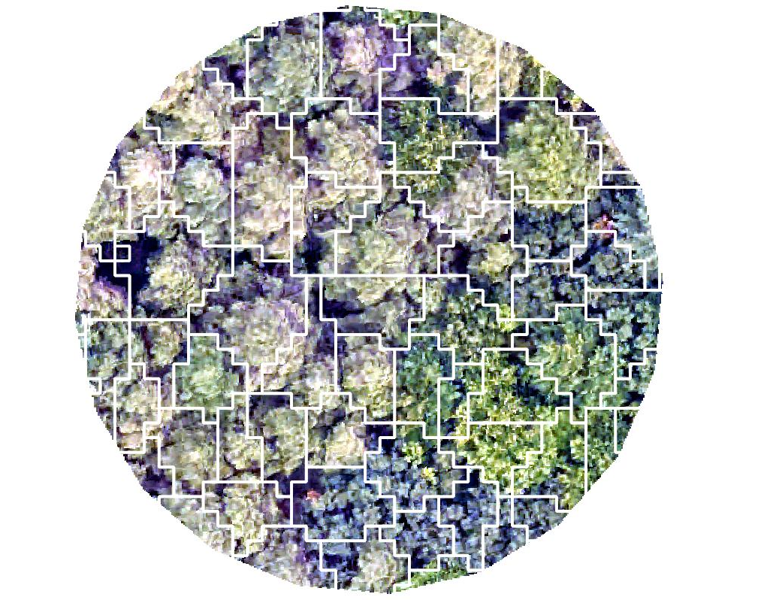
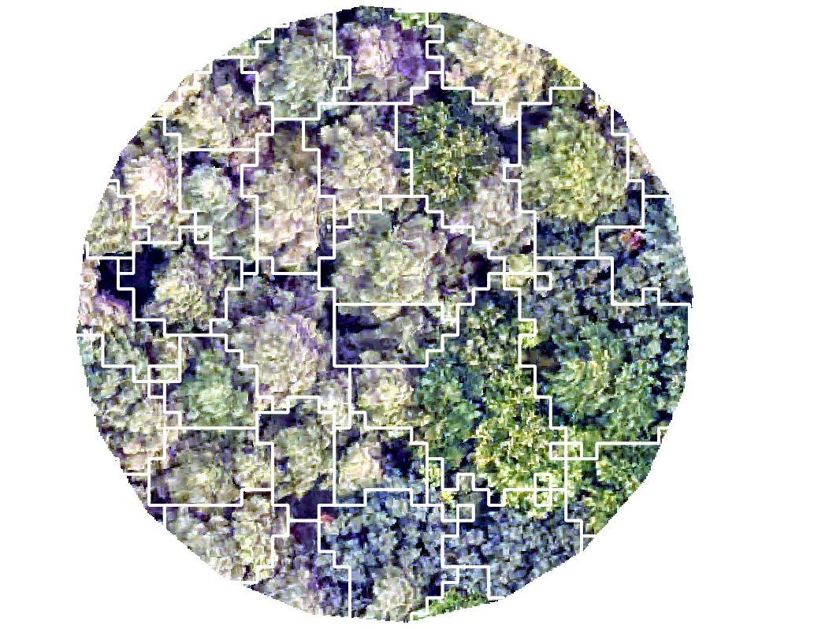
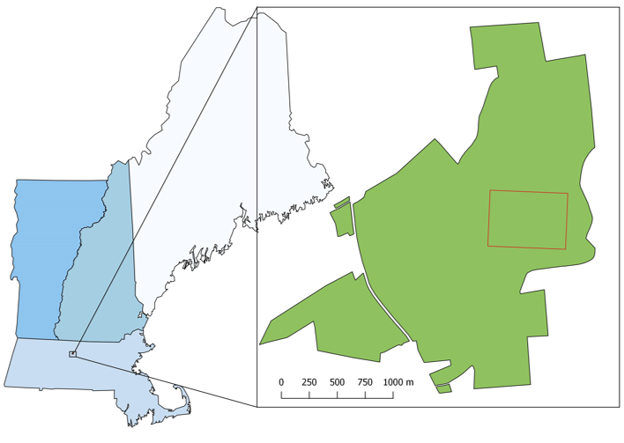
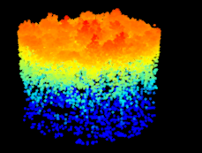
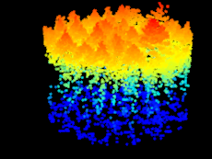
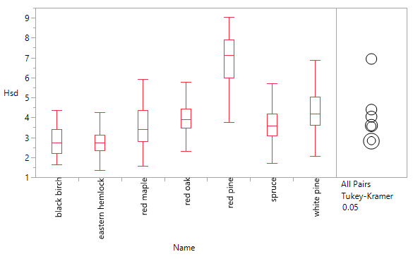
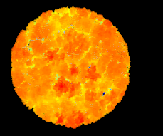
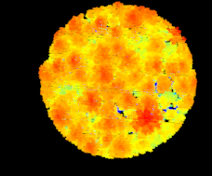
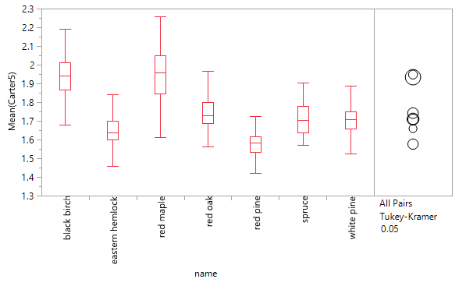
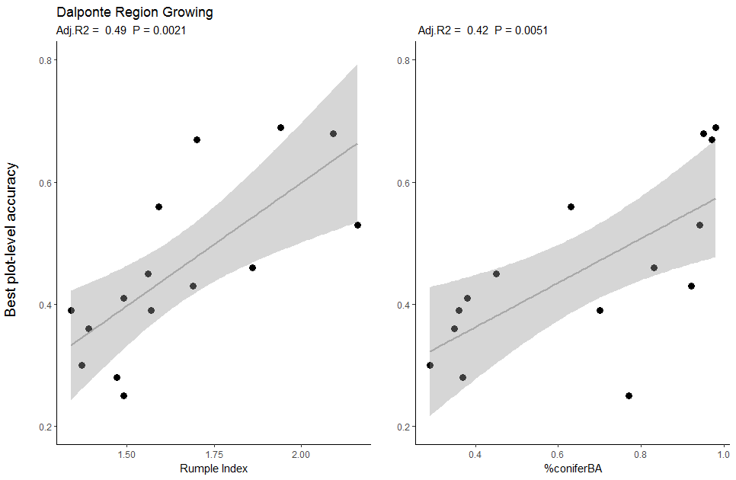
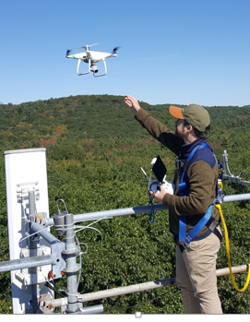
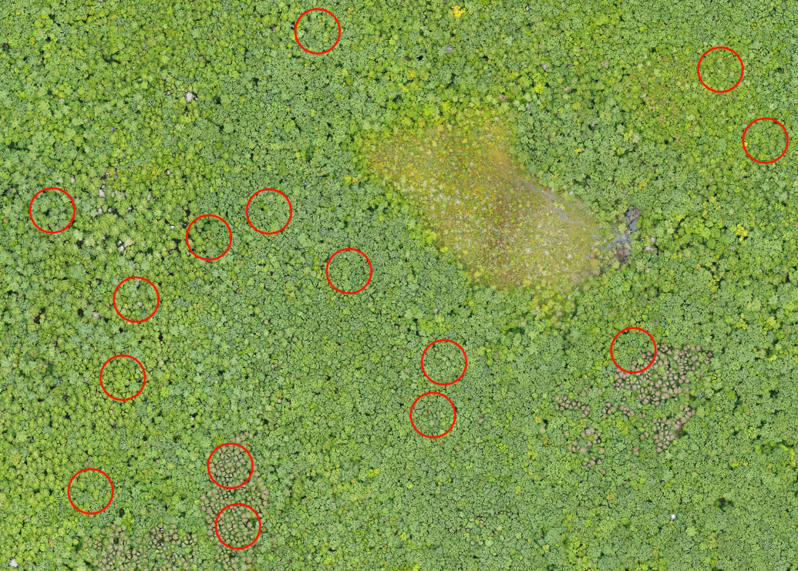




Using Airborne Hyperspectral and LiDAR Remote Sensing to Map
Tree Species Distribution at Harvard Forest, Massachusetts, USA
Jack Hastings¹, Scott Ollinger^{1,2}, Andrew Ouimette², Franklin Sullivan², Michael Palace², David Basler³
1. Department of Natural Resources and the Environment, 2. Earth Systems Research Center, University of New Hampshire, 3. Harvard University
Background
The ability to classify species at the individual tree crown level using high resolution remote sensing is an important step in scaling species – specific information to whole ecosystems. In closed canopy temperate forests, efforts to achieve this goal are hampered by the challenges of:
distinguishing multiple tree species that have similar spectral properties
automating tree crown delineation.
We combined high resolution hyperspectral and LiDAR remote sensing data collected by the National Ecological Observatory Network (NEON) to map and classify individual trees across the Harvard Forest, in Petersham, Massachusetts (Fig 1).
Methods
Using Forest inventory data from the ForestGEO MegaPlot, and multi-temporal UAV imagery, we manually delineated over 1300 tree crowns from 7 dominant tree species. Hyperspectral indices and LiDAR metrics were extracted from each crown and used to train and validate a random forest classifier.
Crown Delineation
Species Classification
The five different automated crown delineation methods included two region-growing methods (Dalptonte2016, Silva2016), a marker-controlled watershed method, a simple watershed method, and a point cloud based method (Li2012). All methods were implemented in the R package ‘lidR’.
Manual delineation
Dalponte2016 region growing
Simple watershed
Under- segmentation
Poor gap
detection
Over-segmentation
Fig 9: Producer’s accuracy for three different species level classification schemes: crown-level hyperspectral, crown-level LiDAR, and crown-level combined hyperspectral and LiDAR. All classification were performed using a random forest method. Crown-level methods were applied to manually delineated tree crowns.
Fig 5: Example of manual crown delineation and two of the five automated crown delineation algorithms. The manual delineation allows for higher accuracy, but it is time intensive. The region-growing methods tend to over-segment the image, and the watershed method tend to under segment the image.
 | black birch | hemlock | red maple | red oak | red pine | spruce | white pine
black birch | 12 | 1 | 0 | 0 | 0 | 0 | 0
hemlock | 0 | 53 | 0 | 0 | 0 | 3 | 1
red maple | 2 | 0 | 40 | 1 | 0 | 0 | 0
red oak | 1 | 0 | 3 | 29 | 0 | 0 | 0
red pine | 0 | 0 | 0 | 0 | 29 | 0 | 1
spruce | 0 | 0 | 0 | 0 | 3 | 20 | 0
white pine | 0 | 1 | 1 | 0 | 1 | 1 | 30
Fig 6: (left) Algorithms were preliminarily tuned to optimize both plot-level and overall accuracy. Best overall accuracy refers to how well the algorithm performed across all 15 sites. The best single-plot refers to the maximum accuracy achieved in the best delineated plot.
Fig 1: MegaPlot location within Harvard Forest.
Fig 10: (above) Error matrix for the combined hyperspectral and LiDAR crown classification. The combined method achieved the highest overall accuracy at 91.5%. Preliminary results of an expanded dataset show methods might not be broadly applicable.
A
B
1.
2.
Fig 2: Automated crown delineations were evaluated against manual crown delineations, and assigned into one of four classes:
1) true delineation
2) under-segmented
3) over-segmented
4) missed delineation.
A
B
Fig 11: (left) Boxplot and Tukey HSD showing the species separation for the top two classification variables: Height standard deviation, and the Carter Ratio Vegetation Stress Index
3.
4.
Fig 7: (above) LiDAR point clouds from two contrasting plots. Plot A has lower rumple (canopy surface area: ground area) and lower % conifer basal area; plot B has more uniform crown shape and spacing, and higher rumple and % conifer basal area.
We evaluated five different automated LiDAR delineation methods for their ability to successfully identify individual tree crowns. Automated methods were compared against manually delineated crowns (Fig 2) in 15 plots that varied in species composition and structure (Fig 4).
Fig 8: (left) The maximum single-plot accuracy is significantly related to plot rumple (A), and to plot % conifer basal area (B).
Conclusions
Individual species can be identified with high accuracy using manually delineated crowns.
Combining remotely sensed spectral and LiDAR metrics improves the classification of species due to distinct species-specific structural characteristics.
Automated detection of individual tree crowns using standard LiDAR-based approaches remains difficult and unreliable (~50% overall accuracy).
The success of automated delineation methods using structural (LiDAR) data alone varied across stands with different species composition and structure.
They performed best in hemlock and pine dominated stands; stands with high canopy structure and distinct, uniform crown shape.
Delineation of hardwood canopies often resulted in over- or under- segmentation because of crown overlap and plasticity, and generally lower canopy structure.
References and Acknowledgements
Dalponte, M. and Coomes, D.A. 2016. Tree-centric Mapping of Forest Carbon Density from Airborne Laser Scanning and Hyperspectral Data. Methods in Ecology and Evolution, 7: 1236-1245
Li, W., Guo, Q., Jakubowski, M.K., and Kelly, M. 2012. A New Method for Segmenting Individual Trees from the Lidar Point Cloud. Photogrammetric Engineering & Remote Sensing. 78(1): 75-84
National Ecological Observatory Network. [2016]. Data Products: [2016 Harvard Forest Hyperspectral and LiDAR data.]. Provisional data downloaded from http://data.neonscience.org . Battelle, Boulder, CO, USA
Orwig D, Foster D, Ellison A. 2015. Harvard Forest CTFS-ForestGEO Mapped Forest Plot since 2014. Harvard Forest Data Archive: HF253
Roussel, J-R, and Auty, D. (2019) lidR Airborne LiDAR Data Manipulation and Visualization for Forestry Applications. R package version 2.0.0. https://CRAN.R-project.org/package=lidR
Silva, C.A., Hudak, A.T., Vierling, L.A., Loudermilk, E.L., O’Brien, J.J., Hiers, J.K., Jack, S.B., Gonzalez-Benecke, C., Lee, H., Falkowski, M.J., Khosravipour, A. 2016. Imputation of Individual Longleaf Pine (Pinus palustris Mill.) Tree Attributes from Field and LiDAR Data. Canadian Journal of Remote Sensing, 42(5): 554 – 573
This project is supported by USDA NHAES (Hatch NH00634), NSF Macrosystems (1638688), the Harvard Forest Long Term Ecological Research program, and the UNH Graduate School.
Fig 3: Dr. Basler collecting UAV imagery over the MegaPlot.
Contact Information:
Jack Hastings
Graduate Research Assistant
jhc33@wildcats.unh.edu
Fig 4: Plot locations within the MegaPlot. Photo credit David Basler.

