Slide 1
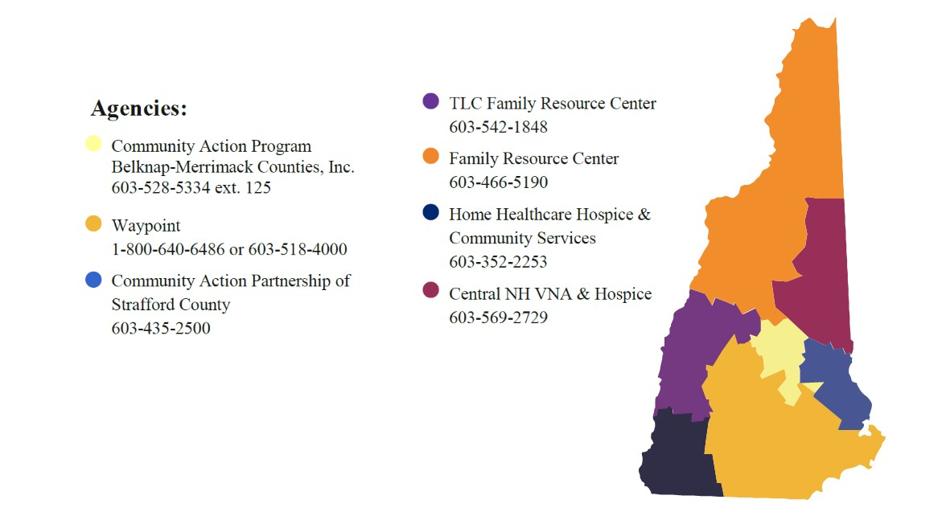


Easing the Onboarding Process: An Electronic Manual for New Supervisors
Julia Pheifer, MS Occupational Therapy
Background
The goal of the HFA-NH project is to
The New Hampshire Department of Health and Human Services (NH-DHHS) provides numerous programs to ensure the health and well-being of all NH citizens.
The Maternal and Child Health (MCH) section within the Division of Public Health Services strives to improve high quality preventative and primary health care for all children and families.
The national Healthy Families America (HFA) model was selected by MCH to provide preventative home visiting services to at-risk, Medicaid-eligible families.
HFA can be provided prenatally through the child’s 3rd birthday, providing home visiting services, child development and maternal depression screenings, resource connection, and parent education and support around parent-child interaction to families.
  The goal of these activities is to promote economic self-sufficiency, school readiness, positive health outcomes, and prevent the occurrence of adverse childhood experiences.
Many HFA sites offer play groups, father engagement programs, and specific programs that address the needs of a given community.
In NH, there are 7 Local Implementing Agencies (LIAs) located across the state.
Create an electronic manual that new supervisors across all LIAs in NH can utilize to ease their transition to this new role.
The manual consists of:
  Frequently used terms/definitions, resources and contact personnel;
  Step by step directions for documentation;
  Timelines to help ease the burden of a comprehensive accreditation process affiliated with meeting best practice standards;
  Required meetings and trainings; and
  Information on compassion fatigue to prevent burnout.
My role in developing the manual
Actively participate in supervisor meetings held every month.
Interview current supervisors at each LIA in NH to gain their perspective as to what they believe would be beneficial information to add to this resource.
  As well as what they received, or lack thereof, during their onboarding process.
Gather and dissect all information to find commonalities/similarities.
Develop an easy-to-read, well organized, electronic resource guide.
Relationship to LEND mission
HFA staff are required to complete extensive role-specific training, and programs must follow 139 best practice standards in order to maintain accreditation through HFA as an evidence-based model.
HFA promotes developmental screening of all target children at regular intervals to support families in identifying potential developmental delays and making referrals for services if a child isn’t meeting developmental milestones. Additionally, the Parents as Teachers and Growing Great Kids curricula provide home visitors with activities to do with families to promote child development.
  Similarly, the LEND program provides trainees with knowledge, resources, and experiences over the course of an academic year to assume leadership roles to improve the health of infants, children and adolescents with disabilities.
Both HFA and LEND strive to improve the overall system in order to achieve optimal health for children and families.
Outcomes
To provide a clear outline of resources and expectations for the NH HFA program outside of that provided by the parent agency of the LIA.
The electronic manual was initially designed for use by new supervisors; however, current supervisors provided positive feedback that this information is useful to them as well.

