Slide 1

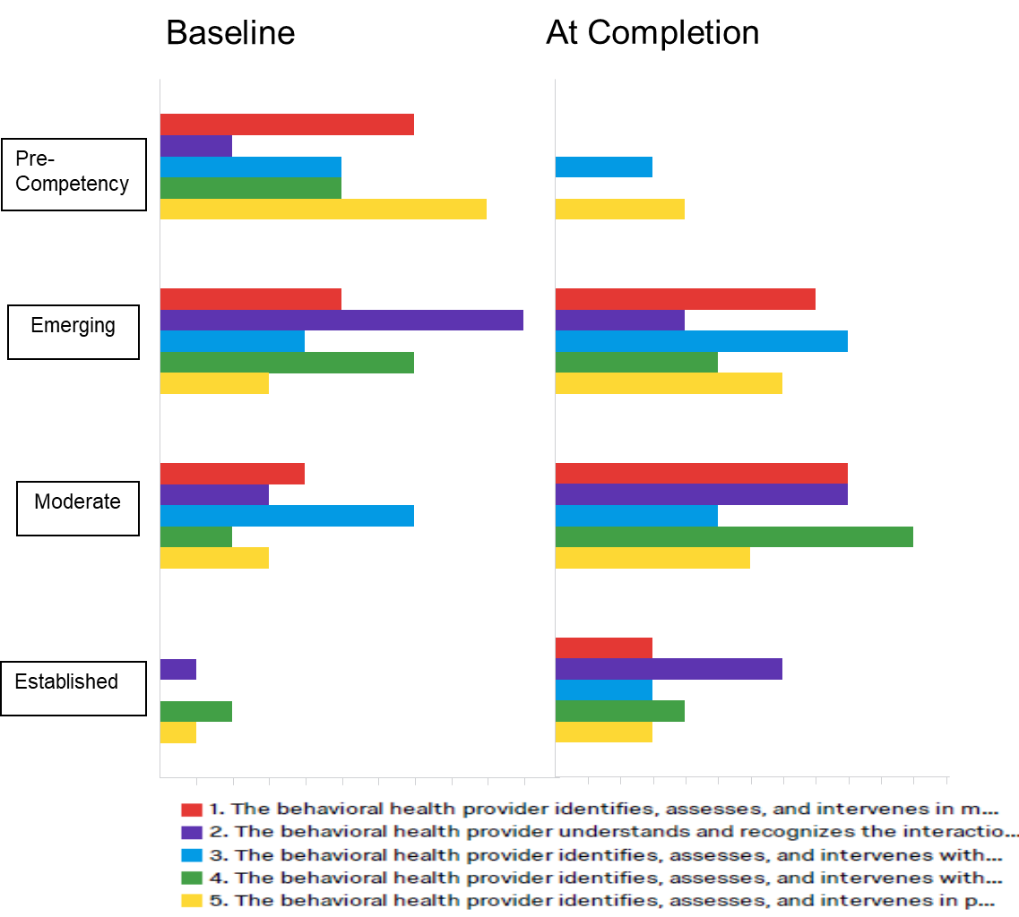
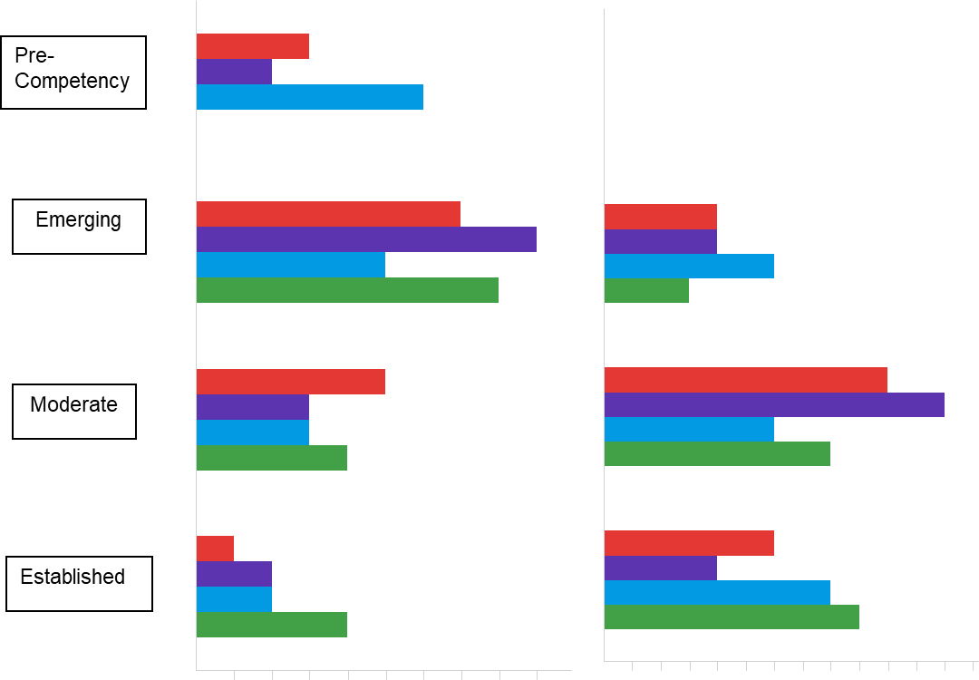
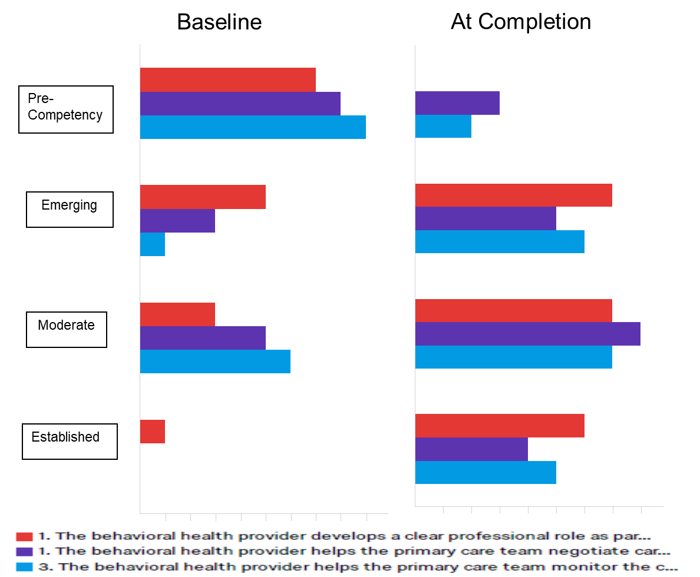
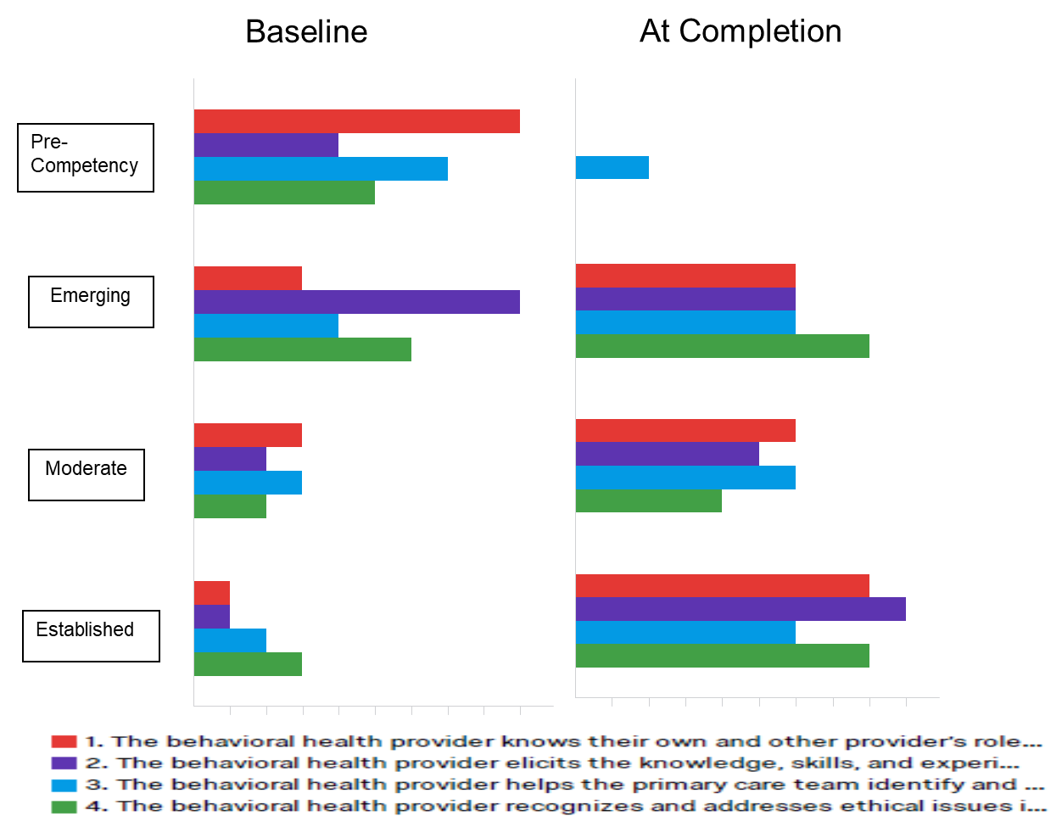
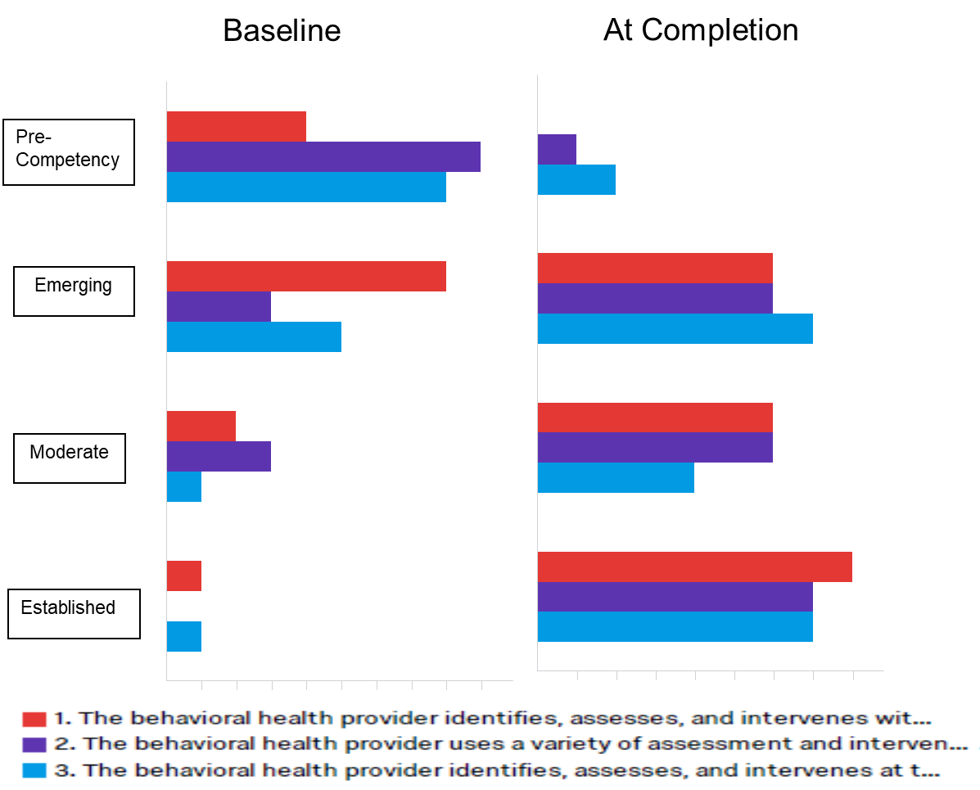
Developing OT Student Competencies in Primary Care Behavioral Health (PCBH) Using an Interprofessional, Team-Based Approach
Alexa Trolley-Hanson MS OTR/L, Will Lusenhop, MSW, Ph.D., LICSW
OT and PCBH
AOTA: AFW 6021
PCBH and OT
UNH PCBH Training Program Description
PCBH: A team-based comprehensive approach to addressing the physical, mental, and behavioral health needs of clients in primary care settings to promote health outcomes.
In September 2017, The University of New Hampshire (UNH) received a 4 year, $1.9 million dollar grant to develop an interprofessional PCBH training program for 116 Masters level occupational therapy (OT) and social work (SW) students. The program includes:
Physical Health
Mental Health
Behavioral Health
Pre-Course Module
6 week-Self-Guided Modules
8 Week Online Summer Course
Assessment and Intervention Skills
Team Based Learning
Focused on:
Team Communication
Sharing Professional Perspectives
Introduction to: IPE/IPP
Working on Teams
Cohort Forming
PCBH 1
PCBH 2
14 Week Online Fall Course
Team-Based Problem Solving
Organization and Systems Change
Clinical Internship
6-9 month clinical internships in PCBH settings
OT students complete as an extended Level 2B Fieldwork Experience or separate internship after Level 2 Fieldwork
Specific assessment and intervention skills dependent on site needs
Adjustment to Illness/Disability
Chronic pain management
Strengthening/ROM
Splinting
Ergonomics
Lifestyle redesign
Healthy habits and routines
Medication management
Occupational balance
Work
Stress management
Self-regulation
CBT strategies
Executive functioning
Social engagement
OT Students Demonstrated Increased Competency Through UNH PCBH Training Program
20 OT and SW students completed a pre/post training competency survey. This data represents initial data from 8 students who have completed the program.
Foundational Knowledge and Skills
Whole Person Care
Collaborative Care Roles
Team Function and Relationships
Efficient and Effective Population Based Care
This project is supported by the Health Resources and Services Administration (HRSA) of the U.S. Department of Health and Human Services (HHS) M01HP31385 title, total award amount and percentage financed with nongovernmental sources). This information or content and conclusions are those of the author and should not be construed as the official position or policy of, nor should any endorsements be inferred by HRSA, HHS or the U.S. Government.

